Slide 1
Potential Effects of Economic Policy in 2025
Presentation to IEEE group
by Lee Price
February 20, 2025
Notes:
Truman reportedly said he wanted a one-armed economist after hearing economists saying ‘on the one hand x but on the other hand. y’
The strong underlying trends in the economy and the Trump policies have offsetting effects for which the net effect is unclear. Most economists would predict that his tariff & immigration policies will negatively affect GDP, inflation and jobs. Budget policies are still being developed but also have the potential of slowing the economy near term.

Slide 2
Real GDP Since 2000
Notes:
This chart shows the deep but short decline in GDP caused by Covid-19 in 2020. It also shows the deep but prolonged decline during the Great Financial Crisis that began in late 2007 and accelerated in late 2008.

Slide 3
Consumer Price Inflation typically falls with recessions
Notes:
Most of you are probably old enough to remember that we had very high inflation in the 1970s and early 1980s. By 1995 inflation had fallen to near 2% where it stayed until 2020 when Covid-19 hit and disrupted supply chains.
Competition from imports was a major factor keeping prices of US producers down.

Slide 4
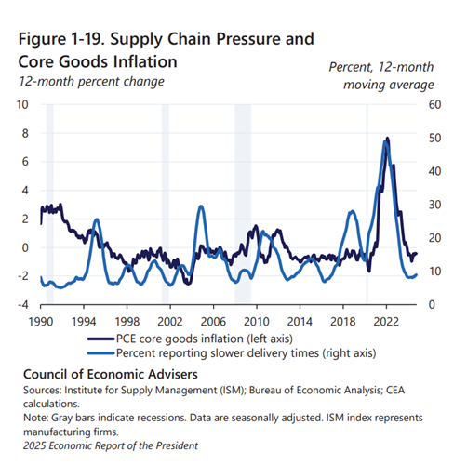
Notes:
The blue line in this chart shows the share of manufacturers reporting delays in shipments. That measure spiked from 2020 to 2023. The black line shows inflation in consumer goods excluding food and energy. You probably remember ships offshore of US ports waiting to dock and unload. Since prices are a function of supply and demand, the reduction in import supply raised prices. Prices didn’t rise only for imports. Less import pressure allowed US producers to raise prices, too. That is a major risk if Trump imposes broad tariff increases.

Slide 5
US Trade Deficit in Manufactures Runs about 4% of GDP
Notes:
Next, let’s consider trade and manufactures trade in particular since that has been the focus of Trump’s rhetoric. This chart shows that, as a percent of GDP, that deficit increased during his first term from 2016 to 2020 as it had during the previous 8 years under Obama. During the last 4 year that ratio declined somewhat.
As Trump has threatened tariffs since November, our trading partners have threatened retaliation. Most prominently, China has threatened to restrict its exports of rare earths and other inputs critical to US advanced technology industries. A serious trade war could hurt our output as well as prices.

Slide 6
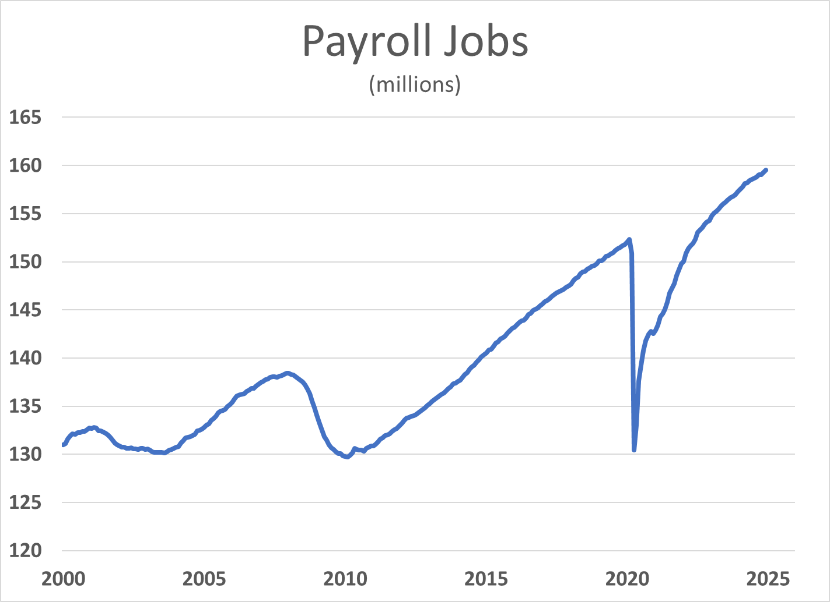
Notes:
The pattern for jobs resembles that for GDP. During the Great Financial Crisis of 2007-9 we lost 8.7 million jobs over 25 months. It took 51 months just to get back to the previous peak.
When covid 19 hit in 2020, we lost 21.9 million jobs in two months. 14 months later we had restored all of the lost jobs. The combination of aggressive fiscal policy and a healthier financial system made a big difference in the two recoveries. Later charts will show the budget effects of covid crisis fiscal policy.

Slide 7
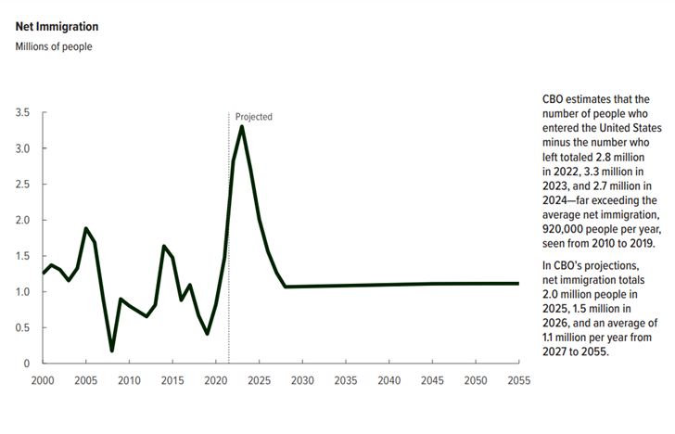
Notes:
Immigration has been a major political issue in recent years and the new Administration has vowed to change policy.
By its nature, unauthorized immigration is difficult to measure with confidence. This chart shows a surge in immigration estimated for recent years. Immigration fluctuated between 2010 and 2019 but averaged about 900,000 per year. Immigration was triple that amount in each of the last three years.

Slide 8
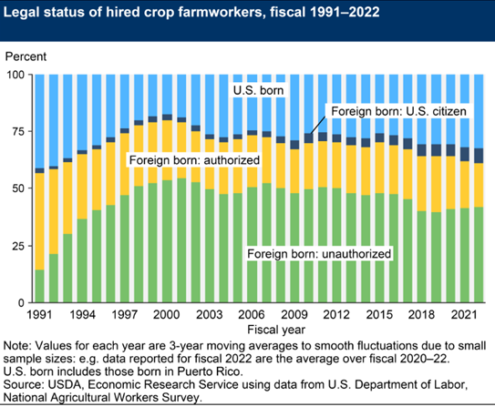
Notes:
It is difficult to measure illegal activity. The USDA does try to measure the share of the paid agricultural work force that is unauthorized. They estimate that share at roughly 40 percent.
Not surprisingly, organizations of farmers have pushed for exemptions from expulsions of their workers. Were a significant number of them to be expelled, farm prices would surely go up.

Slide 9
Notes:
The immigrant share of the construction workforce is also very significant. It is estimated that about one quarter of construction workers are immigrants.
A substantial roundup and expulsion of unauthorized immigrants in the construction industry would also drive up inflation in both the residential and nonresidential sectors.

Slide 10
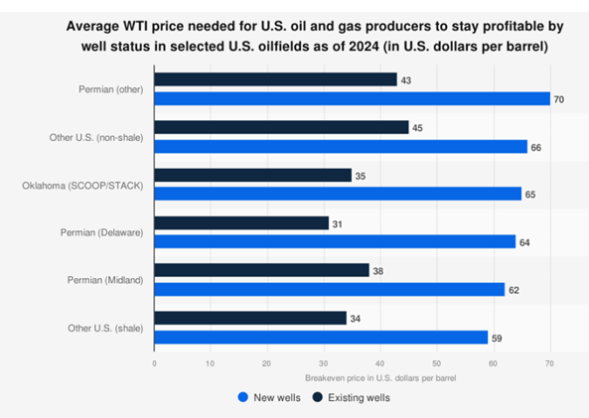
Notes:
It might be hoped that deregulation of US oil and gas production would significantly lower fuel prices and overall inflation. But that effect would be limited and short lived.
The blue bars in this chart show the cost of finding and producing from new wells and from proven wells (in black).
Pumping from proven wells would continue to be profitable but and significant reduction in prices would reduce new drilling which would raise prices in the medium to long run back up to the cost of supply from new wells.

Slide 11
Federal Spending and Revenues as a percent of GDP
Notes:
Next we turn to the federal budget situation. The current deficit now exceeds $1.8 trillion.
Federal revenues are currently running about 17% of GDP even as outlays or spending are about 23%. We last ran a surplus at the end of the Clinton administration 25 years ago.
Note the upward blips in outlays that occurred during the last two deep recessions.

Slide 12
Sources of Federal Revenue
Notes:
Under our tax system, revenues from income taxes rise as a share of GDP when more income is made in higher tax brackets. Periodic tax cuts favoring those with higher incomes have kept the revenue share from rising.
The Congress is now considering cutting taxes by $4 trillion dollars over the next ten years.
Tariff revenue is included in the “other” line. It is too small to make much of a dent in the deficit.
Note that corporate taxes have declined as a share a share of the economy.

Slide 13
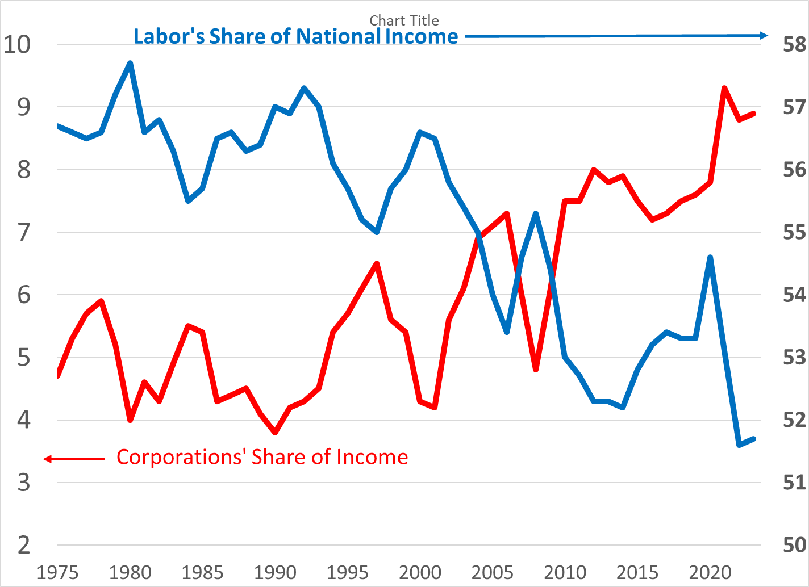
Notes:
Corporate profits as a share of national income bounced around 4-1/2% of GDP b/w 1975 and 1990. It reached around 9% in recent years.
During the same period, labor’s share of income has declined from around 57% to around 52%.
Why have corporate taxes declined even as profits doubled? We’ve seen both cuts in the corporate tax rate and increases in corporate loopholes.

Slide 14
Federal Spending by Major Categories
Notes:
There are many ways to divvy up federal spending but the most straightforward for out purposes is to look at 3 categories.
Mandatory spending results from legislation with formulas but no spending limit like Social Security, Medicare, unemployment benefits, farm subsidies. Putting aside the blips during recessions, the aging of the Baby Boom has raised the mandatory share from about 10% in 2000 to about 14% today and a projected 15% in 10 years.
Discretionary spending from annual appropriations with specific amounts to be spent has been shrinking to about 6% of GDP.
Federal interest payments have risen to 3% of GDP and are projected to rise to 4% in the next 10 years due to increased debt and higher interest rates.

Slide 15
Federal Debt as a Percent of GDP
Notes:
During World War II, the federal government ran large deficits. By the end of the war, the debt was as large as GDP. For a ratio of 100%. That ratio declined until the 1980s despite deficits most years.
As a matter of arithmetic, this ratio declines when the GDP grows faster than the debt. With the debt now roughly equal to the GDP, the ratio would be stable if the growth rate of nominal GDP were as high as the deficit to GDP ratio now running about 6%. Because the GDP growth rate is well below that, the ratio continues to rise. The key point here is that we don’t need to balance the budget for a stable debt situation.

Slide 16
Summary
Policy Change Probable effect
Mass expulsion of immigrants -> raise inflation, lower GDP
Substantial widespread tariffs -> raise inflation
-> lower GDP from foreign retaliation
Deregulation of oil and gas -> lower inflation, but only temporary
Substantial tax cuts -> raise GDP
Substantial spending cuts -> lower GDP in the near term
Increased uncertainty -> lower GDP from less hiring & investment
If inflation heats up, the Federal Reserve will probably raise interest rates which would cool the economy.

Slide 17
