Slide 1
Fun with chemistry
Dr. Kate Biberdorf
December 11, 2015

Slide 2
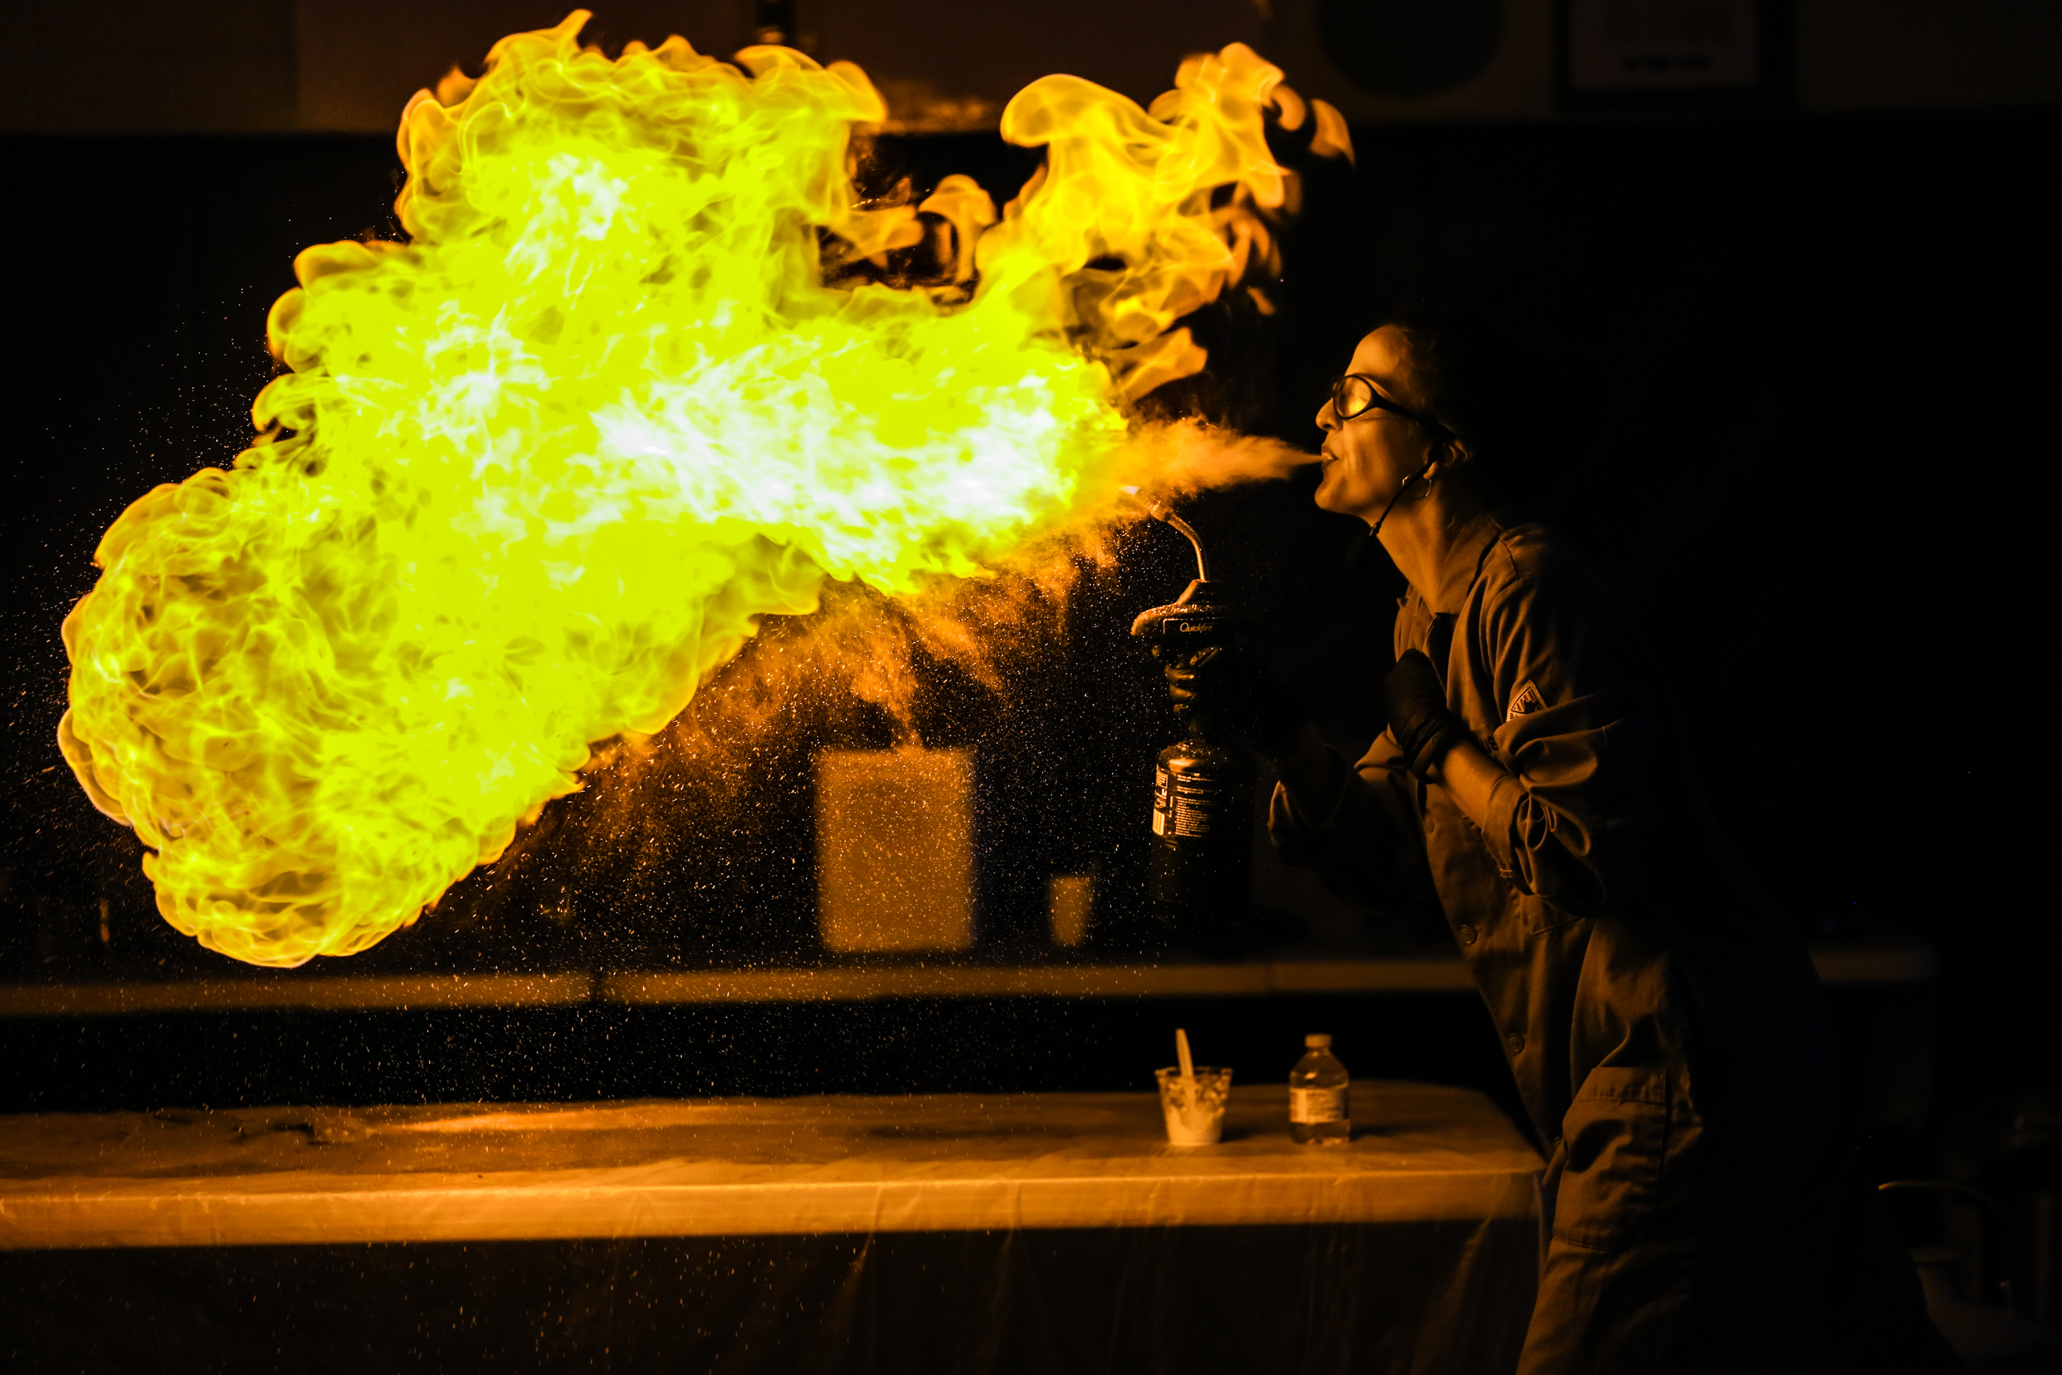
Notes:
Intro Kate

Slide 3
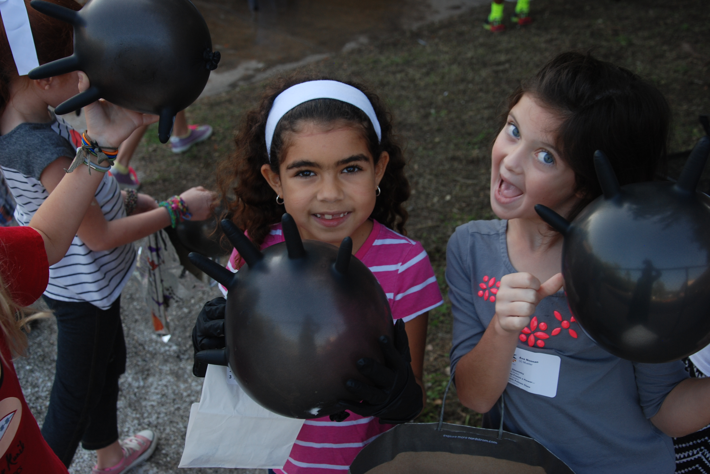
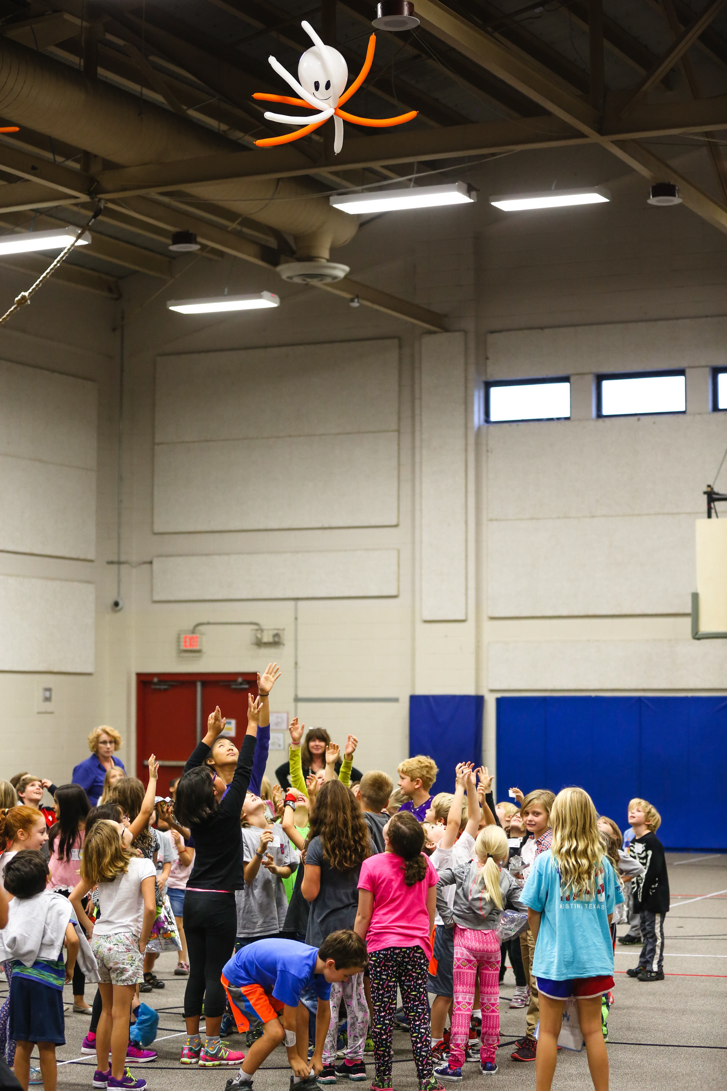
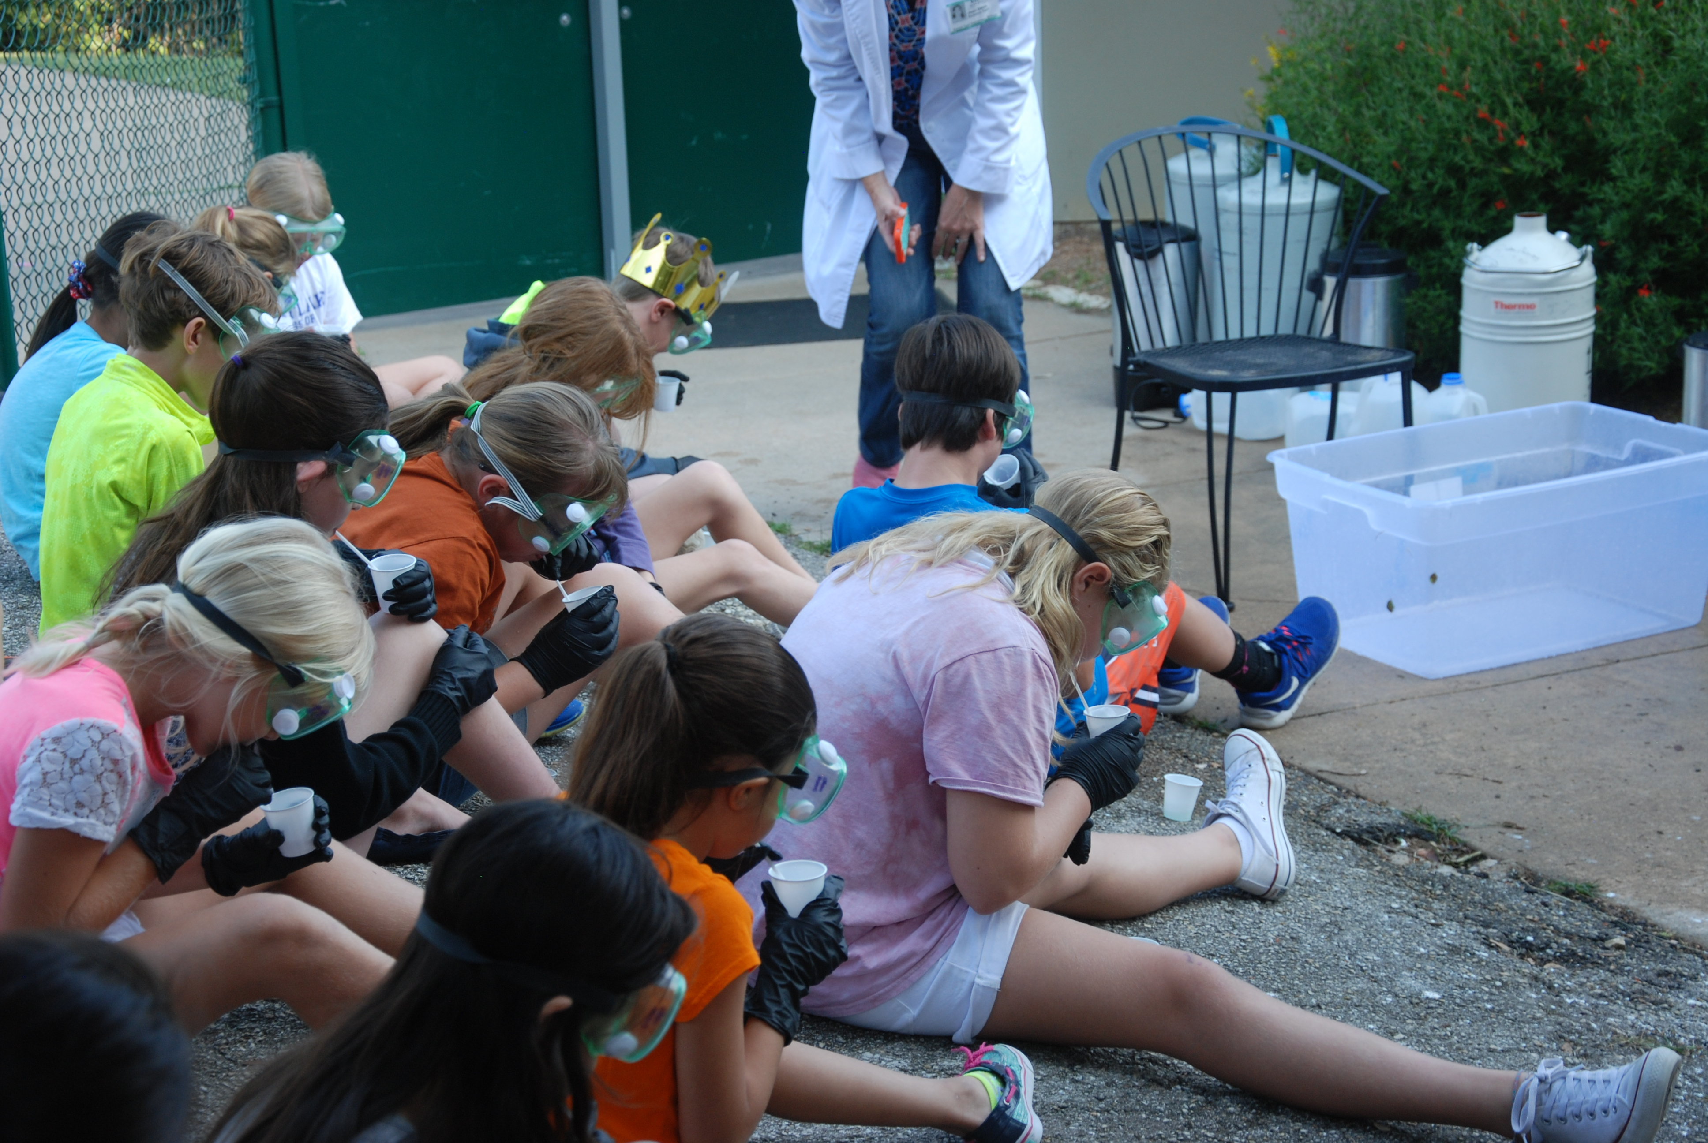
Notes:
Intro Program…Who are we?

Slide 4
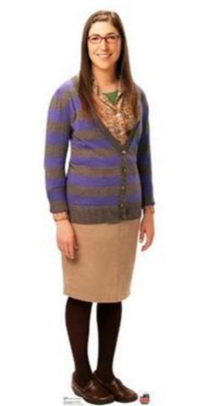
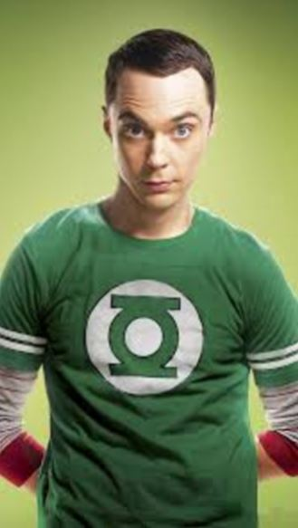
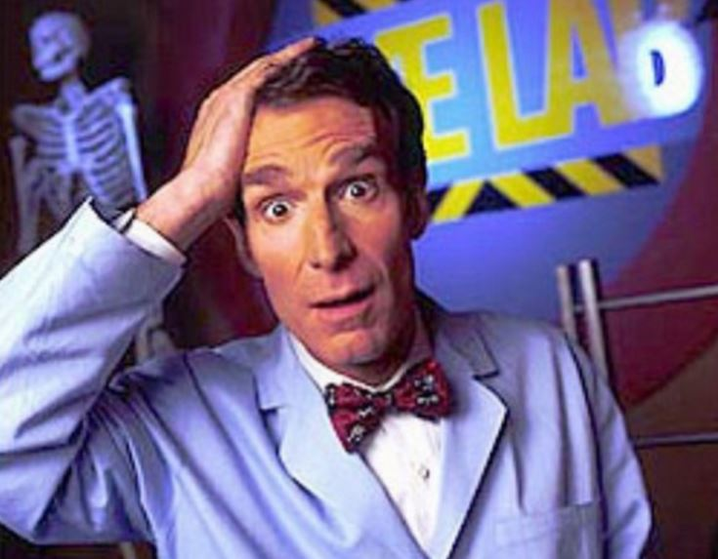
Notes:
Why are we doing this?

Slide 5
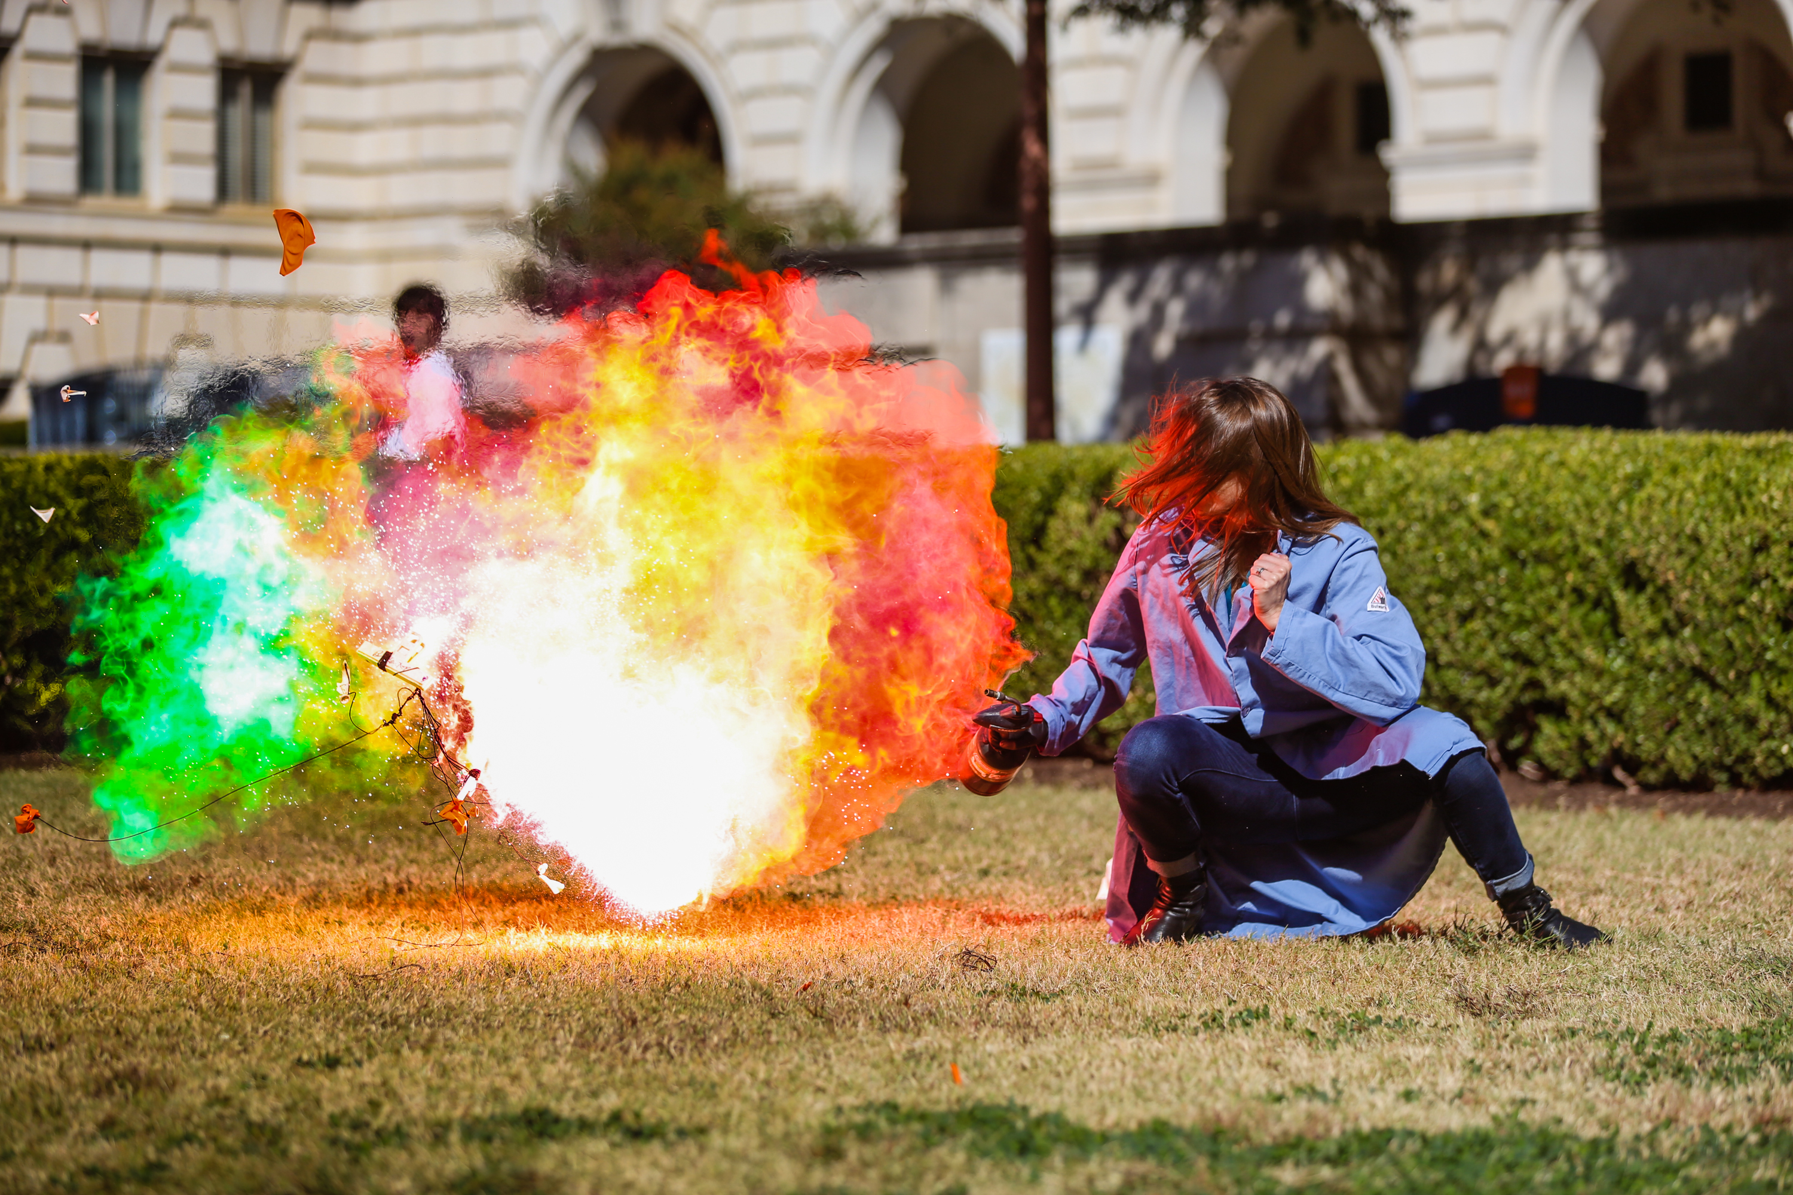
“I’m on a mission. I am going to spend the rest of my life fighting the current image of a chemist. You do not have to be raised by an affluent family, you do not have to be a dork or a nerd – you can just be a normal girl that likes to blow stuff up.”

Slide 6
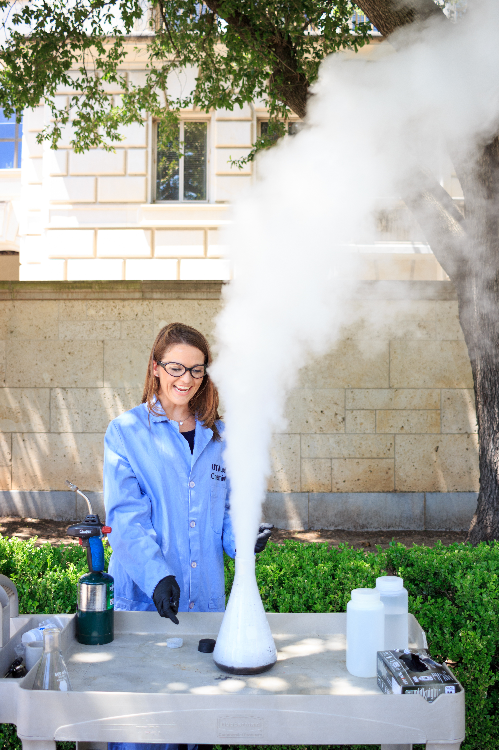
Our Mission
Ignite, inspire, and motive K-12 students to develop a love for learning and exploration in the sciences
Target students that are intimidated by science
Utilize hands-on demonstrations to foster a determination to pursue a science-related degree at the collegiate level

Slide 7
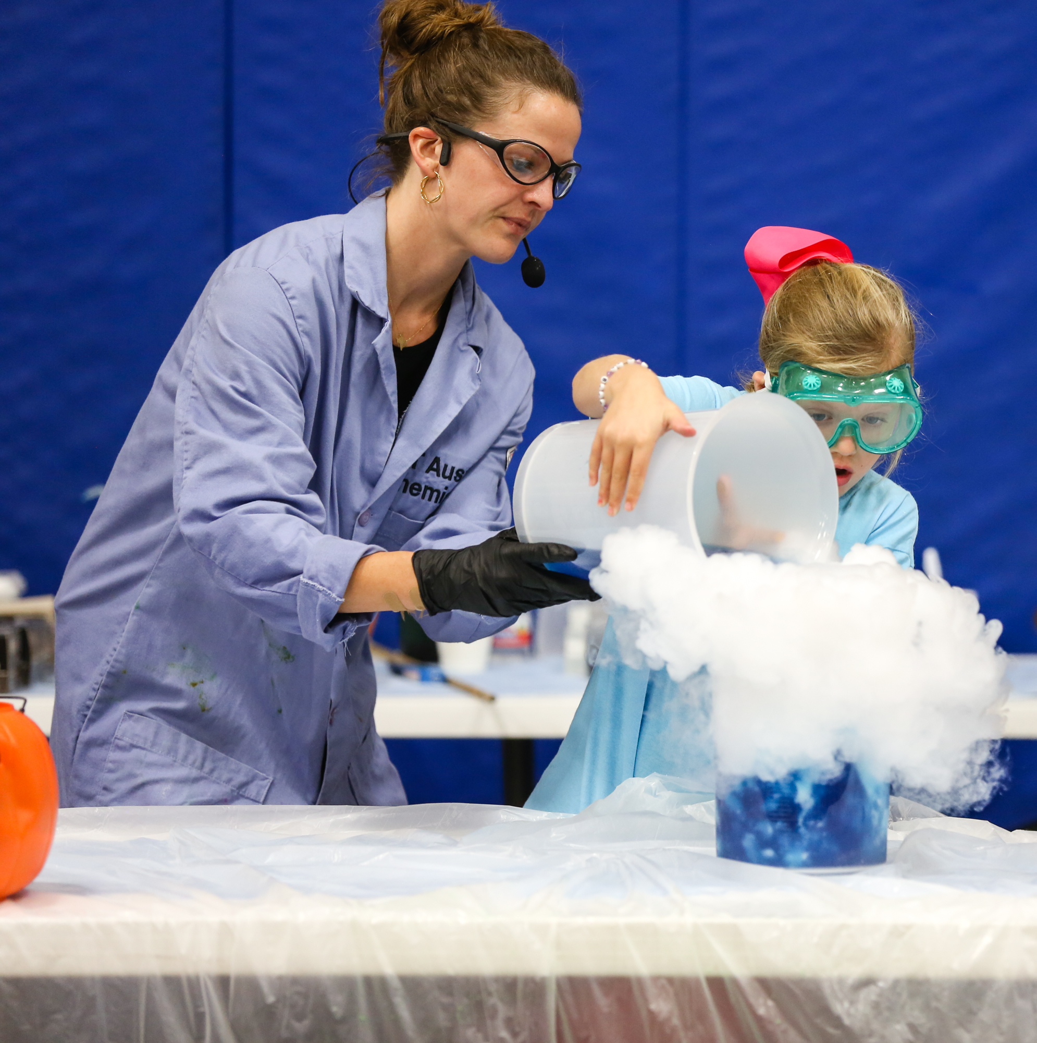
Our Vision
Aspire to interact with every single Austin student once a year
Participate at all Austin community events in hopes of finding “closeted chemists”
To become the preeminent science education program for K-12 students in the greater Austin area

Slide 8
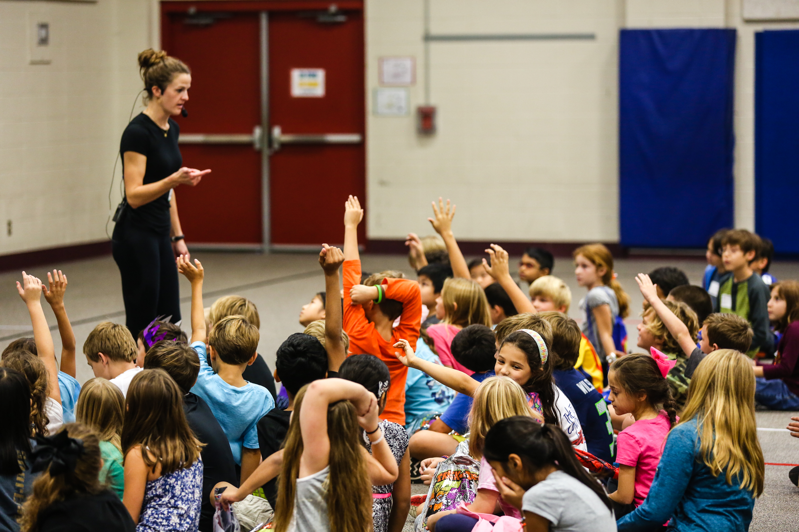
Types of Events
Hands-on Presentation
Lecture

Slide 9
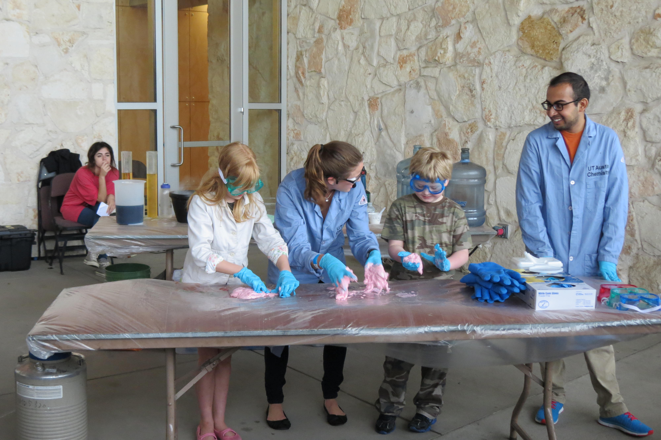
Types of Events
Community Event
Personal/Corporate Event
Notes:
Mention Chirag

Slide 10
Collaborations
Notes:
Mention Chirag

Slide 11
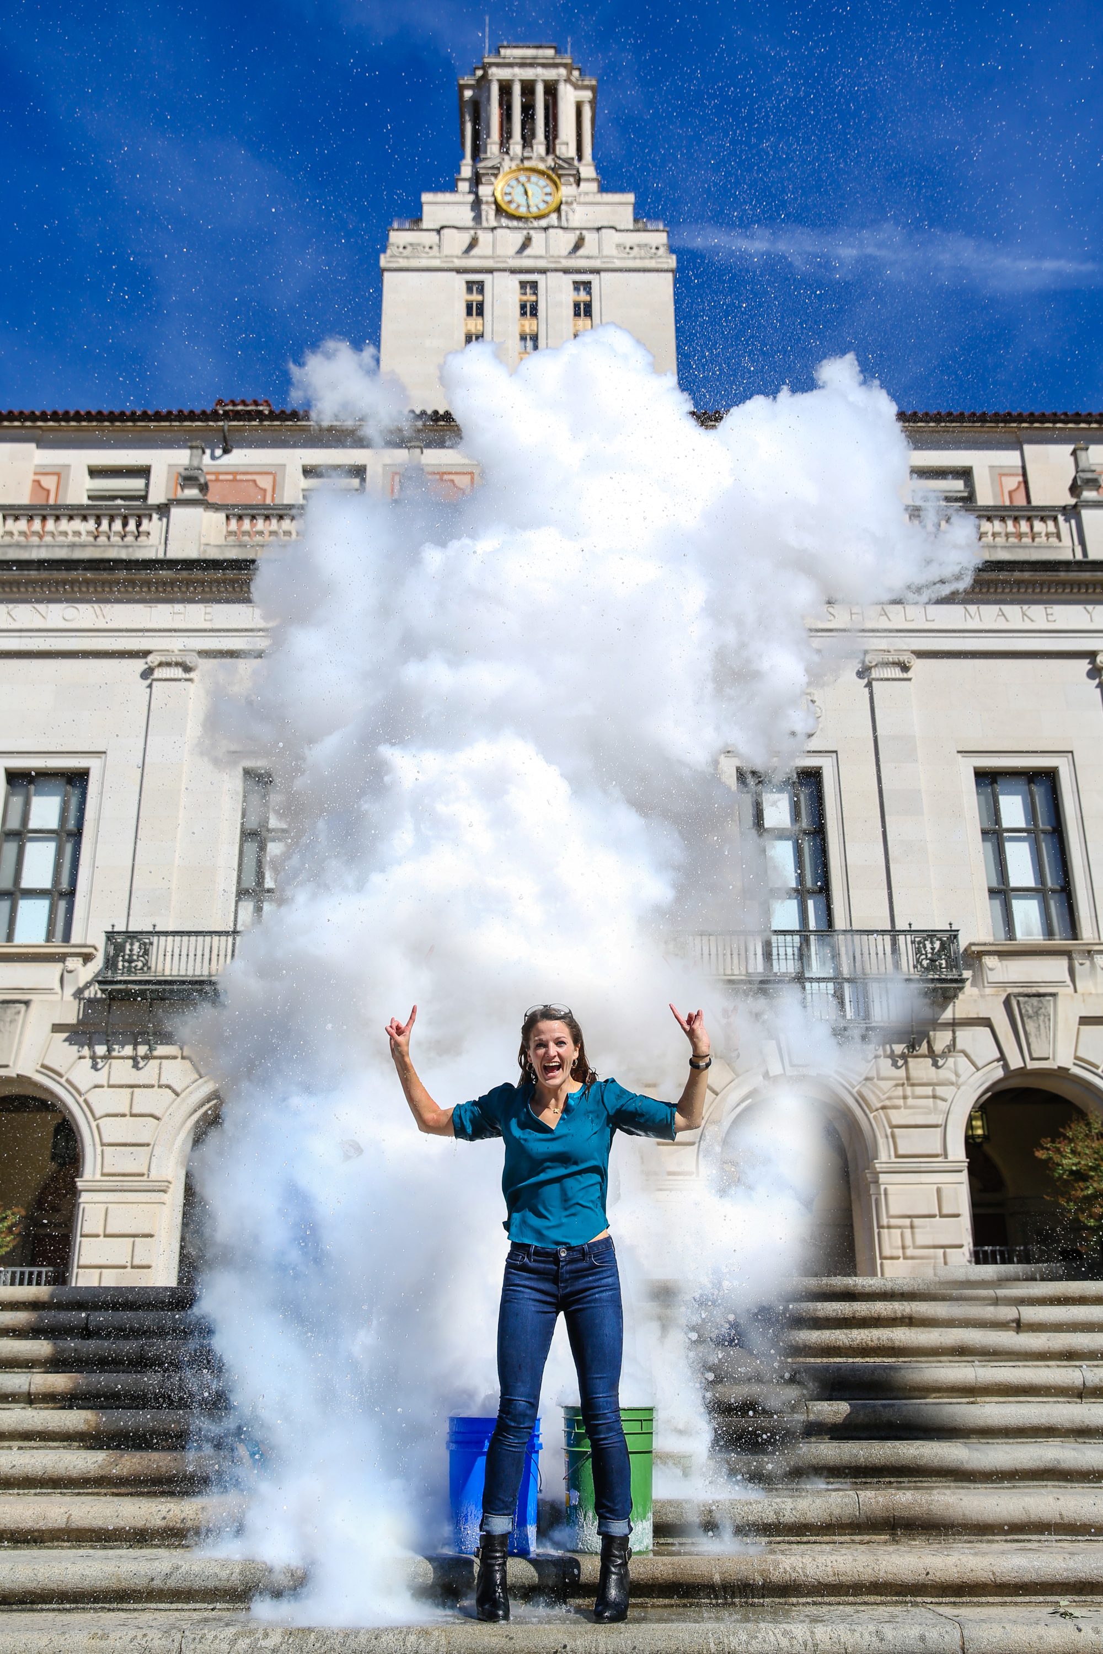
16,607 Student Interactions in 2014-2015

Slide 12
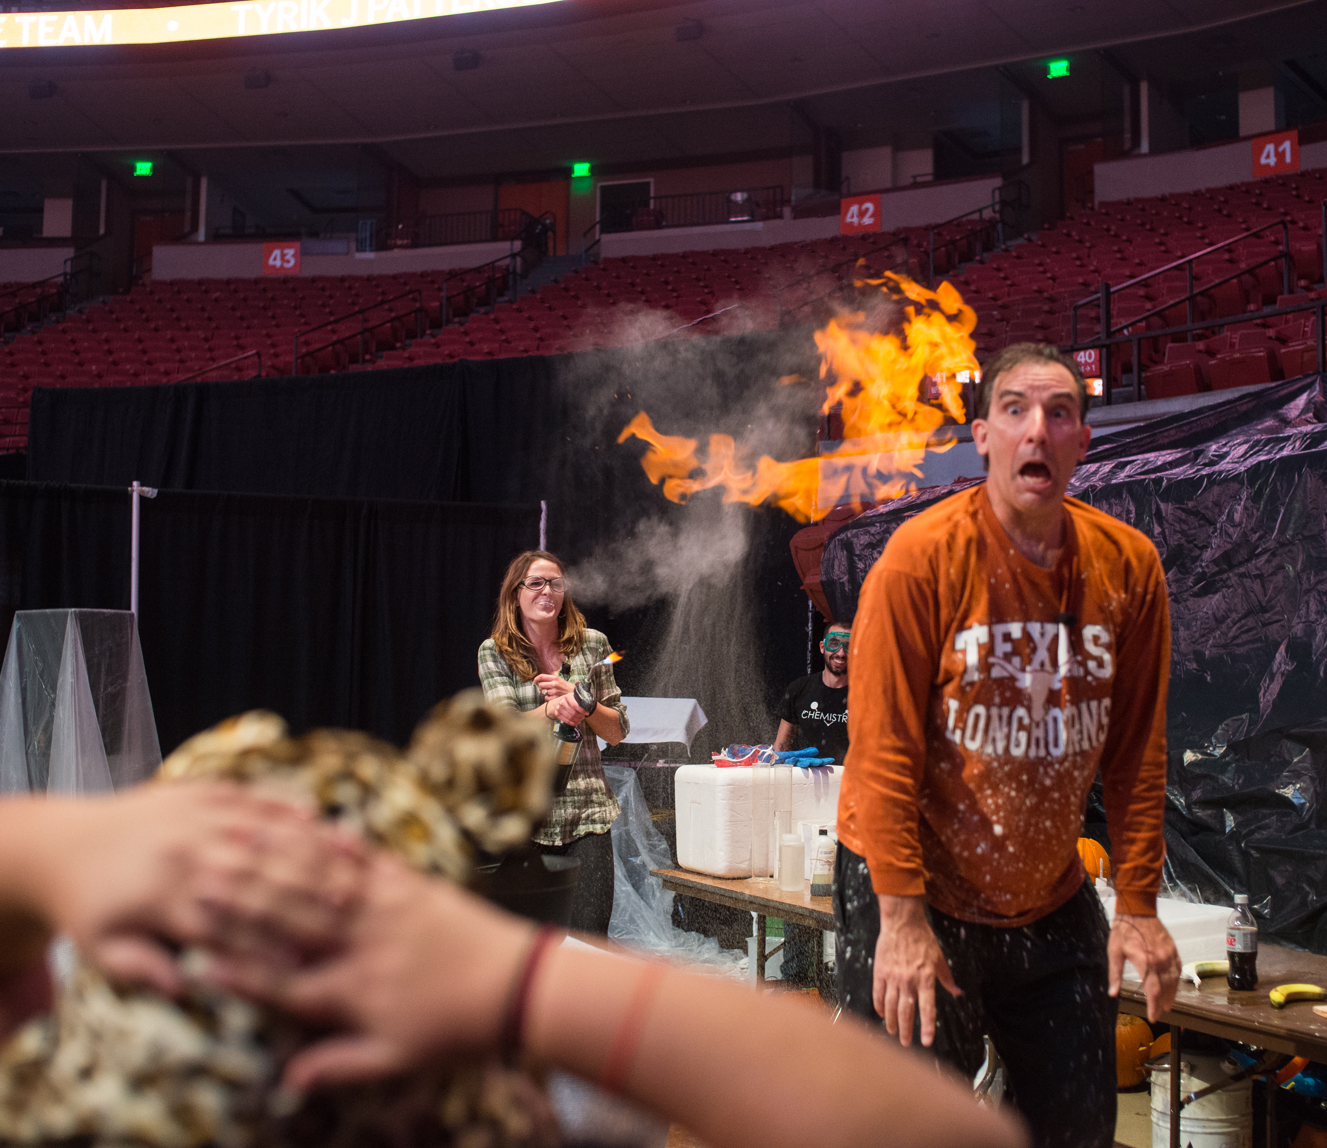
Over 100 Undergraduate Volunteers in 2014-2015

Slide 13
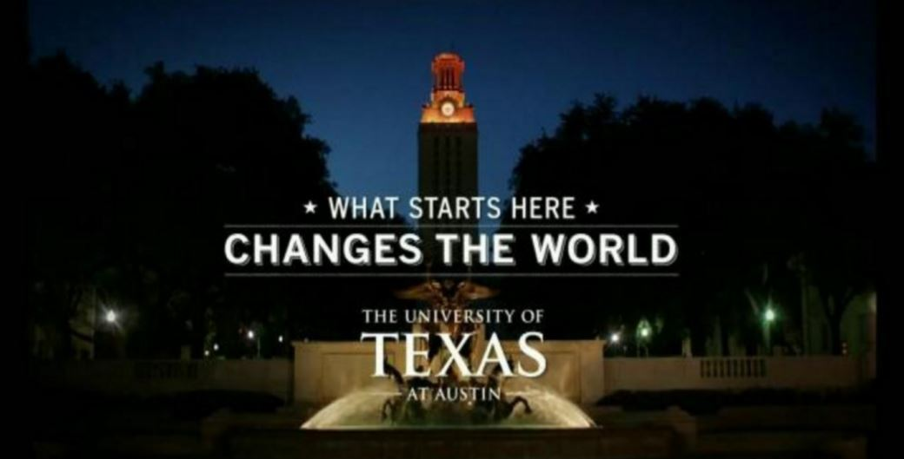

Slide 14
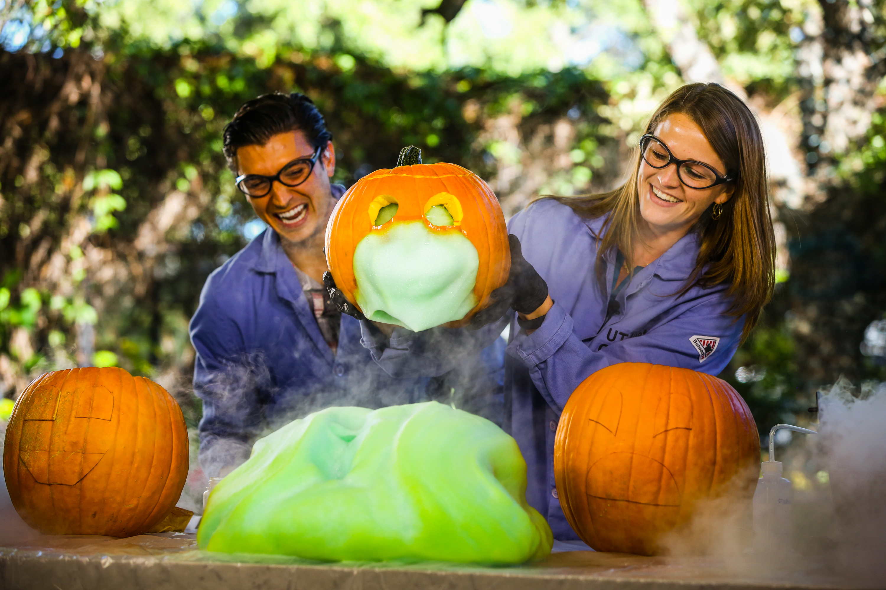
Fun with Chemistry
www.cm.utexas.edu/outreach/funwithchem
FunwithChemistry@utexas.edu
www.katethechemist.com
@FunwithChem

