Slide 1


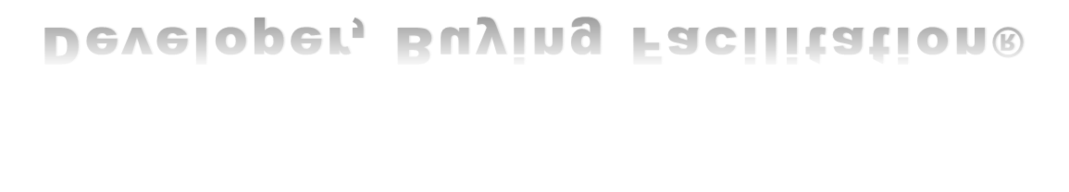

Slide 2





Slide 3



CLOSING
CLOSING
THIS
MONTH
NEXT
MONTH
WHENEVER
WAIT INC.
WAIT
LONGER INC.
WAIT
FOREVER INC.

Slide 4

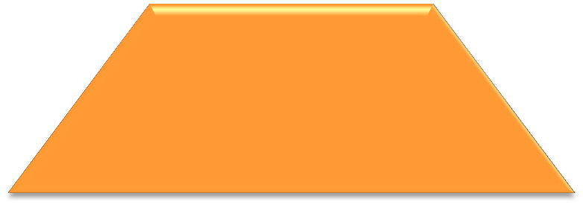


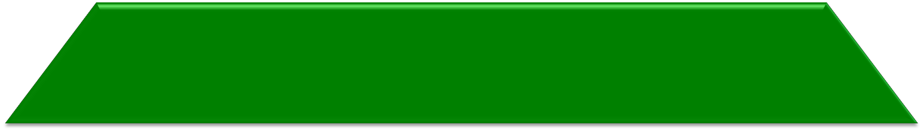
Open
Gather Data
Data Share
Follow Up
Close

Slide 5

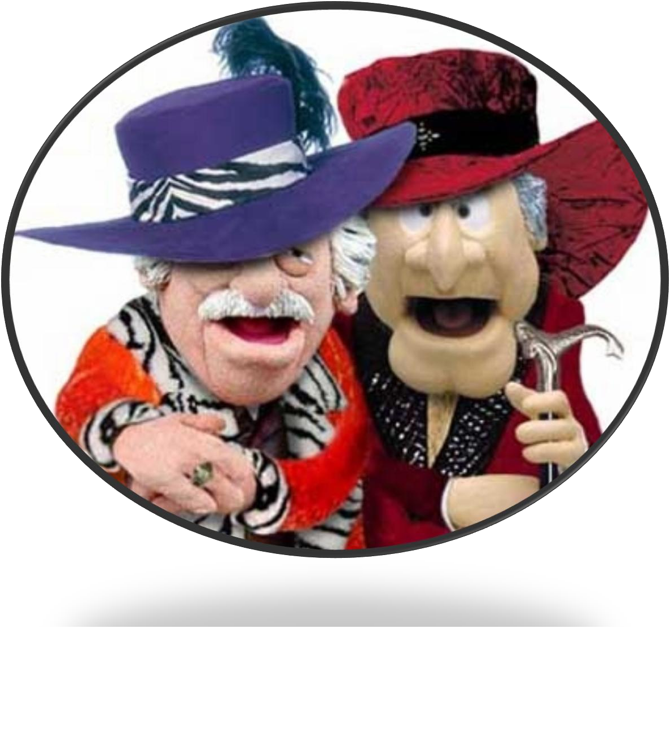

Slide 6
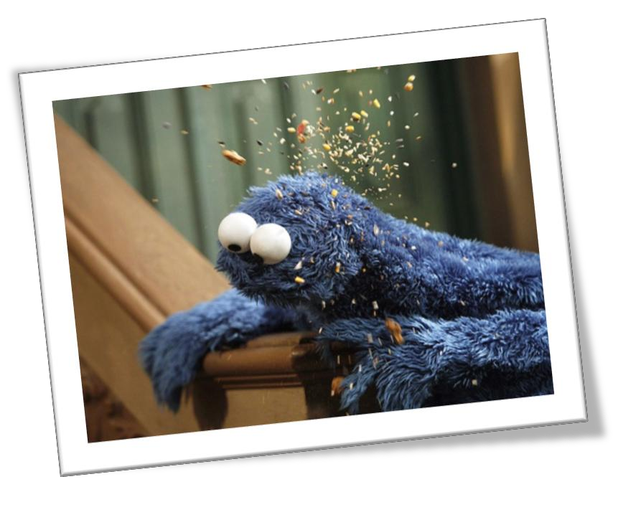


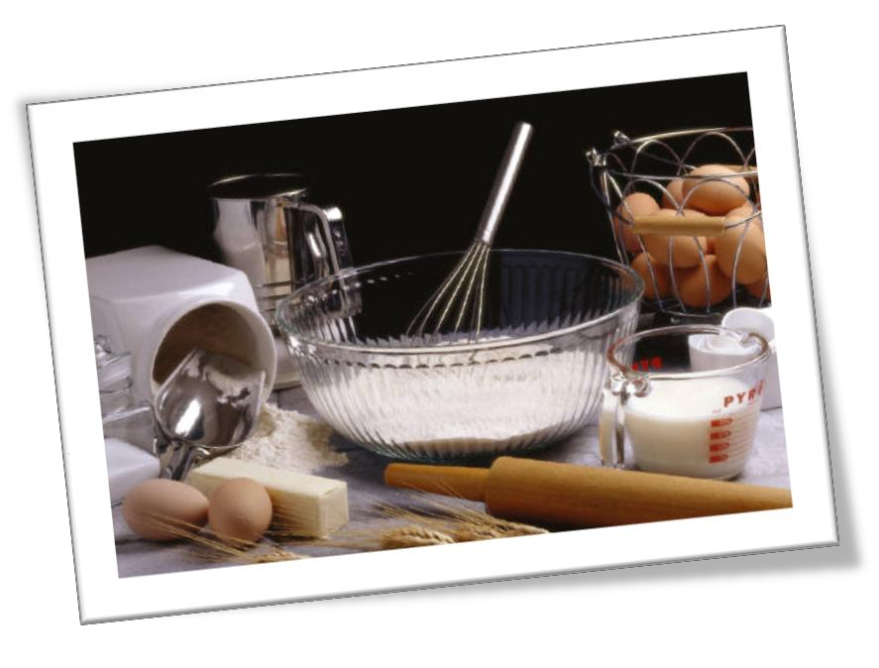
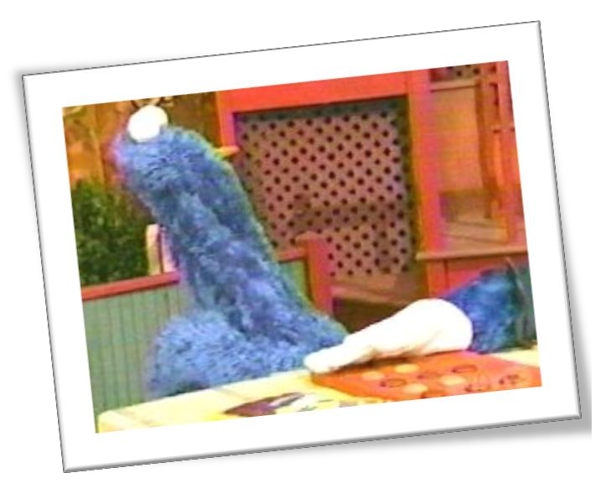



Slide 7
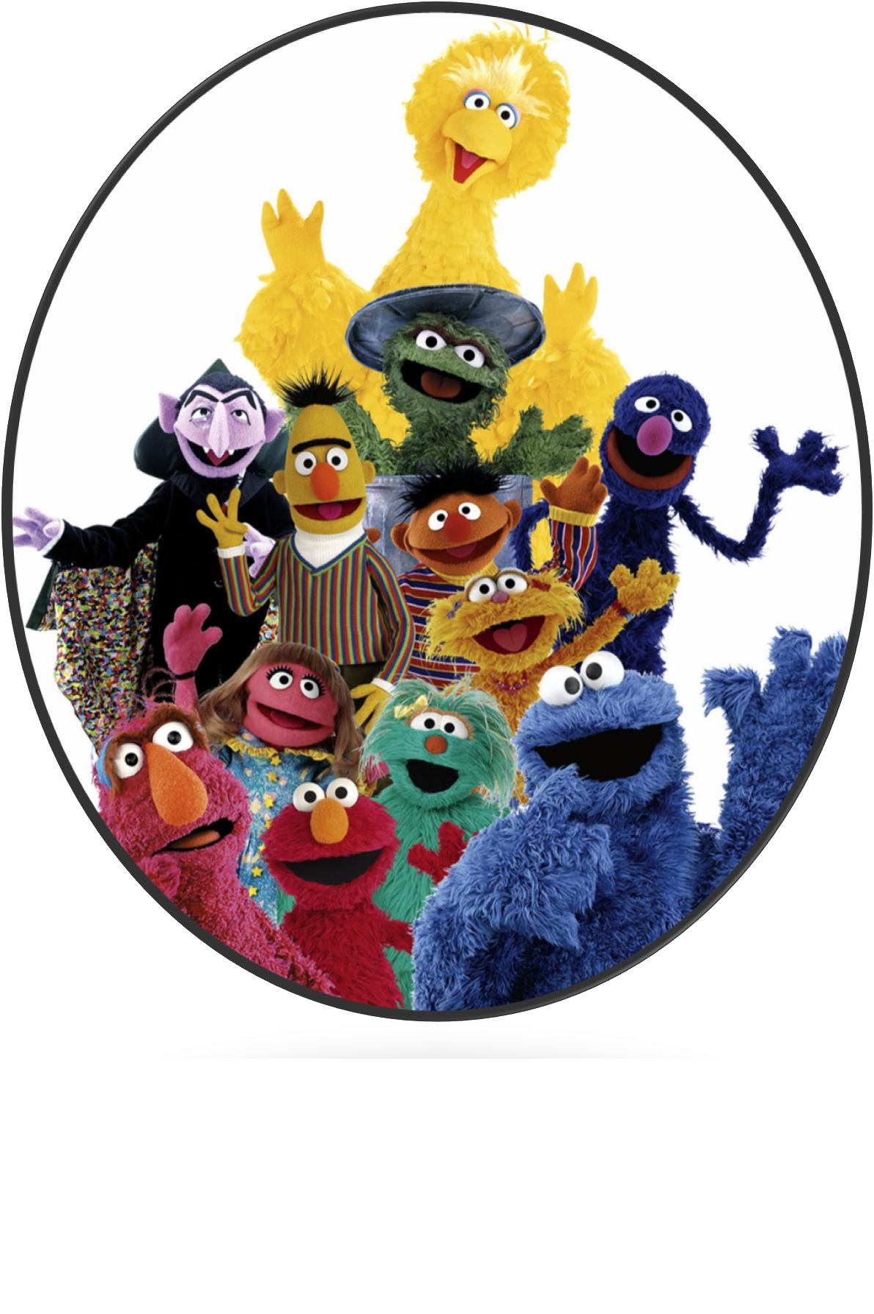








Slide 8
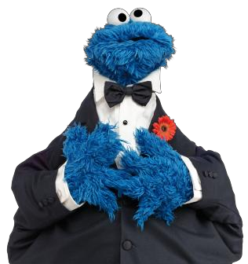

Slide 9


Sales Enablement
Buy-In, Change Management, Behind-The-Scenes, Private
Needs Analysis, Solution Choice
Buying Facilitation®
Step 1
Sales
Step 2

Slide 10

80%
7%
10%
97.5%
.675%
17%

Slide 11
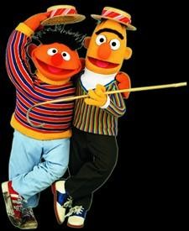
A
purchase
cannot
disrupt
the
system
A problem is not
an isolated
event

Slide 12
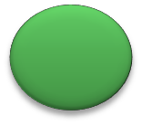
The pain of a problem
is more tolerable than
the pain of disruption.
Until or unless a buyer gets
appropriate buy-in
for change
and knows how to manage
change when a solution enters
they will do nothing.

Slide 13

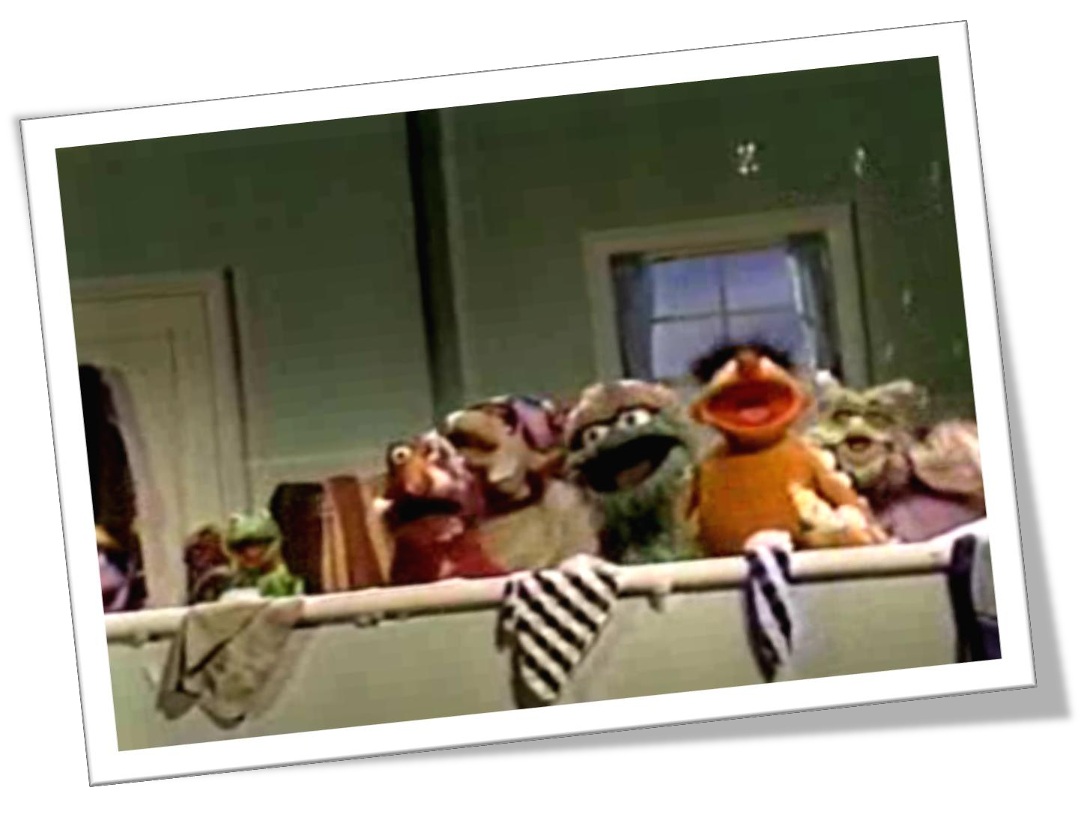

Slide 14
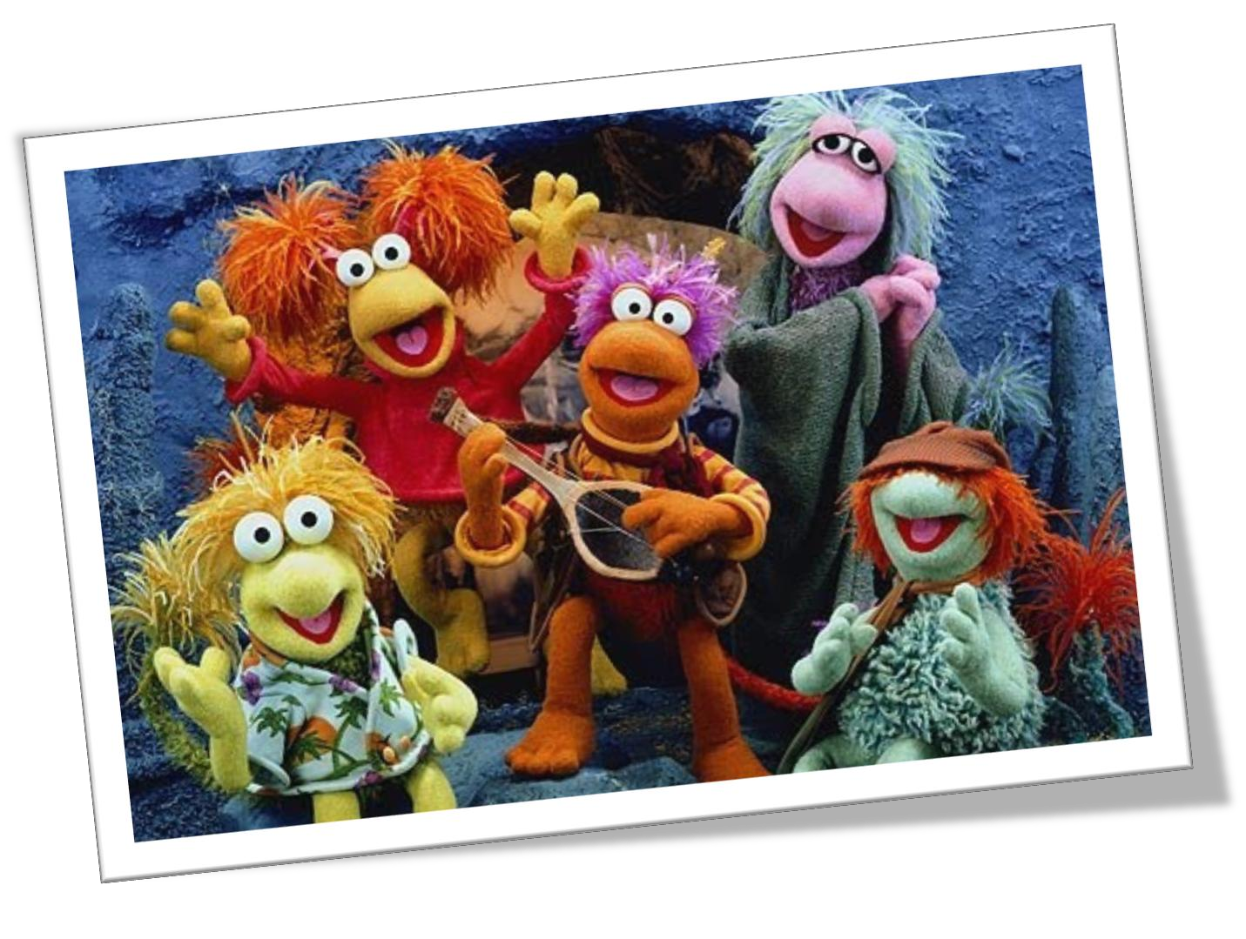
Rules
of
a
system:
• everything within buys in to same rules

Slide 15
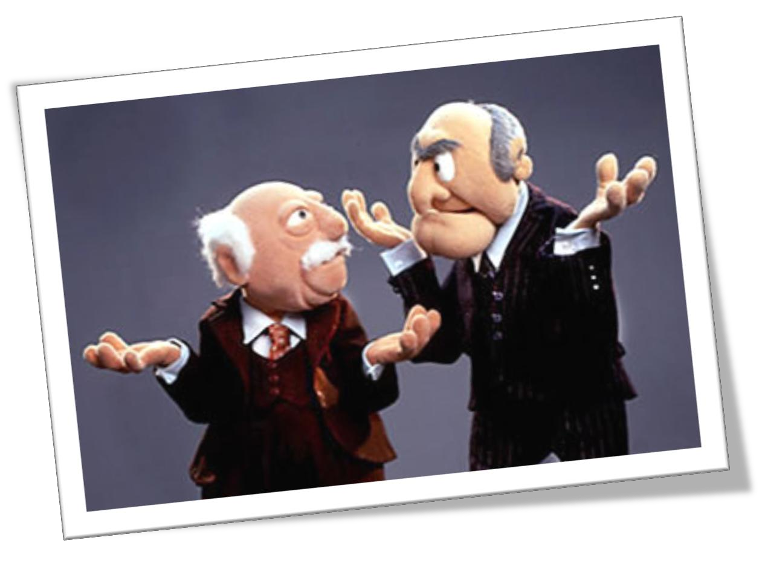
Rules of
a
system:
• the problem is not recognized as a problem

Slide 16
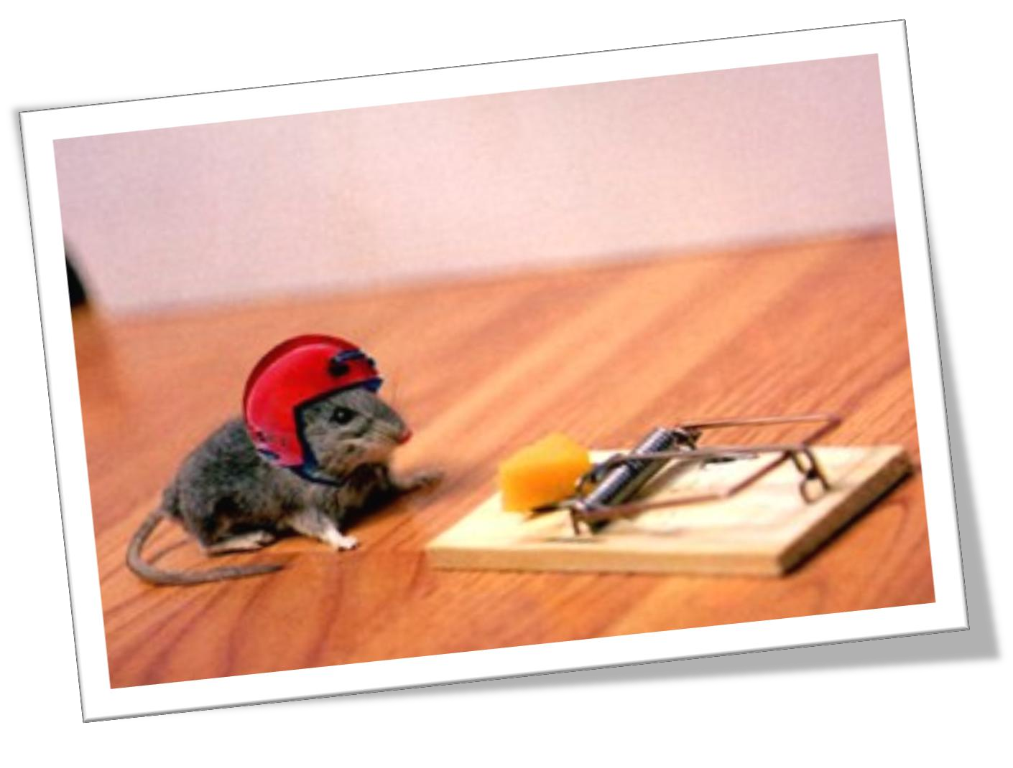
Rules
of a
system:
• change can’t cause disruption or no purchase,
r
egardless of need

Slide 17
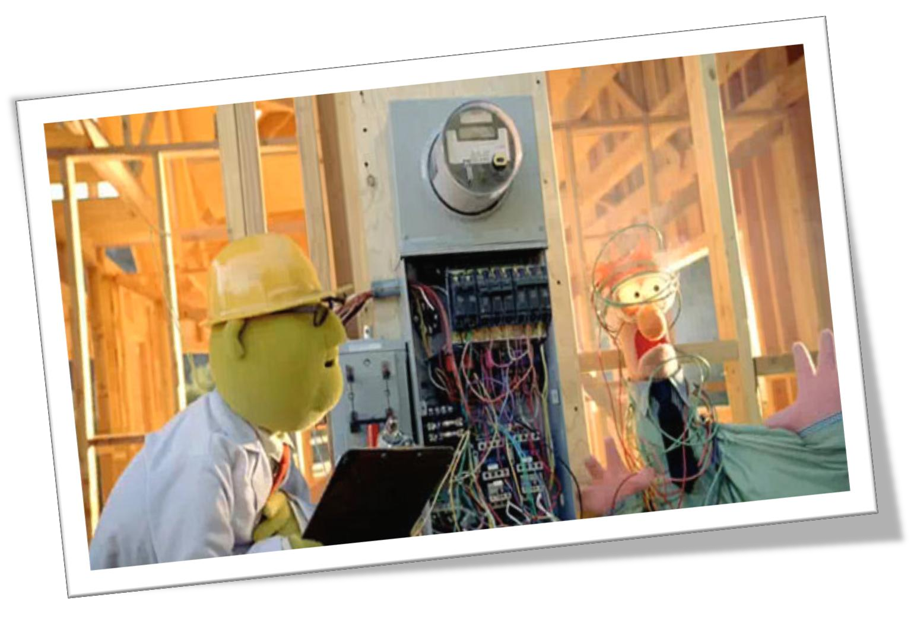
Rules of
a
system:
• would have been resolved if possible

Slide 18
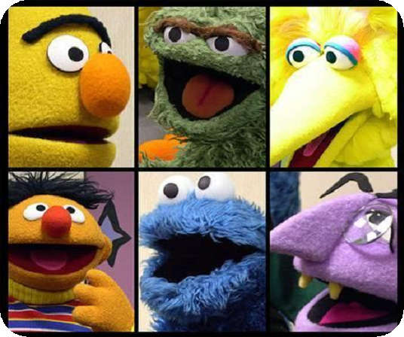

Rules of
a
system:
• stated need will be incomplete unless all who touch
the solution add their unique criteria

Slide 19
We are:
• entering too soon in the buying journey,
• treating ‘needs’ as if isolated events rather than part of
functioning system,
• ignoring pre-purchase behind-the-scenes, political, and
relationship issues,
• acting as if have completed change management,
• ignoring buyer’s reality: the time it takes for the entire Buying
Decision Team to form and buy-in is the length of the sales cycle,
• ignoring decision facilitation to help traverse buying decision
path

Slide 20
Sales Enablement
Buy-In, Change Management, Behind-The-Scenes, Private
Needs Analysis, Solution Choice
Buying Facilitation®
Step 1
Sales
Step 2

Slide 21
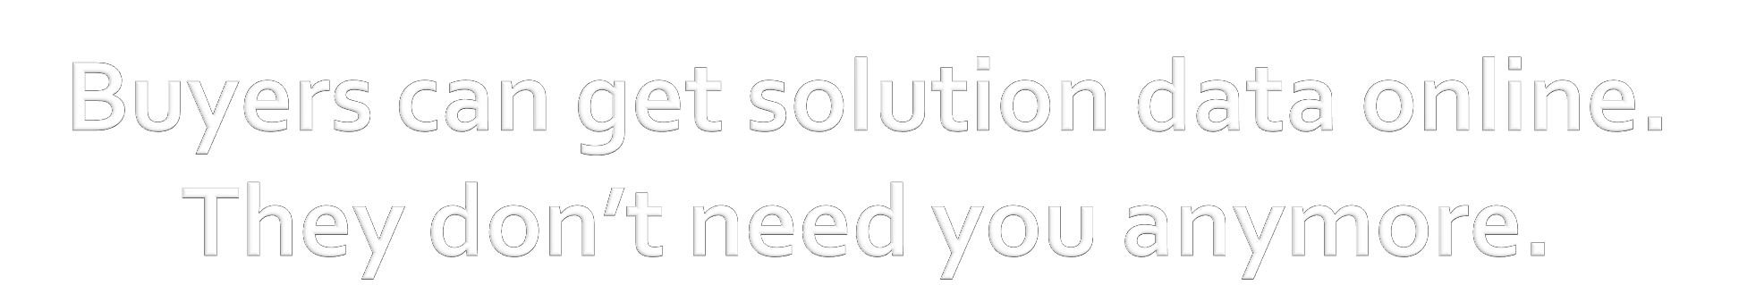
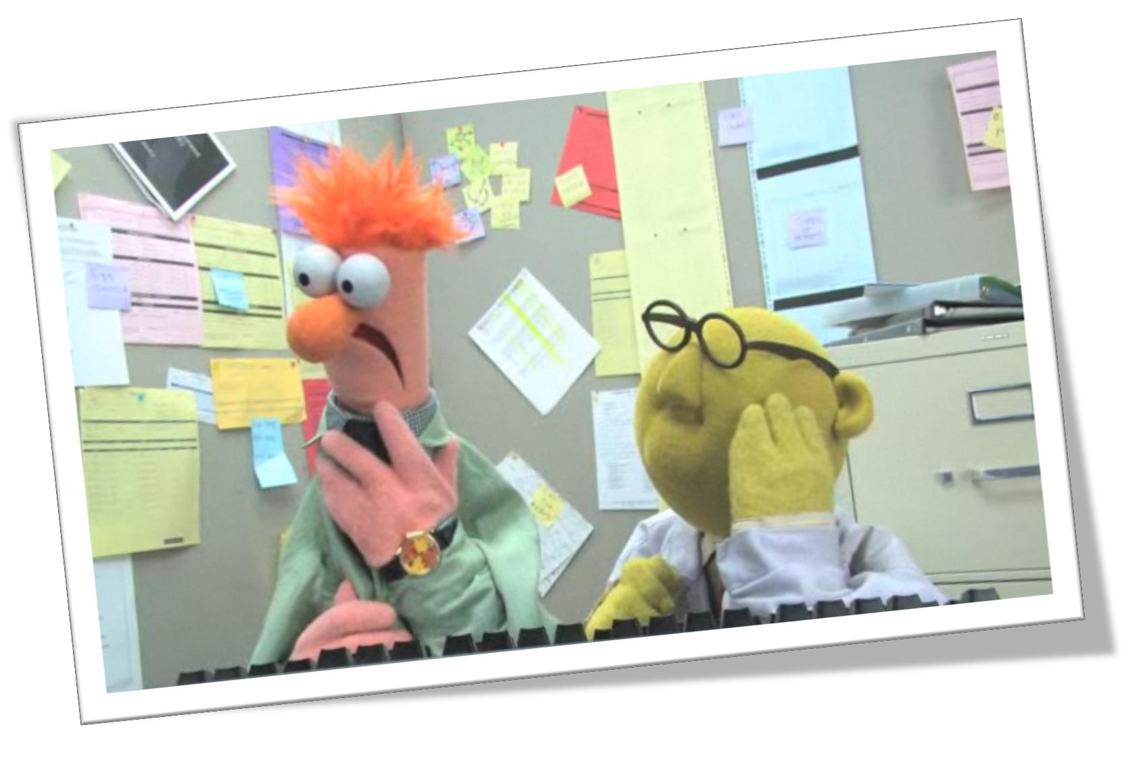

Slide 22
Buying Facilitation® defined
Buying Facilitation® is a decision facilitation model that
teaches buyers how to recognize and manage all of the behind-the-scenes, backend, off-line issues they must address to get the buy-in necessary to bring in a new solution and avoid disruption. It is a change management model and systems based.

Slide 23
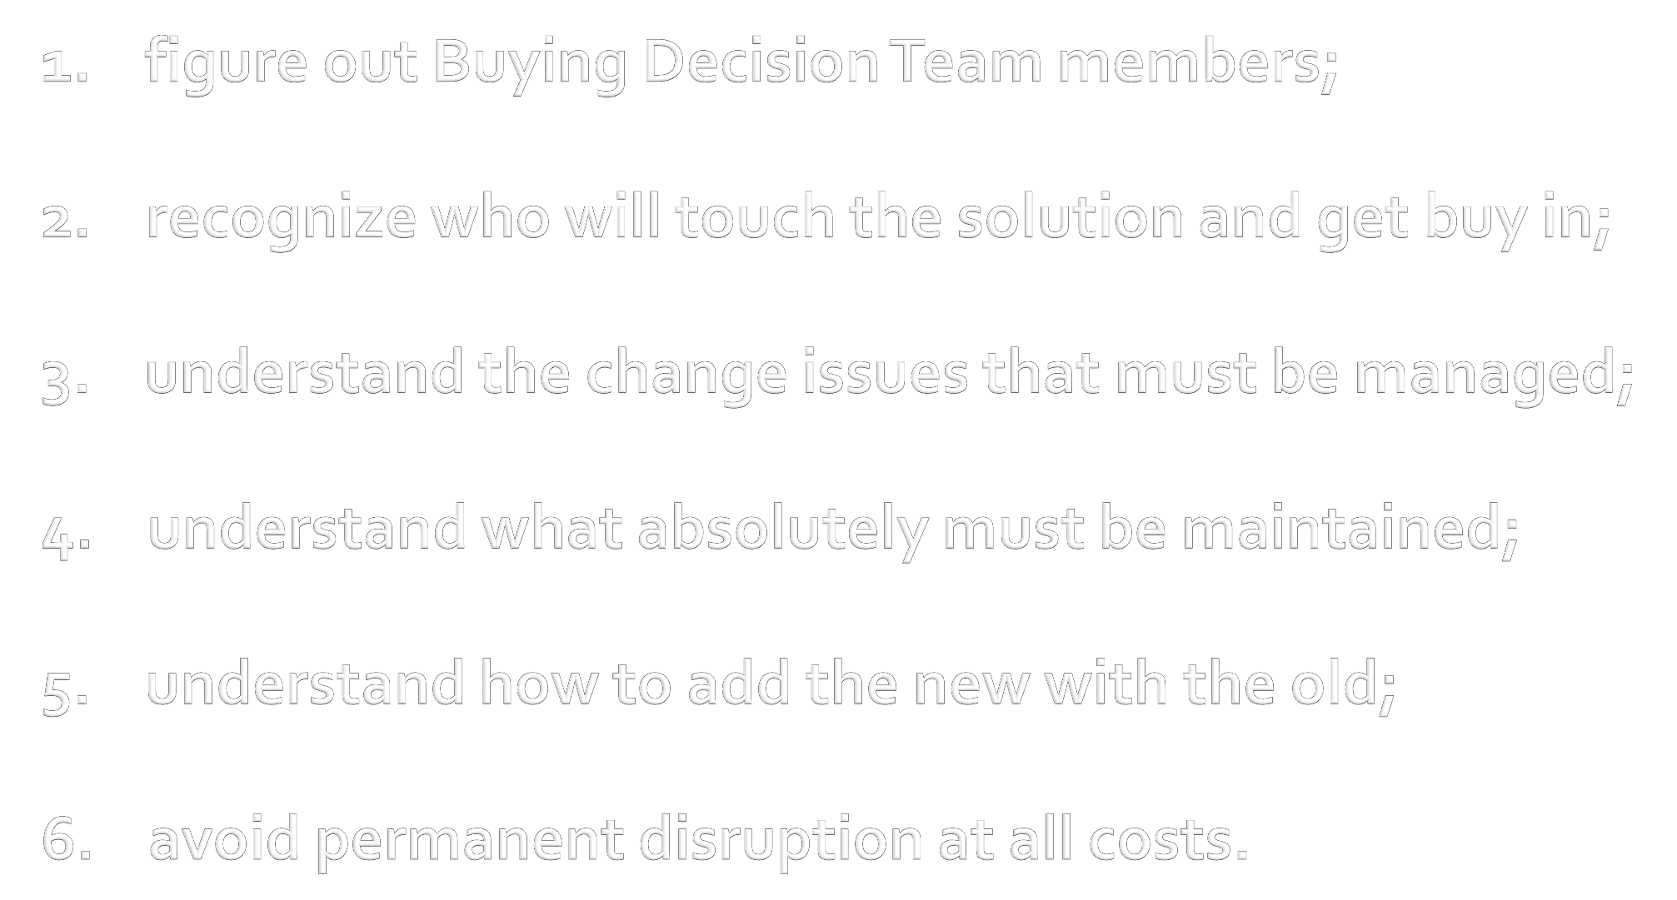
Buyers Must:

Slide 24
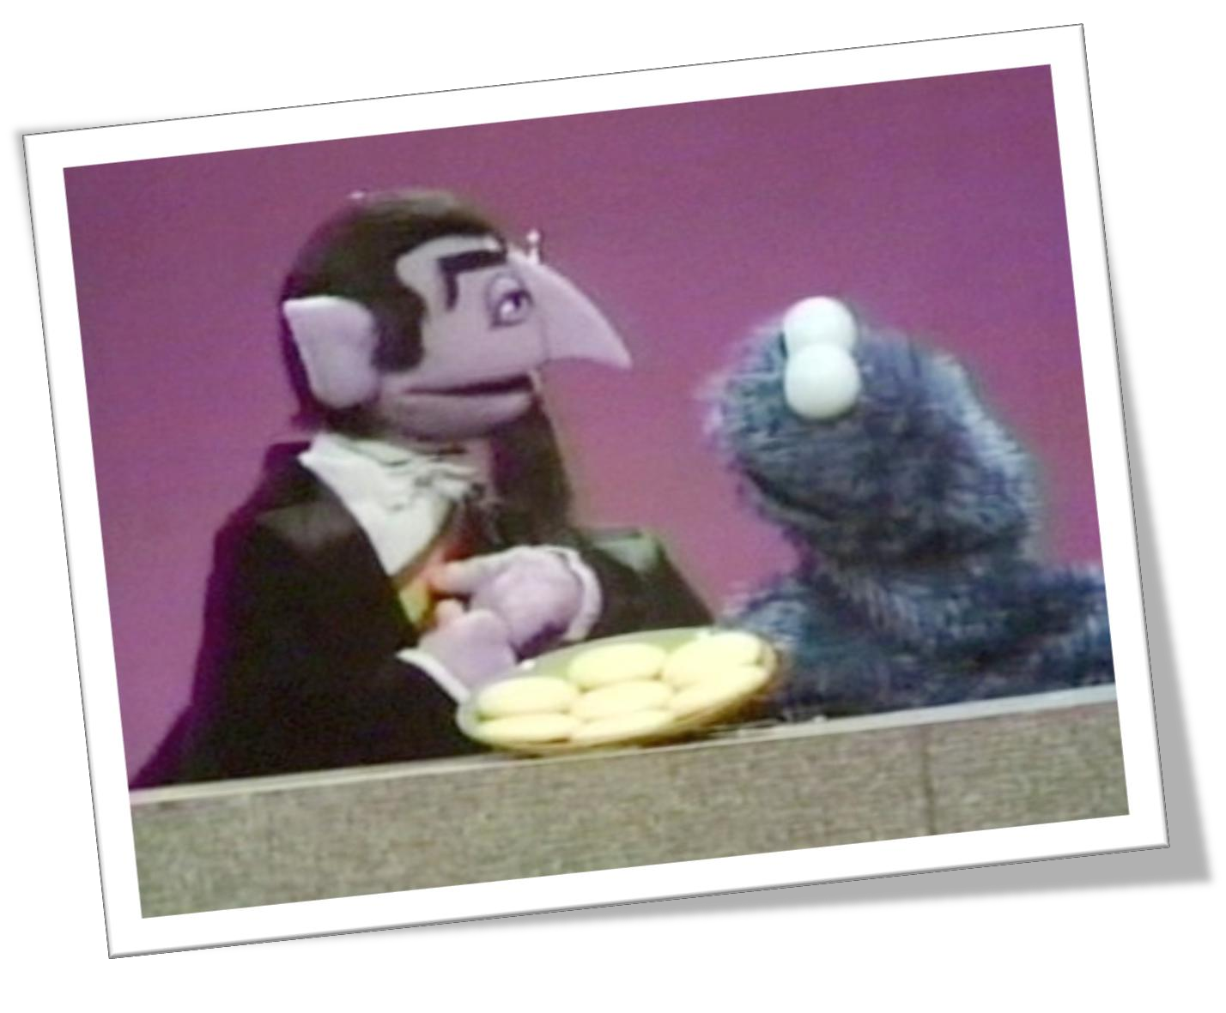
We will never understand.
We are not part of their system.

Slide 25
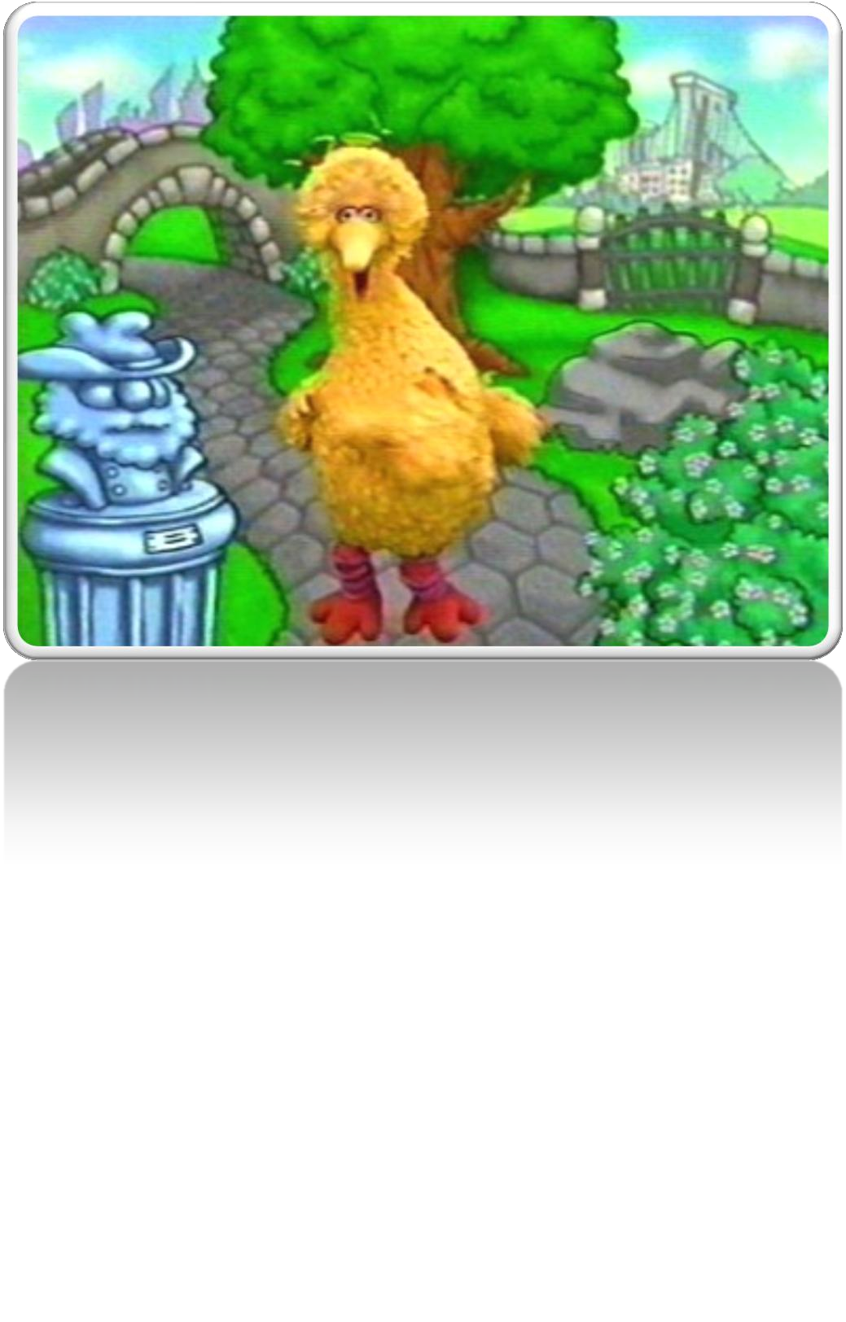
But we can act as Neutral Navigators
and be a GPS system to lead them
through their confusing journey.

Slide 26
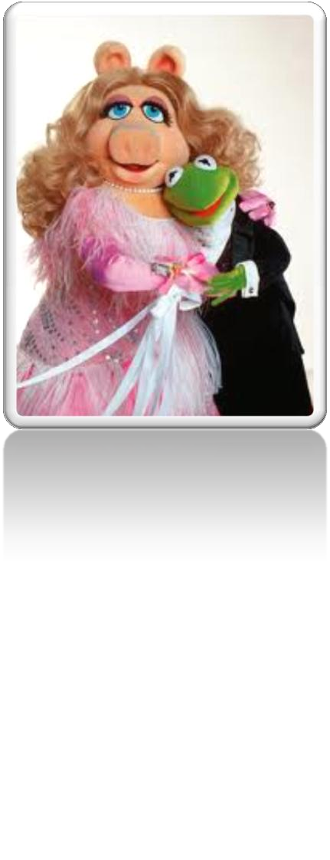
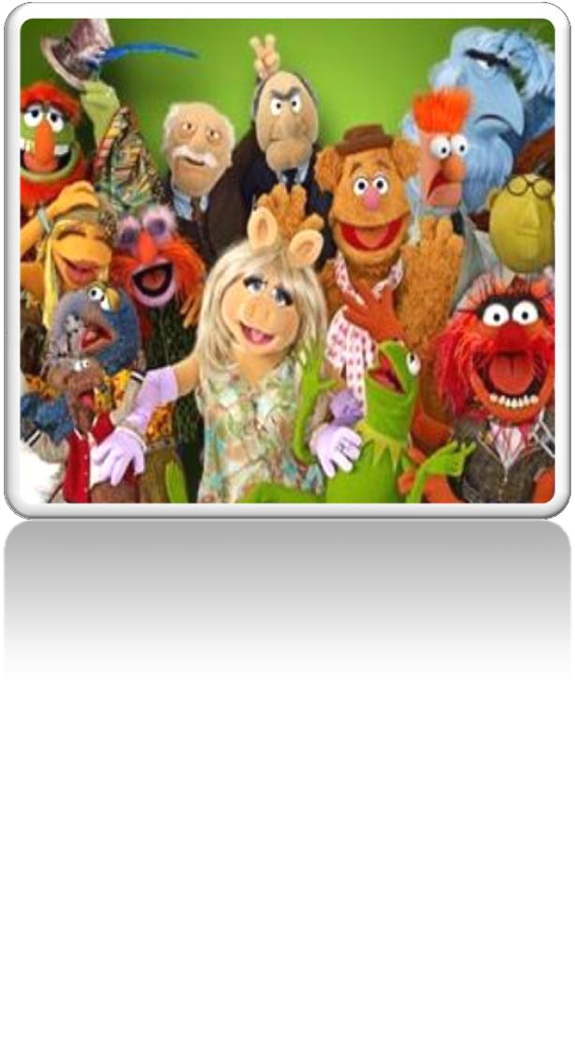

Enter the buying
decision
path
earlier
with:
change managemen
Buying Facilitation®
us on the buying decision p
t
systems thinking
foc
ath
Also enter the decision path earlier
search, marketing automation, and lead
in
scoring.

Slide 27
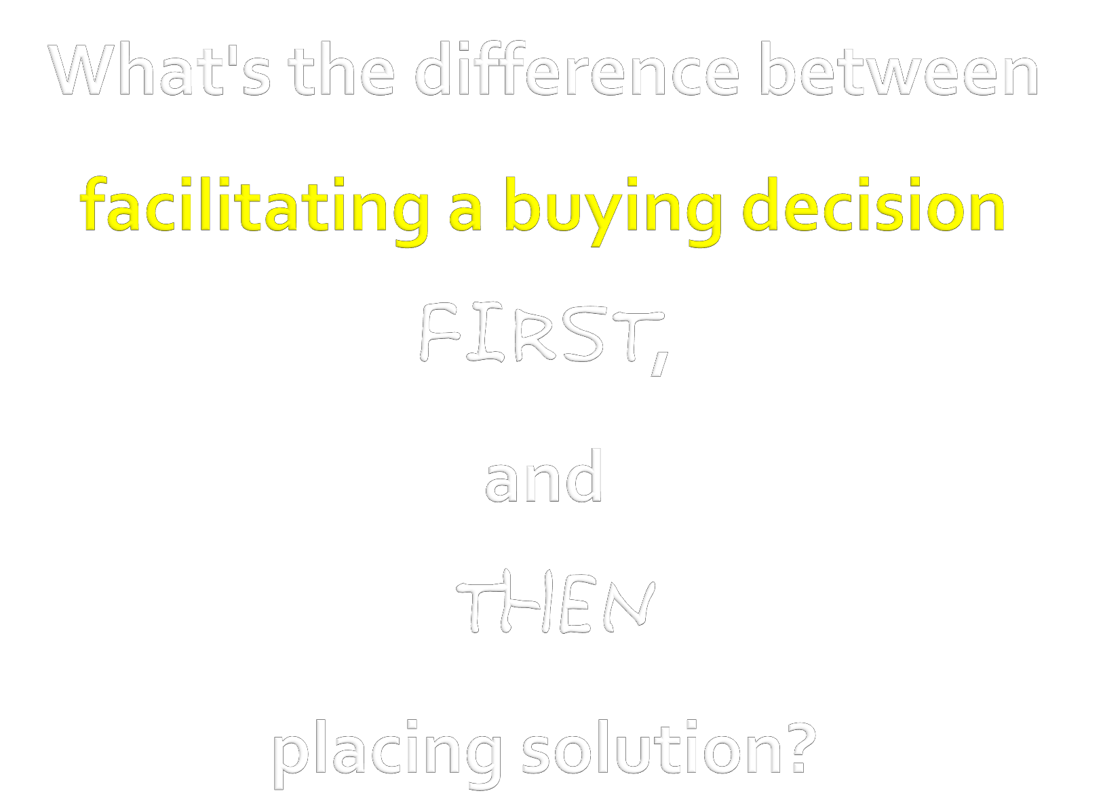

Slide 28
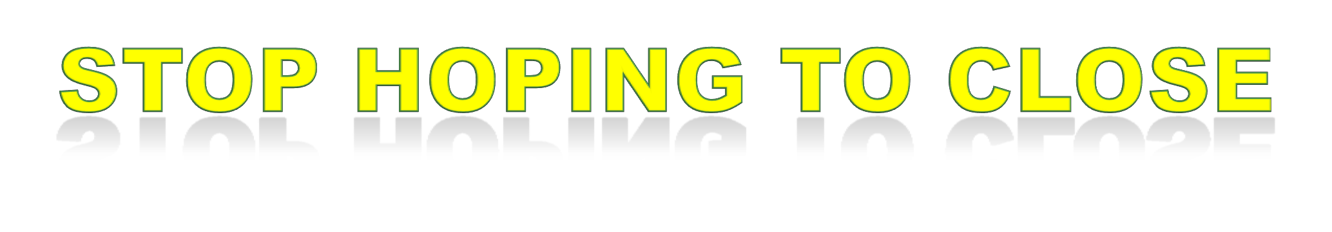

Slide 29
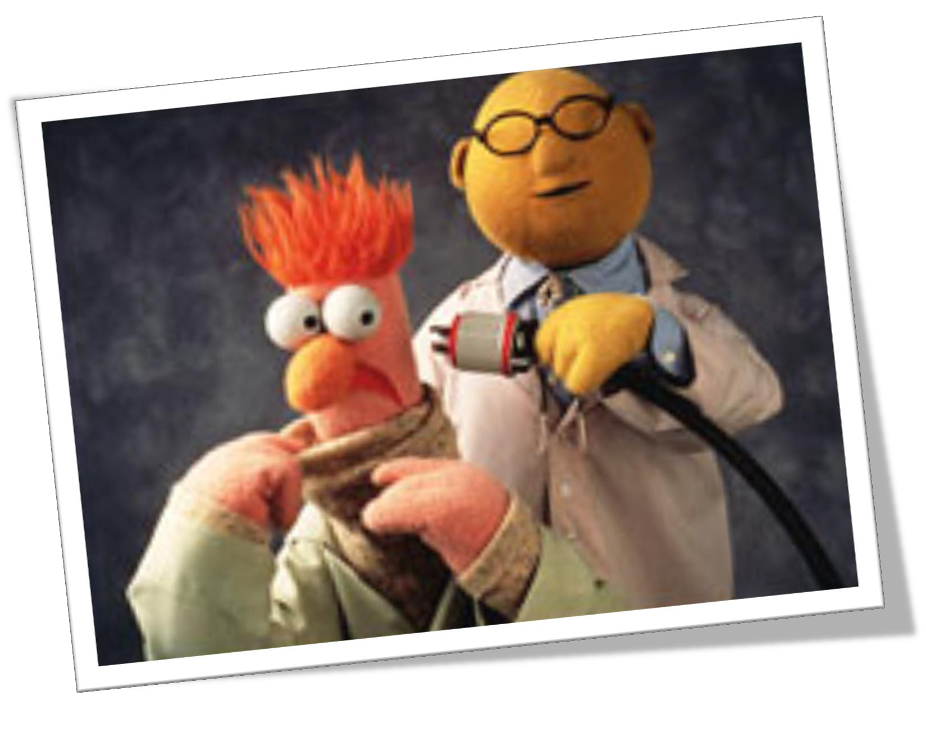

Slide 30

Sharon Drew Morgen
Developer of the Buying Facilitation Method®
Author
of Selling with Integrity & Dirty Little Secrets
NewSalesParadigm.com
sharondrew@newsalesparadigm.com
(512) 457-0246
Buying Facilitation® & all text All rights reserved © 2011 Morgen Facilitations Inc.
© Thank you to the characters of: Sesame Street copyright of Sesame Workshop Muppets copyright of The Muppets Studio
Used for illustrative purposes only. The Muppets are not affiliated with Morgen Facilitations Inc., though we are very grateful for their help!

