Slide 1
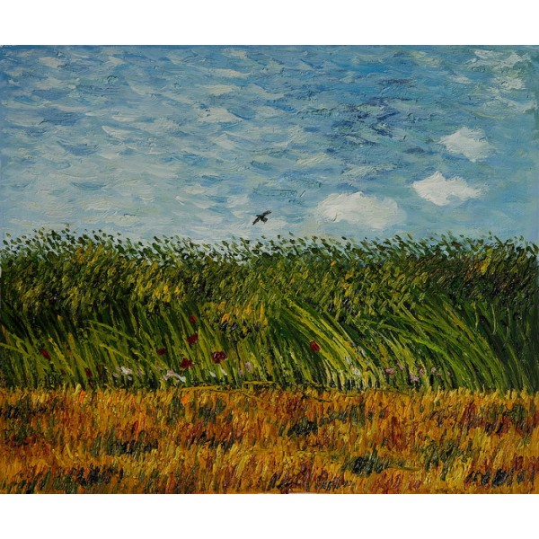
Focus Your Career
Leslie Martinich
2012 IEEE Congressional Fellow
Principal, Competitive Focus
IEEE Central Texas Section, Vice-Chair, Austin
Notes:
Van Gogh, edge of a wheat field with poppies

Slide 2
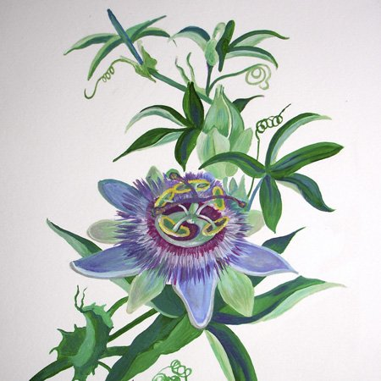
Know Your Passions
Notes:
Passion Flower
Know your passions --maybe multiple passions
What makes you feel energized, engaged, alive?
Make lists of things you love doing
Identify energy gains and drains—bring more energy-inducing activities into your work, avoid the energy-draining activities

Slide 3
Your Personal Venn Diagram
Enjoy
Oppor-tunities
Skills
Notes:
Make them do this’
Tell them to do this with boss, employees, colleagues, spouse etc.

Slide 4
Research
Notes:
Research
IEEE USA Careers
O*NET onetonline.org

Slide 5
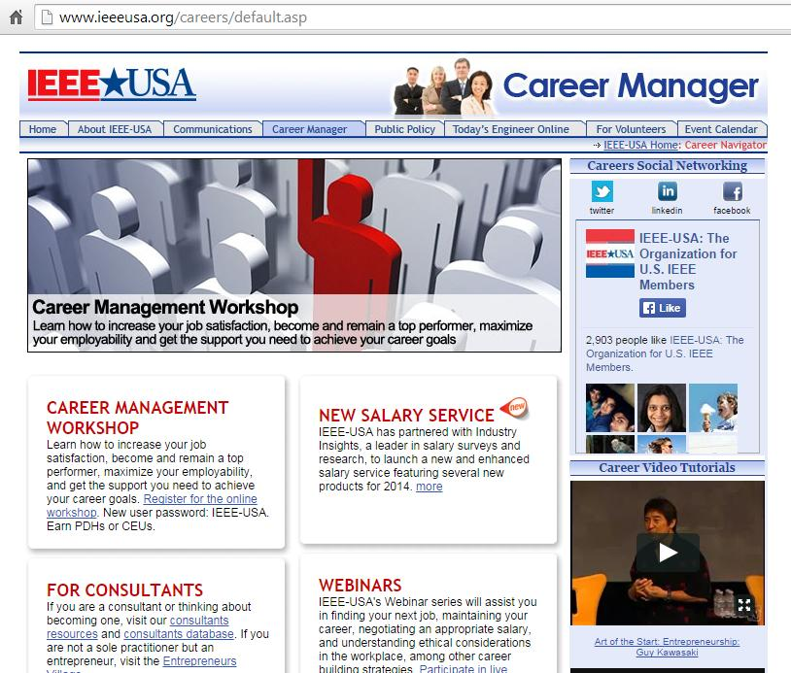

Slide 6
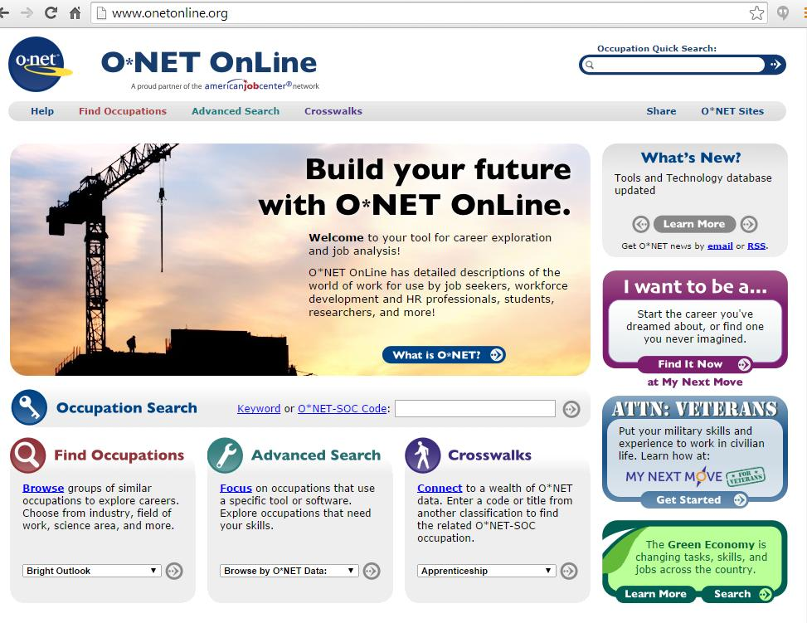

Slide 7
Plan
Notes:
Plan for formal garden
Plan, work at cultivating (growing garden metaphor)
Look at your VIPS (values, interests, personality, skills)
Break it into small steps
See opportunities as opportunities to grow

Slide 8
Your Personal Venn Diagram
Enjoy
Oppor-tunities
Skills
Being Outdoors
Swimming
Life Guard at Barton Springs
What do you need?
Lifeguard certification
CPR training
Apply for the job
Pass the lifeguard test at Barton Springs
Notes:
Make them do this’
Tell them to do this with boss, employees, colleagues, spouse etc.

Slide 9
Your Personal Venn Diagram
Enjoy
Oppor-tunities
Skills
Solving Problems
Circuit Design
Intel Circuit Designer
ARM Circuit Designer
What do you need?
Certification?
Training
Network, meet people
Apply for the job
Notes:
Make them do this’
Tell them to do this with boss, employees, colleagues, spouse etc.

Slide 10
Network and Get Your Hands Dirty
Notes:
Planting, Pieter the Younger
Network, get involved, engagement
Join the professional association for whatever career field interest you.
Attend meetings and conferences
Volunteer
Get your hands dirty (gardening)
hands on experience (internship, apprenticeship, job in that field)

Slide 11
Tend the Garden
Notes:
Self-maintenance
Practice gratitude
Good self-care, nutrition, exercise, hydration
Reach out for help, support
Take steps toward incremental change and acknowledge progress along the way
Consider whole self. What impact will your career choices have on other roles in your life. Don’t neglect your loved ones. (Don’t neglect the back garden.)
Have a great attitude! Accept that changes are usually come incrementally, don’t expect overnight success. Build on accomplishments
Don’t go it alone—look for mentors, mentees, peers for perspective, advice, friendship, or a professional career coach
Never stop learning and changing

Slide 12
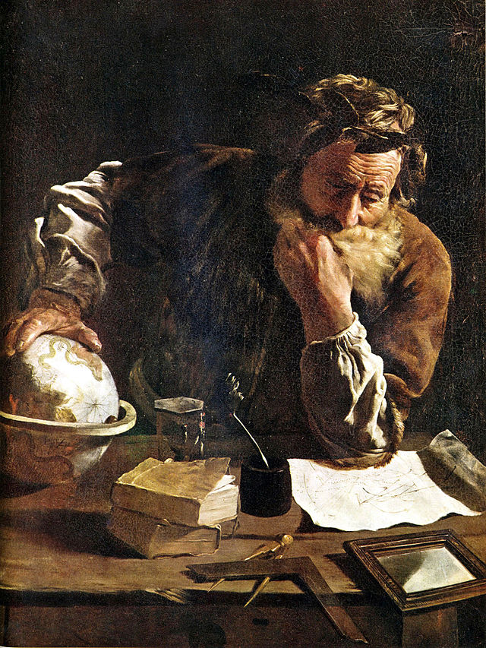
What Will You Use?
Know yourself: Venn Diagram
Research ieeeusa.org/careers
Plan
Network
Self care (education, health, attitude)

