Slide 1




Looking at Your Career from a Turkey’s Perspective
And What to do Instead!

Slide 2


Slide 3
Consultant vs. Employee
Having to shoot your dinner versus
going to the grocery store and buying a steak!
-- Stan Siranovich

Slide 4
Consultant vs. Employee
Who are the current consultants or contractors in the room?

Slide 5
Networking and Your Next Gig
Target the Company

Slide 6
Build Your Target List
#1 – Your Friends

Slide 7
Build Your Target List
#2 – Weak Ties

Slide 8
Build Your Target List
#3 – Austin Business Journal

Slide 9
Build Your Target List
#4 – LinkedIn Advanced Search

Slide 10
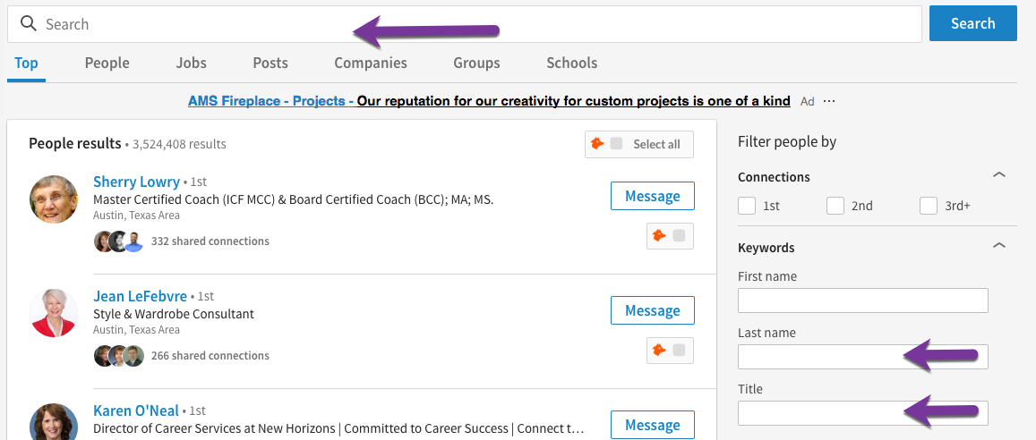
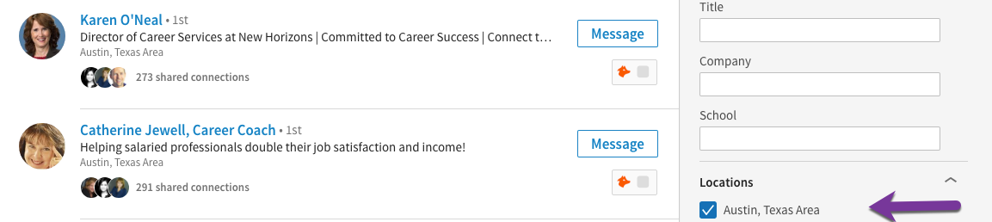
Target List

Slide 11
Build Your Target List
#5 – LinkedIn Company Pages

Slide 12
Build Your Target List
#6 – Public Databases

Slide 13
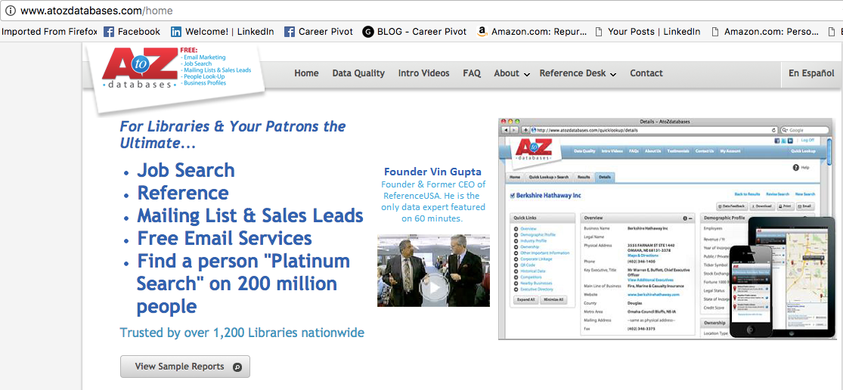
Build Your Target List
Available at All of the Local Libraries

Slide 14
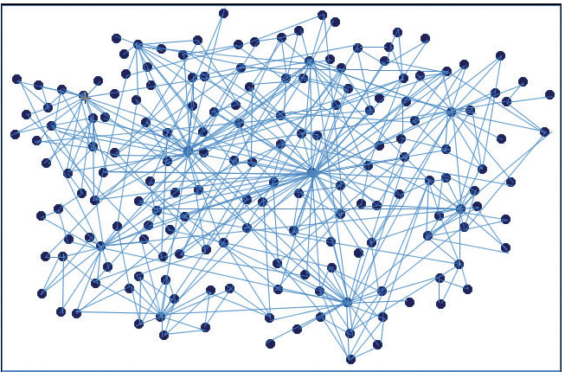
Connect and Follow Recruiters

Slide 15
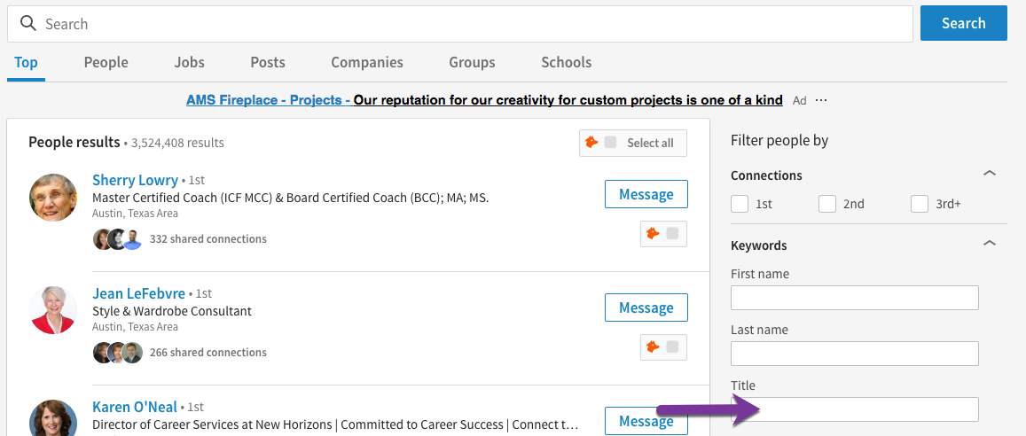
Connect and Follow Recruiters
HR OR human resources OR Recruiter OR Talent

Slide 16
Connecting with Recruiters
Dear insert recruiters name,
I am very interested in a marketing position at xyz company (if there is a current position open mention it). Are you the recruiter who handles these kinds of positions? If not, will you direct me to the recruiter who does? Could we set up a time to talk about your organization? In the mean time, please accept this invitation to connect.
Your name

Slide 17
Tweet to the Recruiter
@recruiter thx for accepting my LinkedIn request. I would love to chat!

Slide 18
Networking Strategically
Current Employee
Target Company
Former Employee

Slide 19
Networking Strategically
Ask for AIR
Advice, Insights and
Recommendations

Slide 20
Saying Thank You
Thank You

Slide 21
Target List
Friends
Weak Ties
Austin Business Journal
LinkedIn Advanced Search
LinkedIn Company Pages
Public Databases

Slide 22
You’re Hired Now What
1 Month
  6 Month Goals
6 Months
  Review and Update Goals
  Update LinkedIn Profile and Resume
12 Months
  Review and Update Goals
  Update LinkedIn Profile and Resume
  Update Target List
18 Months
  Review and Update Goals
  Update LinkedIn Profile and Resume
  Update Target List
  Start search

Slide 23


Repurpose Your Career Book
Available on Kindle

Slide 24
Career Pivot Contact
Marc@careerpivot.com
@CareerPivot – Twitter
Facebook.com/careerpivot
LinkedIn.com/in/MrMiller
CareerPivot.com
CareerPivot.com/Podcast

