Slide 1
Introduction to oneAPI
Agenda
Introduction & Overview to oneAPI
Introduction to the Intel® DevCloud
Introduction to Jupyter notebooks used for training
Introduction to Data Parallel C++
Introduction to Unified Shared memory (USM)
Hands On
Introduction to DPC++ - Simple
Vector-Add Coding Exercise

Slide 2
Learning Objectives
Explain how oneAPI can solve the challenges of programming in a heterogeneous world
Use oneAPI solutions to enable your workflows
Experiment with oneAPI tools and libraries on the Intel® DevCloud
Understand the Data Parallel C++ (DPC++) language and programming model
Use new DPC++ features like Unified Shared Memory to simplify heterogeneous programming
Build a sample DPC++ application through hands-on lab exercises

Slide 3
oneAPI: Industry Initiative & Intel Products
Cross-Architecture Programming for Accelerated Compute, Freedom of Choice for Hardware
One Intel Software & Architecture group
Intel Architecture, Graphics & Software
November 2020
All information provided in this deck is subject to change without notice.
Contact your Intel representative to obtain the latest Intel product specifications and roadmaps.
Notes:
OneAPI offers a unified developer experience to program CPUs, GPUs, FPGAs, and AI accelerators

Slide 4
Programming Challenges for Multiple Architectures
Application Workloads Need Diverse Hardware
Growth in specialized workloads
Variety of data-centric hardware required
Separate programming models and toolchains for each architecture are required today
Software development complexity limits freedom of architectural choice
Scalar
Vector
Spatial
Matrix
Middleware & Frameworks
CPU programming model
GPU programming model
FPGA programming model
Other accel.
programming models
CPU
GPU
FPGA
Other accel.
XPUs
Notes:
Today, each kind of data centric hardware typically needs to be programmed using different languages and libraries, requiring maintaining separate code bases.
In addition, inconsistent tools support across platforms means developers have to waste time learning different sets of tools
That means that developing software for each hardware platform requires a separate investment, with little ability to reuse that work to target a different architecture.

Slide 5
Introducing oneAPI
Application Workloads Need Diverse Hardware
Cross-architecture programming that delivers freedom to choose the best hardware
Based on industry standards and open specifications
Exposes cutting-edge performance features of latest hardware
Compatible with existing high-performance languages and programming models including C++, OpenMP, Fortran, and MPI
Scalar
Vector
Spatial
Matrix
Middleware & Frameworks
Industry Initiative
Intel Product
XPUs
CPU
GPU
FPGA
Other accel.
Notes:
Intel’s solution is oneAPI, a project to deliver a unified software development environment across CPU and accelerator architectures.
oneAPI Industry Initiative – based on standards, open specification
Includes a unified language & libraries that deliver full native code performance
Delivers native code performance across a range of hardware including CPUs, GPUs, FPGAs, & AI accelerators
oneAPI is the foundational programming stack & is used to optimize middleware & frameworks that sit on top of it, including AI frameworks such as Tensorflow
Optimized user and industry applications sit at the top, some of which leverage middleware and frameworks
Based on open specifications and/or standards for cross-vendor compatibility
Intel’s product is a reference implementation: Intel® oneAPI Toolkits^{(Beta)}
This includes advanced porting, analysis & debugger tools that span the software stack – you can debug and profile code across all levels of abstraction

Slide 6
oneAPI Industry Initiative Break the Chains of Proprietary Lock-in
Application Workloads Need Diverse Hardware
A cross-architecture language based on C++ and SYCL standards
Powerful libraries designed for acceleration of domain-specific functions
Low-level hardware abstraction layer
Open to promote community and industry collaboration
Enables code reuse across architectures and vendors
Middleware & Frameworks
...
oneAPI Industry Specification
oneAPI Industry Specification
Direct Programming
API-Based Programming
Libraries
Math
Threading
DPC++ Library
Data Parallel C++
Analytics/ ML
DNN
ML Comm
Video Processing
Low-Level Hardware Interface
The productive, smart path to freedom for accelerated computing from the economic and technical burdens of proprietary programming models
XPUs
CPU
GPU
FPGA
Other accel.
Visit oneapi.com for more details
Notes:
Intel’s solution is oneAPI, a project to deliver a unified software development environment across CPU and accelerator architectures.
oneAPI Industry Initiative – based on standards, open specification
Includes a unified language & libraries that deliver full native code performance
Delivers native code performance across a range of hardware including CPUs, GPUs, FPGAs, & AI accelerators
oneAPI is the foundational programming stack & is used to optimize middleware & frameworks that sit on top of it, including AI frameworks such as Tensorflow
Optimized user and industry applications sit at the top, some of which leverage middleware and frameworks
Based on open specifications and/or standards for cross-vendor compatibility
Intel’s product is a reference implementation: Intel® oneAPI Toolkits^{(Beta)}
This includes advanced porting, analysis & debugger tools that span the software stack – you can debug and profile code across all levels of abstraction

Slide 7
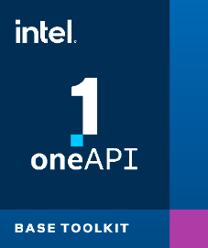
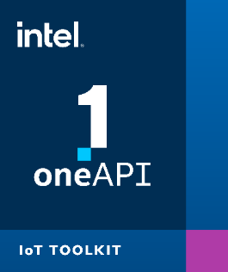
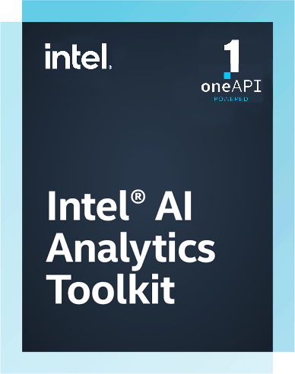
Intel® oneAPI Toolkits
A complete set of proven developer tools expanded from CPU to XPU
Intel® oneAPI Base Toolkit
A core set of high-performance tools for building C++, Data Parallel C++ applications & oneAPI library-based applications
Native Code Developers
Add-on Domain-specific Toolkits
Intel® oneAPI Rendering Toolkit
Intel® oneAPI Tools for HPC
Intel® oneAPI Tools for IoT
Deliver fast Fortran, OpenMP & MPI applications that scale
Build efficient, reliable solutions that run at network’s edge
Create performant, high-fidelity visualization applications
Specialized Workloads
Toolkits powered by oneAPI
Intel® AI Analytics Toolkit
Intel® Distribution of OpenVINO™ Toolkit
Accelerate machine learning & data science pipelines with optimized DL frameworks & high-performing Python libraries
Deploy high performance inference & applications from edge to cloud
Toolkit
Data Scientists & AI Developers
Notes:
These are the Intel oneAPI cross-architecture products are going Gold in December.
[however, the openvino toolkit was already production-ready before]

Slide 8
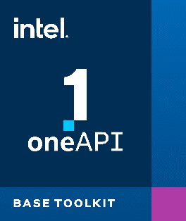
Intel® oneAPI Base Toolkit Accelerate Data-centric Workloads
Intel® oneAPI Base Toolkit
Direct Programming
API-Based Programming
Analysis & debug Tools
Intel® oneAPI DPC++/C++ Compiler
Intel® oneAPI DPC++ Library oneDPL
Intel® VTune™ Profiler
A core set of core tools and libraries for developing high-performance applications on Intel® CPUs, GPUs, and FPGAs.
Who Uses It?
A broad range of developers across industries
Add-on toolkit users since this is the base for all toolkits
Top Features/Benefits
Data Parallel C++ compiler, library and analysis tools
DPC++ Compatibility tool helps migrate existing code written in CUDA
Python distribution includes accelerated scikit-learn, NumPy, SciPy libraries
Optimized performance libraries for threading, math, data analytics, deep learning, and video/image/signal processing
Intel® DPC++ Compatibility Tool
Intel® oneAPI Math Kernel Library - oneMKL
Intel® Advisor
Intel® Distribution for Python
Intel® oneAPI Data Analytics Library - oneDAL
Intel® Distribution for GDB
Intel® FPGA Add-on for oneAPI Base Toolkit
Intel® oneAPI Threading Building Blocks - oneTBB
Intel® oneAPI Video Processing Library - oneVPL
Intel® oneAPI Collective Communications Library
oneCCL
Intel® oneAPI Deep Neural Network Library - oneDNN
Intel® Integrated Performance Primitives - Intel® IPP
Learn More: intel.com/oneAPI-BaseKit
Notes:
Intel’s reference implementation of oneAPI is a set of toolkits.
For direct programming, Data Parallel C++ (or DPC++) is an evolution of C++ for productive data-centric coding that will target CPUs, GPUs FPGAs and AI accelerators
We’ll provide a source code to source code porting tool to ease the transition to DPC++ for developers with existing code written in CUDA [Intel® DPC++ Compatibility Tool]
For API based programming, a range of performance libraries are included spanning several workload domains that benefit from acceleration
library functions are custom-coded for each target architecture, so no developer tuning is required when developers migrate code between supported architectures
And finally, analysis and debug tools include enhanced versions of the VTune Profiler and Advisor performance tools
Note that support for AI accelerators (Intel® NNP) is coming in the future (will not be in the Beta release)

Slide 9
Setup Intel® DevCloud and Jupyter Environment

Slide 10
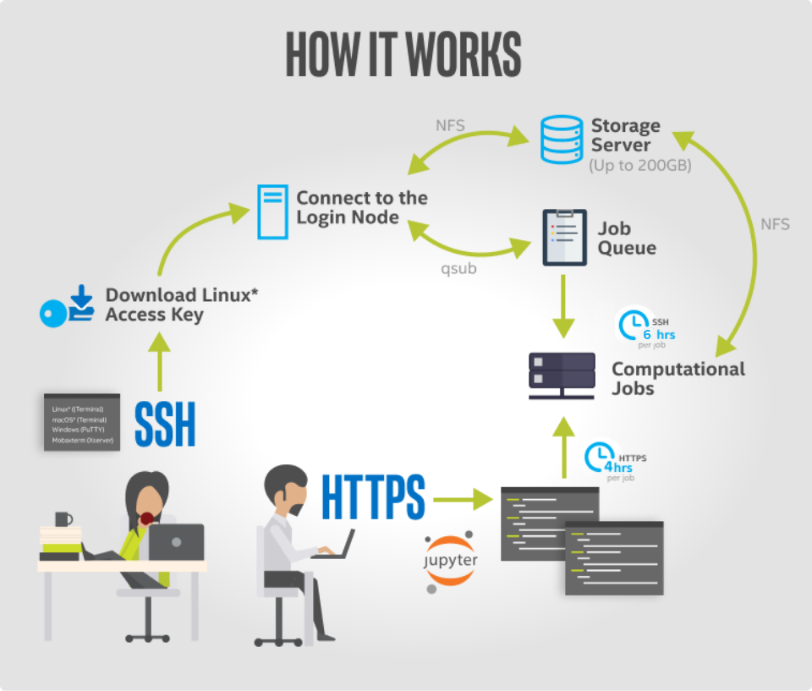
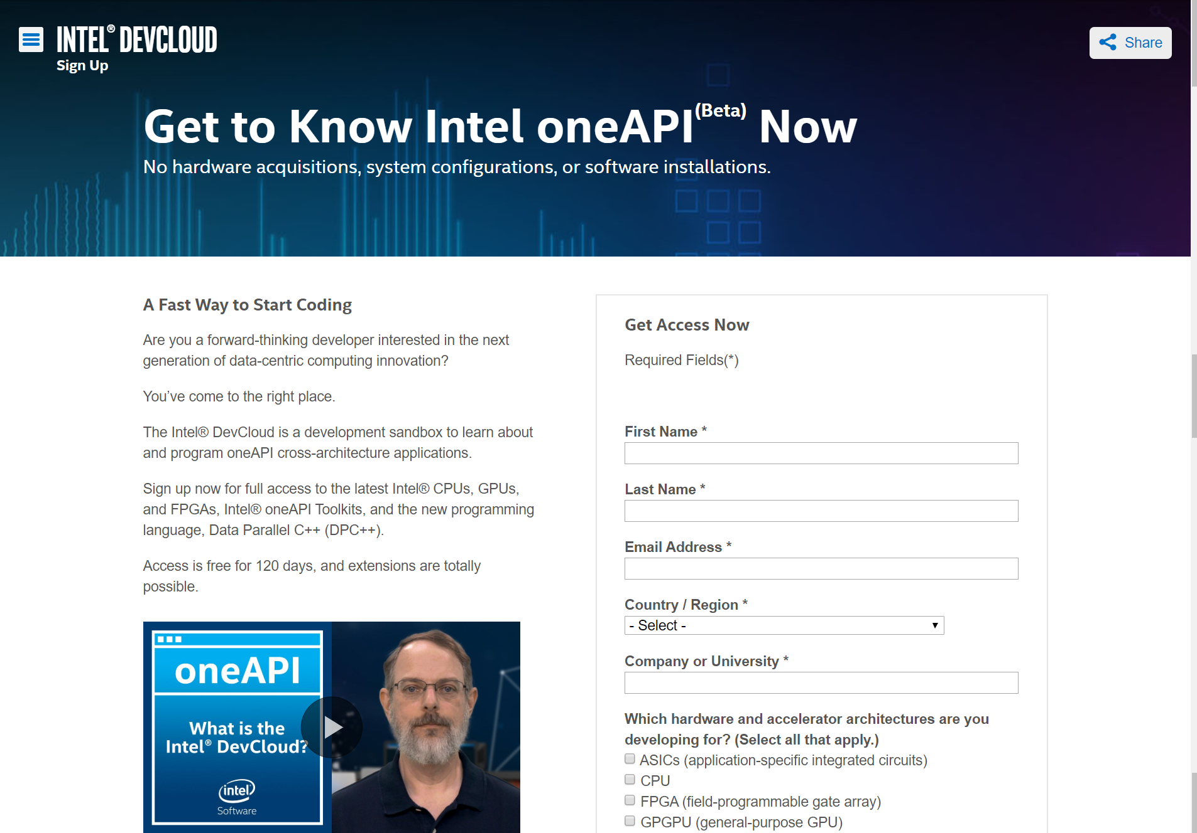
Intel® devcloud for oneAPI
access
A development sandbox to develop, test and run workloads across a range of Intel CPUs, GPUs, and FPGAs using Intel® oneAPI beta software
A fast way to start coding
Try the oneAPI toolkits, compilers, performance libraries, and tools
Get 120 days of free access to the latest Intel® hardware and oneAPI software
No downloads; No hardware acquisition; No installation

Slide 11
Intel® DevCloud
access
Remote access for professors and students to next-generation deep learning and machine learning development environments.
Developers may use the cluster for research, coursework, labs, tutorials, and projects
Hardware Available:
Includes a state-of-the-art server cluster powered by the Intel® Xeon® Scalable processor family, Intel® optimized frameworks, and other tools and libraries. Each processor has up to 56 cores with two-way hyper-threading and up to 192 GB of on-platform DDR4 RAM.
Intel® Arria® 10 FPGAs
Intel® Xeon® processors with Intel Graphics Technology
Each developer is provided 220 GB of file storage during the access period.
Each user’s home/user directory is not visible to others. Users’ home directories on the cluster are deleted after the access period.
Request access by visiting http://software.intel.com/devcloud/oneapi
There will still be a need to tune for each architecture.

Slide 12
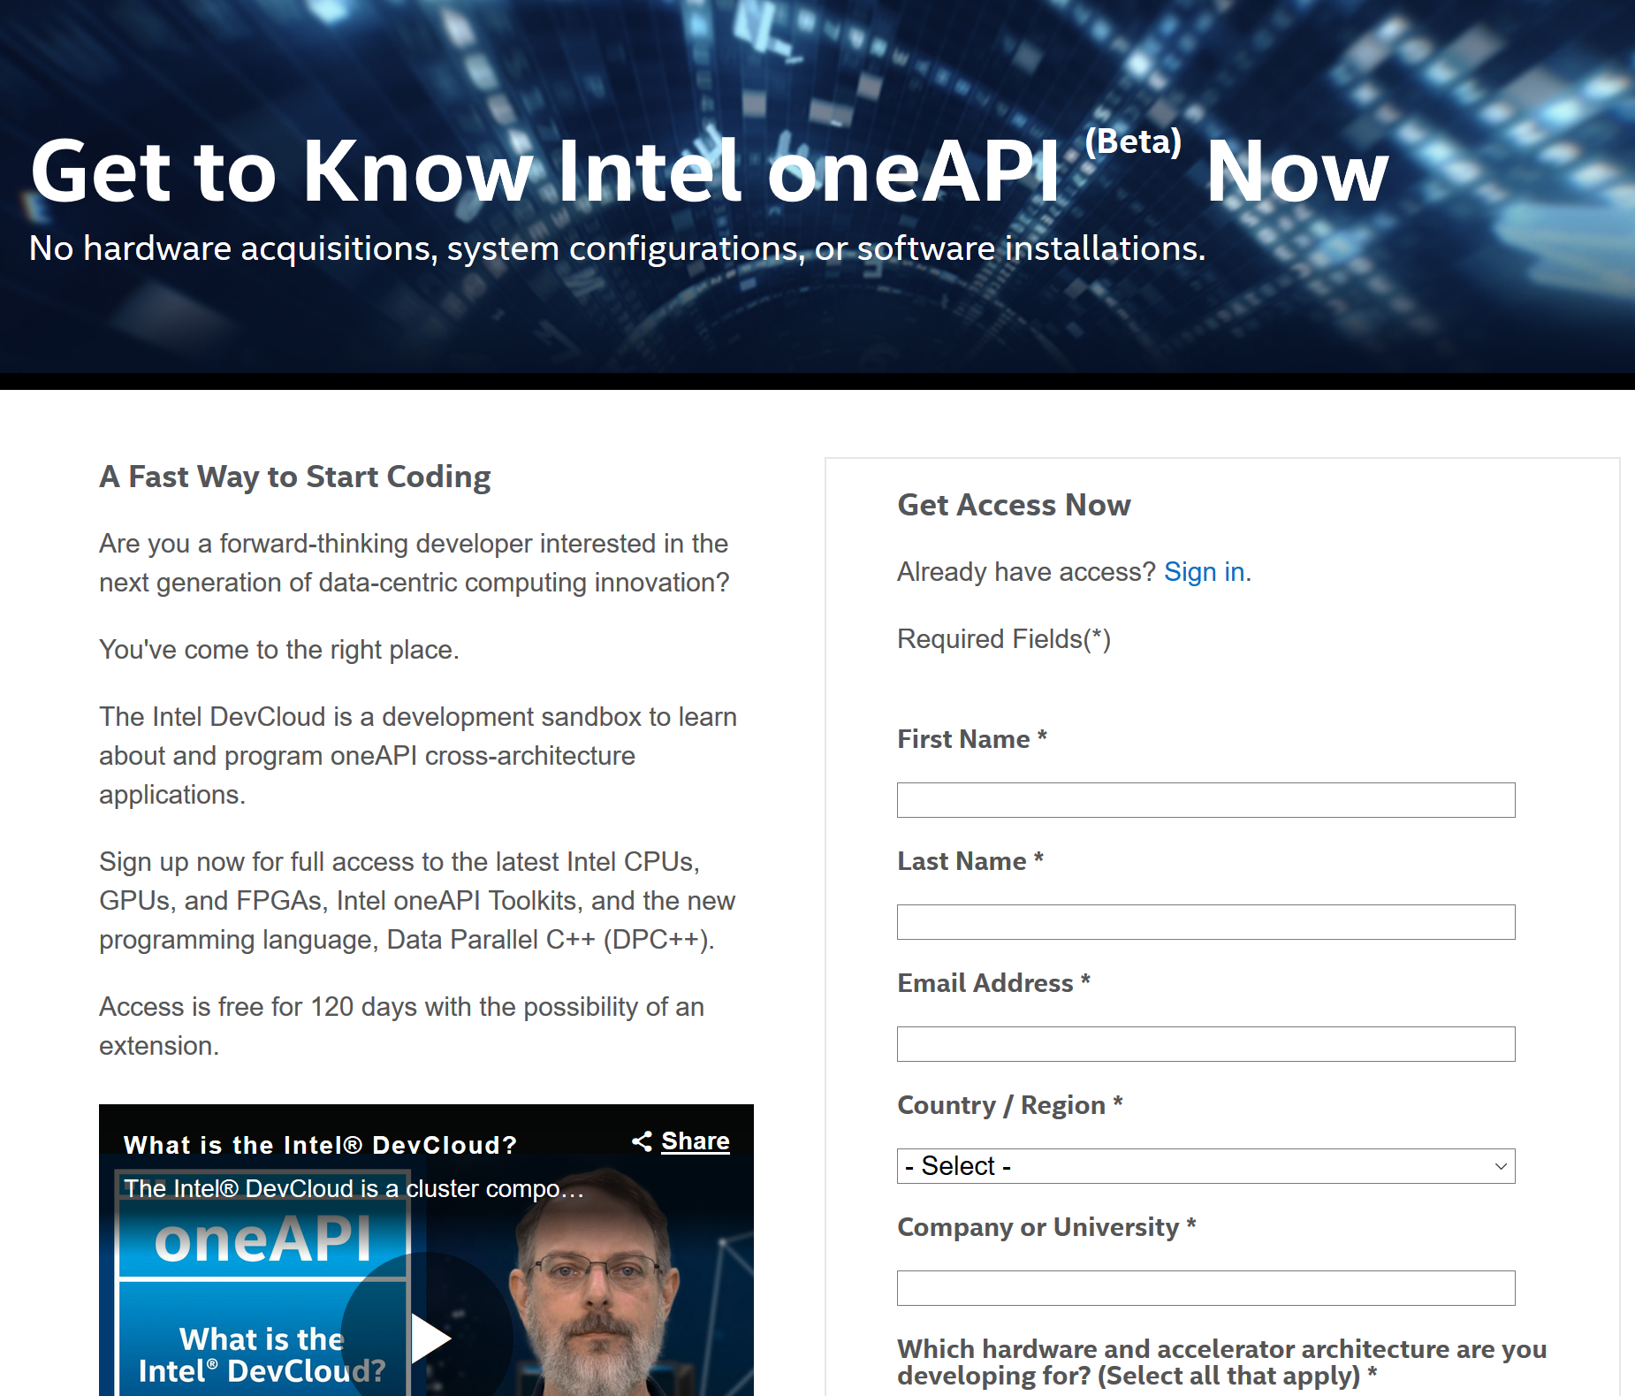
Steps
Sign up for a DevCloud for oneAPI account here: https://intelsoftwaresites.secure.force.com/devcloud/oneapi
Open a Jupyter lab notebook
Common recipes on the DevCloud

Slide 13
Setup Intel® DevCloud and Jupyter Environment

Slide 14
Accept & Connect

Slide 15
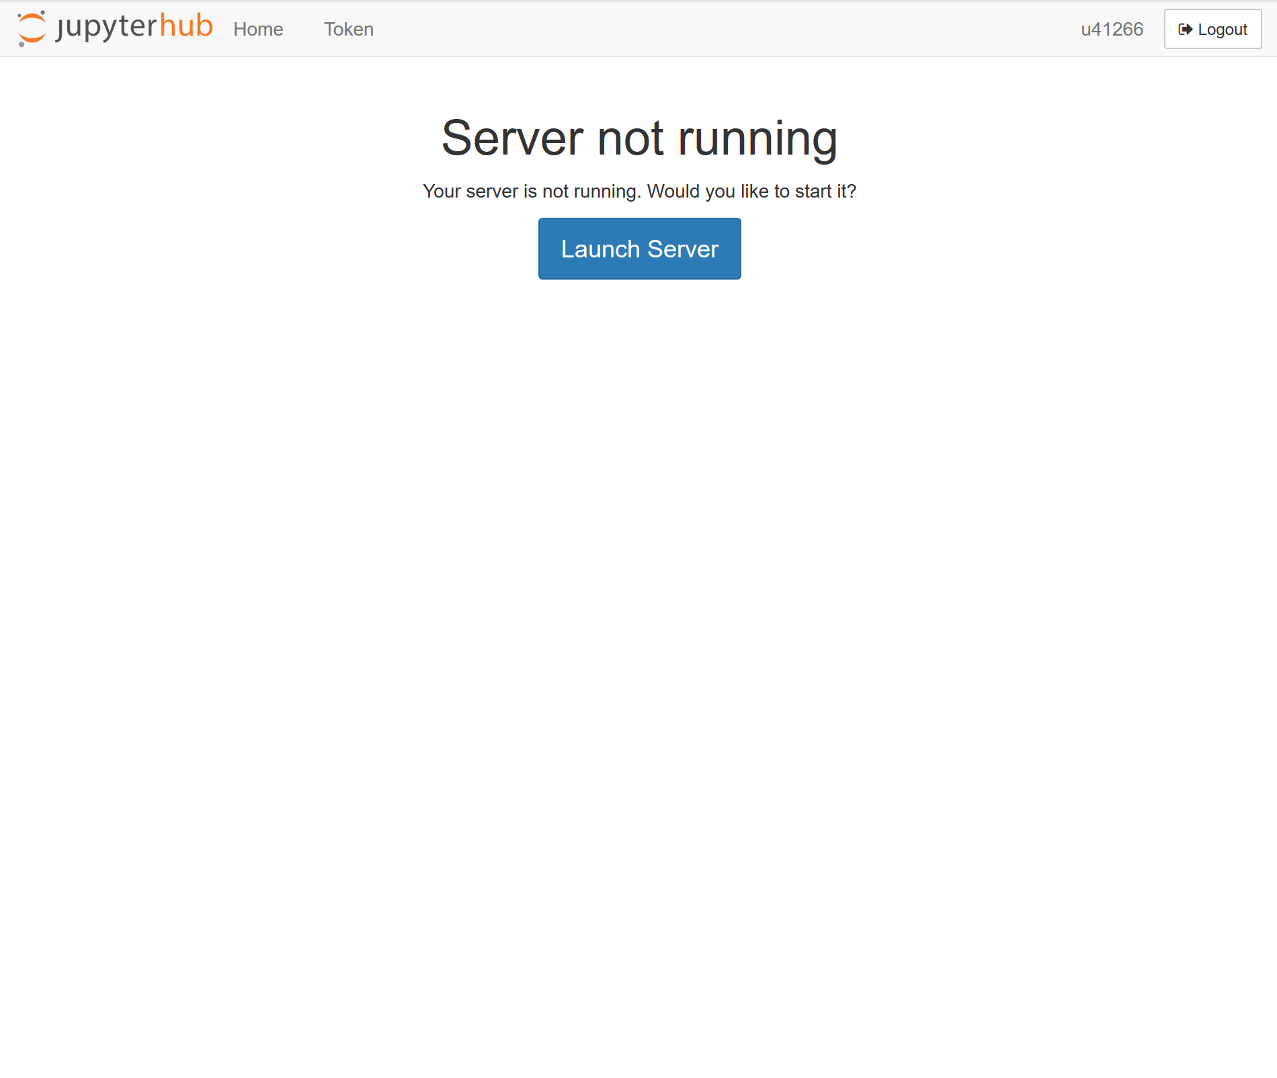
Jupyter & Launch

Slide 16
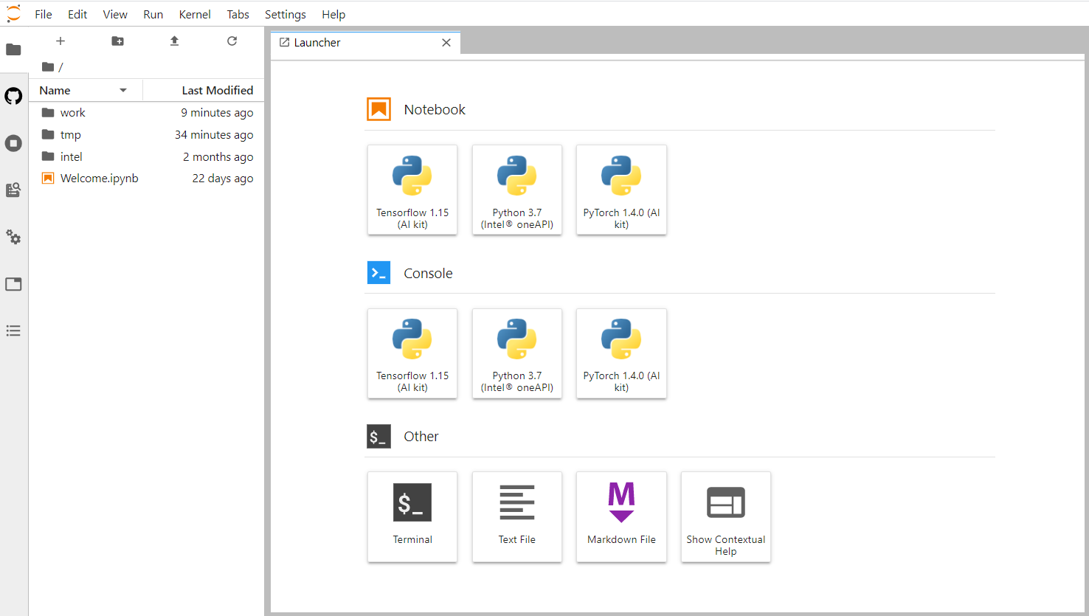
Launch Jupyter and select Terminal

Slide 17
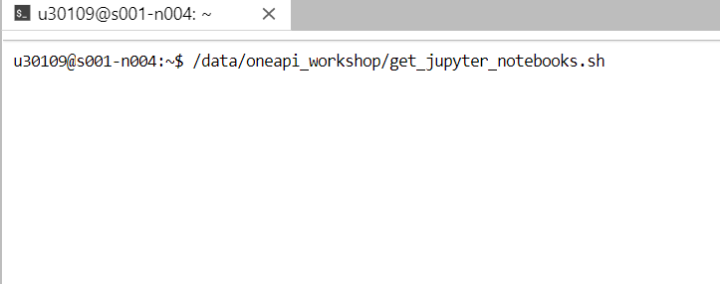
Commands to input in terminal
Please execute the following commands in the Jupyter Terminal window
/data/oneapi_workshop/get_jupyter_notebooks.sh
This command copies workshop into the user directory
Notes:
Please execute the following commands in the Jupyter Terminal window
source /opt/intel/inteloneapi/setvars.sh – this sets up the oneAPI environment
/data/oneapi_workshop/get_oneapi_workshop.sh – copies workshop material into your user directory

Slide 18
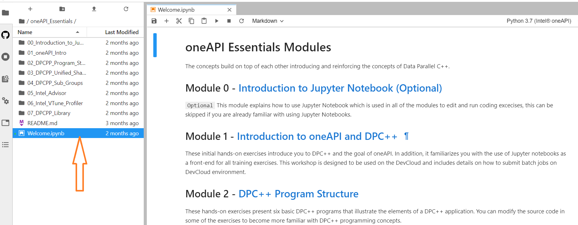
Select Welcome.ipynb

Slide 19
DPC++essentials Course
DPC++ Essentials Course Curriculum provides 20 hours of training and exercises using Jupyter Notebooks integrated with Intel® DevCloud

Slide 20
Qsub
qsub can be used to submit jobs to the DevCloud job queue
Jobs run asynchronously and report status upon completion
The traditional way to execute qsub is to pass it a script:
“qsub <script.sh>”
qsub requires absolute paths, e.g. /bin/ls
qsub –w $PWD – Runs in current folder
Output file is <scriptname>.o<jobid>

Slide 21
Qstat/qdel
qstat displays running jobs
qdel <jobid> deletes pending jobs

Slide 22
Interactive shells
Getting an interactive shell
qsub –I
Requesting an iGPU/FPGA node
qsub -I -l nodes=1:gpu:ppn=2
clinfo – lists iGPU info

Slide 23
Hands-on Coding on Intel DevCloud Run Simple DPC++ Program

Slide 24
Data Parallel C++ Standards-based, Cross-architecture Language DPC++ = ISO C++ and Khronos SYCL
Parallelism, productivity and performance for CPUs and Accelerators
Delivers accelerated computing by exposing hardware features
Allows code reuse across hardware targets, while permitting custom tuning for specific accelerators
Provides an open, cross-industry solution to single architecture proprietary lock-in
Based on C++ and SYCL
Delivers C++ productivity benefits, using common, familiar C and C++ constructs
Incorporates SYCL from the Khronos Group to support data parallelism and heterogeneous programming
Community Project to drive language enhancements
Provides extensions to simplify data parallel programming
Continues evolution through open and cooperative development
Direct Programming:
Data Parallel C++
Community Extensions
Khronos SYCL
ISO C++
Apply your skills to the next innovation, not rewriting software for the next hardware platform
The open source and Intel DPC++/C++ compiler supports Intel CPUs, GPUs, and FPGAs.
Codeplay announced a DPC++ compiler that targets Nvidia GPUs.
Notes:
High-level language designed for data parallel programming productivity
Based on the C++ language for broad compatibility
Provides full native high level language performance on par with standard C++
Simplifies code migration from proprietary languages with a programming model familiar to GPU SW developers
Starting point is SYCL* being developed under the industry consortium Khronos Group
Intel is addressing gaps in language through extensions that we’ll drive into the standard
Includes source code to source code compatibility tool to assist with migration of CUDA code to DPC++
Leverages well-proven LLVM compiler technology as well as Intel’s history of compiler leadership
There will still be a need to tune for each architecture

Slide 25
What is Data Parallel C++?
Data Parallel C++
= C++ and SYCL* standard and extensions
Based on modern C++
C++ productivity benefits and familiar constructs
Standards-based, cross-architecture
Incorporates the SYCL standard for data parallelism and heterogeneous programming
Notes:
oneAPI programs are written in Data Parallel C++ (DPC++). It is based on modern C++ and incorporates the SYCL standard for data parallelism and heterogeneous programming.

Slide 26
DPC++ Extends SYCL* standard
Enhance Productivity
Simple things should be simple to express
Reduce verbosity and programmer burden
Enhance Performance
Give programmers control over program execution
Enable hardware-specific features
DPC++: Fast-moving open collaboration feeding into the SYCL* standard
Open source implementation with goal of upstream LLVM
DPC++ extensions aim to become core SYCL*, or Khronos* extensions
Notes:
Talk about difference from SYCL. Why DPC++?
User problem – so much parallelism is available, what is the abstract model that allows you to reason about it across multiple devices that will enact the parallelism?
Stress why the listener should care – specialized hardware (accelerators) will be required to offer the performance that users need. oneAPI enables programmers access to this performance in an optimized way. Can also execute on CPUs

Slide 27
A Complete DPC++ Program
Single source
Host code and heterogeneous accelerator kernels can be mixed in same source files
Familiar C++
Library constructs add functionality, such as:
#include <CL/sycl.hpp>
constexpr int N=16;
using namespace sycl;
int main() {
queue q;
int *data = malloc_shared<int>(N, q);
q.parallel_for(N, [=](auto i) {
data[i] = i;
}).wait(); for (int i=0; i<N; i++) std::cout << data[i] << "\n";
free(data, q);
return 0;
}
Host code
Accelerator device code
Construct | Purpose
queue | Work targeting
malloc_shared | Data management
parallel_for | Parallelism
Host code

Slide 28
Buffer Memory Model
Buffers: Encapsulate data in a SYCL application
Across both devices and host!
Accessors: Mechanism to access buffer data
Create data dependencies in the SYCL graph that order kernel executions
queue q;
std::vector<int> v(N, 10);
{ buffer buf(v);
q.submit([&](handler& h) {
accessor a(buf, h , write_only);
h.parallel_for(N, [=](auto i) { a[i] = i; });
});
}
for (int i = 0; i < N; i++) std::cout << v[i] << " ";
Notes:
Buffers are 1,2 or 3 dimensional array that is shared between host and devices.
Accessors access buffer data in the host or inside the kernel and also communicate data dependencies between the application and different kernels.
If two kernels use the same buffer, the second kernel needs to wait for the completion of the first kernel to avoid race conditions.

Slide 29
DPC++ Code Anatomy
void dpcpp_code(int* a, int* b, int* c) {
// Setting up a DPC++ device queue
queue q;
// Setup buffers for input and output vectors
buffer buf_a(a, range<1>(N));
buffer buf_b(b, range<1>(N));
buffer buf_c(c, range<1>(N));
//Submit Command group function object to the queue
q.submit([&](handler &h){
//Create device accessors to buffers allocated in global memory
accessor A(buf_a, h, read_only);
accessor B(buf_b, h, read_only);
accessor C(buf_c, h, write_only);
//Specify the device kernel body as a lambda function
h.parallel_for(range<1>(N), [=](auto i){
C[i] = A[i] + B[i];
});
});
}
Step 1: create a device queue
(developer can specify a device type via device selector or use default selector)
Step 2: create buffers
(represent both host and
device memory)
Step 3: submit a command for (asynchronous) execution
Step 4: create buffer accessors to access buffer data on the device
Step 5: send a kernel (lambda) for execution
Step 6: write a kernel
Kernel invocations are executed in parallel
Kernel is invoked for each element of the range
Kernel invocation has access to the invocation id
Done!
The results are copied to vector `c` at `buf_c` buffer destruction
Notes:
Code walkthrough of a simple DPC++ application. Follow steps 1 to 6 to understand the building blocks of the DPC++ program

Slide 30
Unified Shared Memory (USM)
Unified Shared Memory is pointer-based approach to memory model for heterogeneous programming
Notes:
SYCL introduced buffers
USM is an alternative approach, pointer-based approach for memory model that is familiar for C++ programmers

Slide 31
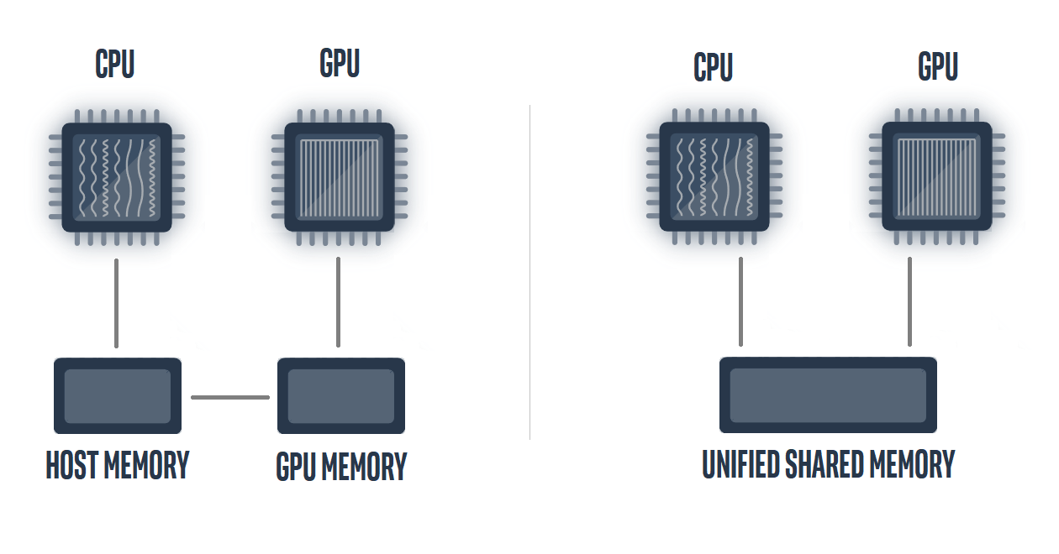
Developer View of USM
Developers can reference same memory object in host and device code with Unified Shared Memory
Notes:
The picture below shows __developer view of memory__ without USM and with USM.
With USM, the developer can reference that same memory object in host and device code.

Slide 32
Unified Shared Memory
Unified Shared Memory enables the accessing memory on the host and device with same pointer reference
queue q;
int *data = malloc_shared<int>(N, q);
for(int i=0;i<N;i++) data[i] = 10;
q.parallel_for(N, [=](auto i){
data[i] += 1;
}).wait();
for(int i=0;i<N;i++) std::cout << data[i] << " ";
free(data, q);
Setup Unified Shared Memory
Host can initialize
Device can modify
Host has output
Notes:
USM code flow, simple, define USM, host and device code can be reference with same

Slide 33
Unified Shared Memory
Unified shared memory provides both explicit and implicit models for managing memory.
Automatic data accessibility and explicit data movement supported
Allocation Type | Description | Accessible on HOST | Accessible on DEVICE
device | Allocations in device memory (explicit) | NO | YES
host | Allocations in host memory (implicit) | YES | YES
shared | Allocations can migrate between host and device memory (implicit) | YES | YES
Notes:
USM types – device, host and shared allocations
Supports explicit and implicit movement of data
Explicit for more controlled movement of data,
implicit for simplifying porting and get functionality quickly

Slide 34
Hands-on Coding on Intel DevCloud Complex Multiplication with DPC++

Slide 35
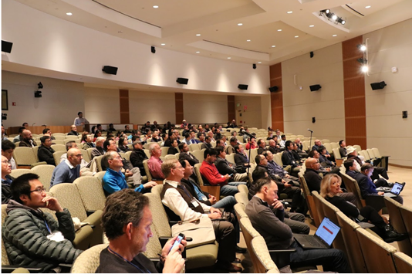
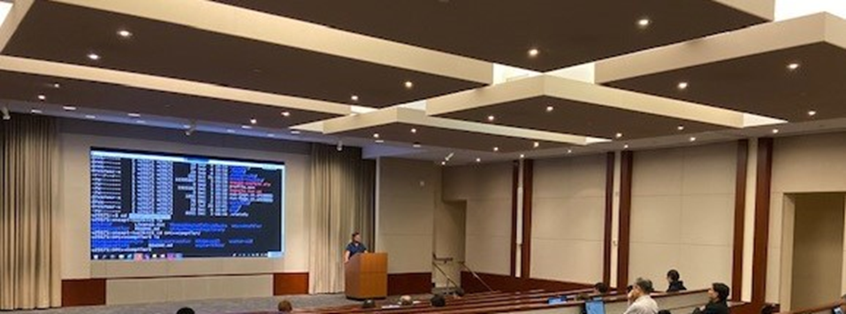
Developer Community Program
Intel oneAPI
Sujata Tibrewala
Sujata.tibrewala@intel.com

Slide 36
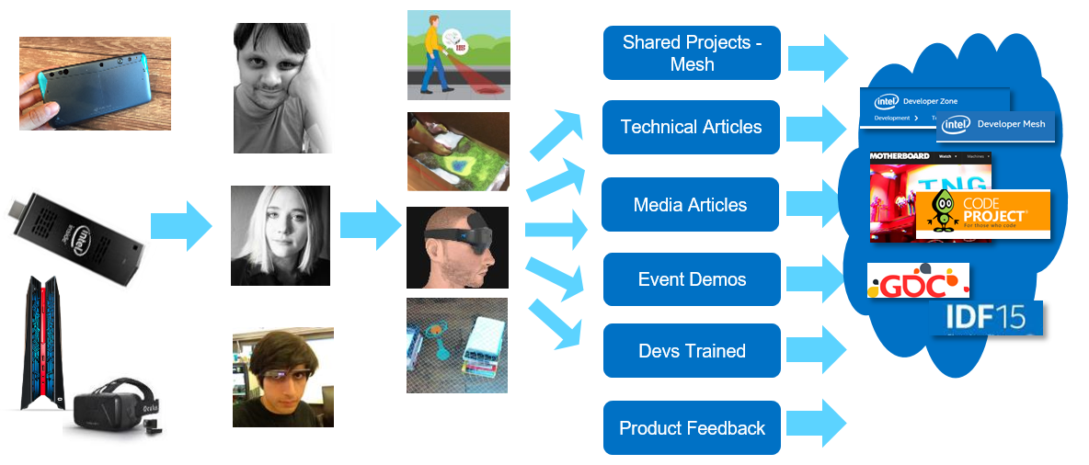
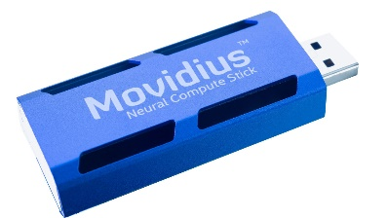
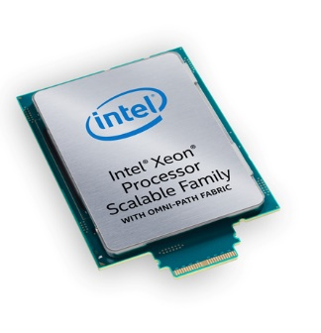
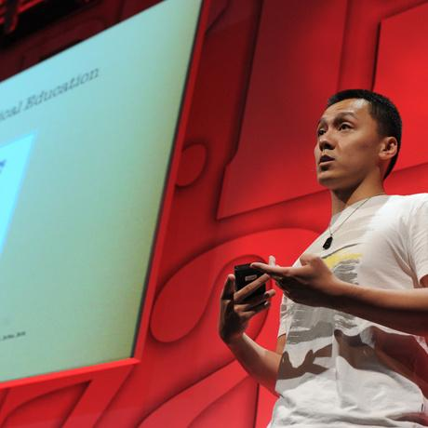
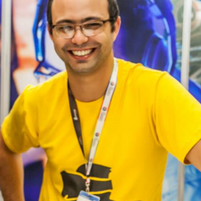
Introduction to Innovator Program (https://devmesh.intel.com-> member Programs)
Top Tier Experts Who
Innovate & Like To Share Work Go under NDA
Access to Intel Hardware & Intel Expertise
Early Experiments, Prototypes, Testing & Research
Spotlight
Speakerships & Demos at Major conferences and Public Events
Projects Innovators/ SA
are passionate About

Slide 37
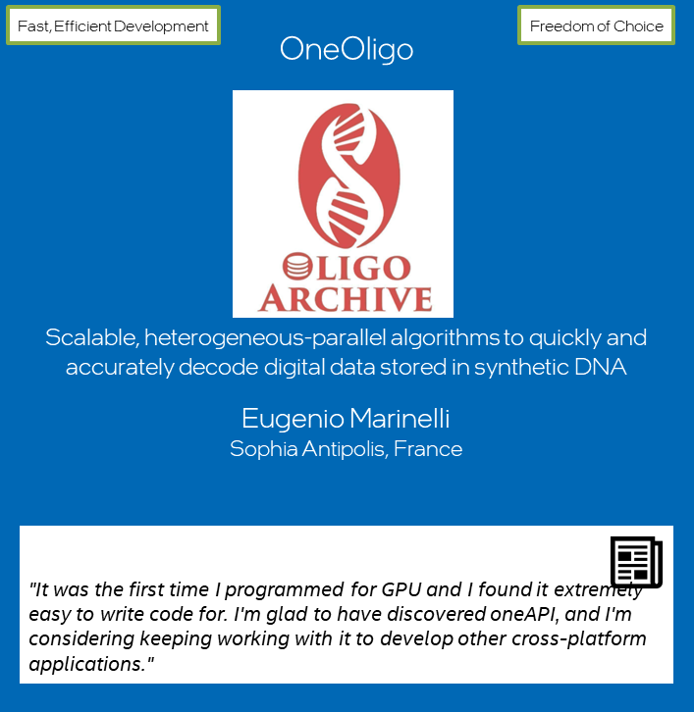
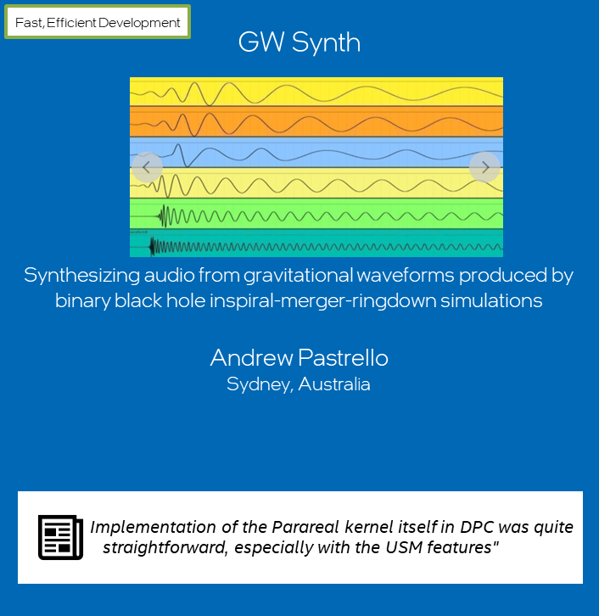
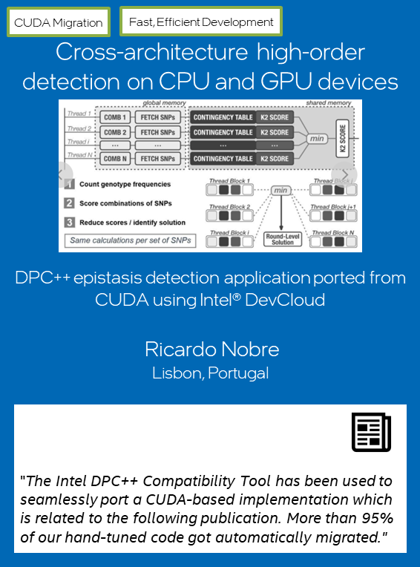
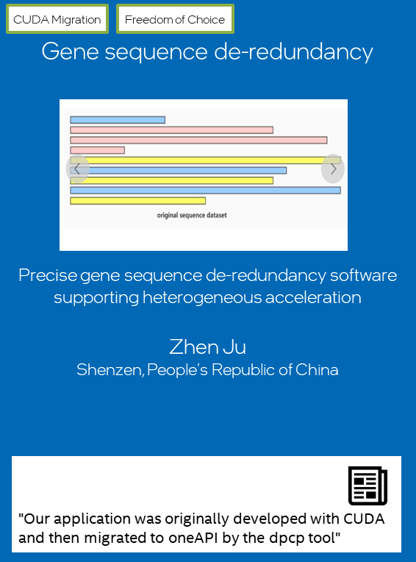
Challenge Winners
Eugenio Marinelli
Andrew Pastrello
Ricardo Nobre
Rafael Campos
Zhen Ju

Slide 38
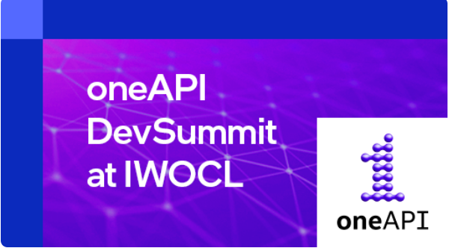
April 26th oneapi.com/events

Slide 39
Agenda
 | Time (CET) | Speaker
Introduction | 10:00 – 10:10 AM | Sujata Tibrewala
Vender Update SYCL 2021 Vendor Update | 10:10 – 10:50 AM | Peter Zuzek, Steffen Larsen, Ronan Keryell, Igor Vorobstov
DevCloud Update Developer tools to get you started on oneAPI | 10:50 – 11:20 AM | Henry Gabb
Hands-On Session Application Optimization with Cache-aware Roofline Model and Intel oneAPI tools | 11:20 – 12:50 PM | Aleksandar Ilic, Diogo Marques, Rafael Campos
Lunch | 12:50 – 1:10 PM
Tech Talk AI > A Deep Dive into a Deep Learning Library for the A64FX Fugaku CPU – Meet the Developer | 1:10 – 1:40 PM | Kentaro Kawakami
Lightning Talk Great Cross-Architecture Challenge Application Showcase | 1:40 – 2:10 PM | Andrew Pastrello, Zhen Ju
Key Note SYCL 2020 in hipSYCL: DPC++ features on AMD GPUs, NVIDIA GPUs and CPUs | 2:10 – 2:40 PM | Aksel Alpay
Lightning Talk Bringing SYCL to Super Computers with Celerity | 2:40 – 3:00 PM | Biagio Cosenza
Break | 3:00 – 3:10 PM
Great Cross-Architecture Challenge Application Showcase | 3:10 – 3:30 PM
Tech Talk It’s acceleration but faster! | 3:30 – 4:00 PM | David James
Tech Talk Migrating and tuning a CUDA-based stencil computation to DPC++ | 4:00 – 4:30 PM | Clicia S. Pinto
Break | 4:30 – 4:45 PM
Tech Talk Comparative Analysis of Intel HLS Design Tools on a Case Study in Neuromorphic | 4:45 – 5:15 PM | Luke Kljucaric
Tech Talk TAU Performance System | 5:15 – 5:45 PM | Sameer Shende
Conclusion | 5:45 – 6:00 PM | Sujata Tibrewala
Happy Hour | 6:00 – 7:00 PM | Sujata Tibrewala, Russel Beutler

Slide 40
Thank you!

Slide 41
Recap
oneAPI solves the challenges of programming in a heterogeneous world
Take advantage of oneAPI solutions to enable your workflows
Use the Intel® DevCloud to test-drive oneAPI tools and libraries
Introduced to DPC++ language and programming model
Important Classes for DPC++ application
Device selection and offloading kernel workloads
DPC++ Buffers, Accessors, Command Group handler, lambda code as kernel
Hands on activities
Introduction to DPC++ - Simple
Vector-Increment/Vector-add exercise – demonstrate coding ease by modifying the sample source code.

Slide 42
Notices & Disclaimers
This document contains information on products, services and/or processes in development. All information provided here is subject to change without notice. Contact your Intel representative to obtain the latest forecast, schedule, specifications and roadmaps.
The products and services described may contain defects or errors known as errata which may cause deviations from published specifications. Current characterized errata are available on request. No product or component can be absolutely secure. Intel technologies’ features and benefits depend on system configuration and may require enabled hardware, software or service activation. Learn more at intel.com, or from the OEM or retailer.
Software and workloads used in performance tests may have been optimized for performance only on Intel microprocessors. Performance tests, such as SYSmark and MobileMark, are measured using specific computer systems, components, software, operations and functions. Any change to any of those factors may cause the results to vary. You should consult other information and performance tests to assist you in fully evaluating your contemplated purchases, including the performance of that product when combined with other products. For more complete information visit www.intel.com/benchmarks.
INFORMATION IN THIS DOCUMENT IS PROVIDED “AS IS”. NO LICENSE, EXPRESS OR IMPLIED, BY ESTOPPEL OR OTHERWISE, TO ANY INTELLECTUAL PROPERTY RIGHTS IS GRANTED BY THIS DOCUMENT. INTEL ASSUMES NO LIABILITY WHATSOEVER AND INTEL DISCLAIMS ANY EXPRESS OR IMPLIED WARRANTY, RELATING TO THIS INFORMATION INCLUDING LIABILITY OR WARRANTIES RELATING TO FITNESS FOR A PARTICULAR PURPOSE, MERCHANTABILITY, OR INFRINGEMENT OF ANY PATENT, COPYRIGHT OR OTHER INTELLECTUAL PROPERTY RIGHT.
Copyright ©, Intel Corporation. All rights reserved. Intel, the Intel logo, Xeon, Core, VTune, and OpenVINO are trademarks of Intel Corporation or its subsidiaries in the U.S. and other countries.
Optimization Notice
Intel’s compilers may or may not optimize to the same degree for non-Intel microprocessors for optimizations that are not unique to Intel microprocessors. These optimizations include SSE2, SSE3, and SSSE3 instruction sets and other optimizations. Intel does not guarantee the availability, functionality, or effectiveness of any optimization on microprocessors not manufactured by Intel. Microprocessor-dependent optimizations in this product are intended for use with Intel microprocessors. Certain optimizations not specific to Intel microarchitecture are reserved for Intel microprocessors. Please refer to the applicable product User and Reference Guides for more information regarding the specific instruction sets covered by this notice. Notice revision #20110804

