Slide 1
Building a Consulting Business from Scratch
David E. Swenson
2609 Quanah Drive
Round Rock, TX 78681
512/244-7514 – Office
512/922-0740 Cell
static2@swbell.net

Slide 2
What is a Consultant?
One who gives professional advice or services
Not always considered a good thing but the service provided may be important and save a client lots of $$
Generally an independent contractor
But can be associated with a larger group
The advice or service provided is not available within the organization – or at least not a price they want to pay (time and money)
This is important to understand – the potential client would not be talking to you if they did not need something you can provide – it also helps to establish what you can charge

Slide 3
So, you (think you) want to be a consultant?
First question:
Do you have a regular paying job?
Keep it as long as you can.
Second Question:
Do you have an expertise that is in limited supply in the market area you intend to work in?
If not, try to keep the regular job as long as you can

Slide 4
Continued:
If you want to become a consultant, will you be in competition with your current or recent employer?
Are you intending to do work that is similar to what you were doing for an employer?
Will they help you or give you assistance?
Send you work?
Give you leads?
Sue you for breach of contract or breach of a confidentiality agreement?

Slide 5
Continued:
Is your consulting idea outside of or different than what you are doing now?
What is the basis of your expertise?
A passion or hobby that you know well?
Do you have credentials to support your expertise?
Are you going to continue your education in order to obtain expertise and possible credentials?

Slide 6
Continued:
Forming a consulting company
Sole Proprietorship
Corporation
Partnership
LLC
Might need help from an attorney and an accountant to establish your company
You can do this yourself if you want to spend the time (it will be lots cheaper)

Slide 7
Continued:
Establish a banking account
Separate from your personal account(s)
Learn “Quick Books” or some other accounting program
Obtain an Employer Identification Number (EIN)
Prepare a W-9 to give to your clients
Obtain a number from Dun & Bradstreet
Obtain a CCR –Central Contractor Registration (for government work https://www.bpn.gov/ccr/ )
CCR registration is stopping the end of May 2012
SAM number replaces it – System for Award Management

Slide 8
So, where did Affinity Static Control Consulting, LLC come from?
Long time dream to be my own boss
Or nearly so –
Work for wife – she is the CEO
Until this consulting business started I didn’t know I needed supervision 24/7

Slide 9
Background for Affinity Static Control Consulting, LLC
Able to retire during a downsizing effort at 3M
Able to continue work in an area that was part of my normal routine
Continuing involvement in a US industry association for over 30 years – served as president and many other positions
Well known in small industry
Helped develop multiple industry standards

Slide 10
Affinity Static Control Consulting, LLC
Even being well known in an area or (small) industry does not guarantee instant success:
Known in a small circle but (as I found out) not so well outside of that circle
Most business comes from outside of the known circle
The inner circle does help with referrals
Creates a need to become known to a broader audience

Slide 11
Becoming better known
Web Site is critical
Becoming or staying “published” helps to keep your name up on search engines
Other Social Media
May work for you – depends on who you need to reach
Advertising
Depends on what you need to push
Use media that reaches the intended audience

Slide 12
Other tools:
Brochures
Business Cards
Industry events
Trade shows
Conferences
Panels
Industry Associations – get involved

Slide 13
What does Affinity Static Control Consulting, LLC offer – in general
Prepare operational plans for a facility to control static electricity in their processes
Conduct audits to 2 industry standards (US and International)
Material testing
Process troubleshooting
Training
Expert witness

Slide 14
Preparing Proposals:
Hopefully an inquiry to your consulting firm will result in a request for a formal proposal or quote:
Introduction
What you intend to do for the client
When you can deliver
How much it will cost
including an itemized list of anticipated expenses with a clause to allow revision if expenses change – airfare
Your company terms

Slide 15
Clients
Establish a file for each client or potential client:
Much of the work you get may well be repeat business so treat your customers well – you want them to come back to you
Prepare reports like you are writing a best seller
Reports reflect directly on the amount of care you have put into the work you have done
Be sure of the facts, figures, charts, graphs, calculations, details and terminology in all reports
Have someone else read all reports to assure clarity and accuracy – including spelling and structure

Slide 16
Records
Maintaining customer records is important
Keeping track of expenses is critical
You need to deduct all you can legally deduct
Keeping up with your income and taxes will (maybe help) keep you out of jail

Slide 17
Your workspace
No matter what your consulting job consists of you will need some form of workspace:
Office facility – desk, storage and file cabinets
Computer(s)
Printers
Fax (maybe not, but still comes in handy)
Phone system
Copier
Vehicle?

Slide 18
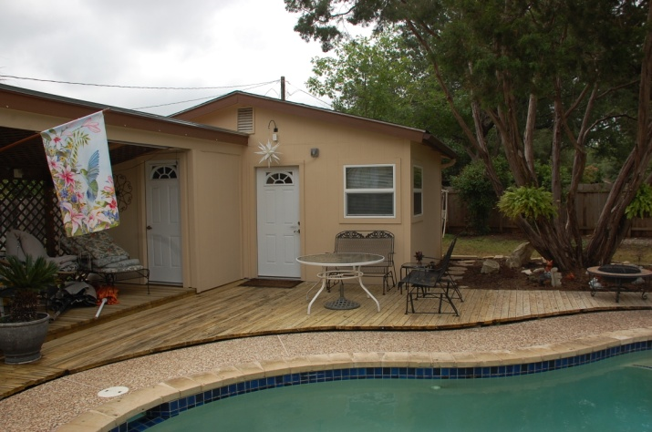
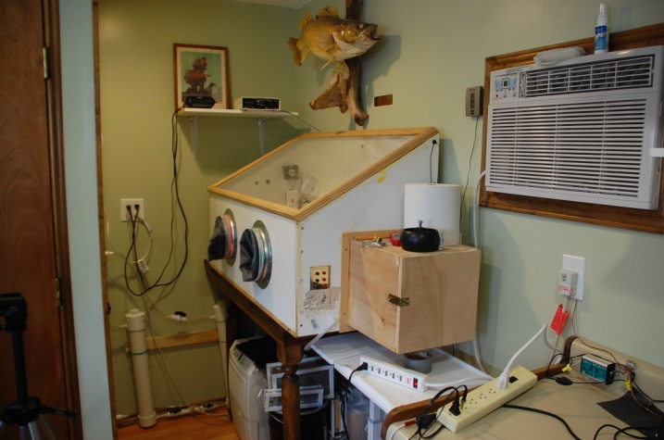
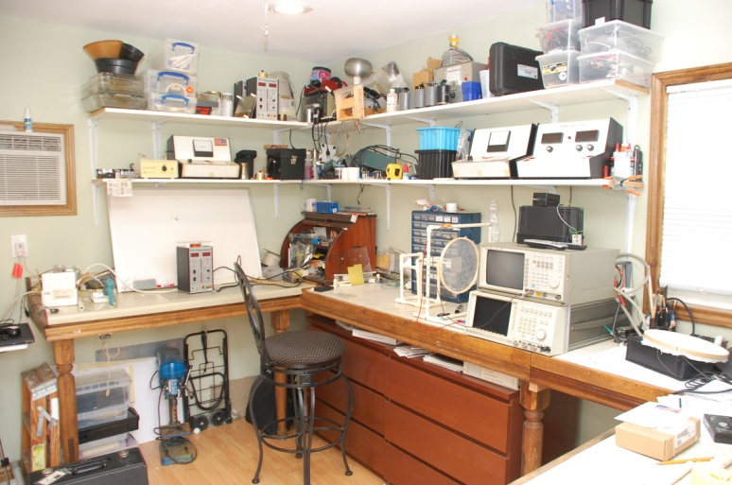
Need other space?
Workshop?
Lab?
Technical equipment?
Best to separate from your living space if you can (keep peace in family)

Slide 19
Establishing Your Rates
Can you find out what others in similar businesses charge?
Without violating any laws!
Will you have multiple rates for different activities?
Sometimes necessary to reduce a standard rate to get certain work
Charging for travel time seems objectionable to most clients

Slide 20
Rates continued:
Hourly or daily rates
Need to establish both
Managing travel costs
Depending on your business, travel is a burden to most clients
Keep good records of all travel expenses and get reimbursed for all that you can – direct deduction

Slide 21
Invoicing
Prepare invoices as soon as possible after work is completed
Make sure you find out the proper way to submit invoices for each client
Find out normal payment time for each client so you know when to expect payment
Love your clients that pay quickly
There are many that take a long time to pay ( it is very tough when the payment time is over 45 days)
Your expenses will be due before you get paid

Slide 22
Income
Keep a separate folder for all payments received
Makes it easier at Tax time
Keep a separate folder for your travel expenses
Same reason
Keep track of other business expenses and deductions monthly
Keep yourself reimbursed

Slide 23
Expense Sheet:
Additional form used for office Expenses

Slide 24
Dedication to your business
Be prepared for total immersion
Be prepared to work longer hours than you ever did when you were working for a paycheck
Be prepared for less time off
Be prepared to enjoy work more than ever before

Slide 25
Wrap Up
Establishing a consulting business is incredibly rewarding
You will be busier than you have ever been in your life if you are fortunate

Slide 26
Thanks for your attention
Any Questions?

