Slide 1
Evolution of the Panama Canal from 1999 to the Present
William M. Isenhower, Ph.D.
Austin, Texas

Slide 2
Tonight’s Speaker
Bill Isenhower is a retired civil engineer and software developer
BSCE, MS, Ph.D. in Civil Engineering, The University of Texas at Austin
During his career, Bill has worked in private consulting, the Texas DOT, university professor, and twice was an Expert on Mission for the United Nations Development Program in India
From 1997 to 2016 he was a consulting engineer and program manager for Ensoft, Inc./Lymon C. Reese & Associates, an engineering software development and consulting firm located in Austin, Texas
Over his career, Bill has worked on projects in 17 countries and 42 US states
In December 2005, Bill and his colleague Dr. Gonzalo Vasquez were contracted by the Autoridad del Canal de Panamá to train their geotechnical engineers how to use software developed by Ensoft for the analysis and design drilled foundations in soft rock to support the guide walls of the Neopanamax locks

Slide 3
Tonight’s Topics
How the Panama Canal Works
A Tour of the Panama Canal
The Neopanamax locks
The Events that Lead to Torrijos-Carter Treaties of 1977 and the Handover of the Panama Canal from the United States to Panama in 1999
The Panama Palindrome

Slide 4
How the Panama Canal Works
(103) How Does the Panama Canal Work? - YouTube

Slide 5
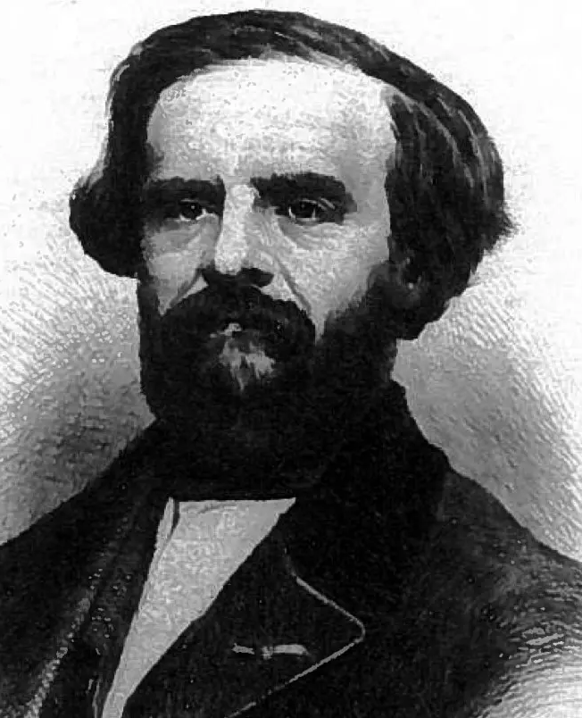
The Man Who Proposed How to Build the Panama Canal
Adolphe Godin de Lépinay was the Chief Engineer of the Corps des Ponts et Chaussées. He had worked in the tropics, building the railroad between Córdoba and Veracruz, Mexico in 1862. On this project, one third of the labor force and two thirds of the engineering staff had died from yellow fever and malaria. From this bad experience, he understood that:
the conditions in Panama were deadlier than in Mexico, and
He understood that the differences in tides along the Caribbean and Pacific coasts made a “sea-level” canal impossible to build
In May 1879, de Lépinay proposed a plan that created a man-made lake to submerge the rain forests and used “lock canals” to connect the man-made lake to the oceans. Unfortunately, Ferdinand de Lesseps, who led the French effort to build the Panama Canal, did not follow this plan and failed.
Adolphe Godin de Lépinay

Slide 6
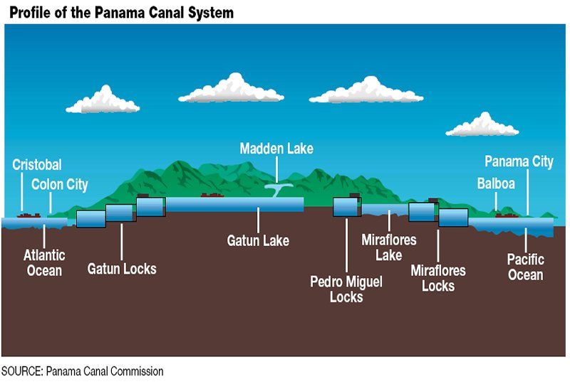
Lake Ajajuela
(Lake Madden)
Cristobal
Colon
Panama City
Balboa
Gatun Lake
(Elevation +85 ft, main channel water
depth 38 ft,
fresh water supply
for Panama City
and Colon)
Miraflores Lake
(Elevation +54 ft, water depth +38 ft)
Caribbean
Sea
Miraflores Locks
(Lift to +54 ft, approach
channel dredge
depth −45 ft)
Pacific
Ocean
Gatun Locks
(approach channel dredge depth −35.5 ft)
Pedro Miguel Locks
(Lift to +85 ft)
Notes:
This slide illustrates the general plan chosen for the Panama Canal. Concept, A sea-level cannot succeed in Panama, because of the difference in tidal elevations in the Carribean Sea (1,5 ft) and Pacific Ocean (15 ft) would make the canal unnavigable at times. So, a canal using locks is required When locks are used, there must be a source of water upstream because water will be lost downstream each time a ship transits a lock. For the Panama Canal, the source of water is a large man-made lake, Gatun Lake, which was created by building a dam on the Chagres River. In this plan, ships are lifted by the locks from sea level to the elevation of Gatun Lake (+85 ft). So, in Panama, ship crosses the isthmus by using the locks and a large man-made lake to travel over Panama, not through it.
This plan for a canal with locks in Panama was first proposed by Baron Adolphe Godin de Lépinay, Chief Engineer of the Corps des Ponts et Chaussées in 1879. de Lépinay first proposed this plan in opposition to the plan promoted by Count Ferdinand de Lesseps for a sea-level canal.
John Stevens believed a sea-level canal in Panama to be "an entirely untenable proposition“ because of the difference in tides between the Caribbean and Pacific coasts. Stevens convinced Theodore Roosevelt of the necessity and feasibility of selecting this plan in 1906. The US planned the design of the locks on the largest locks in use in the US at that time, 1200 ft long, 110 ft wide. The lock with the largest lift in the uS is the Wilson Lock on The Tennessee River at 103 ft. The oldest locks in the US were built in 1840, 185 years old.

Slide 8
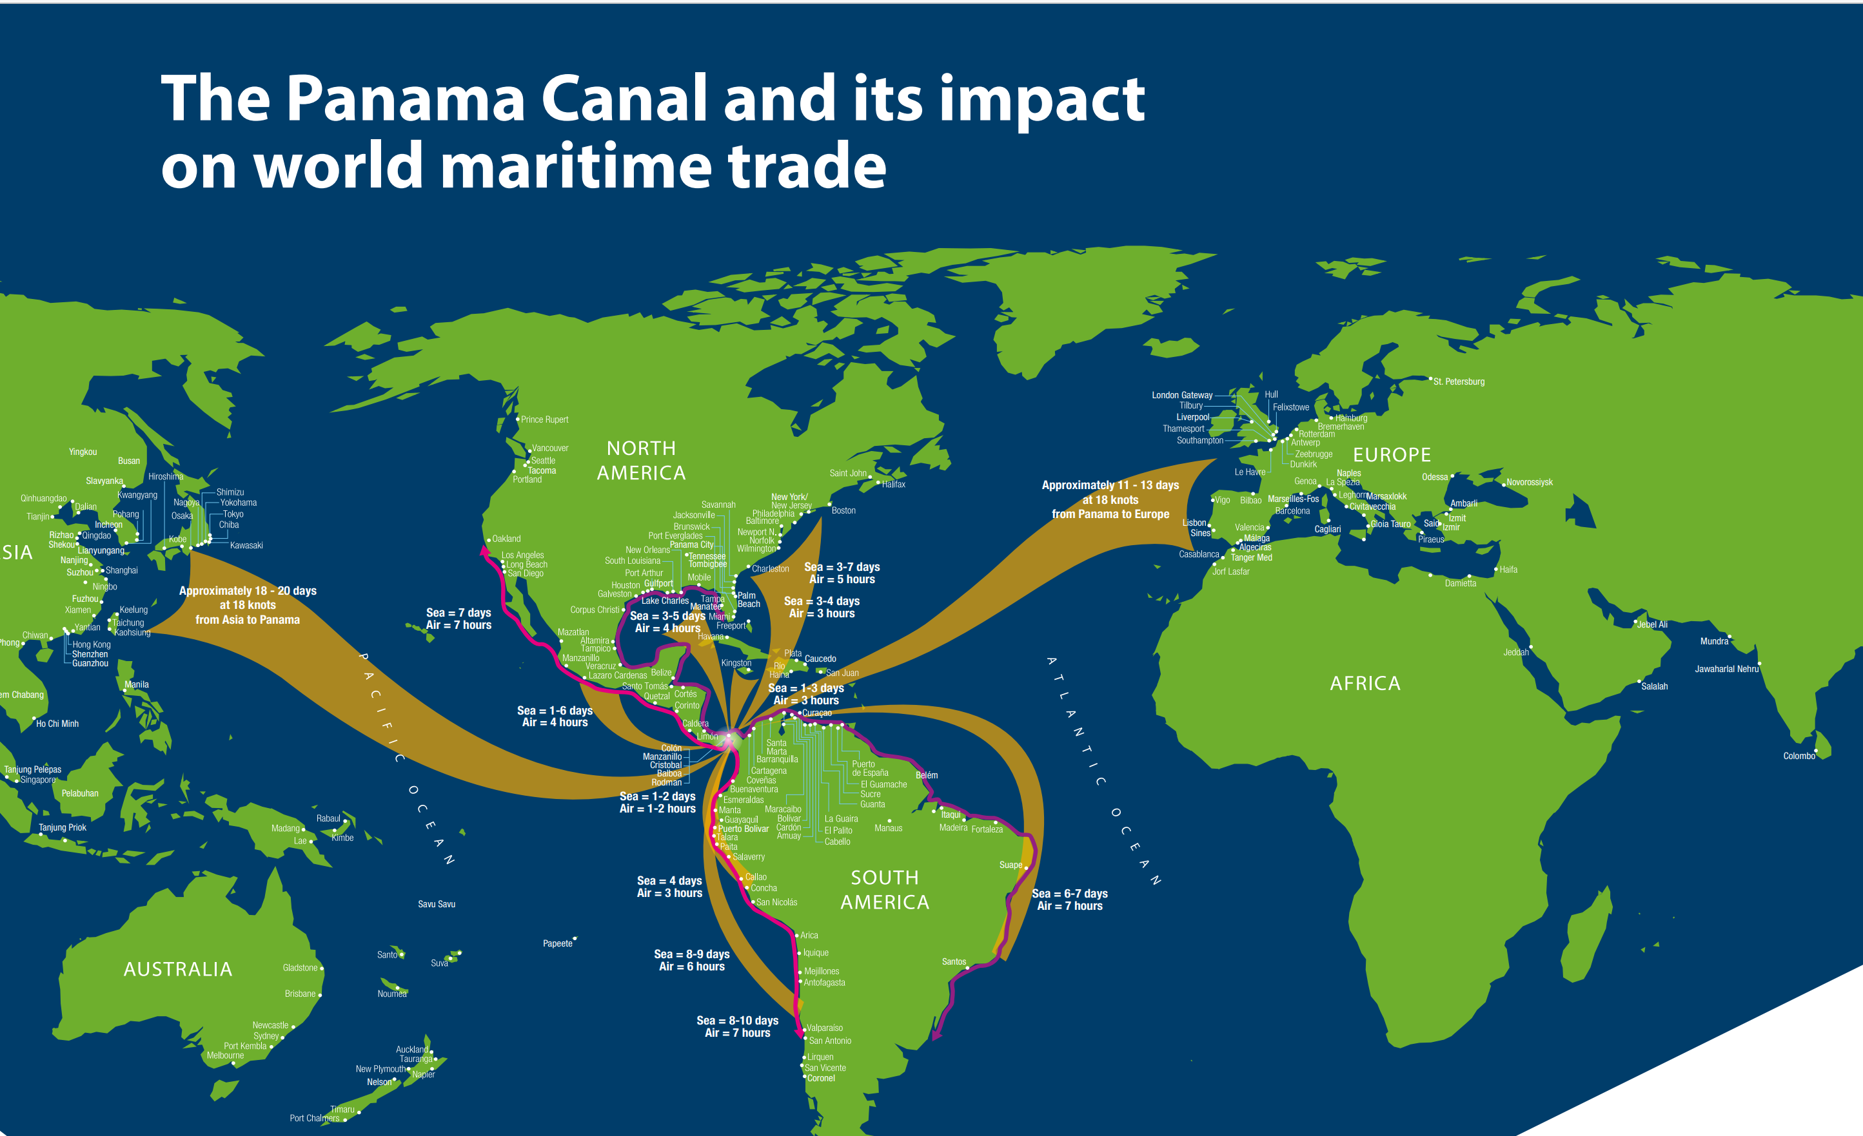

Slide 9
The Panama Canal Connects the World
Nearly 3% of Global Maritime Trade Transits the Panama Canal
The Canal connects 180 routes in 170 countries, through 1,920 ports worldwide
The Panama Canal’s main trade routes (by tonnage) are:
• U.S. East Coast – Asia
• U.S. East Coast - South America’s West Coast
• South America’s West Coast - Europe
• South America’s Intercostal route
• South America’s East Coast - Asia

Slide 10
The New Panamax Locks

Slide 11
The Need for Larger Locks
Prior to 1999, the Corps of Engineers designed a third set of larger locks four times between 1943 and 1999
On three of the four designs, the objective was to enable the largest aircraft carriers and battleships to use the canal
These efforts were canceled when the wars ended
For the other design, the objective was to enable larger tankers to use the canal
In this case, the project was canceled when the US domestic production of oil increased
The final design was made to enable the passage of larger container ships to use the canal

Slide 12
Water is saved when a lock is emptied is re-used when the locks are re-filled
The fraction of the water saved depends on the number of water-saving basins
Three water-saving basins are used for each lock chamber In the new locks
60% of the water used is saved to re-fill the lock
Gatun Lake is 85 ft (25.8 m) above sea level
The maximum depth of each water-saving basin is 2.88 m (9.4 ft)
The area of each basin is equal to the area of the lock
Water saving has been implemented on the original locks by cross-draining between adjacent lock chambers whenever possible

Slide 13
Dimensions of Lock Chambers
Panamax Lock Chambers
Length =1,000 ft (304.9 m), Width = 110 ft (33.54 m),
Depth = 39.5 ft, Max. Lift = 31 ft (9.45 m)
Panamax Ship Dimensions
Length = 950 ft (289.6 m), Beam = 106 ft (32.31 m),
Draft = 39.5 ft (12.01 m), Air Draft = 190 ft (57.9 m)
Displacement = 90,000 to 100,000 tonnes, 3,100,000 to 3,445,000 cubic feet
Neopanamax Lock Chambers
Length = 1,400 ft (427 m), Width = 180 ft (55 m), Depth = 60 ft (18.3 m)
Neopanamax Vessel Dimensions
Length = 1,200,ft ( m), Beam = 161 ft (49 m),
Depth = 49.9 ft (15.2 m), Air Draft = 190 ft (57.9 m) ,
Displacement 150,000 to 170,000 tonnes = 5,170,000 to 5,860,000 cubic ft

Slide 14
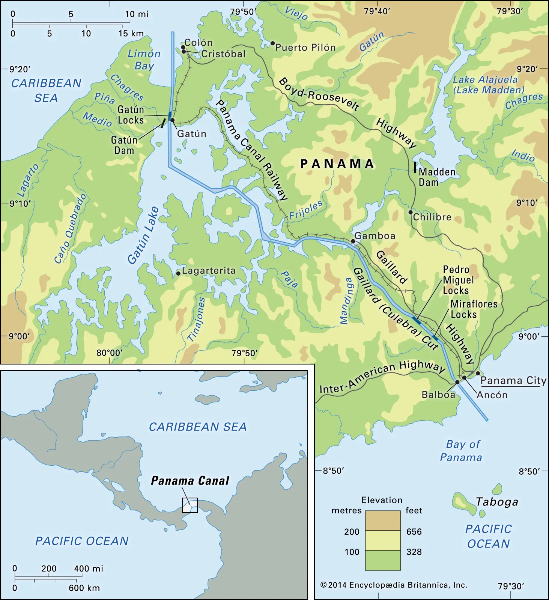
Design Water Elevations:
Gatun Lake = +85 ft
Miraflores Lake = +54 ft
Panamax Lock Lifts:
Miraflores Locks = 2 × 33 ft
Pedro Miguel Locks = 33 ft
Gatún Locks = 3 × 33 ft
Neopanamax lock lifts are similar, but the locks are deeper to fit the deeper drafts of the Neopanamax ships

Slide 15
The Time Line for Design and Construction
The new locks were designed by ACP between 2006 and 2010.
The expansion project was approved in a national referendum in 2006
Construction began in 2007 and was completed in May 2016.
The new locks officially began commercial operation on June 26, 2016
The new locks are a huge success, saving water, and increasing freight capacity

Slide 16
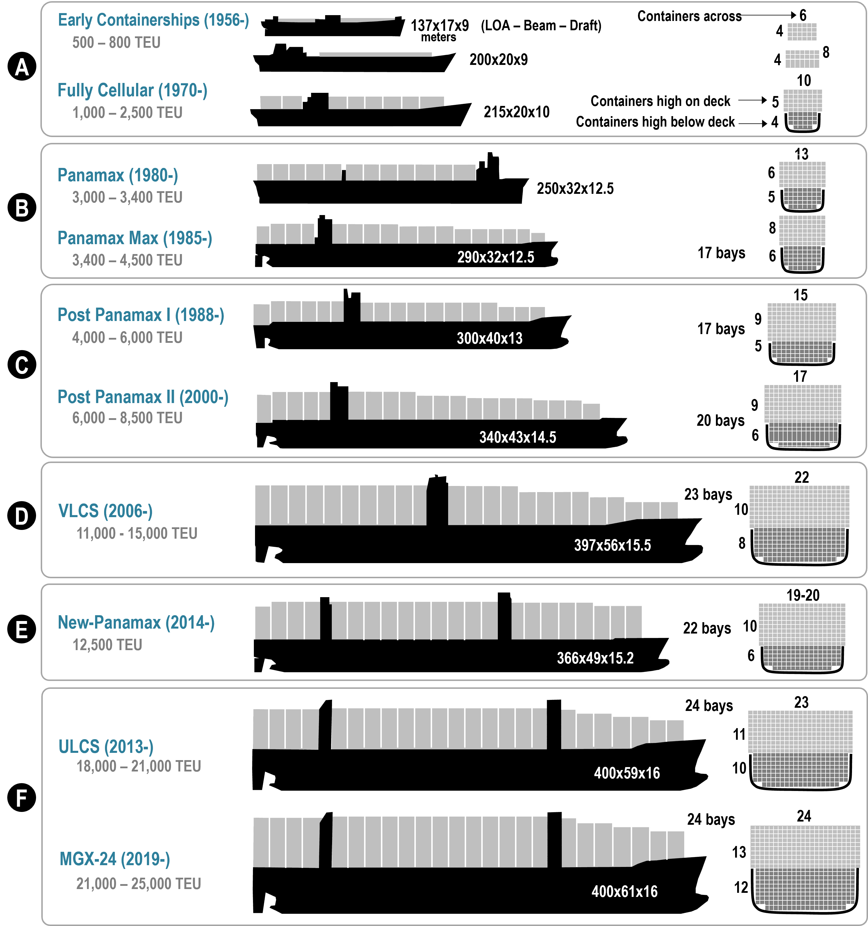
The Largest Ships that can use the Panama Canal
13
Panamax (1980-)
3,000 – 3,400 TEU
New-Panamax or
Neopanamax (2014-)
12,500 TEU
12 bays
6
820’x106'x41’ 250x32x12.5
5
19 - 20
10
22 bays
6
1,200'x161'x50'
22 bays 10
6
19 - 20
1,200’x160’x50’ 366x49x15.2

Slide 17
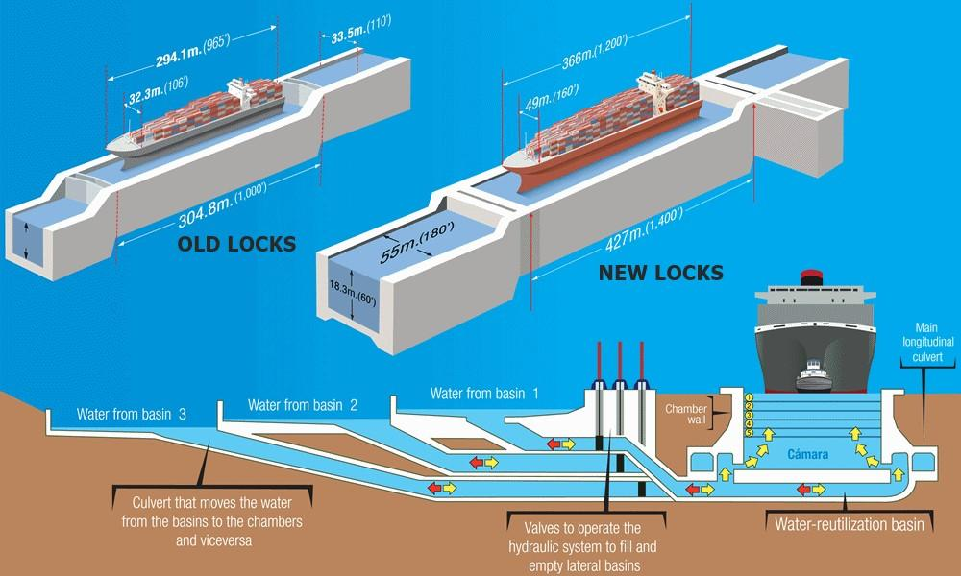
Chamber wall
Lock Chamber
Culvert for water flowing to and from the lock chamber
Valves to operate the hydraulic system to fill & drain the lateral basins
Culvert used to move water to & from the lock chamber

Slide 18
Neopanamax Lock Chamber
VT
VM
VB

Slide 19
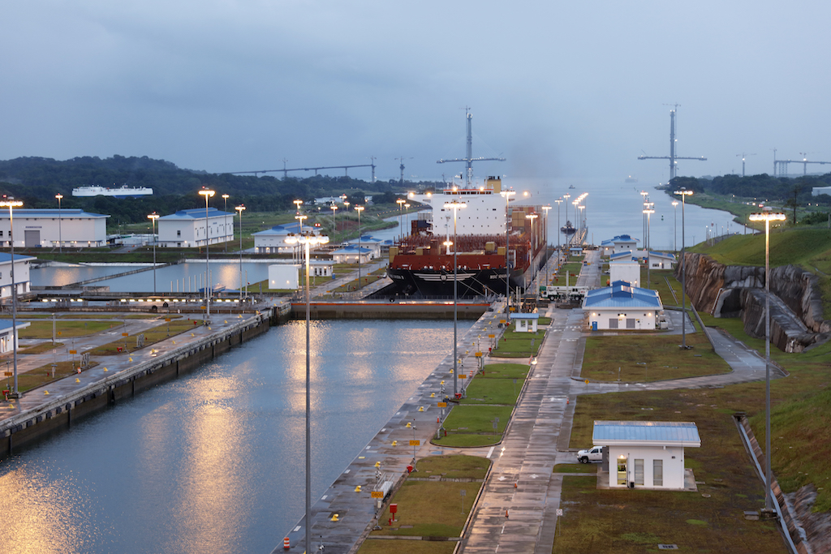

Slide 20
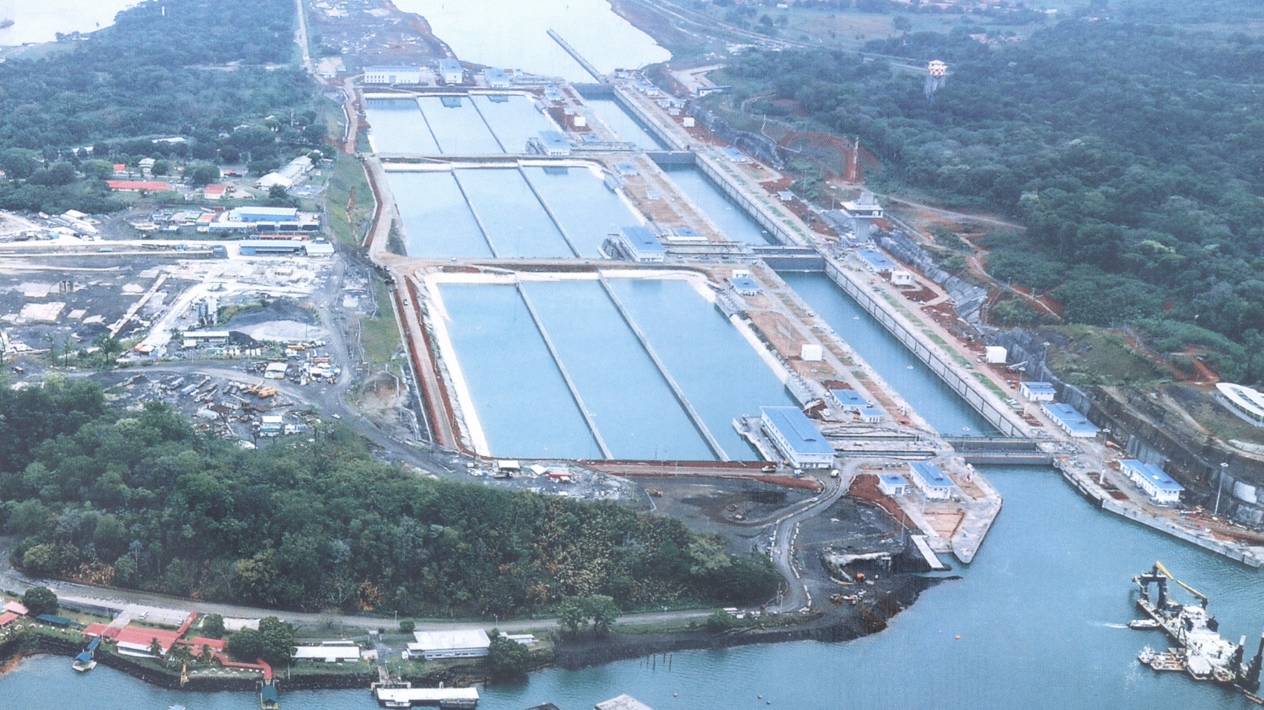

Slide 21
A Tour of the Panama Canal
(as it was in 2005)

Slide 22
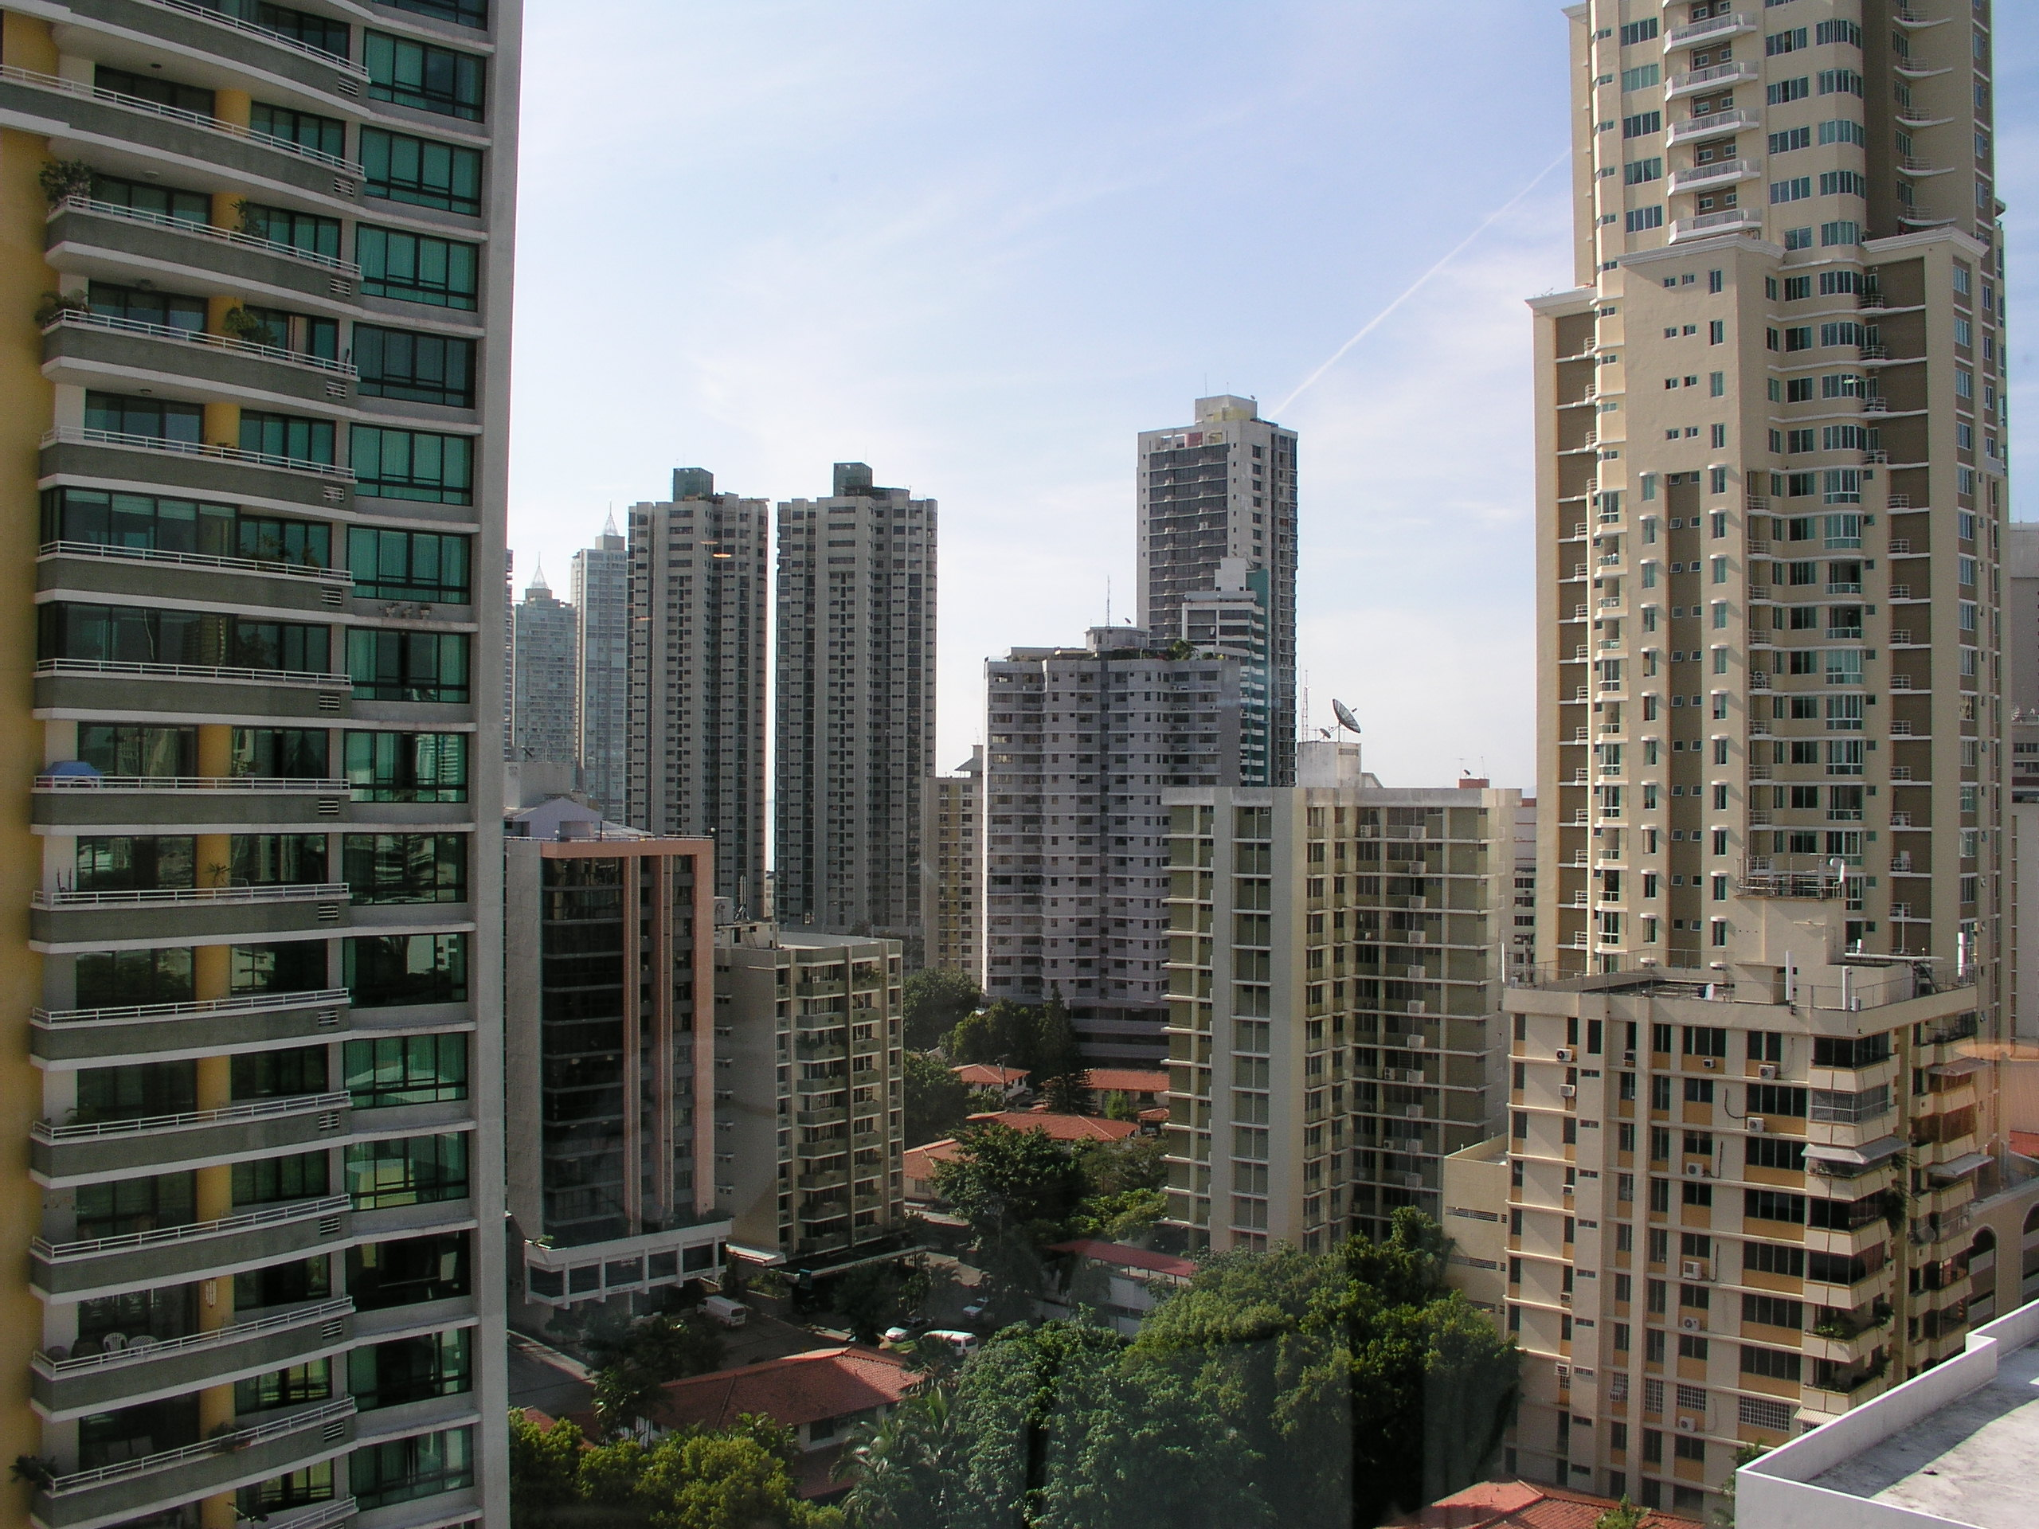
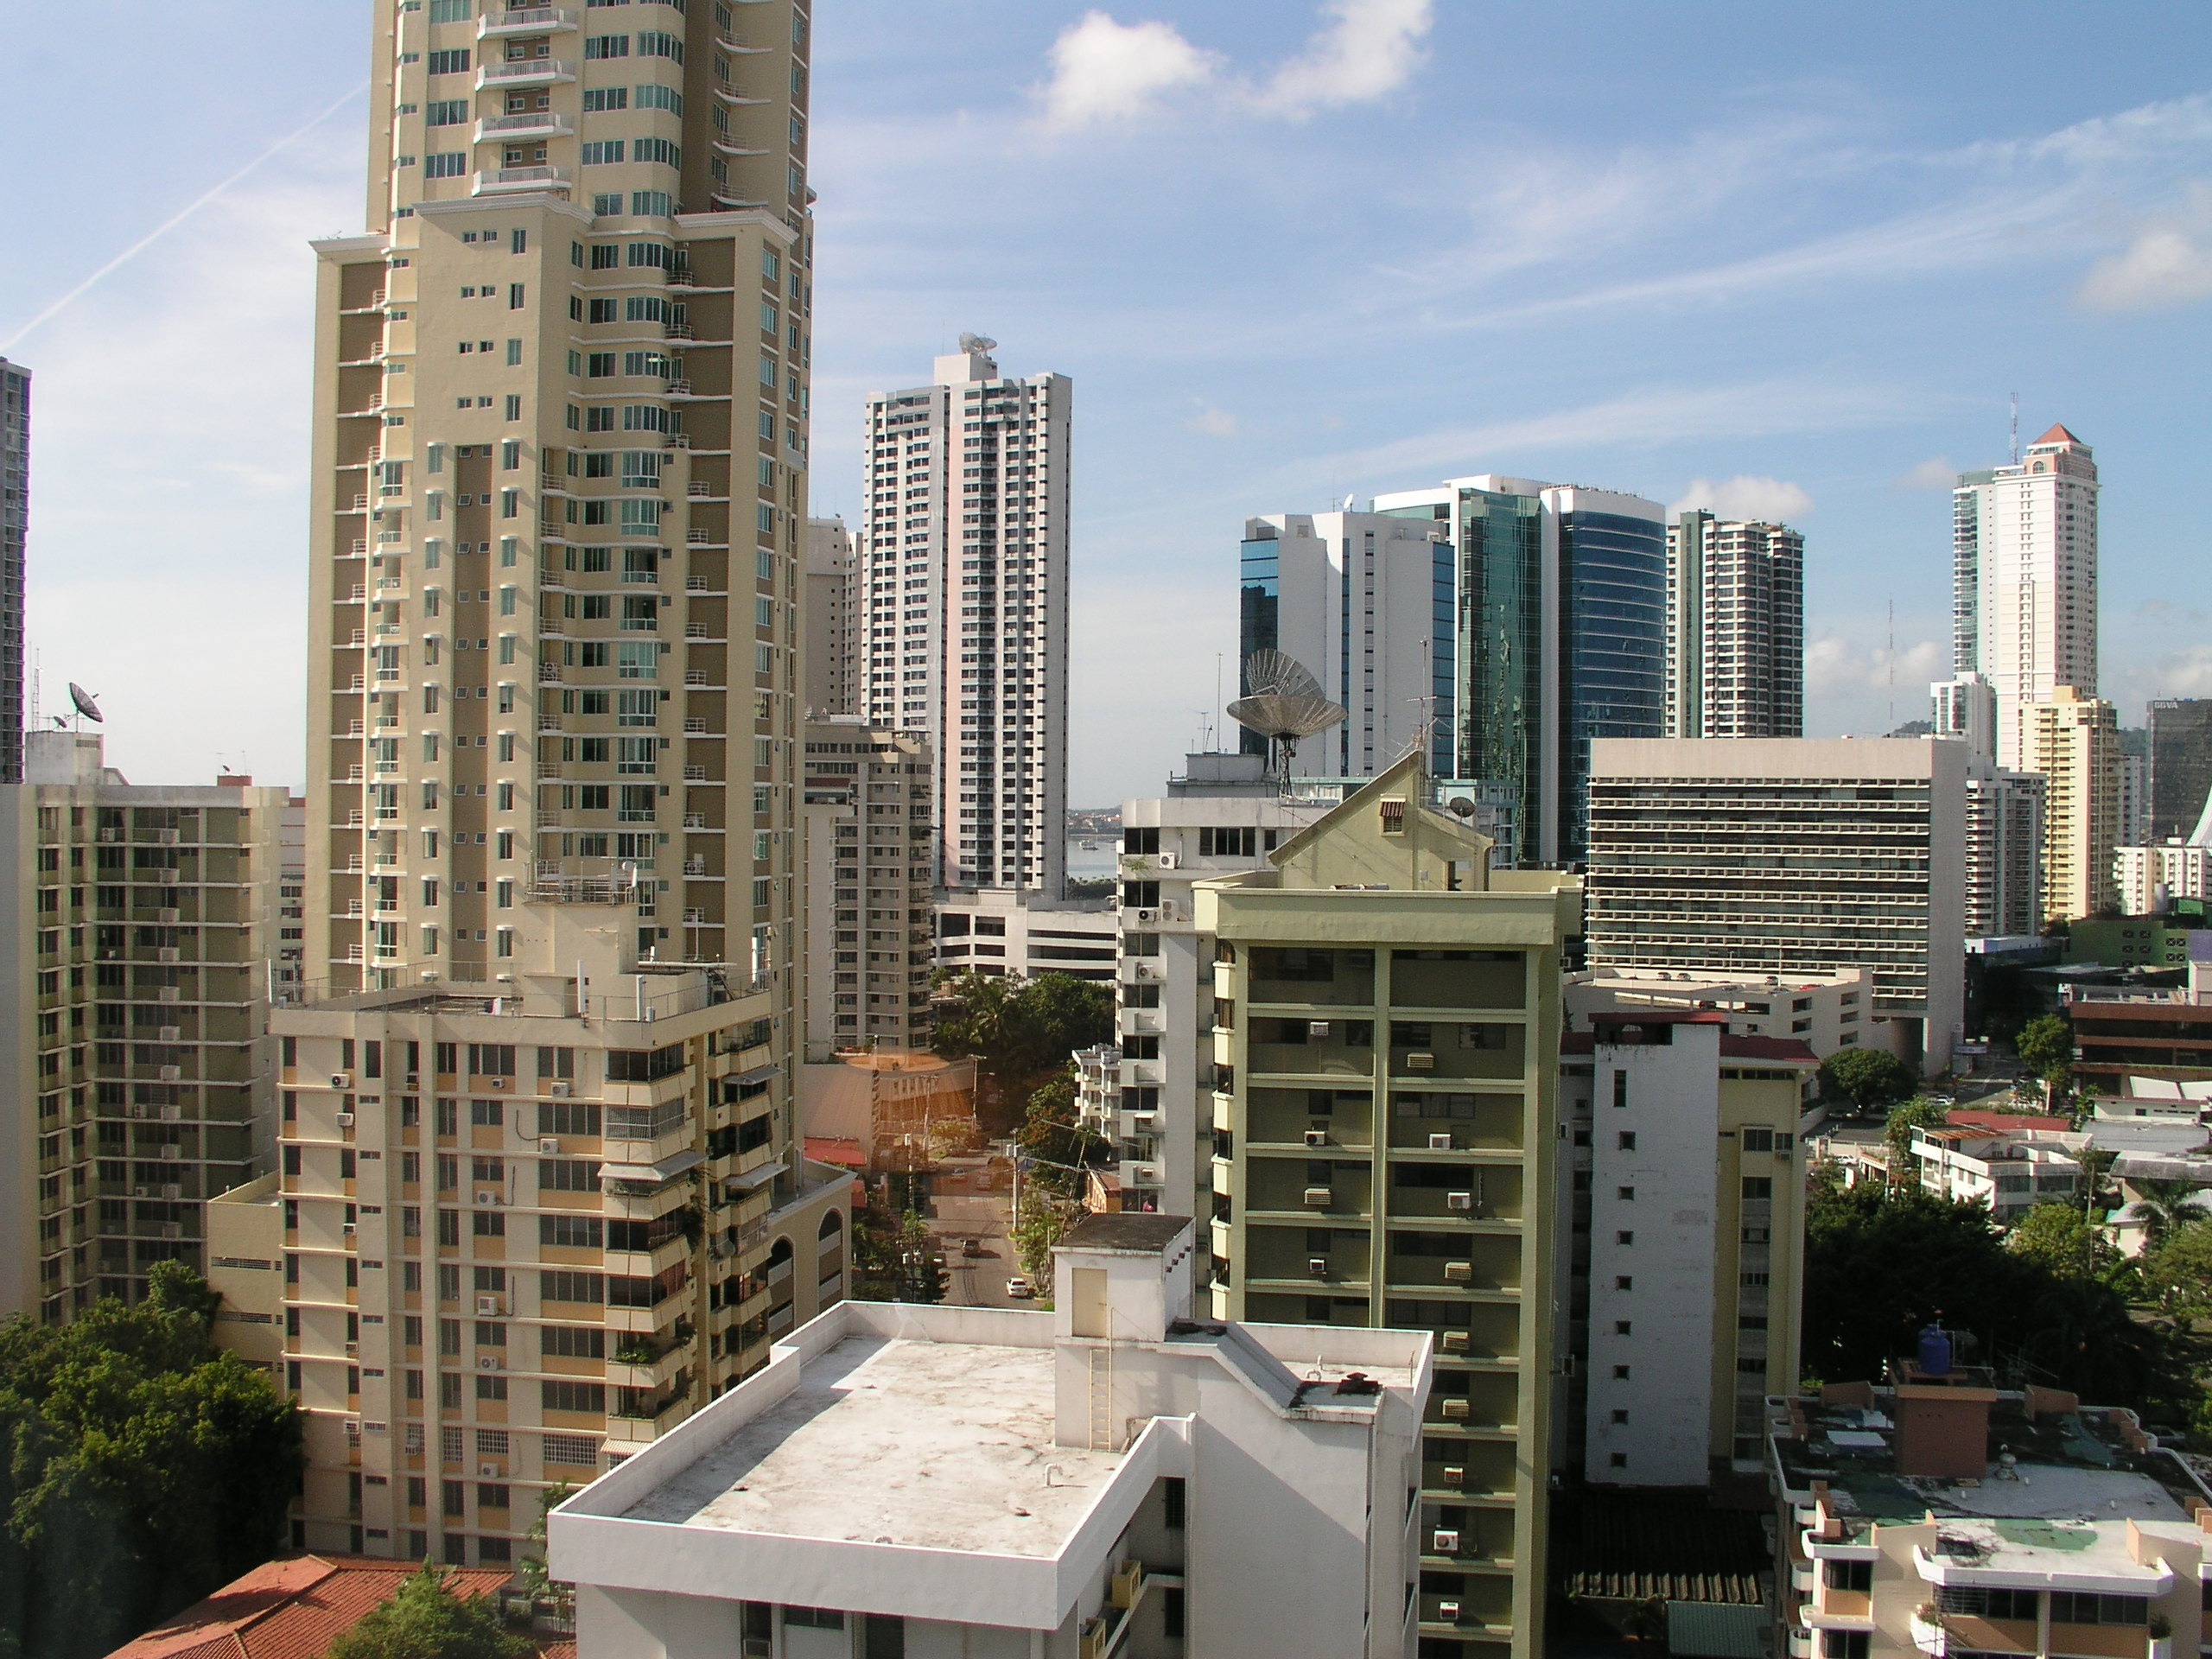
If you need to drive a car in Panamá City, a car with GPS, and knowledge of Spanish, are essential because of the short, one-way streets!

Slide 23
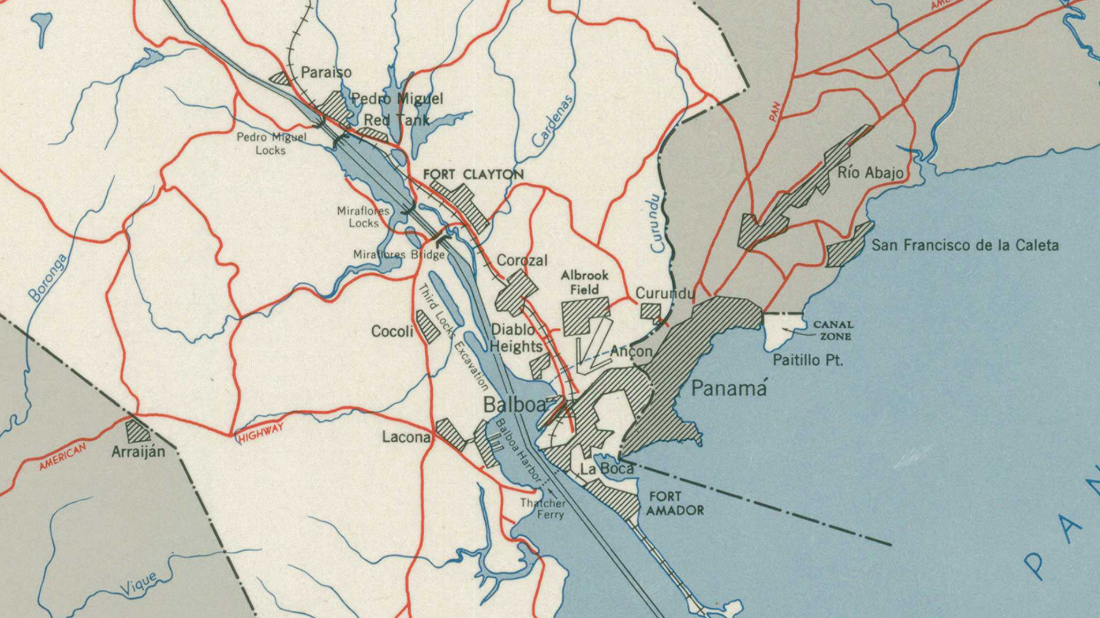
CENTENNIAL
BRIDGE
Flight Path
“Fourth” Bridge (unnamed)
Under construction, 21% complete
Bridge of the Americas

Slide 24
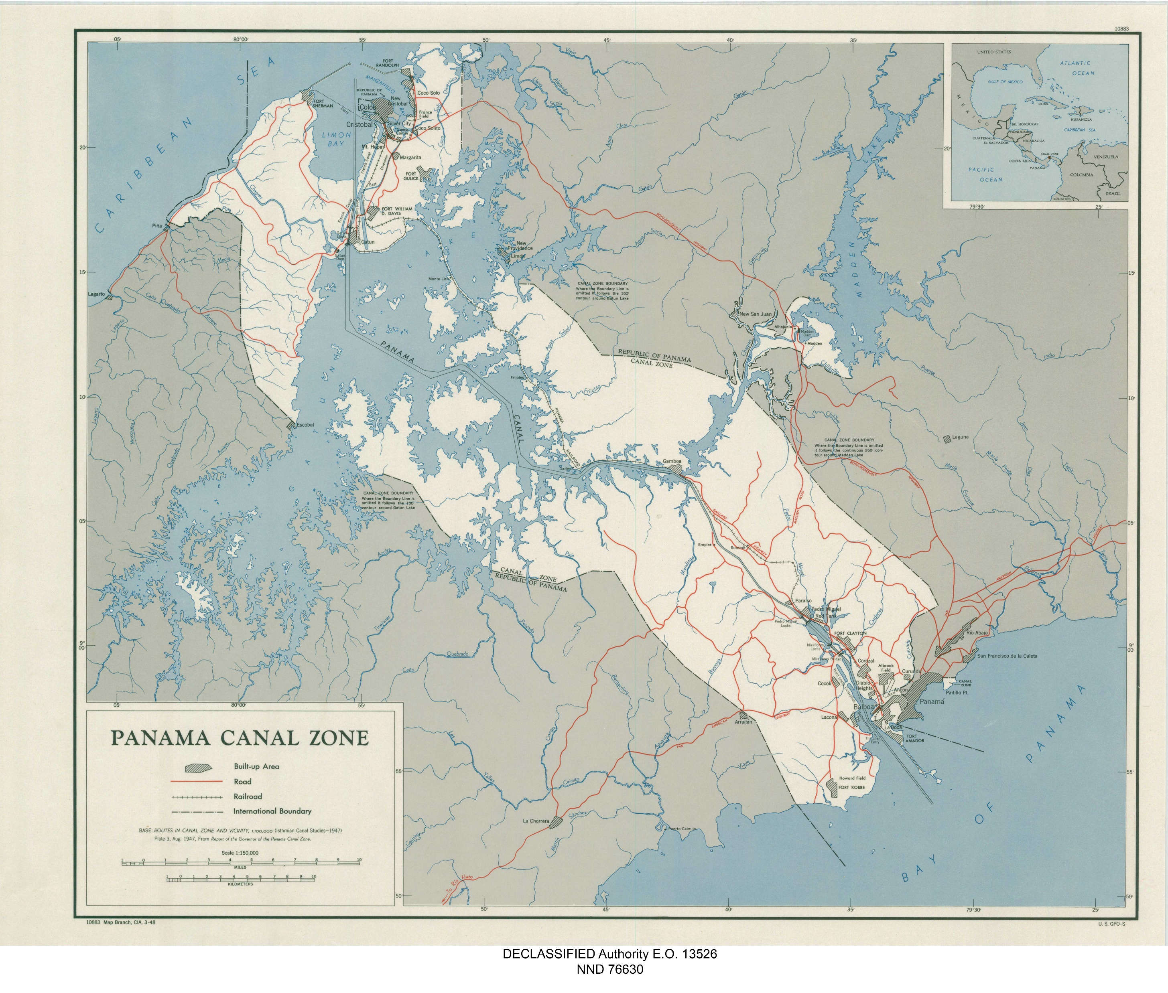
Flight Path Along the Culebra (Gaillard) Cut
Gold
Hill
CENTENNIAL
BRIDGE

Slide 25
Atlantic
Bridge
Southbound Flight Path
3
Southbound Navigation Aids from Gatun Locks to Gamboa Turn shown in Red
4
1
2
5
6
7
8

Slide 26

Taking off to towards the Pacific from Albrook Field
Ancon Hill Port of Balboa

Slide 27
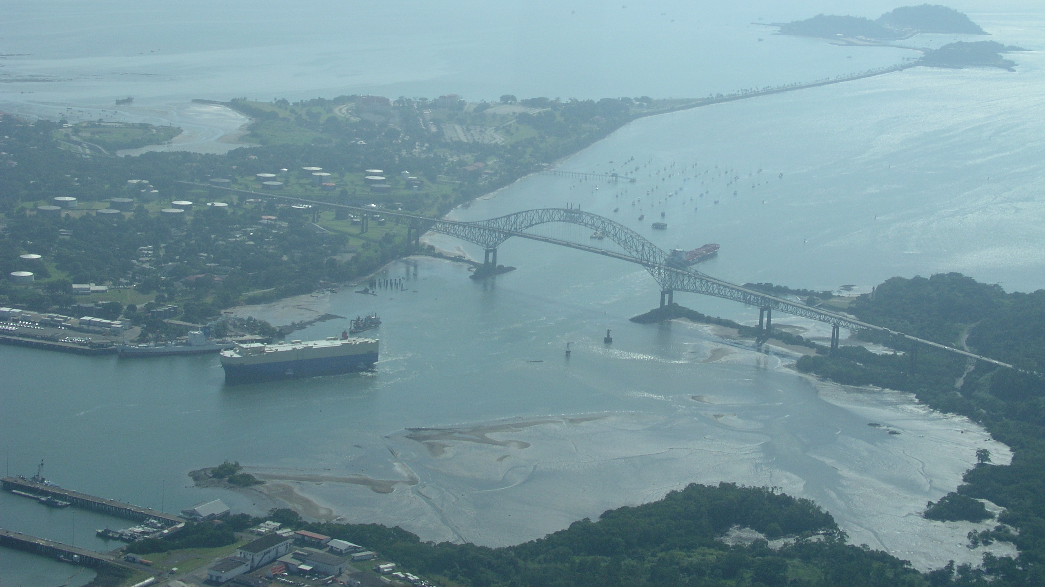
Pacific Ocean
Bridge of the Americas
Old Navy Base

Slide 28
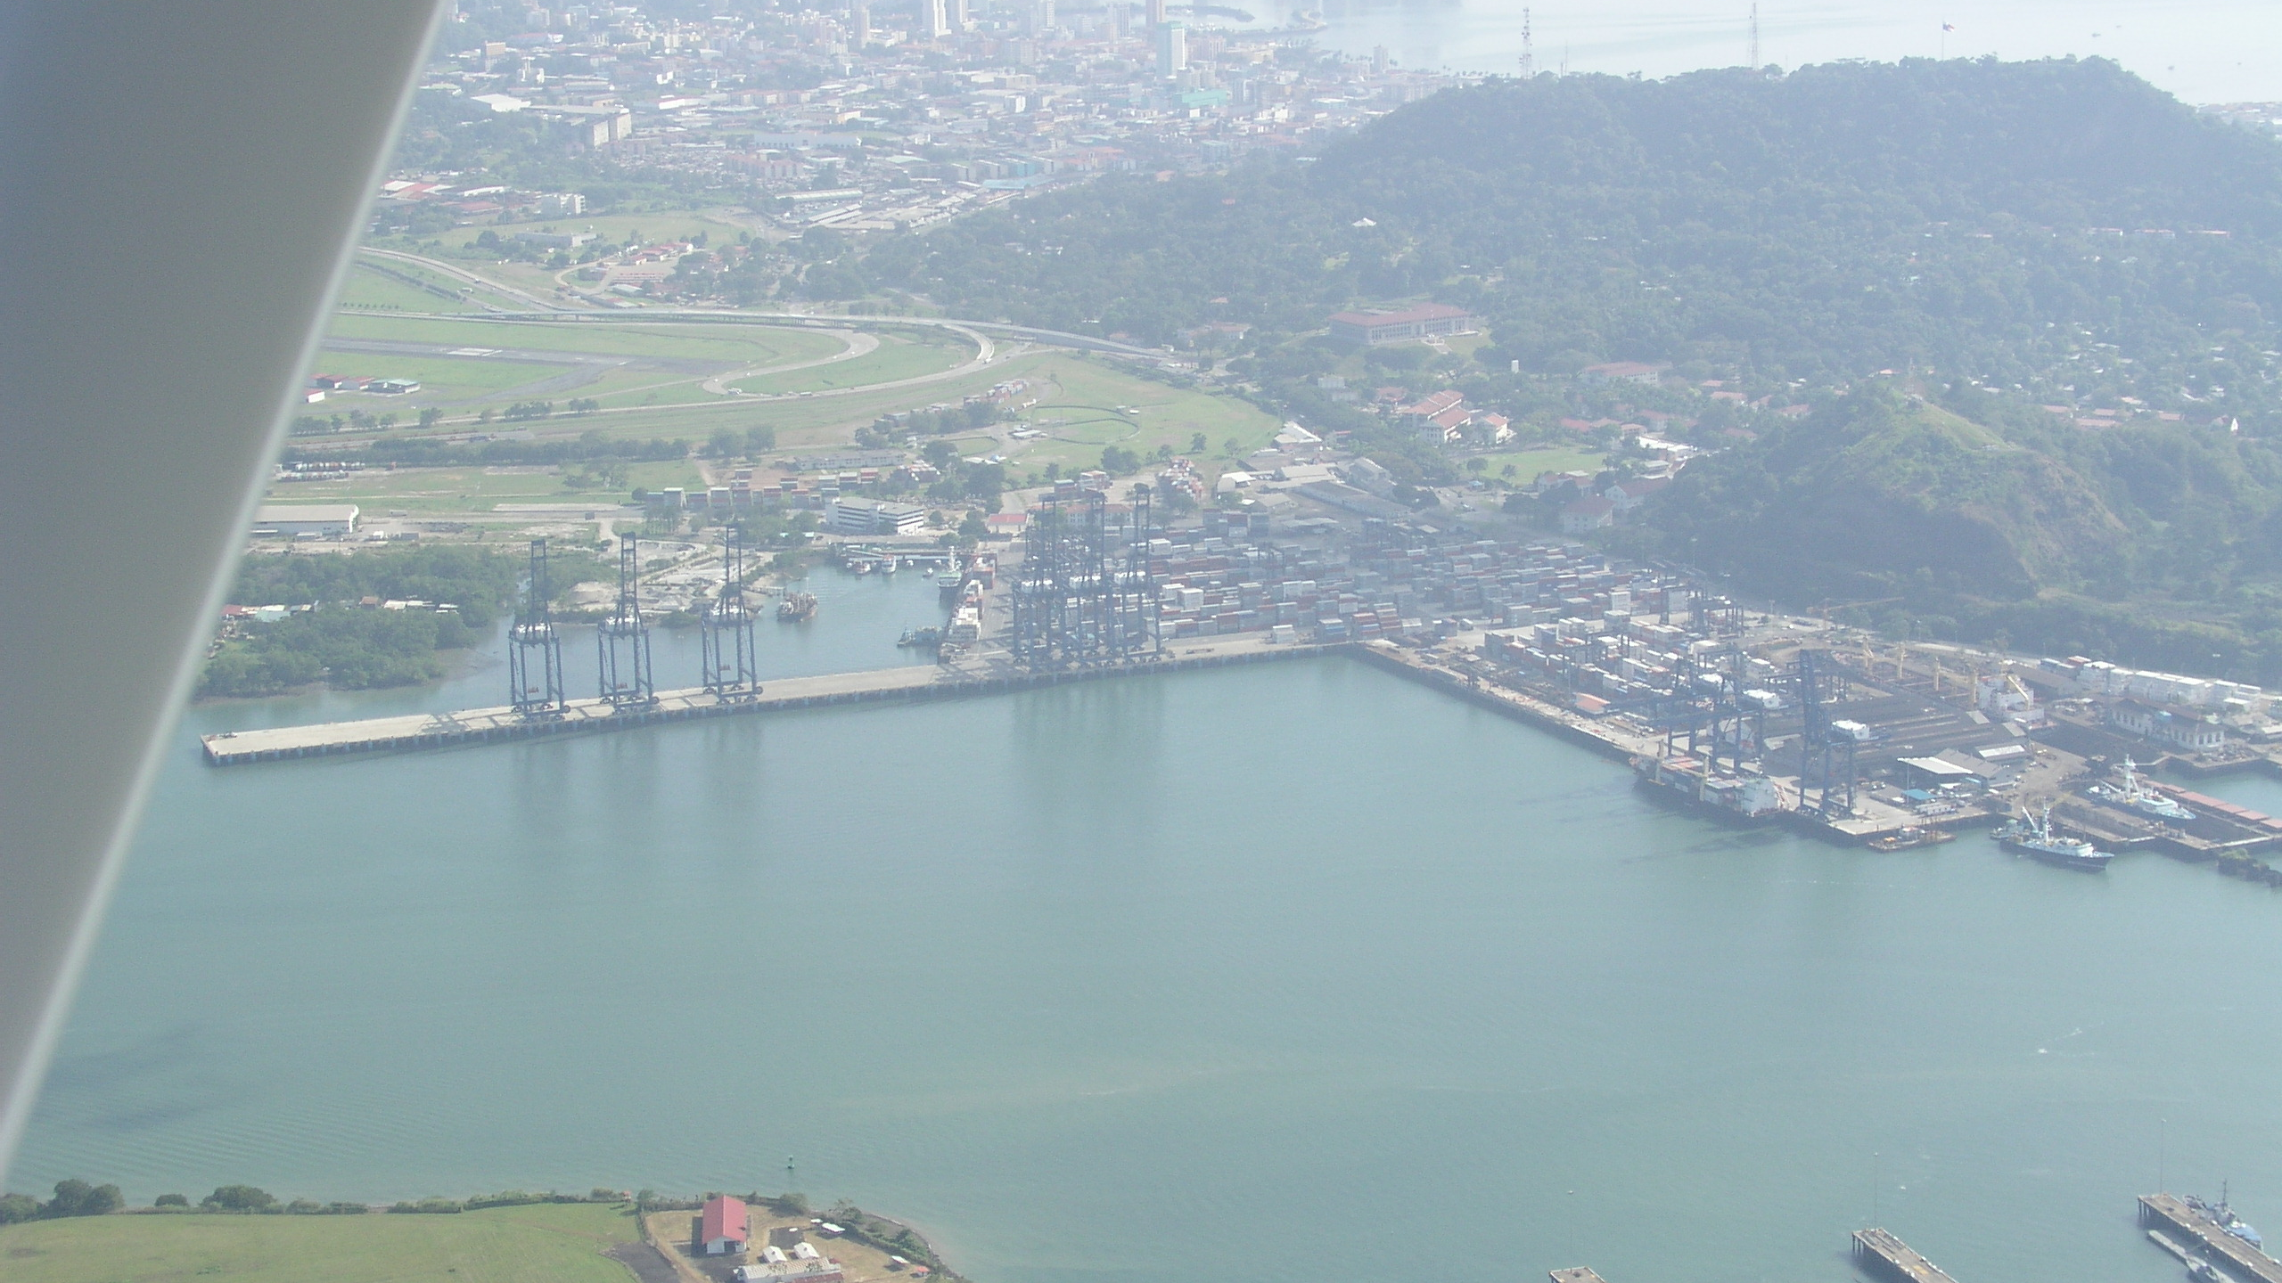
ACP Headquarters Building
Balboa Container Terminal
Old Navy Base

Slide 29
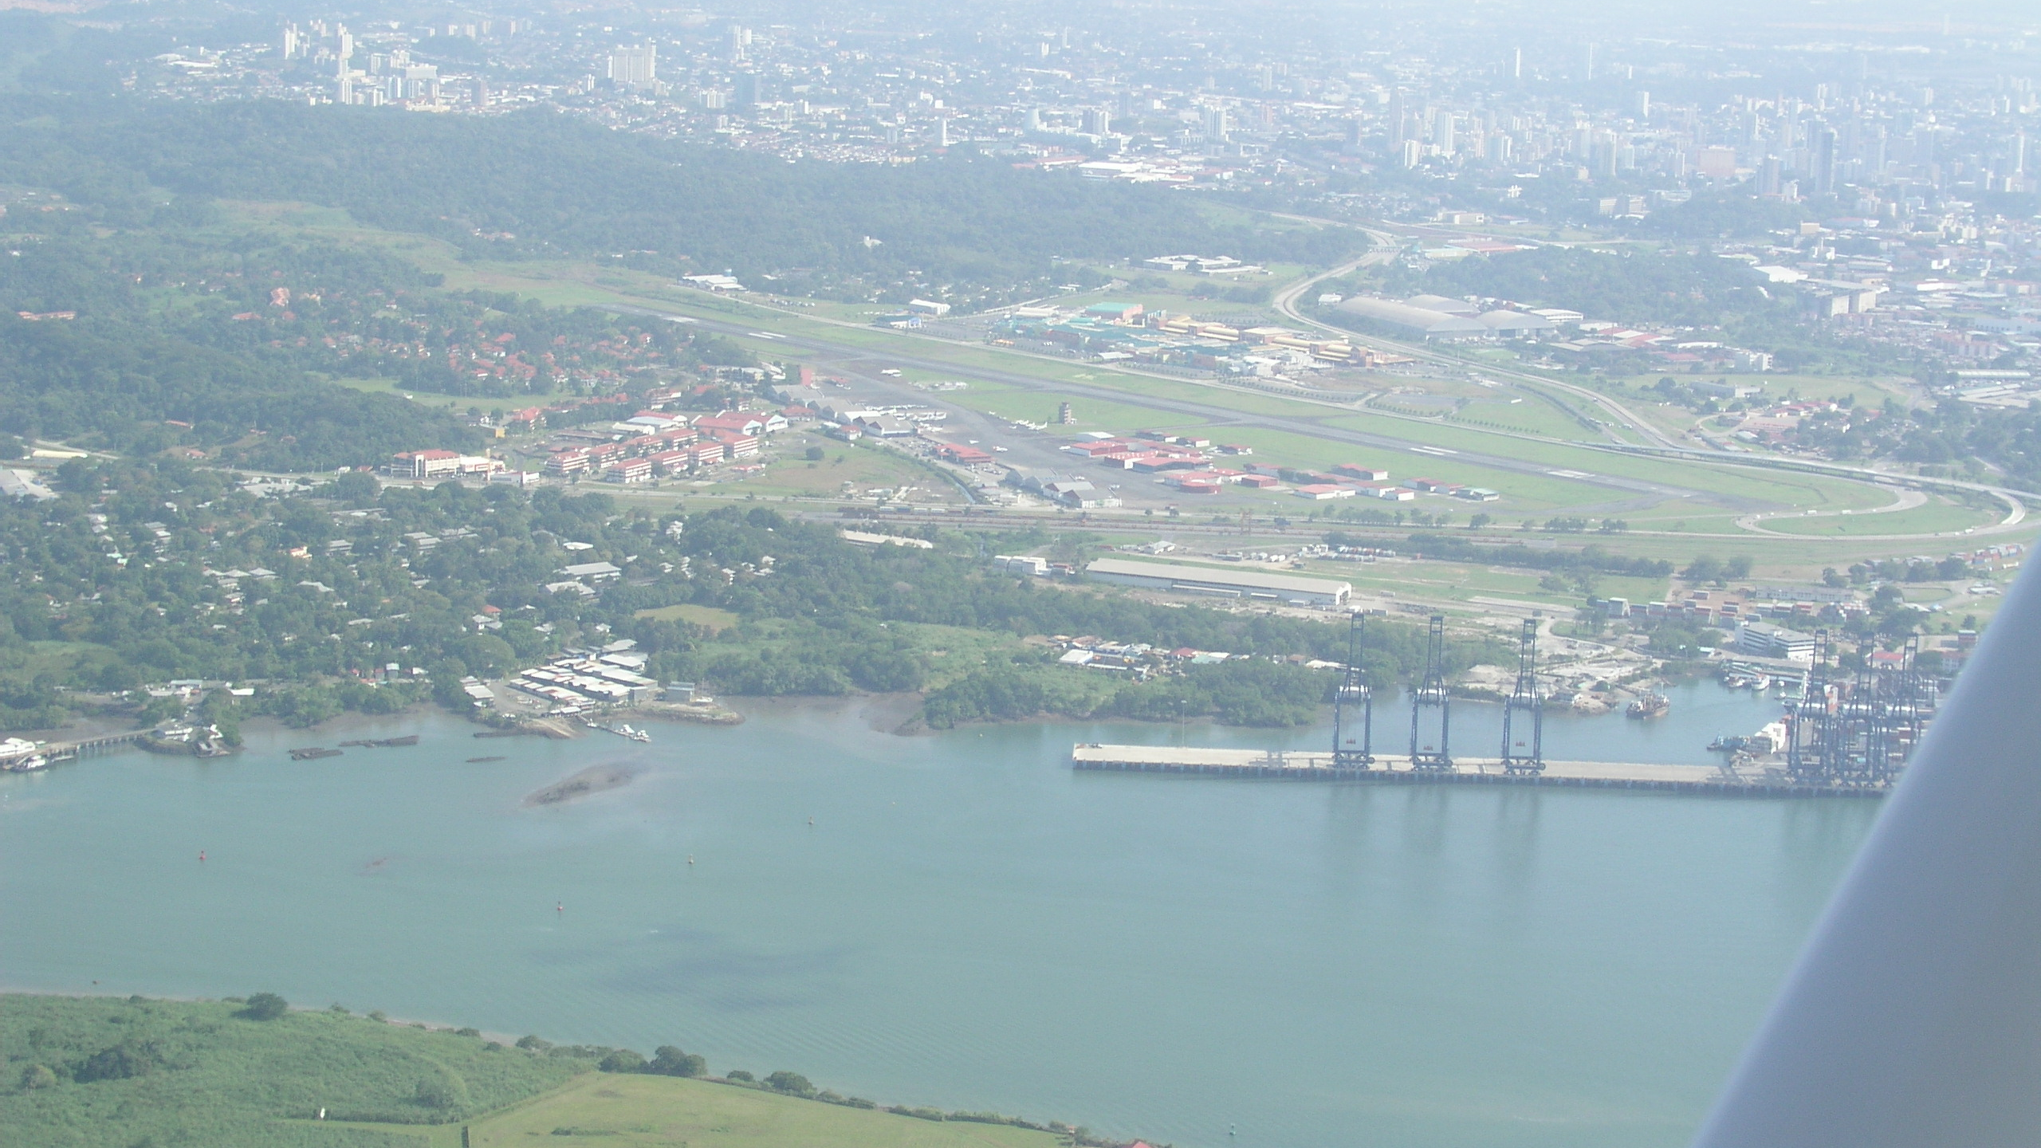
Albrook Field
Balboa Container Terminal

Slide 30
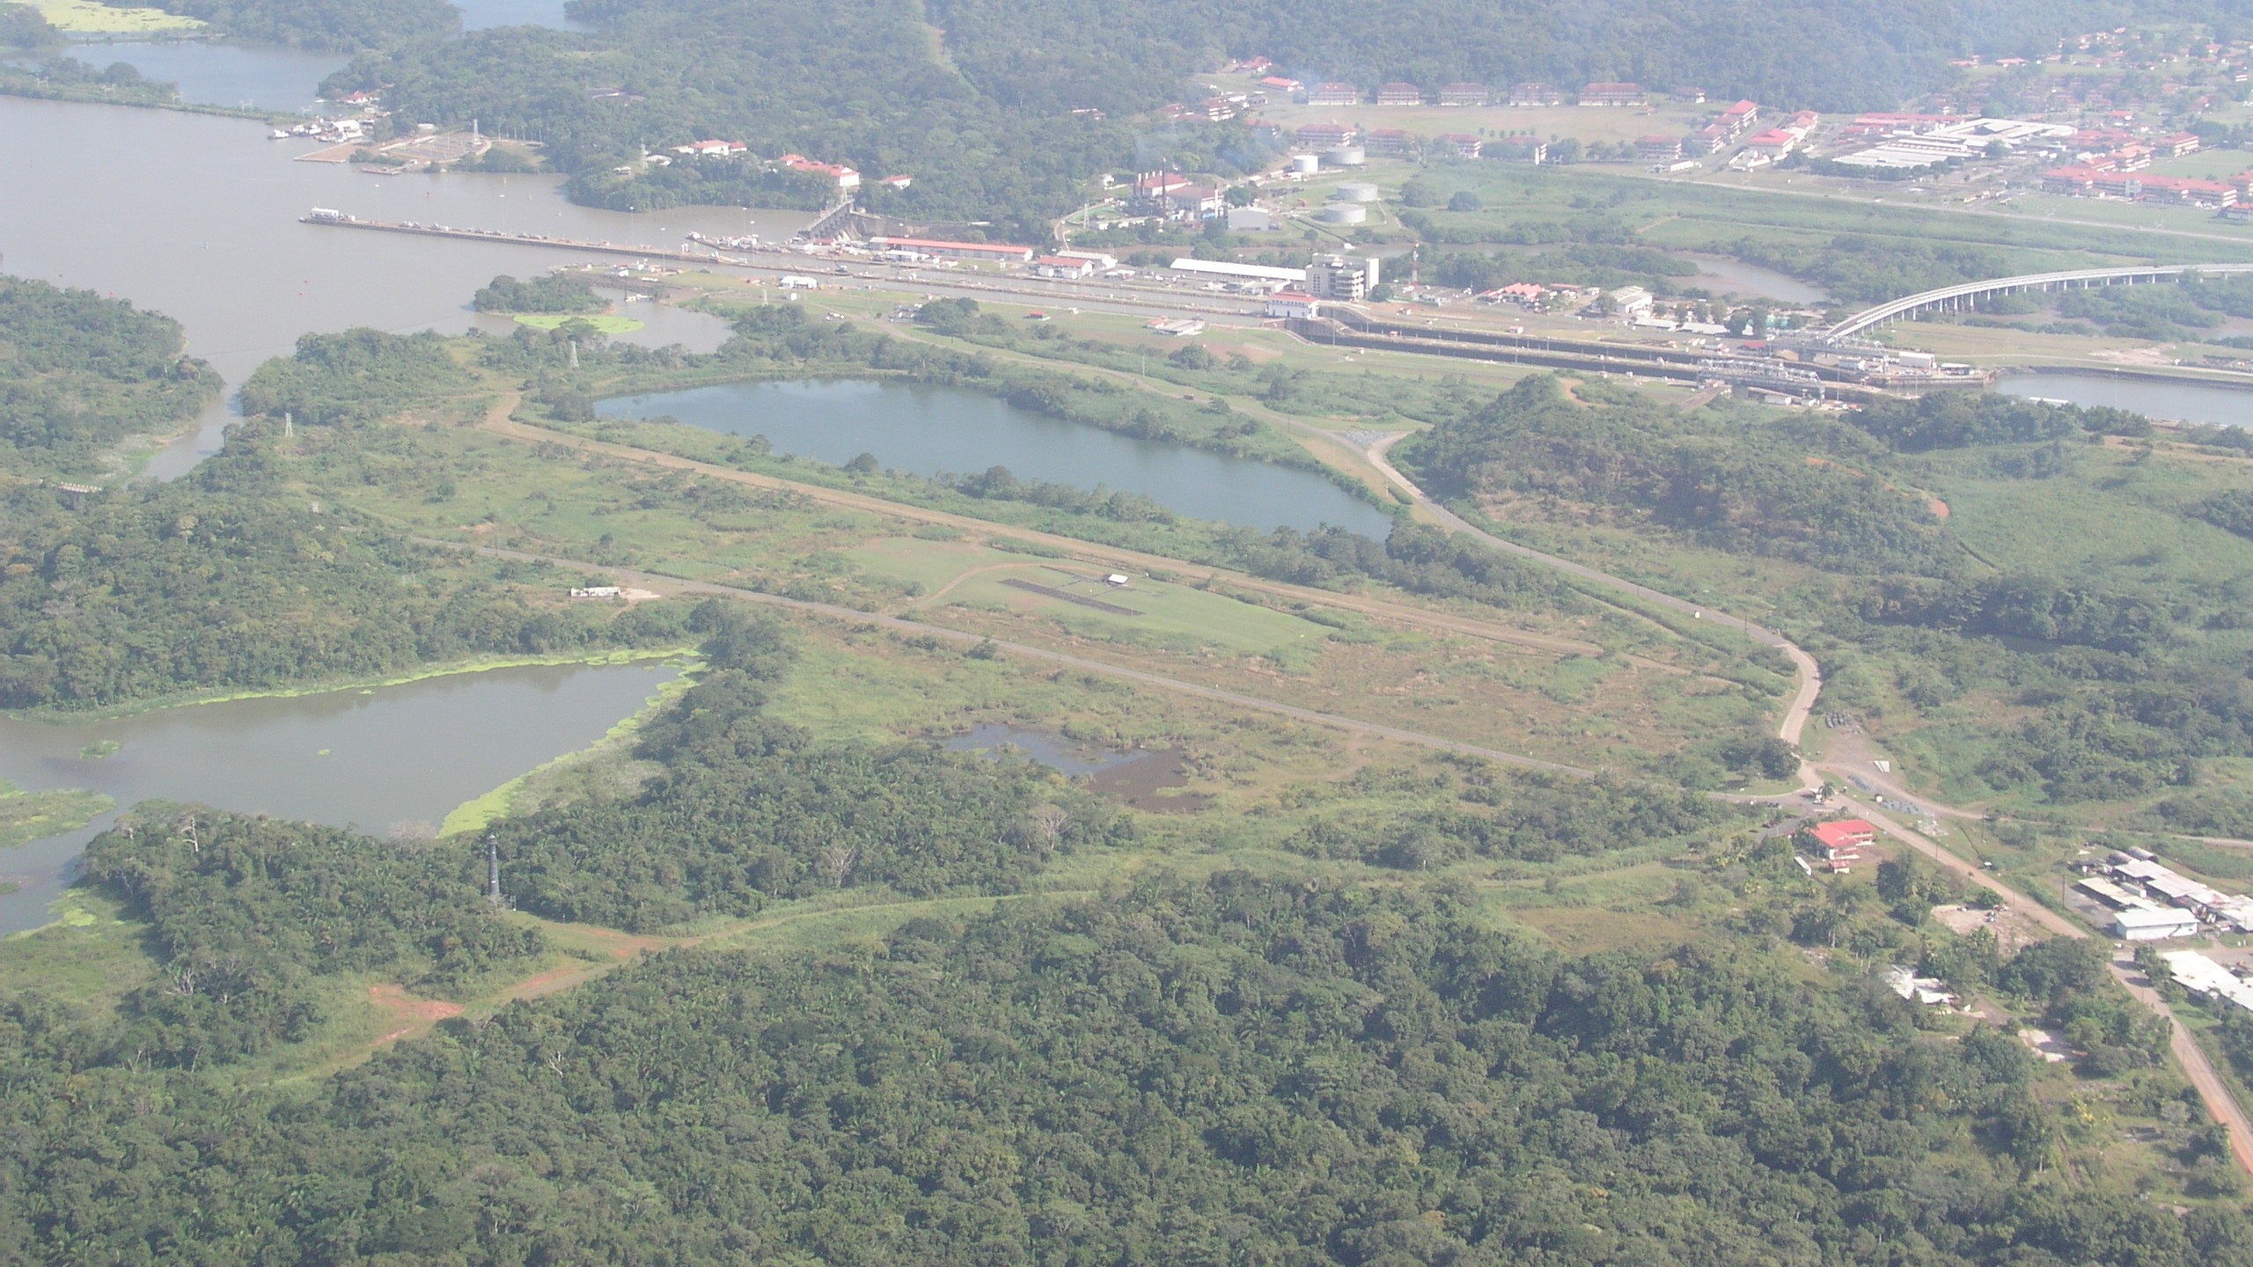
Miraflores Locks
Abandoned excavation for third locks from WWII
Site of Neopanamax Locks

Slide 31
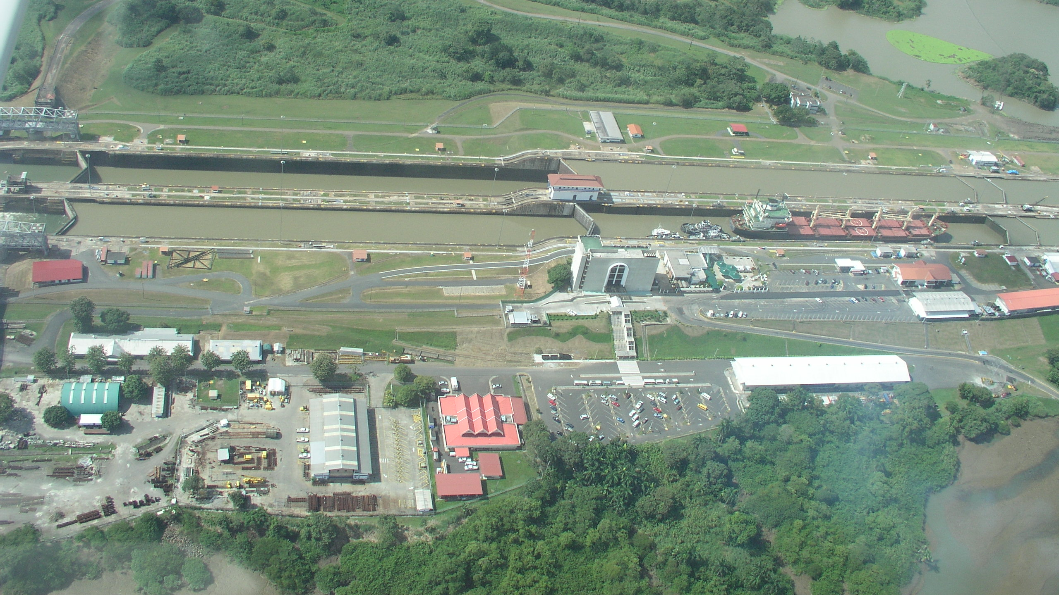
Miraflores Locks and
Panama Canal Museum

Slide 32
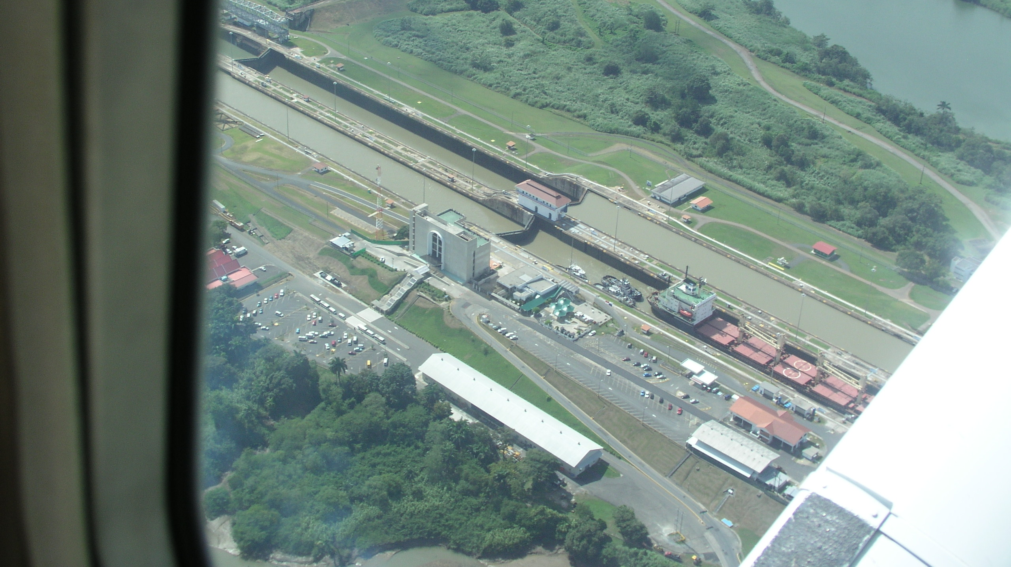
Miraflores Locks and
Panama Canal Museum

Slide 33
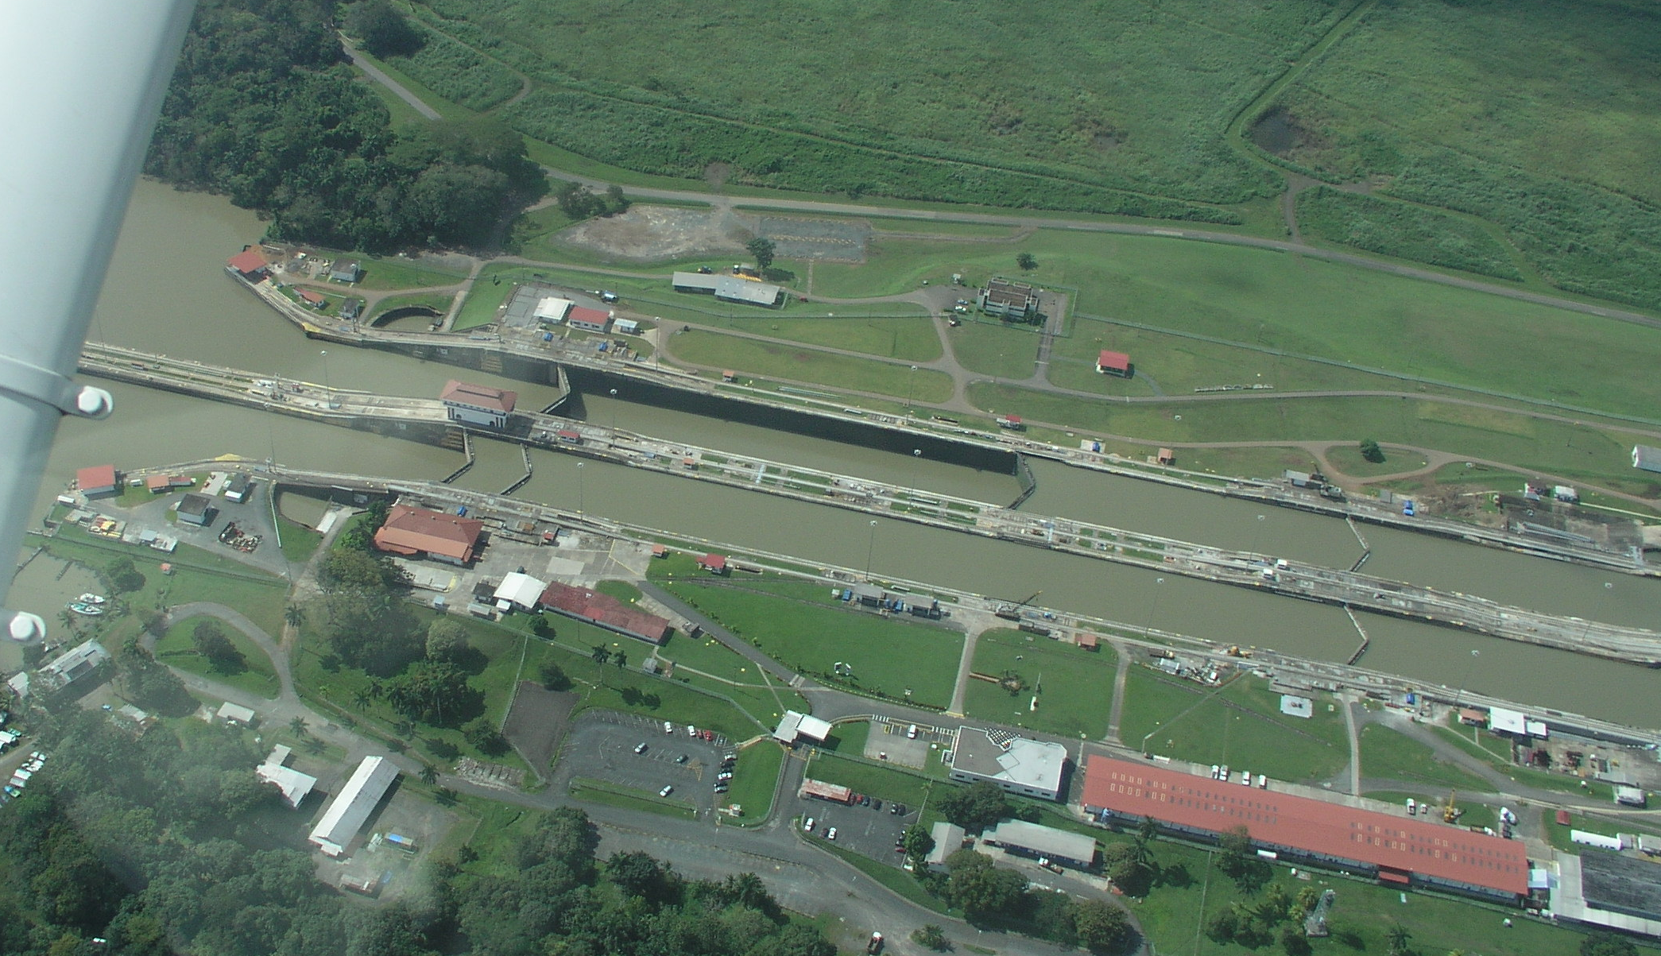
Pedro Miguel Locks

Slide 34

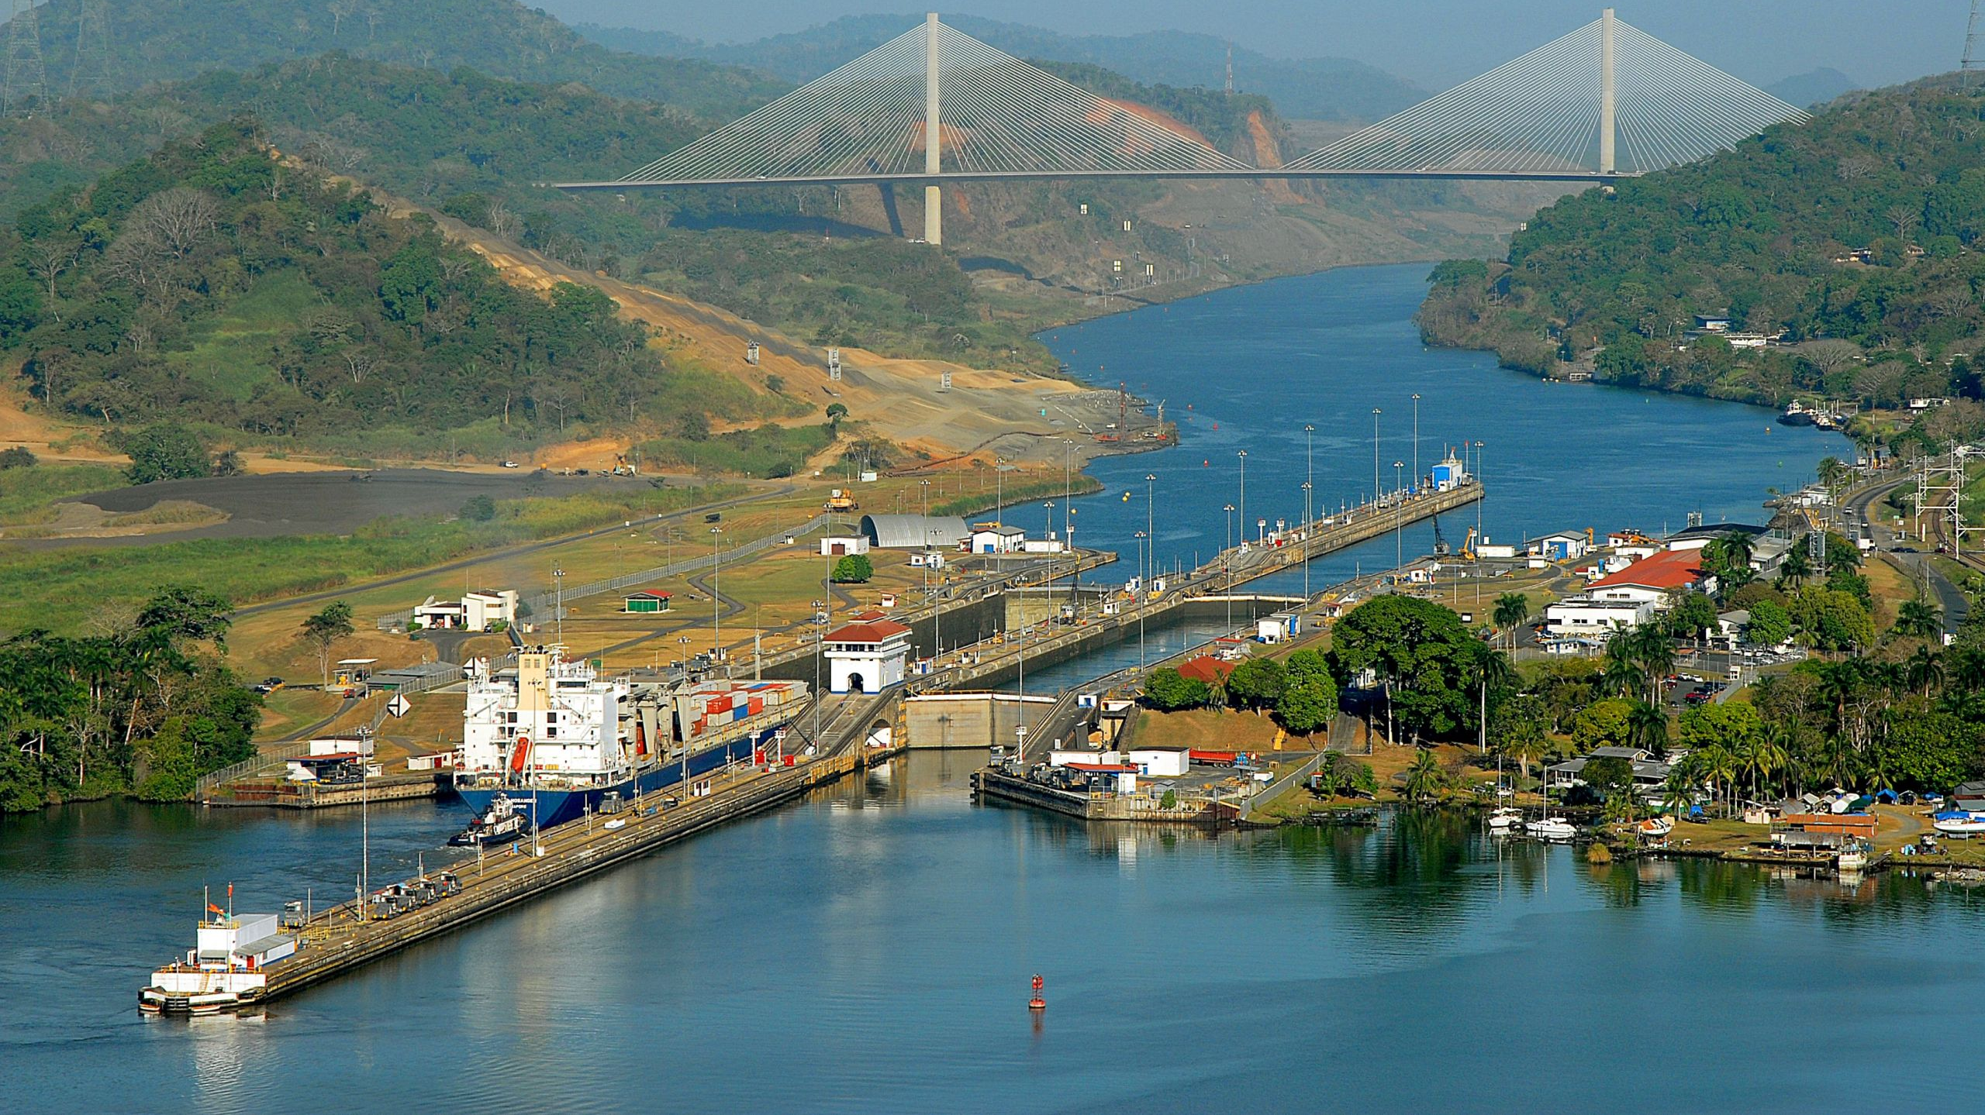

Slide 35
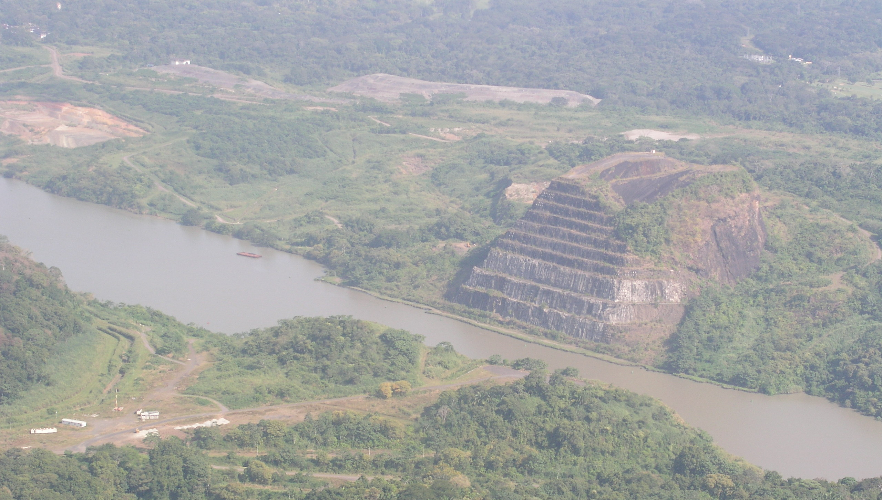
“Gold Hill”
(Deepest excavation along the Culebra Cut)
Notes:
25 Gold Hill in Culebra Cut

Slide 36
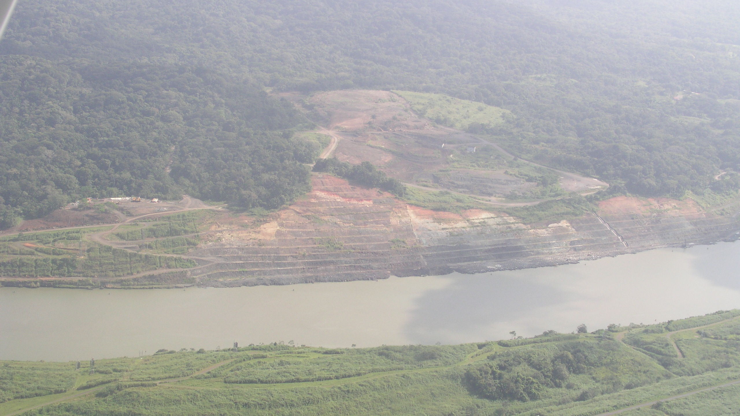
Culebra (Gaillard) Cut
Notes:
23 northern Culebra Cut

Slide 37
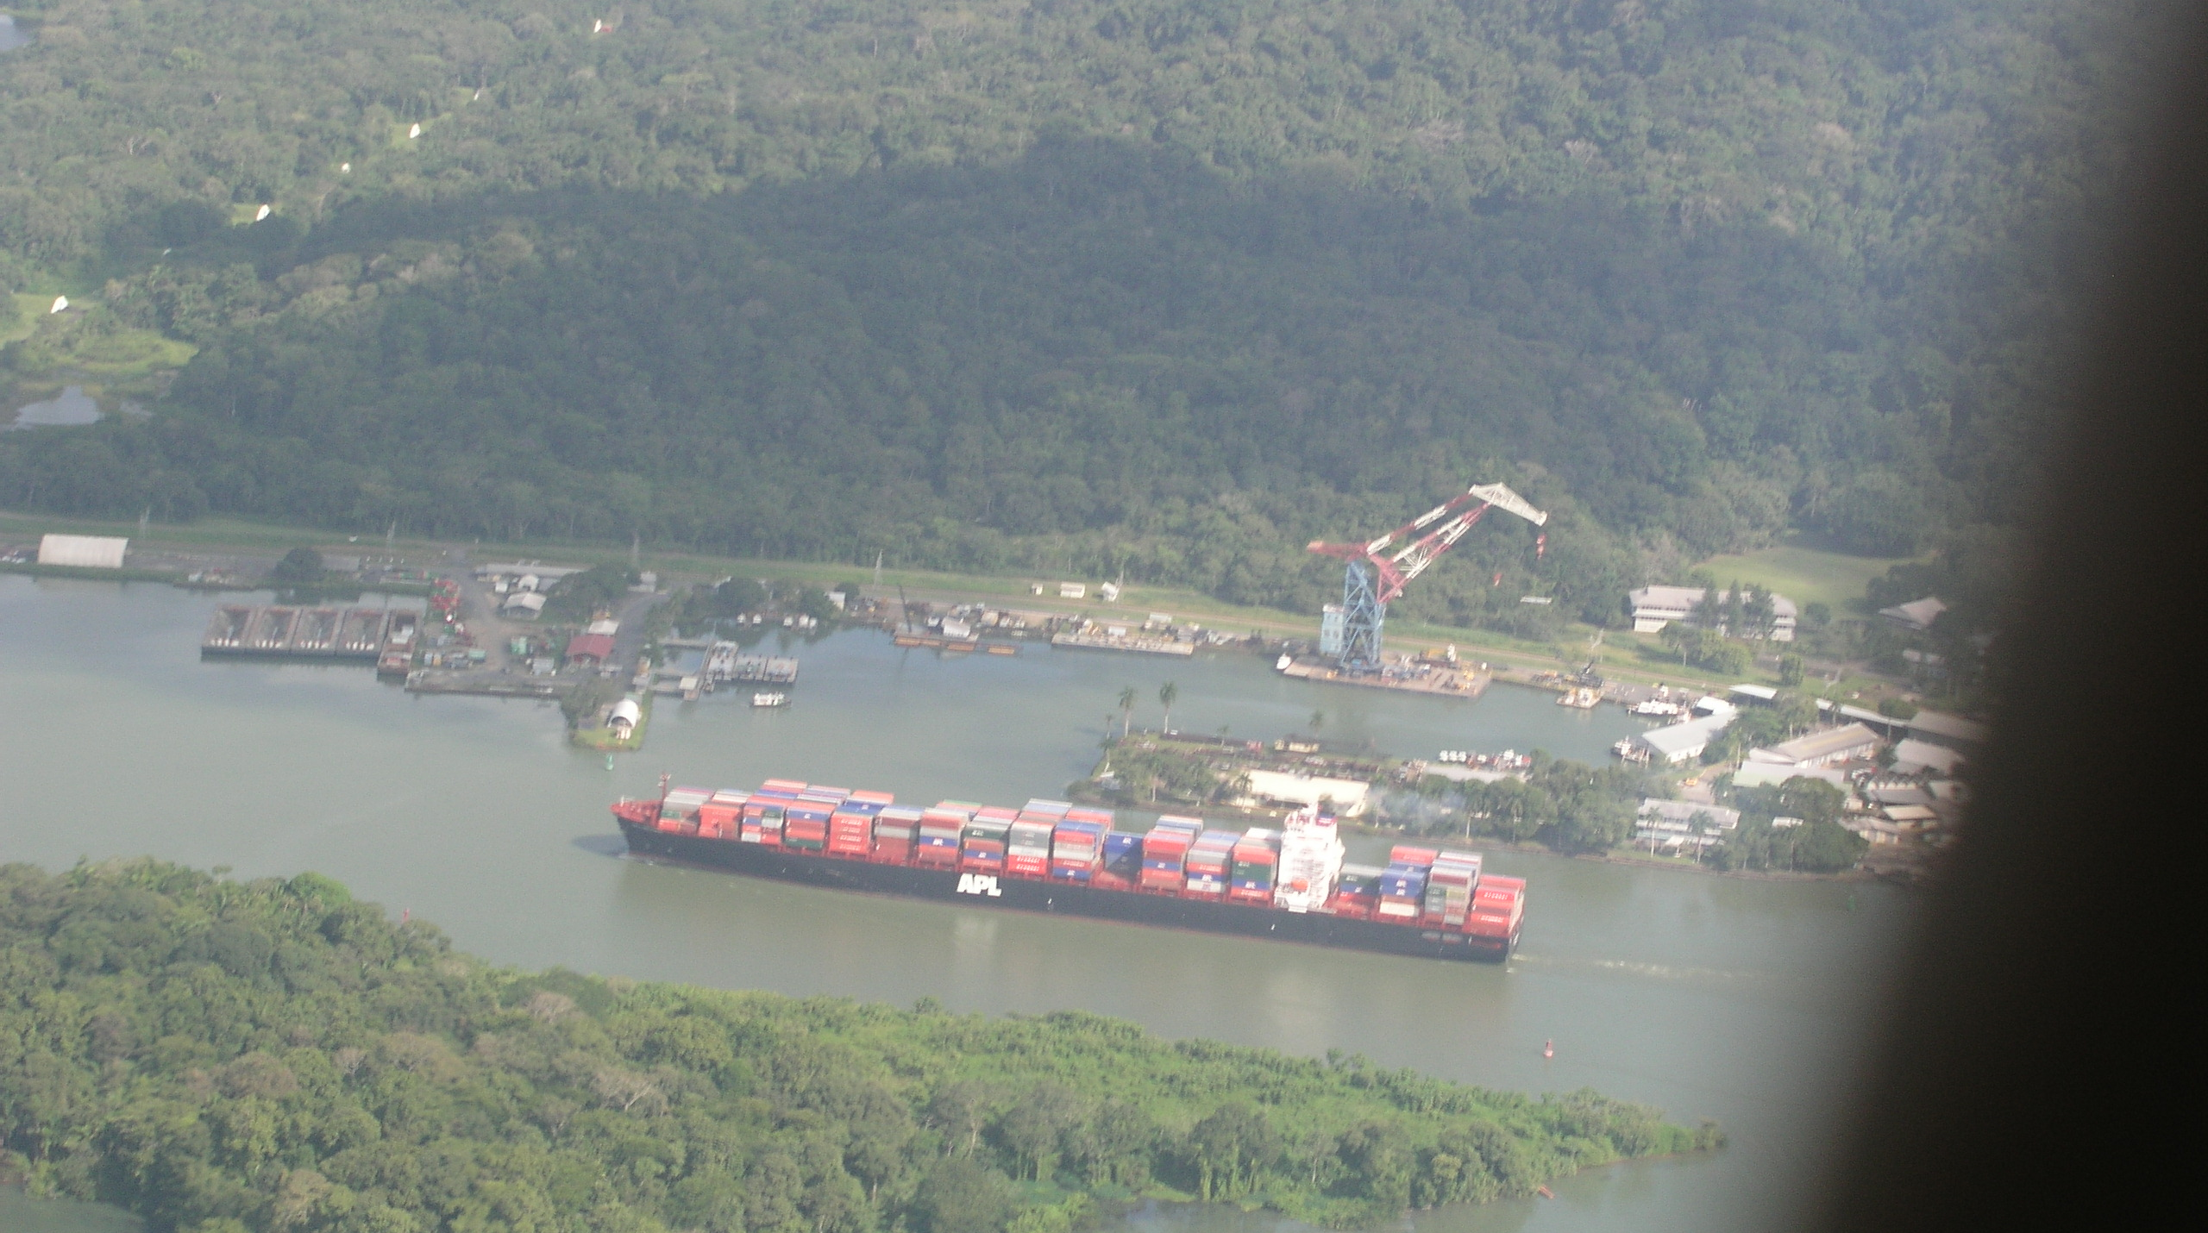
Gamboa,
Lock Maintenance Facility with the Barge-mounted Krupp Crane
Panama Railroad

Slide 38
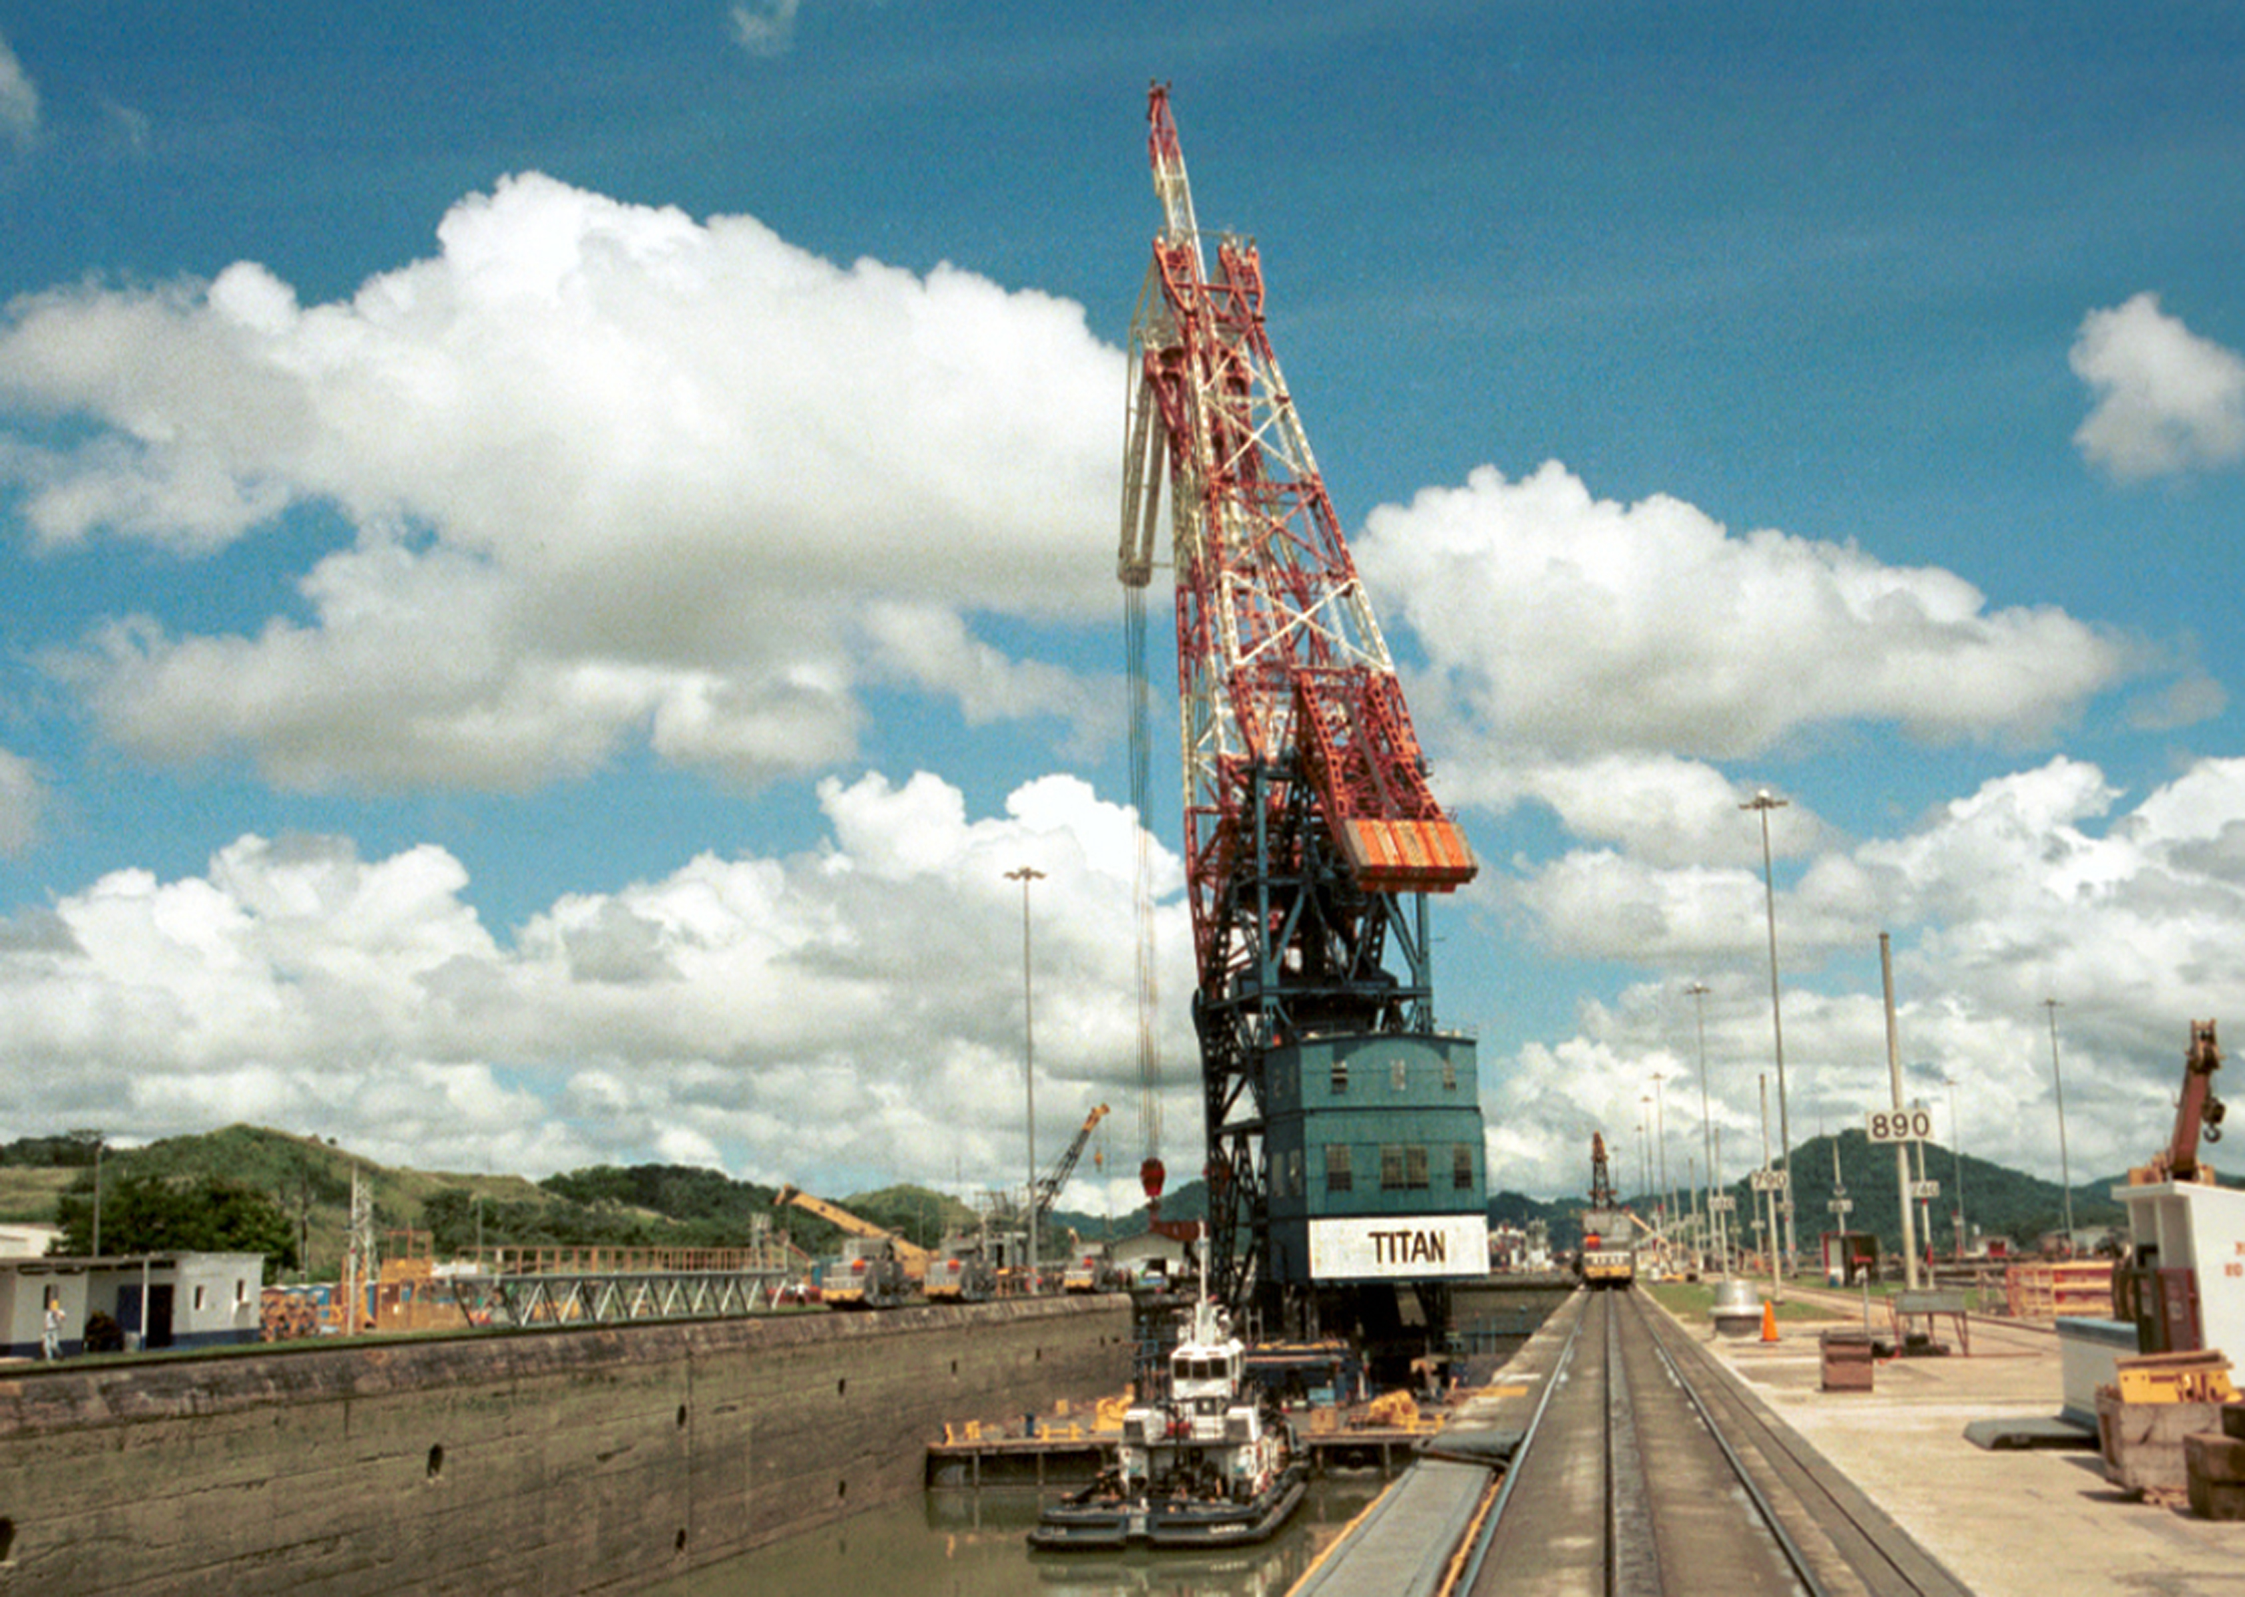

Slide 39
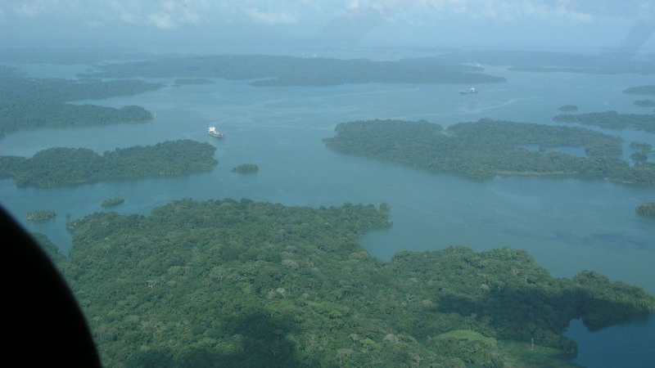
Ships Travel 23 miles across Gatún Lake
Navigation Aid
Notes:
14

Slide 40
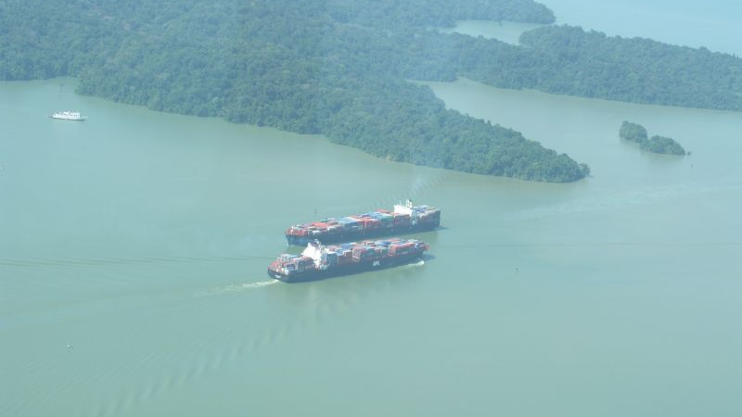
Notes:
26 Gaun Lake

Slide 41
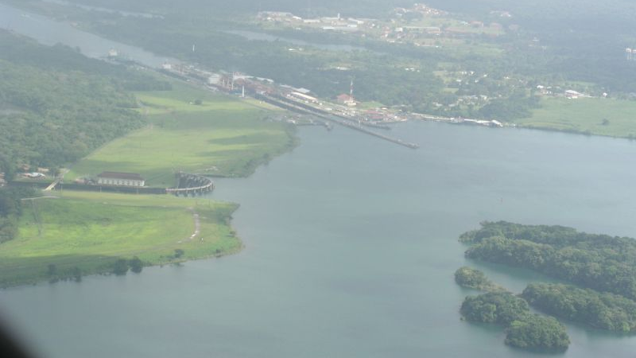
Gatún Locks
Site of New Locks
Gatún Dan and Powerplant
Gatún Lake
Notes:
When the dam was built, it was the largest earth and rock fill dam in the world and Lake Gatun was the largest man-made lake. Gatun Lake is the #2 largest man-made Lake Kariba, located on the border of Zambia and Zimbabwe, by both volume and surface area.

Slide 43
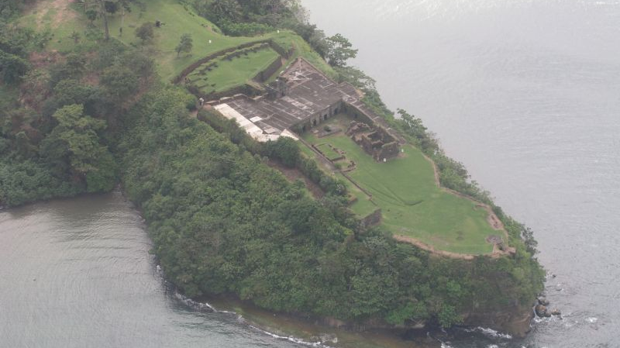
Castillo de San Lorenzo
Chagres River
Caribbean Sea
Notes:
20 San Lorenzo

Slide 44
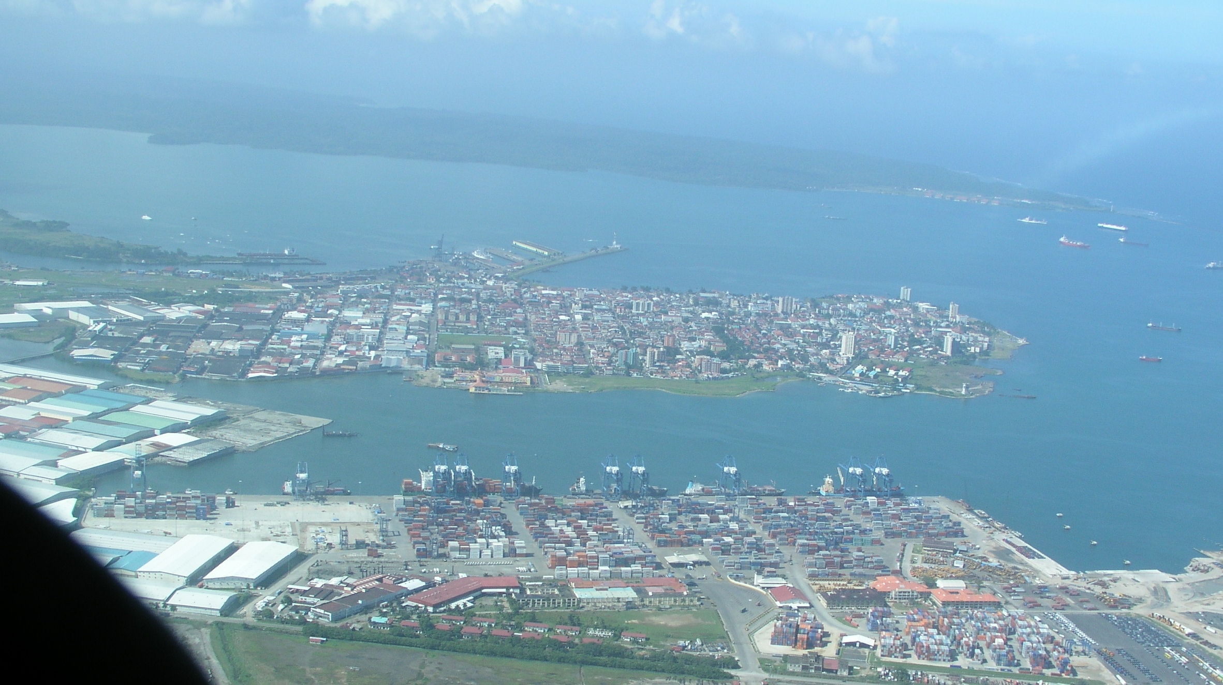
Fort Sherman
Old Navy Base
Cristobal
Limon Bay
Colón
Manzanillo Bay
New Cristobal Container Terminal

Slide 45
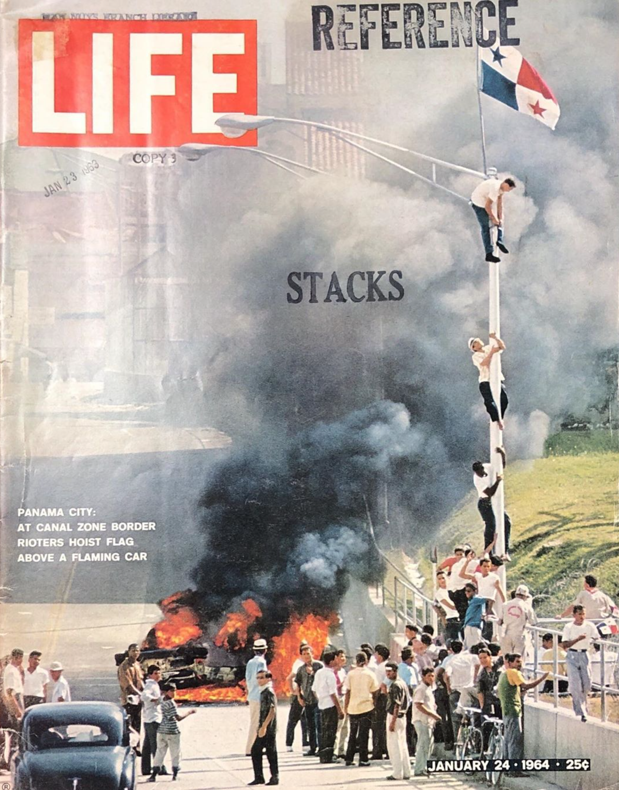
Events Leading to the Handover of the Panama Canal to Panama, 1964 to 1999

Slide 46
Introduction
In 1963, the Panama Canal was managed by the Panama Canal Company and several U.S. agencies
The Panama Canal Company led operations, supported by US Army Corps of Engineers, and several civil, military, and diplomatic agencies
Many of the US citizens living in the Canal Zone had been living there for several generations. They were living in a privileged world in which they had well-paid civil service jobs with subsidized medical care, great schools for their children, and housing.
The US residents living the Canal Zone were known as “Zonians” or “Zonies”. Many considered their lives in Panama like living in a Utopia, wth a high standard of living and security unmatched any where else.

Slide 47
On January 9, 1964,
LBJ’s 48th Day as President
Violence erupted in the Panama Canal Zone after a confrontation between American and Panamanian students over the right to fly an historic Panamanian flag alongside the US flag in the Zone. This escalated into riots, during which 21 Panamanians and 4 U.S. soldiers were killed. The incident sparked a severe diplomatic break, with Panama cutting off diplomatic relations with the United States.

Slide 48
LBJ’s Reactions to the Violence
His Immediate Response was Measured and Diplomatic
  He publicly expressed regret over the loss of lives
  He said there was a need for a peaceful and diplomatic solution
  He ordered the US forces avoid escalating violence and instructed US government officials to avoid inflammatory rhetoric
Diplomatic Actions
  He agreed to send envoys to negotiate with Panamanian leaders
  The US agreed to talks about revising the Panama Canal Treaties, and
  He acknowledged that Panama had legitimate grievances
He set these Strategic Goals for the US government
  To maintain US control of the Canal
  To prevent further diplomatic isolation of the US in Latin America
Notes:
President Johnson's Reaction:
Immediate Response (Measured and Diplomatic):
Although the events began under President John F. Kennedy’s policy framework, it was President Johnson who had to deal with the fallout.
Johnson expressed regret over the loss of life and emphasized the need for a peaceful and diplomatic solution.
He ordered U.S. forces to avoid escalating violence and instructed officials to avoid inflammatory rhetoric.
Diplomatic Action:
Johnson agreed to send envoys to negotiate with Panamanian leaders.
Under his administration, the U.S. eventually agreed to talks about revising the Panama Canal treaties—a significant policy shift.
His administration acknowledged that Panamanians had legitimate grievances, including the symbolic issue of sovereignty over the Canal Zone.
Strategic Goal:
Johnson sought to preserve U.S. control of the canal while preventing further diplomatic isolation in Latin America, where anti-American sentiment was growing.
Long-Term Outcome:
Although new treaties were not signed until President Jimmy Carter's term in the late 1970s (the Torrijos–Carter Treaties of 1977), Johnson’s willingness to open negotiations laid the foundation for the eventual transfer of the Canal to Panama.
Summary:
President Johnson reacted to the January 9, 1964 events with cautious diplomacy, aiming to de-escalate violence, restore relations, and begin a long-term process of negotiation that acknowledged Panamanian sovereignty concerns—marking a shift in U.S. policy toward the Canal Zone.

Slide 49
LBJ’s Personal Reactions as Perceived by the Panamanians
LBJ’s initial reactions were:
He questioned the US attitude of keeping control of the Canal forever
He wanted to transfer control of the Canal to Panama as soon as possible
He wanted to solve the problems with Panama and the Canal now to show the countries in Central and South America that the US could be a good neighbor
Panama informal reactions to LBJ’s initial reactions were:
Panama has no one capable of running or maintaining the Canal
Panama needed time and assistance to train the necessary personnel to run the Canal
Panama recognized that LBJ was the first US President who was open to renegotiating the treaties with Panama

Slide 50
The Long-Term Outcome of Martyrs’ Day
LBJ’s laid the foundation for the eventual transfer of the Canal to Panama.
Re-negotiations started with the US
The Torrijos-Carter Treaties of 1977 were the result
The Canal was officially handed over to the Republic of Panama on December 31, 1999
Notes:
Long-Term Outcome:
Although new treaties were not signed until President Jimmy Carter's term in the late 1970s (the Torrijos–Carter Treaties of 1977), Johnson’s willingness to open negotiations laid the foundation for the eventual transfer of the Canal to Panama.

Slide 51
Timeline
Before 1977:
  There were Panamanians employed by the Panama Canal Company (a U.S. government agency) and the Corps of Engineers, but most were in subordinate roles, and there was no formalized program aimed at preparing them for full operational control of the canal.
1977 – Torrijos–Carter Treaties:
  These treaties, signed on September 7, 1977, outlined the process of gradually transferring control of the Panama Canal to Panama by December 31, 1999.
  The treaties called for a progressive "Panamanianization" of the Canal workforce and administration.

Slide 52
The Treaties were Supported Widely
Military: the Joint Chiefs of Staff, Admiral Elmo Zumwalt, General Maxwell Taylor
Democrats: Seators Robert Byrd, Ernest Hollings, and Hubert Humphrey, AFL-CIO president George Meany
( National Security Advisor Zbigniew Brzezinski attributed much of the political support for the treaty to his assuring attendees at a meeting including Byrd, that the United States would invoke the treaty to overthrow any Panamanian government that shut down the canal); Displomats: Averell Harriman, Dean Rusk, George Ball, Henry Cabot Lodge, and John Sherman Cooper, and former first lady Lady Bird Johnson

Slide 53
Support for the Treaties (con’t.)
Republicans: Senator Howard Baker, President Gerald Ford, Sec. of State Henry Kissinger, William F. Buckley Jr.., and John Wayne
Foreign Leaders:
Barbados Prime Minister Tom Adams,
Bolivian President Hugo Banzer,
Dominican President Joaquín Balaguer,
Guatemalan President Kjell Laugerud, Guyanese Prime Minister Forbes Burnham,
Nicaraguan President Anastasio Somoza,
Peruvian President Francisco Morales Bermúdez,
Chilean President Augusto Pinochet,
Costa Rican President Daniel Oduber, and
Venezuelan President Carlos Andrés Pérez.

Slide 54
Timeline - continued
Late 1970s to 1980s:
  After the treaties, the U.S. Army Corps of Engineers and the Panama Canal Commission (created to replace the Panama Canal Company) began deliberate efforts to hire, train, and promote Panamanians into the technical, managerial, and leadership roles in the Panama Canal Commission.
  The Training and Development Division was expanded, and many Panamanians were sent abroad, mostly to the U.S., for education in engineering, canal operations, and infrastructure maintenance.
1990s:
  By the early 1990s, Panamanians held a majority of the positions, including high-level technical and executive posts.
  The Corps of Engineers had largely transitioned out of operational roles by the late 1990s while the Panama Canal Authority (Autoridad del Canal de Panamá)—a Panamanian entity—prepared to take full control.

Slide 55
Terms of the Torrijos-Carter Treaties of 1977
Transits through the Canal were open to ALL NATIONS
Set the Date of the Handover of the Panama Canal to December 31, 1999
Established a training program that was targeted to train the future leadership of the Canal
Notes:
Timeline:
Before 1977:
There were Panamanians employed by the Panama Canal Company (a U.S. government agency) and the Corps of Engineers, but most were in subordinate roles, and there was no formalized program aimed at preparing them for full operational control of the canal.
1977 – Torrijos–Carter Treaties:
These treaties, signed on September 7, 1977, outlined the process of gradually transferring control of the Panama Canal to Panama by December 31, 1999.
The treaties called for a progressive "Panamanianization" of the Canal workforce and administration.
Late 1970s to 1980s:
After the treaties, the U.S. Army Corps of Engineers and the Panama Canal Commission (created to replace the Panama Canal Company) began deliberate efforts to hire, train, and promote Panamanians into technical, managerial, and leadership roles.
The Training and Development Division was expanded, and many Panamanians were sent abroad, including to the U.S., for education in engineering, canal operations, and infrastructure maintenance.
1990s:
By the early 1990s, Panamanians held a majority of the positions, including high-level technical and executive posts.
The Corps of Engineers had largely transitioned out of operational roles by the late 1990s while the Panama Canal Authority (Autoridad del Canal de Panamá)—a Panamanian entity—prepared to take full control.
Summary:
The U.S. Army Corps of Engineers began formally hiring and training Panamanians in earnest after the 1977 Torrijos–Carter Treaties, with the process ramping up through the 1980s and 1990s to ensure a smooth transition to Panamanian control by 1999.
Prior to 1977, while Panamanians worked in the Canal Zone, there was no strategic training program geared to preparing for a full transfer of authority in 1999

Slide 56
Thank you for coming tonight
Questions?

