Slide 1
A History of the Founding of Panama and Construction of the Canal

Slide 2
Construction of the Panama Canal
The United States made their first diplomatic effort to gain permission to take over the building of the Canal from Colombia during the McKinley Administration
The Republic of Panamá was created on December 1903 with the support of the USA during the first Roosevelt administration
The US constructed the canal from 1904 to 1914
Teddy Roosevelt visited Panamá during the rainy season in 1912, but never saw the completed canal or ever returned Panamá
End of Section 3

Slide 3
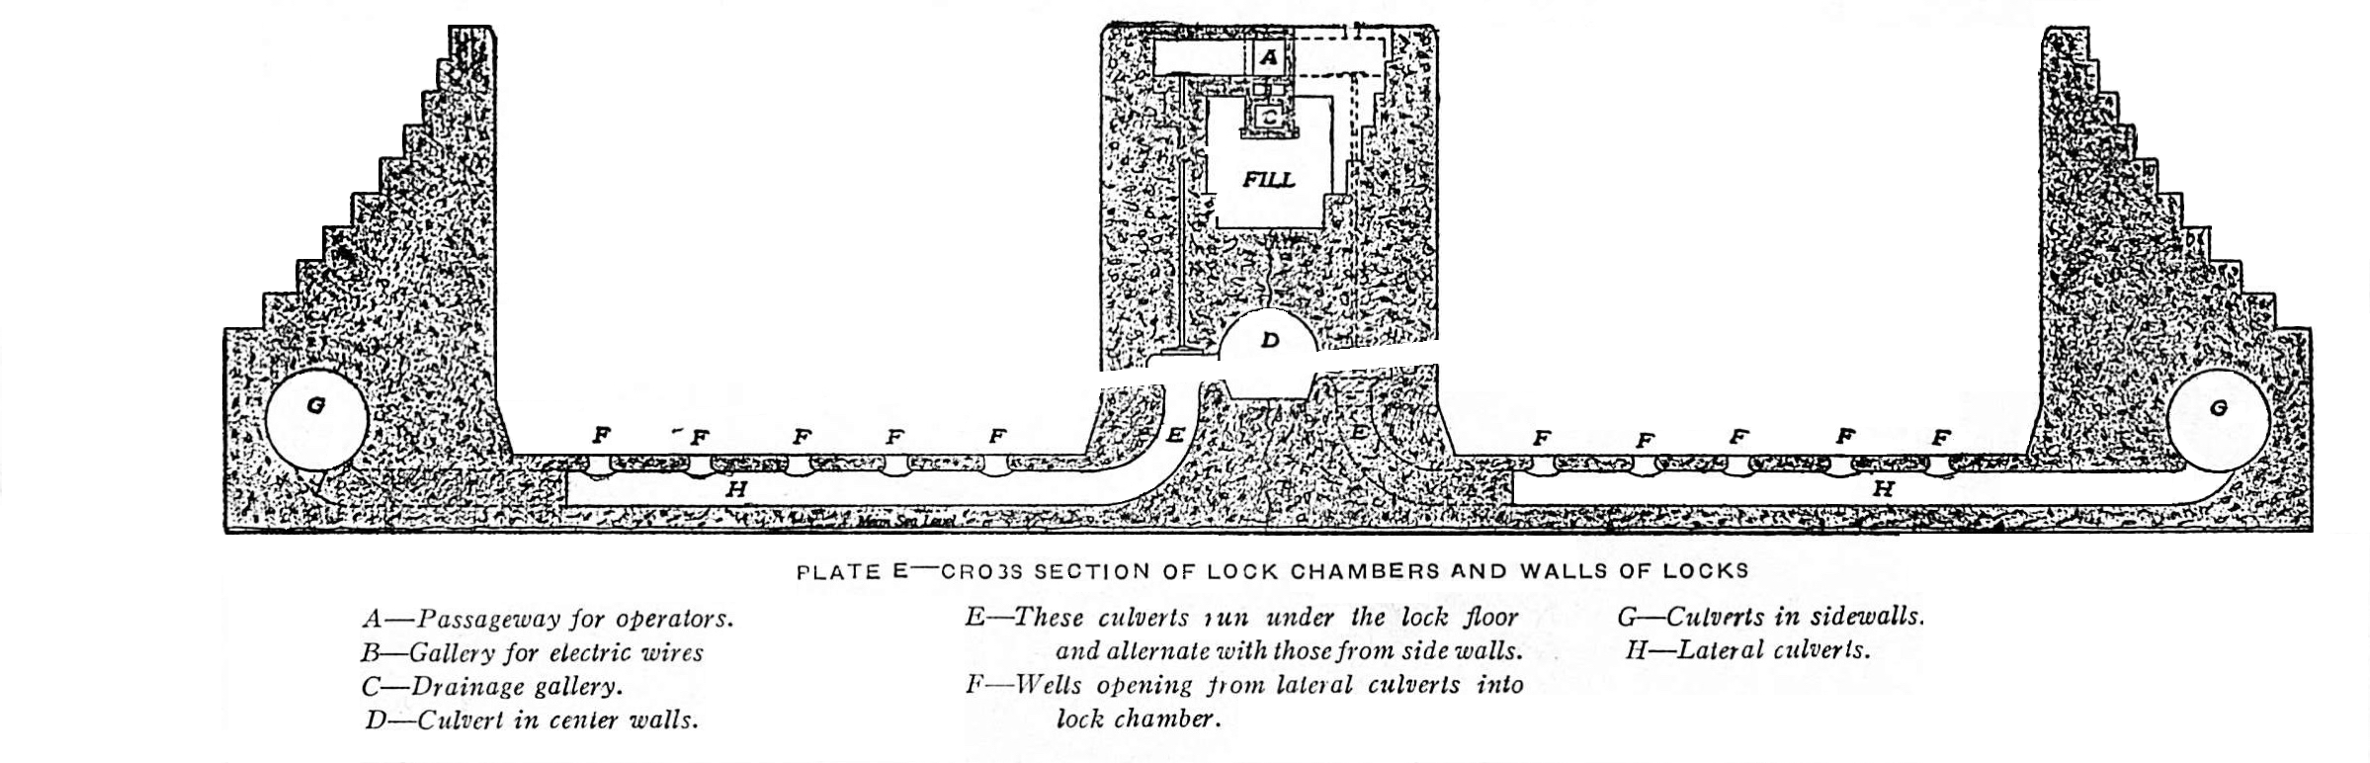
A Profile Drawing of a Lock Showing the Culverts and Wells
110 ft
78 ft
CROSS-SECTION OF LOCK CHAMBERS AND WALLS
A - Passageway for Operators E – These culverts run under the lock floor G – Culverts in sidewalls
B – Gallery for electric wires and alternate with those from side walls H – Lateral Culverts
C - Drainage Gallery F – Wells opening from lateral culverts into
D - Culvert in center walls lock chamber

Slide 4
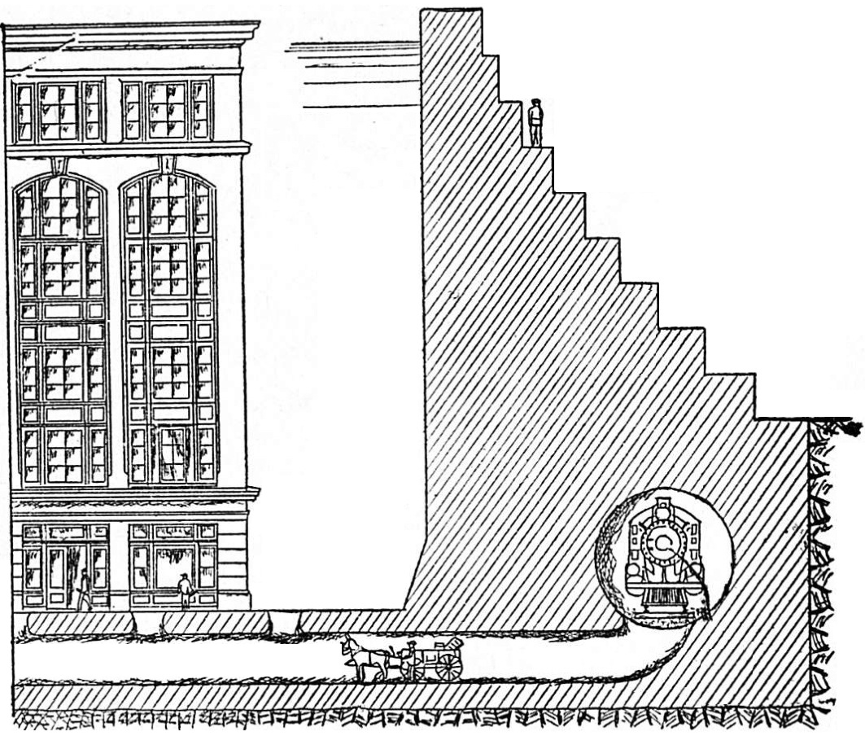
The Depth of a Lock Chamber equals the Height of 6-Story Building and the Lateral Culverts are as large as a Train Locomotive
78 ft
SIDE WALL OF LOCKS COMPARED WITH SIX-STORY BUILDING

Slide 5
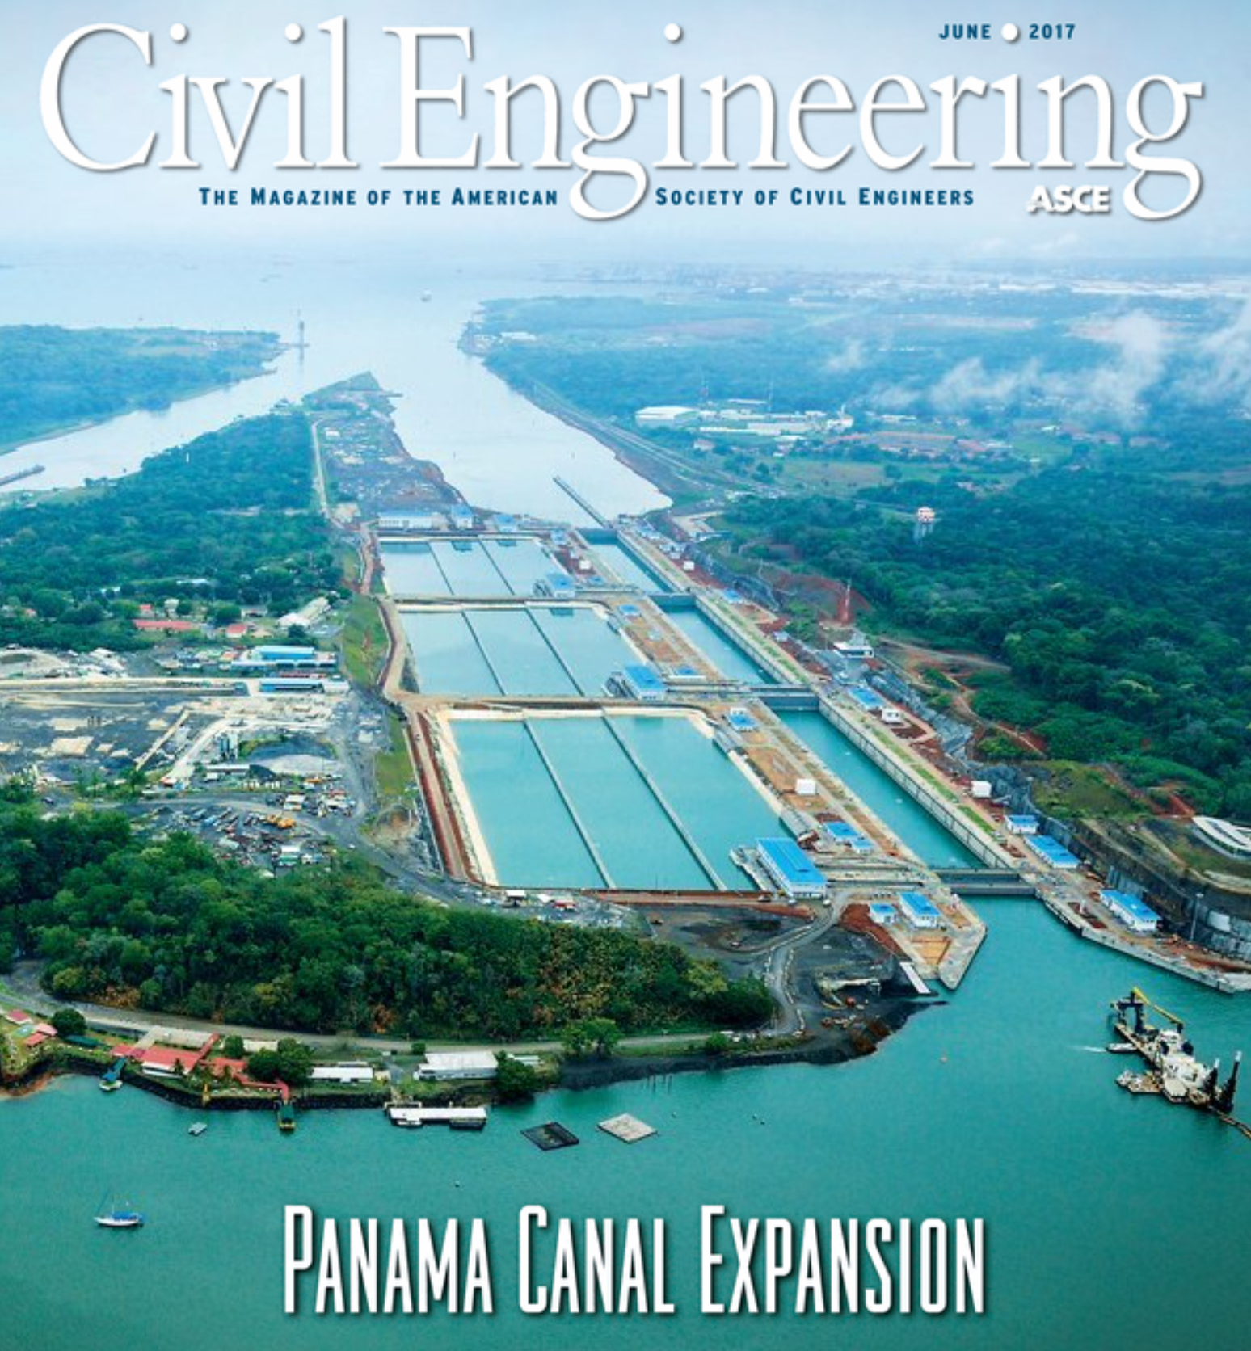

Slide 6
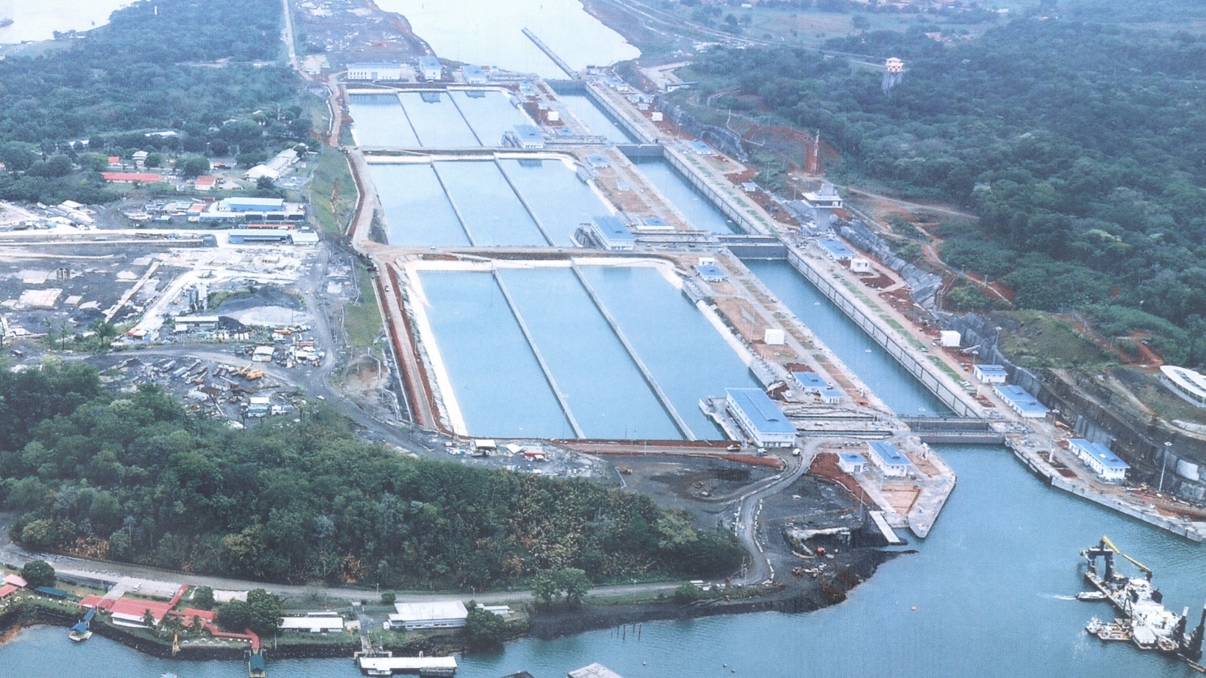

Slide 7
Bridge of the Americas (Puente de las Américas)
Minimum Clearance | 201 | ft |  | 61.28 |  | m
Total length | 5425 | ft |  | 1,654 |  | m
Main Span | 1128 | ft |  | 344 |  | m
High Point | 384 | ft |  | 117 |  | m
Centennial Bridge
Minimum Clearance | 262 | ft |  | 80 |  | m
Total length | 3,451 | ft |  | 1,052 |  | m
Main Span | 1,378 | ft |  | 420 |  | m
High Point | 604 | ft |  | 184 |  | m
Atlantic Bridge (Puente Atlántico)
Minimum Clearance | 246 | ft |  | 75 |  | m
Total length | 9,250 | ft |  | 2,820 |  | m
Main Span | 1,738 | ft |  | 530 |  | m
High Point | 697 | ft |  | 213 |  | m
Fourth Bridge (under construction)
Minimum Clearance | 246 |  | ft |  | 75 | m
Total length | 6,888 |  | ft |  | 2,100 | m
Main Span | 1,591 |  | ft |  | 485 | m

Slide 8
Panama Canal Company
U.S. government-owned corporation (est. 1950)
Operated and maintained the canal
Headquartered in Balboa Heights, near Panama City and the Pacific Ocean
President of the Company was also the Governor of Canal Zone

Slide 9
Duties of the Canal Zone Government
Civil administration of the Canal Zone
Provided police, schools, health services, and civilian courts
Independent from the Company, but operationally linked

Slide 10
Department of the Army
Oversight through the Secretary of the Army
Supported infrastructure and construction
Engineering support via U.S. Army Corps of Engineers
Waterway Experiment Station
Geotechnical Laboratory for field and laboratory testing of soils, slope stability analysis
Information Technology Laboratory for 3-D Finite Element Stress and Fracture Analysis

Slide 11
Background of the Incident of January 9, 1964
January 9th of 1964 is now known as 'Martyrs’ Day’ and is a national holiday in Panama
The conflict began a group of unarmed Panamanian college students tried to fly the Panamanian flag alongside the US flag at Balboa High School in the Canal Zone
The Canal Zone Police were on high alert in the Canal Zone due to the Cuban Missile Crisis in October 16-28, 1962 and the assassination of President Kennedy on November 22, 1963
A major riot started after an historic Panamanian flag was torn down by some Balboa HS students, In the riot, Panamanian college students were killed during the subsequent conflict with Canal Zone Police and Canal Zone residents
The student protest escalated into major riots by over 5,000 Panamanians in the Canal Zone and all over Panama after the initial confrontation, resulting in 21 Panamanians and 4 U.S. soldiers killed.
Panama severed diplomatic relations with the United States.

Slide 12
President Johnson’s Immediate Reaction
Expressed regret over loss of life and called for restraint.
Ordered U.S. forces to avoid escalation.
Directed U.S. officials to avoid inflammatory rhetoric.
Emphasized the need for diplomatic engagement.

Slide 13
Diplomatic Actions
Dispatched envoys to open talks with Panama.
Agreed to discussions about revising the Panama Canal treaties.
Acknowledged that Panamanians had legitimate grievances over sovereignty issues.
Worked to prevent further isolation of the U.S. in Latin America.

Slide 14
Long-Term Significance
President Johnson’s response:
marked a shift in US policy toward recognizing Panamanian sovereignty concerns.
opened the door for eventual renegotiation of canal treaties.
set a precedent for peaceful resolution of sovereignty disputes.
paved the way for later agreements under Presidents Carter and Torrijos.

Slide 15
In Summary
President Johnson reacted with caution, diplomacy, and strategic foresight.
Avoided escalating the crisis militarily.
Initiated dialogue that reshaped U.S.–Panama relations.
His actions laid groundwork for the eventual 1977 Torrijos–Carter Treaties.

Slide 17
Section 5 Construction of the Neopanamax Locks

Slide 18
Height Above Waterline Restrictions
In all cases, the height restriction is 190 feet (58 meters) for the height in salt water at high tide at the Bridge of the Americas
If the Bridge of the Americas is taken down, the height restriction will increase to 246 feet (75 meters) for the other three bridges over the Canal
The ships most likely to have access limited by their height are cruise ships constructed with aluminum hulls. This type of construction is becoming more common because more cabins can have balconies, which demand a price premium
Aluminum-hulled cruise ships are also more likely to suffer hull damage due to hitting obstructions or guide walls in high winds

Slide 19


Volume Ratio of Water Lost
$$\frac{Vlost}{VLock}=1−\frac{N}{1+N+\left({AL}/{AB}\right)}$$
If A_{B} = A_{L} and N = 3
$$\frac{Vlost}{VLock}=1−\frac{3}{1+3+1}=0.4$$

Slide 20
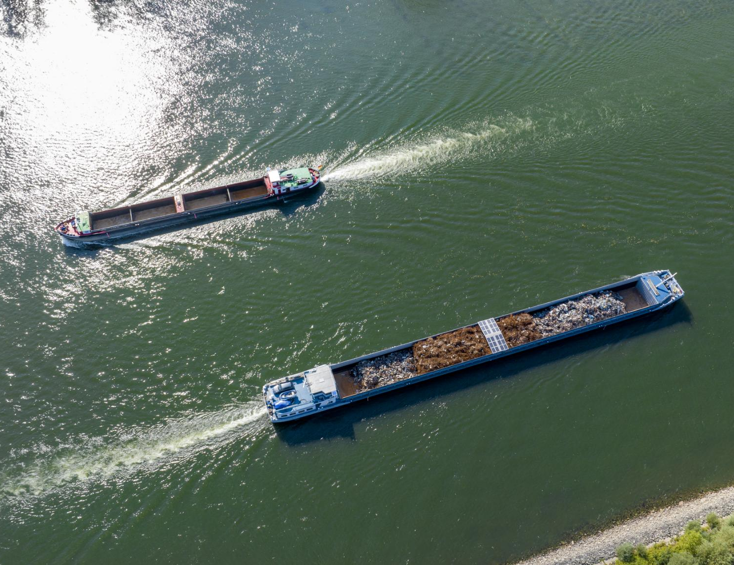
The Panama Canal – the World’s Gateway Between the Atlantic and Pacific Oceans
Connecting Two Oceans
The Panama Canal links the Atlantic and Pacific Oceans, enabling efficient global maritime transportation and trade.
Engineering Marvel
Completed in 1914, the canal stands as a testament to human ingenuity and engineering achievement.
Economic and Strategic Importance
The canal is a crucial route for international shipping, significantly reducing travel time and boosting global commerce.
Notes:
Image source: Microsoft 365 content library The Panama Canal is a vital waterway connecting the Atlantic and Pacific Oceans, drastically reducing shipping times for global trade. Completed in 1914, it stands as a remarkable feat of engineering. The canal has significant economic and strategic importance, serving as a key route for maritime transportation worldwide.

Slide 21
Section 6 Recent Problems and Plans for the Future

Slide 22
Water Lost per Ship – Neopanamax Wins!
15,340.000 cubic feet of water is released into the oceans for every Panamax-size ship that passes through the old locks of the Panama Canal
The Neopanamax-size ships can carry approximately 2.7 times as much cargo as the Panamax-sized ships
The design of the Neopanamax-size locks have three water saving basins per lock chamber that can save 60% of the normal volume of water lost
The Neopanamax locks are so efficient that a Neopanamax sized ship passing through the canal will use 25% less water per canal transit than the Panamax-sized ships use and 72% less water per TEU carried through the canal

Slide 23
Volume of Water Lost Per Ship Transit and Per TEU
180 ft
Neopanamax Locks
= 42,840,000 ft³ w/o water saving
= 17,136,000 ft³ with water saving
= 11,480,000 ft³ with (w/ship)
= 75% of Panamax locks
= 894 ft³/TEU (28%)
110 ft
170 ft
1,400 ft
170 ft
1,000 ft
Panamax Locks
= 18,700,000 ft³ (if empty)
= 15,340,000 ft³ (w/ship)
= 3,210 ft³/TEU

Slide 24
Future Plans
Addition of Two More Container Terminals
Improvements to the Panama Railroad
Addition of Tanker Terminals on Both Coasts and Pipelines to connect them
End of Section 6

Slide 25
How the Panama Canal Works
(103) How Does the Panama Canal Work? - YouTube

Slide 26
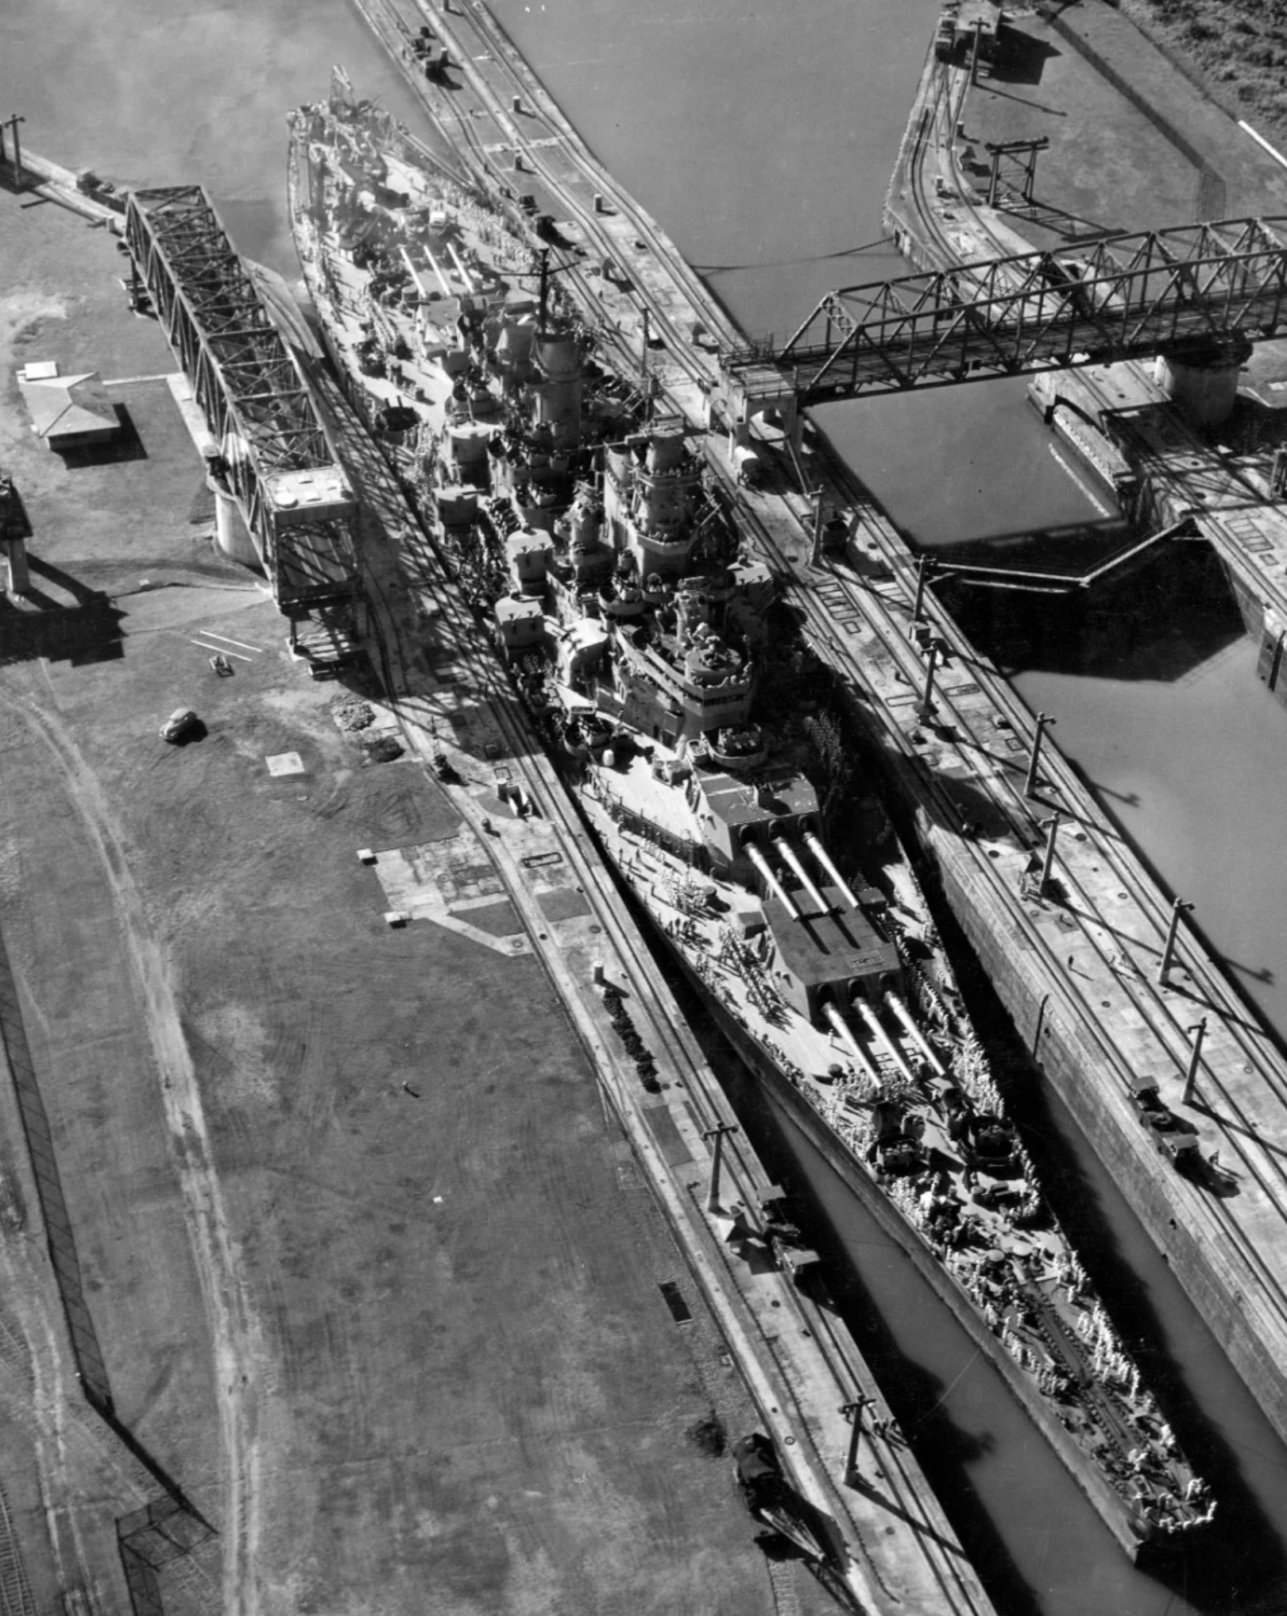
USS Missouri transiting the Miraflores Locks in World War II Nimitz Class Aircraft Carriers can transit the Neopanamax Locks, but cannot pass under the Bridge of the Americas

Slide 28
Operation of New Neopanamax Locks Transiting Downstream
SAVED
SAVED
SAVED

Slide 29
Neopanamax Lock Chamber
VT
VM
VB

Slide 30
Transiting Upstream

Slide 31
Transiting Downstream
Saved
Saved
Top elevation of water saved in basin cannot be higher than the minimum water elevation in a lock
Saved
LOST
LOST

Slide 32
Transiting Upstream
LOST
LOST
Refilled
Bottom elevation of water in lock cannot be higher than the bottom water elevation of basin
Saved
Refilled
Saved
Refilled
Saved

Slide 33
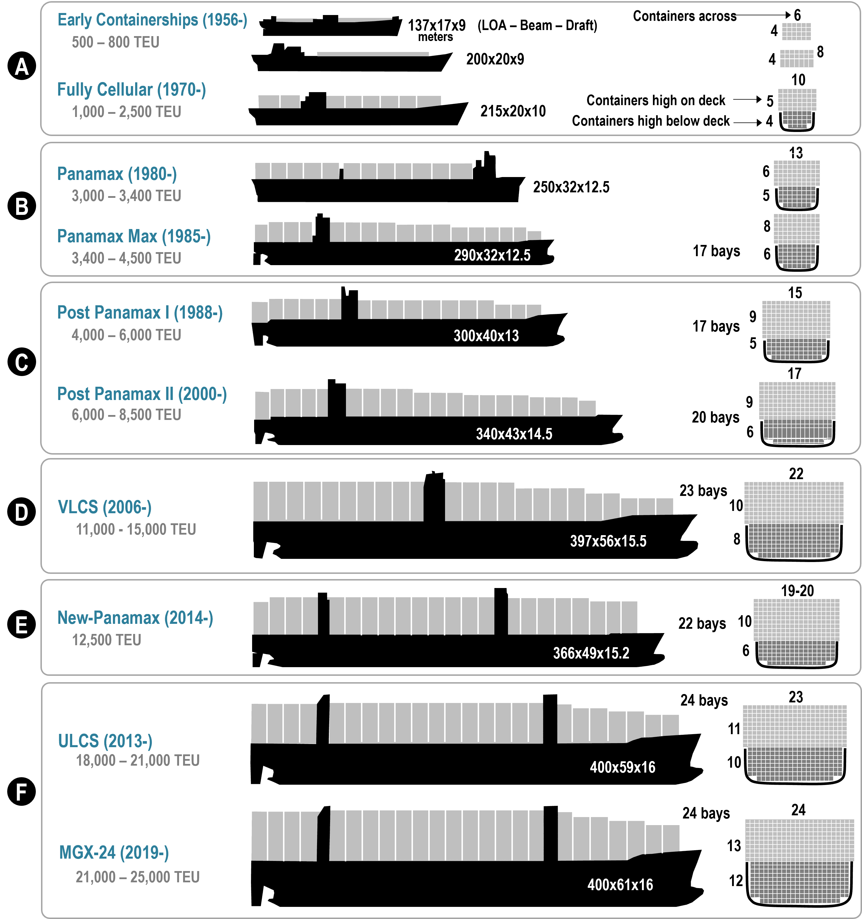
Sizes of Cargo Vessels, 1956 to 2019
820'x105'x41’
950'x105'x41’
984'x131'x42.6’
820'x105'x41’
950'x105'x41’
984'x131'x42.6’
1,115'x141'x47.6’
MV Dali

Slide 34
1,300'x184'x50.84'
1,200'x161'x50'
1,312'x194'x52.5’
1,312’x200'x52.5’

Slide 36
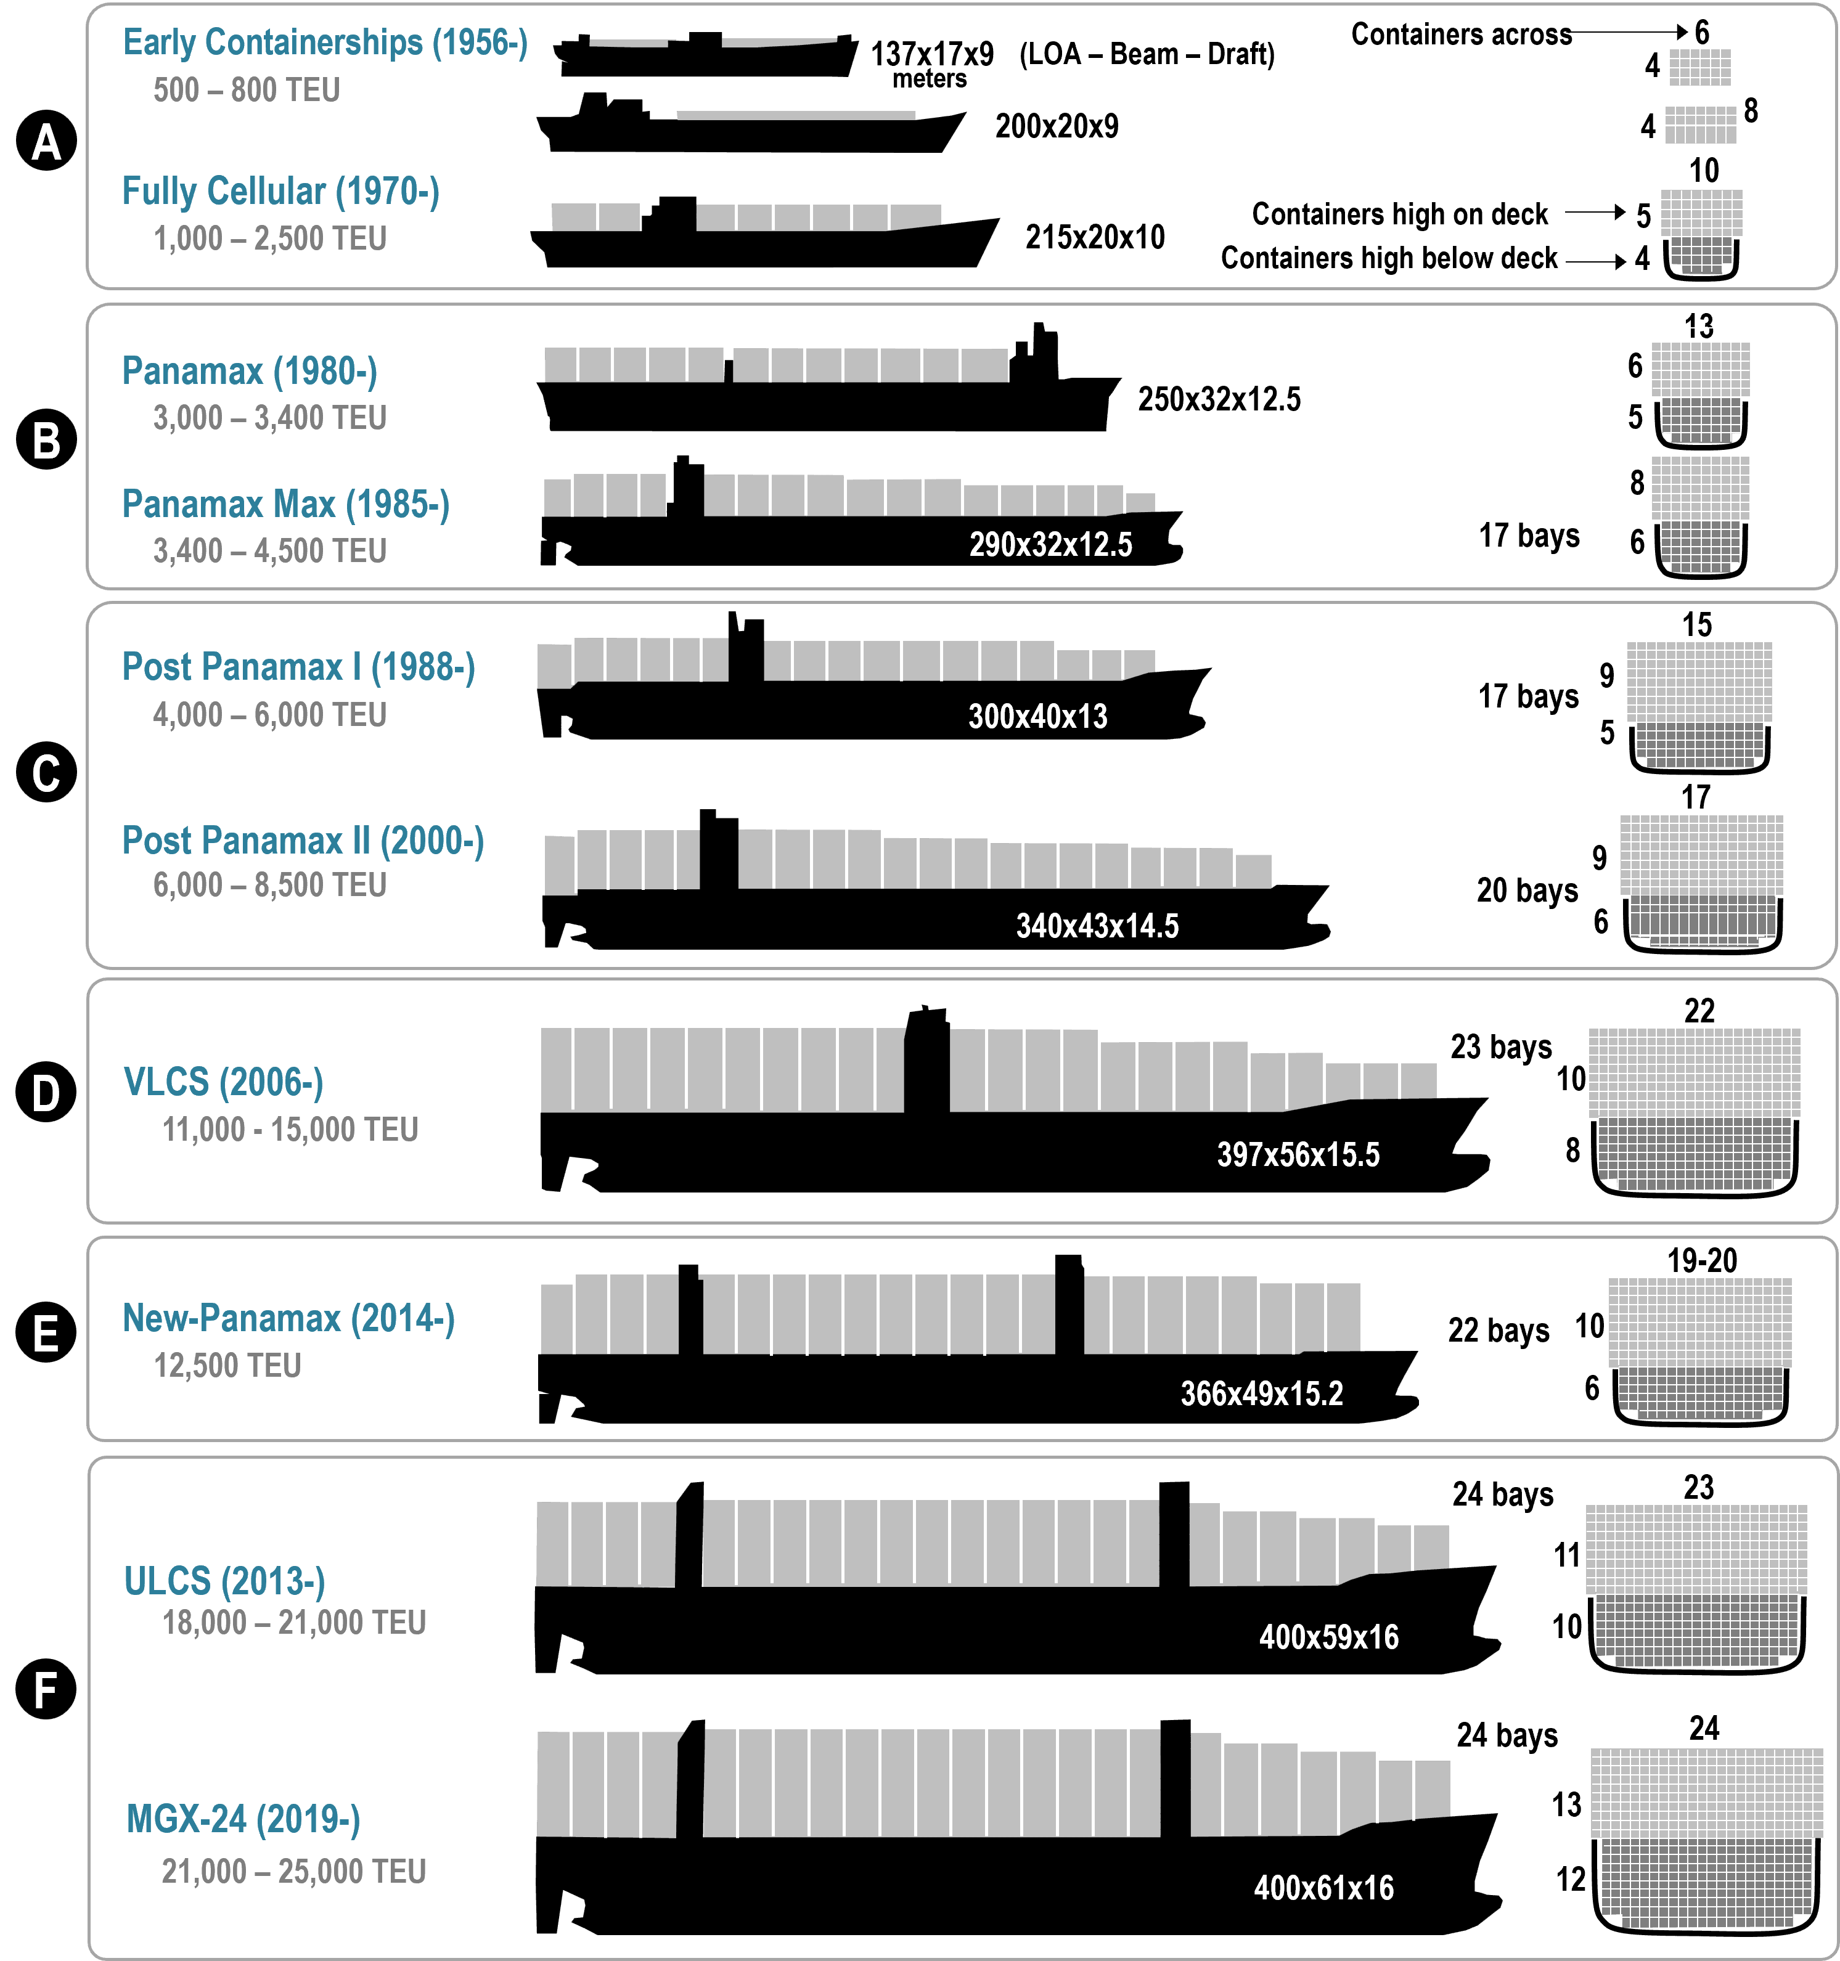

Slide 38
USS Missouri transiting the Miraflores Locks in World War II Nimitz Class Aircraft Carriers can transit the Neopanamax Locks, but cannot pass under the Bridge of the Americas

Slide 39
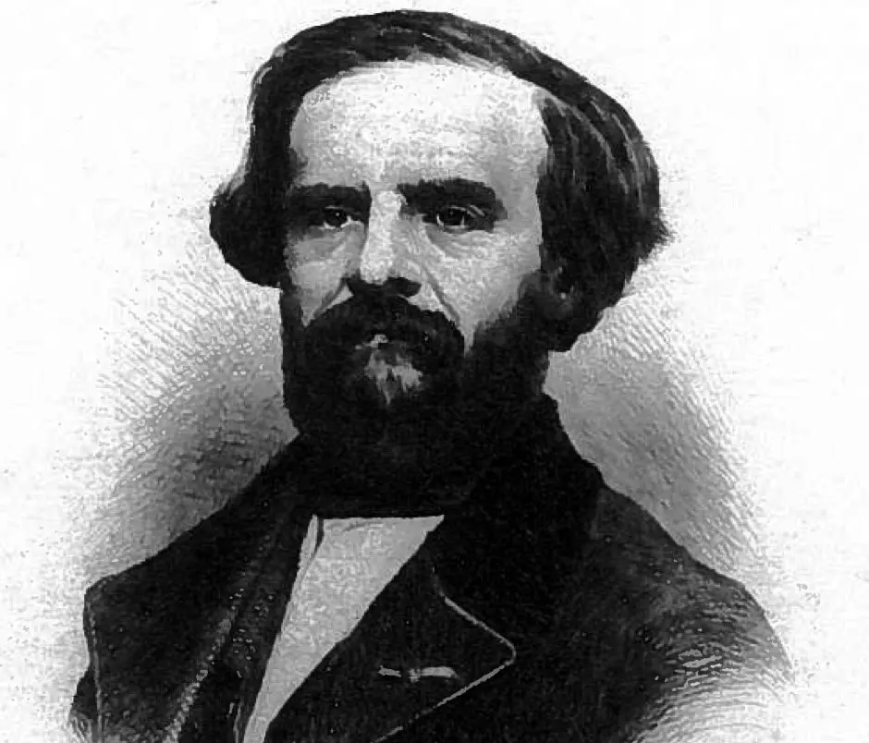
Adolphe Godin de Lépinay The Forgotten Man of the Panama Canal

Slide 40
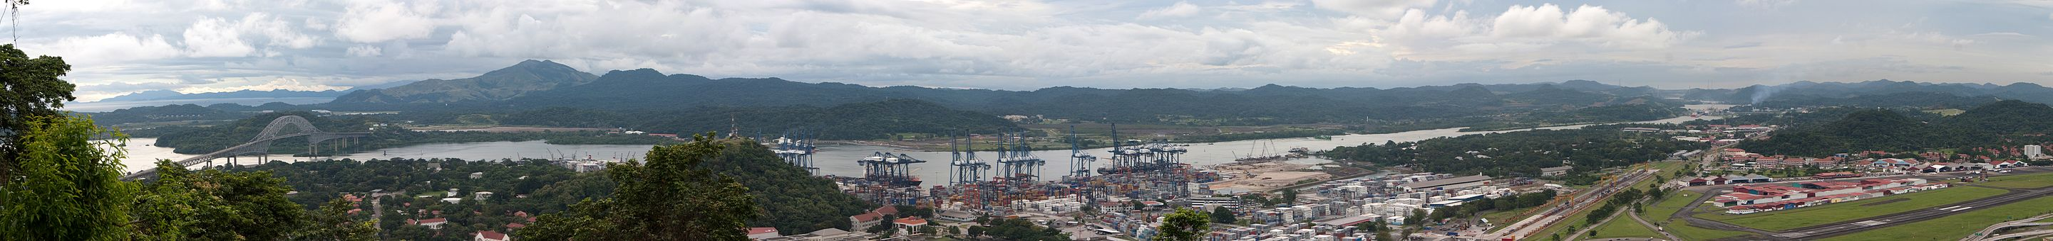
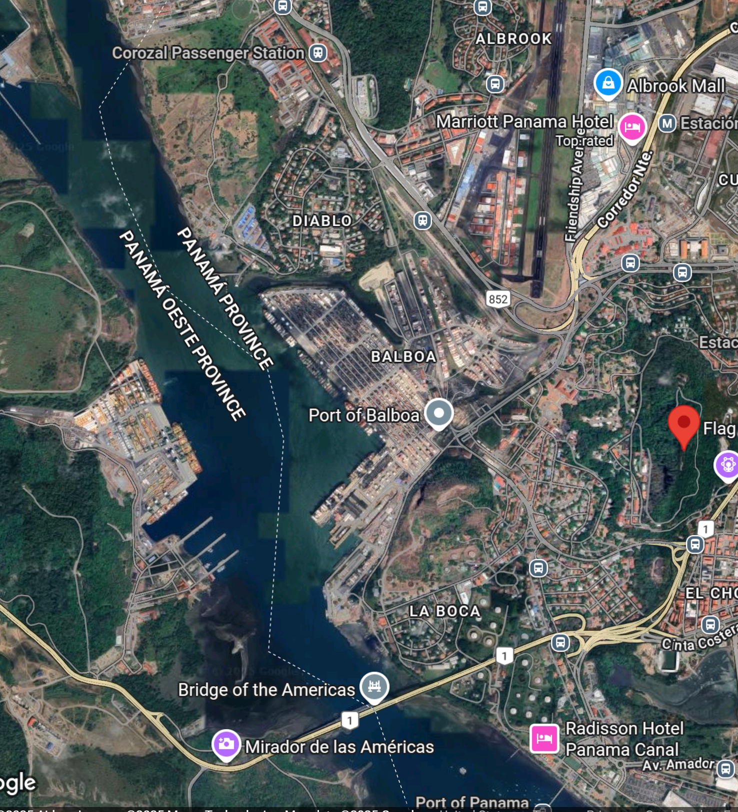
Panorama from Ancon Hill
“Fourth” Bridge

Slide 41
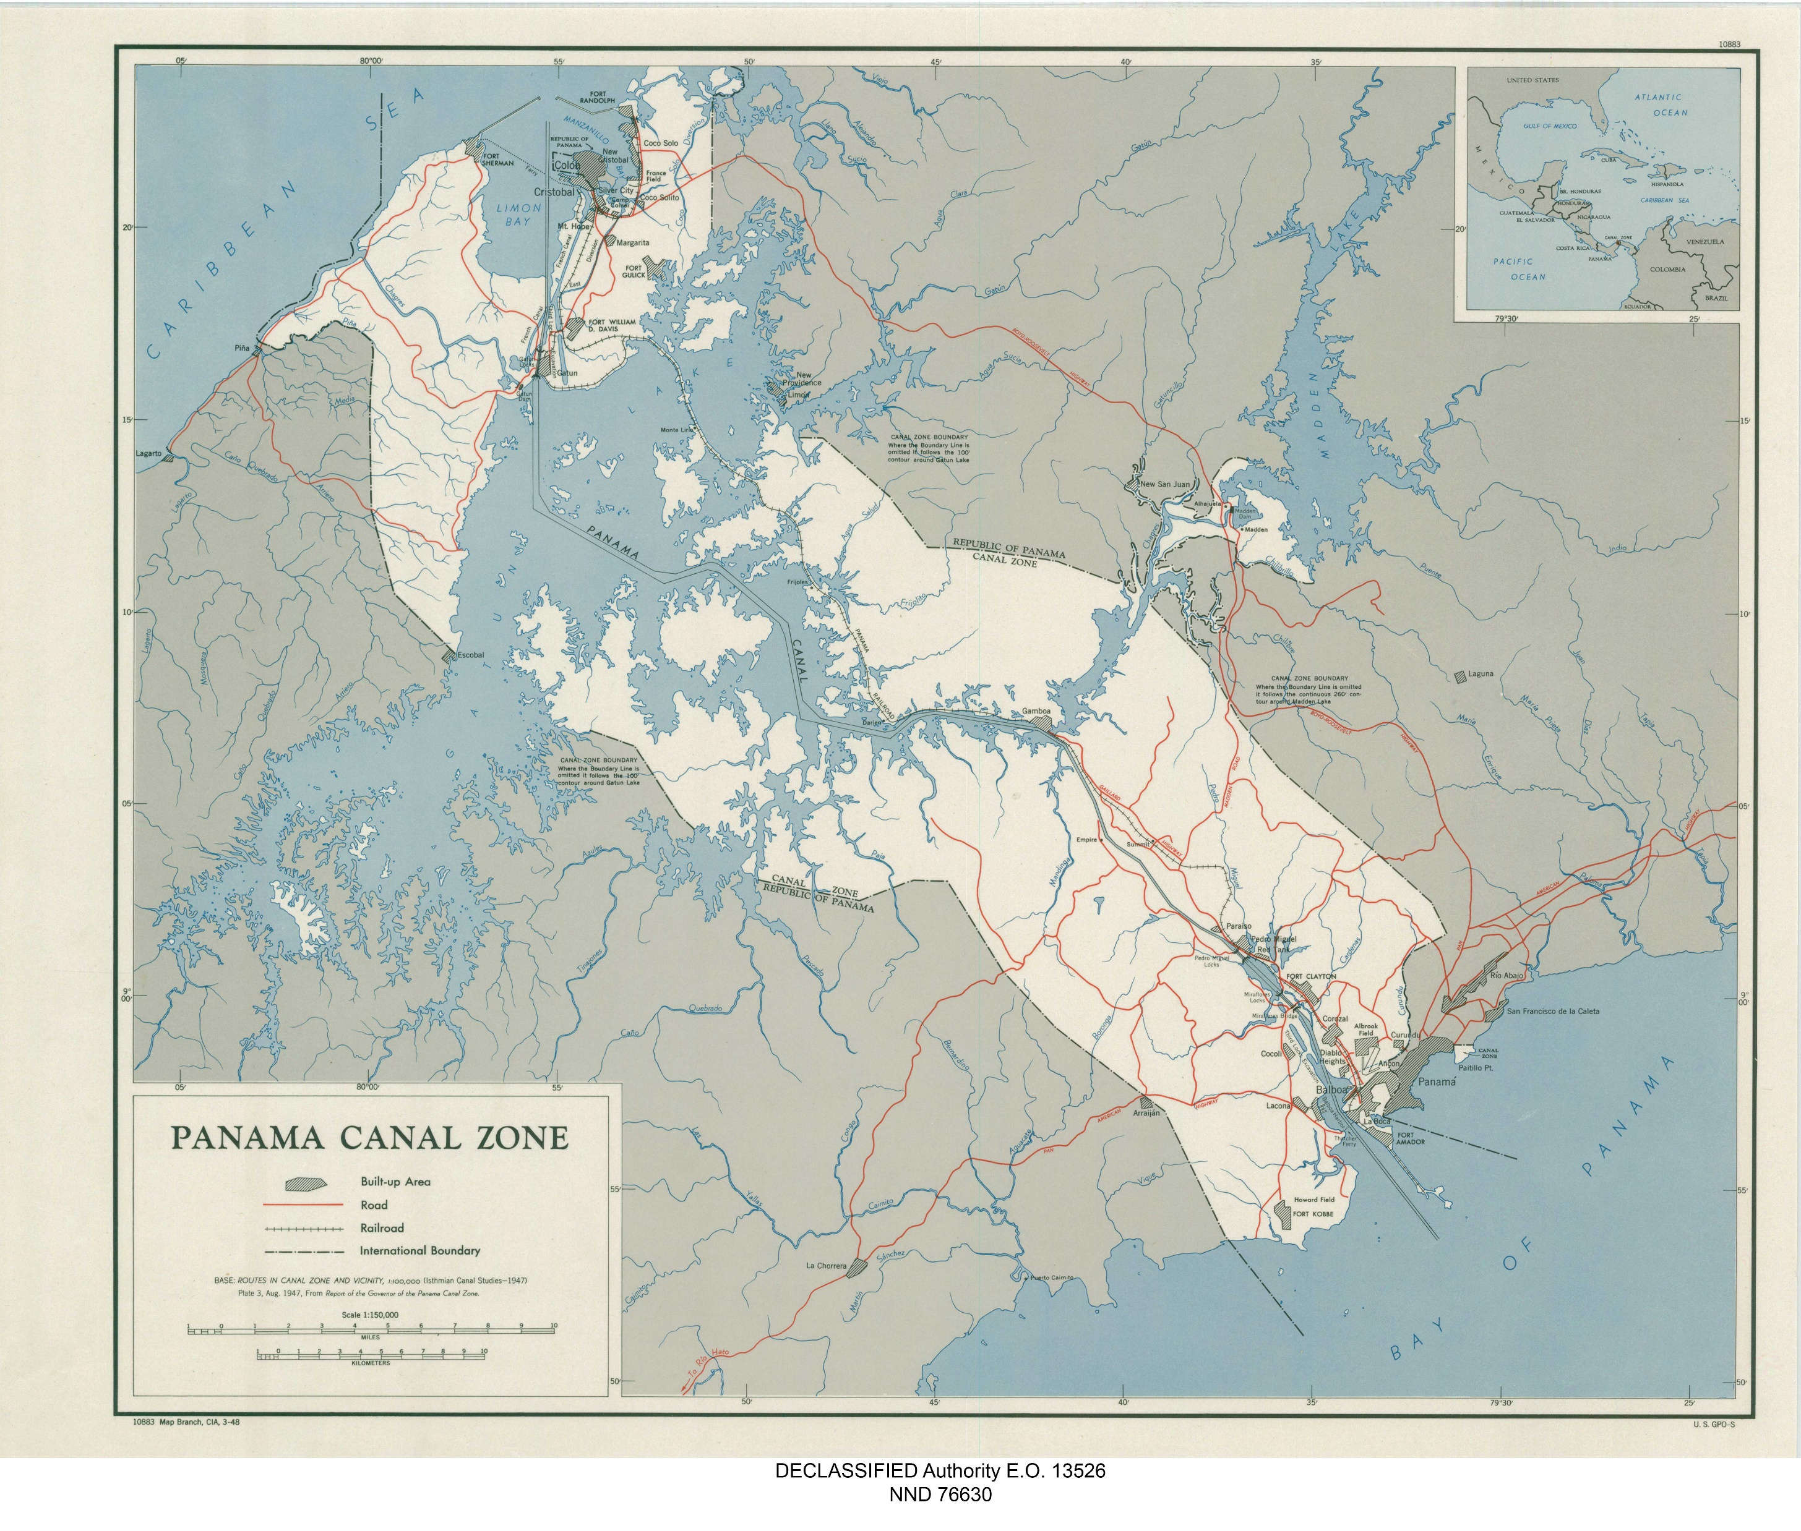
--
Southbound Flight Path
Centennial
Bridge

Slide 42
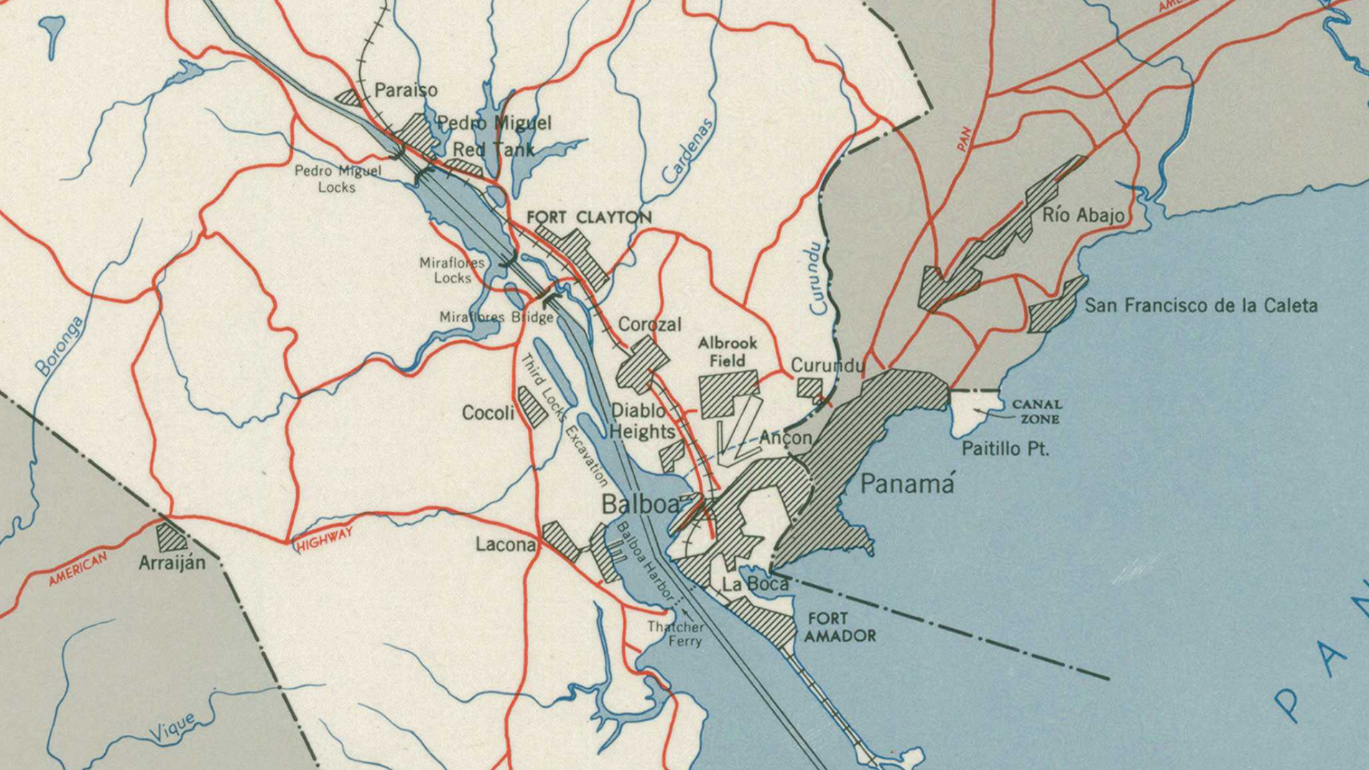
Southbound Flight Path to Landing
“FOURTH”BRIDGE
(Under construction, 21% complete, June 2025)
BRIDGE OF THE AMERICAS

Slide 43
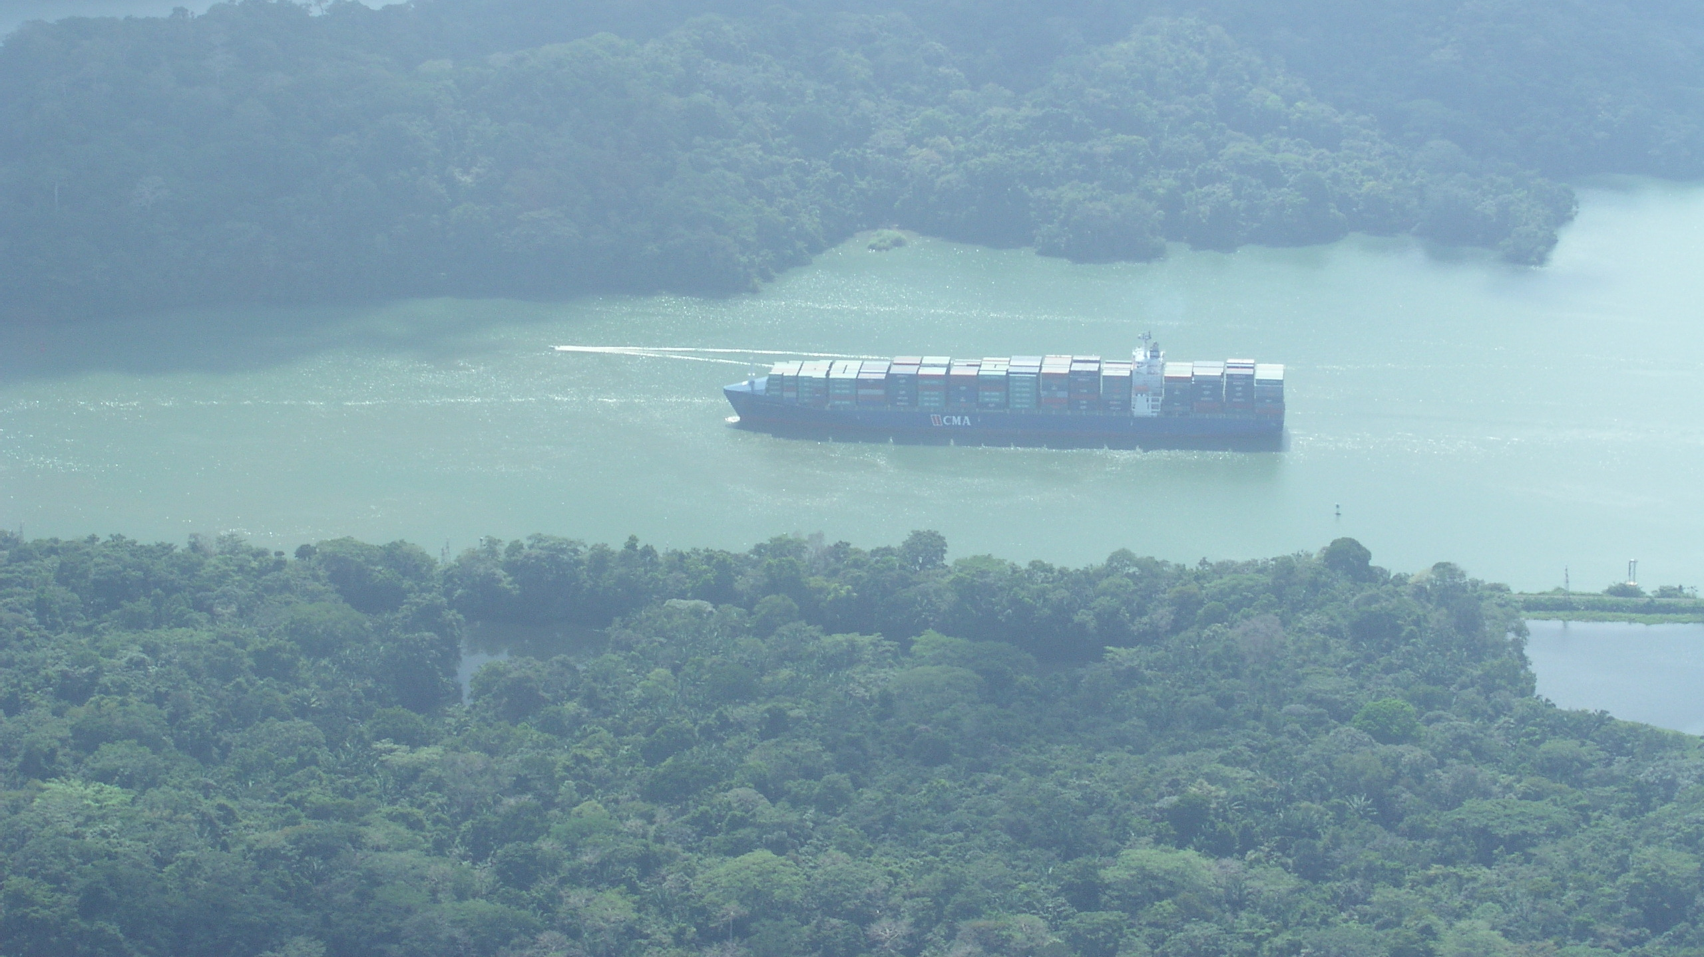
Entrance to Gaillard Cut

Slide 44
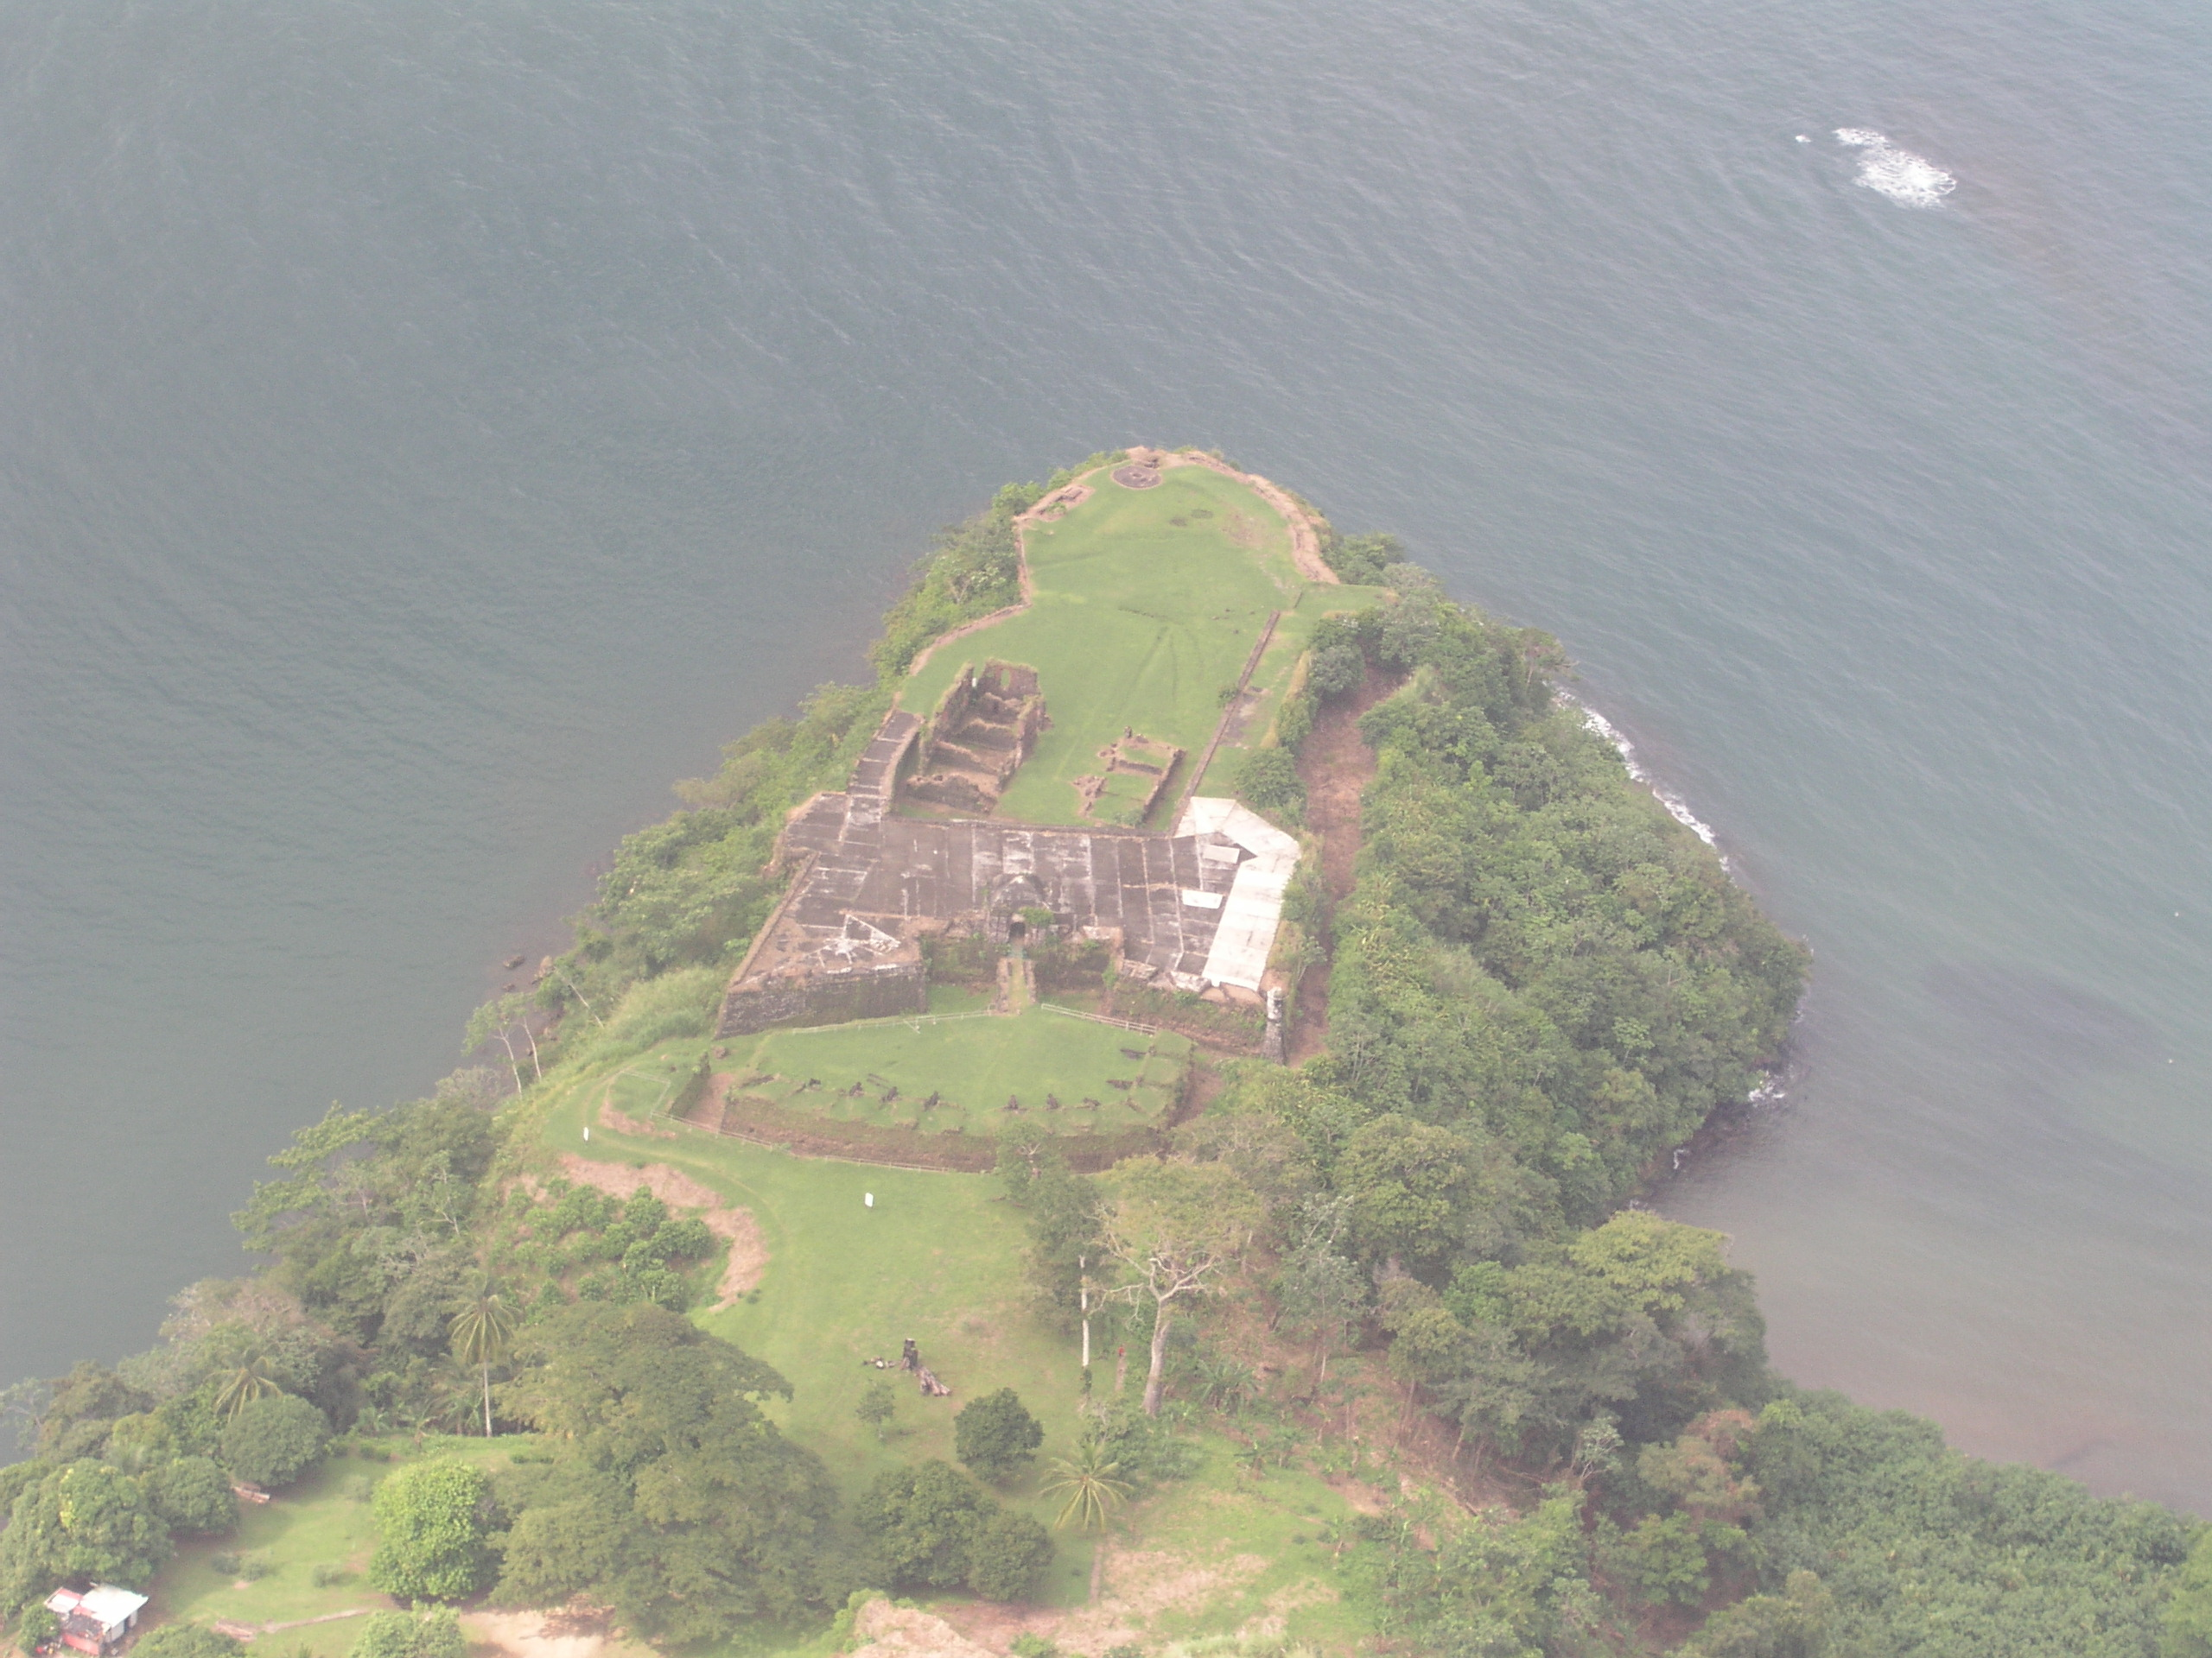
Castillo de San Lorenzo
Caribbean Sea
Chagres River
27
Notes:
27

Slide 46
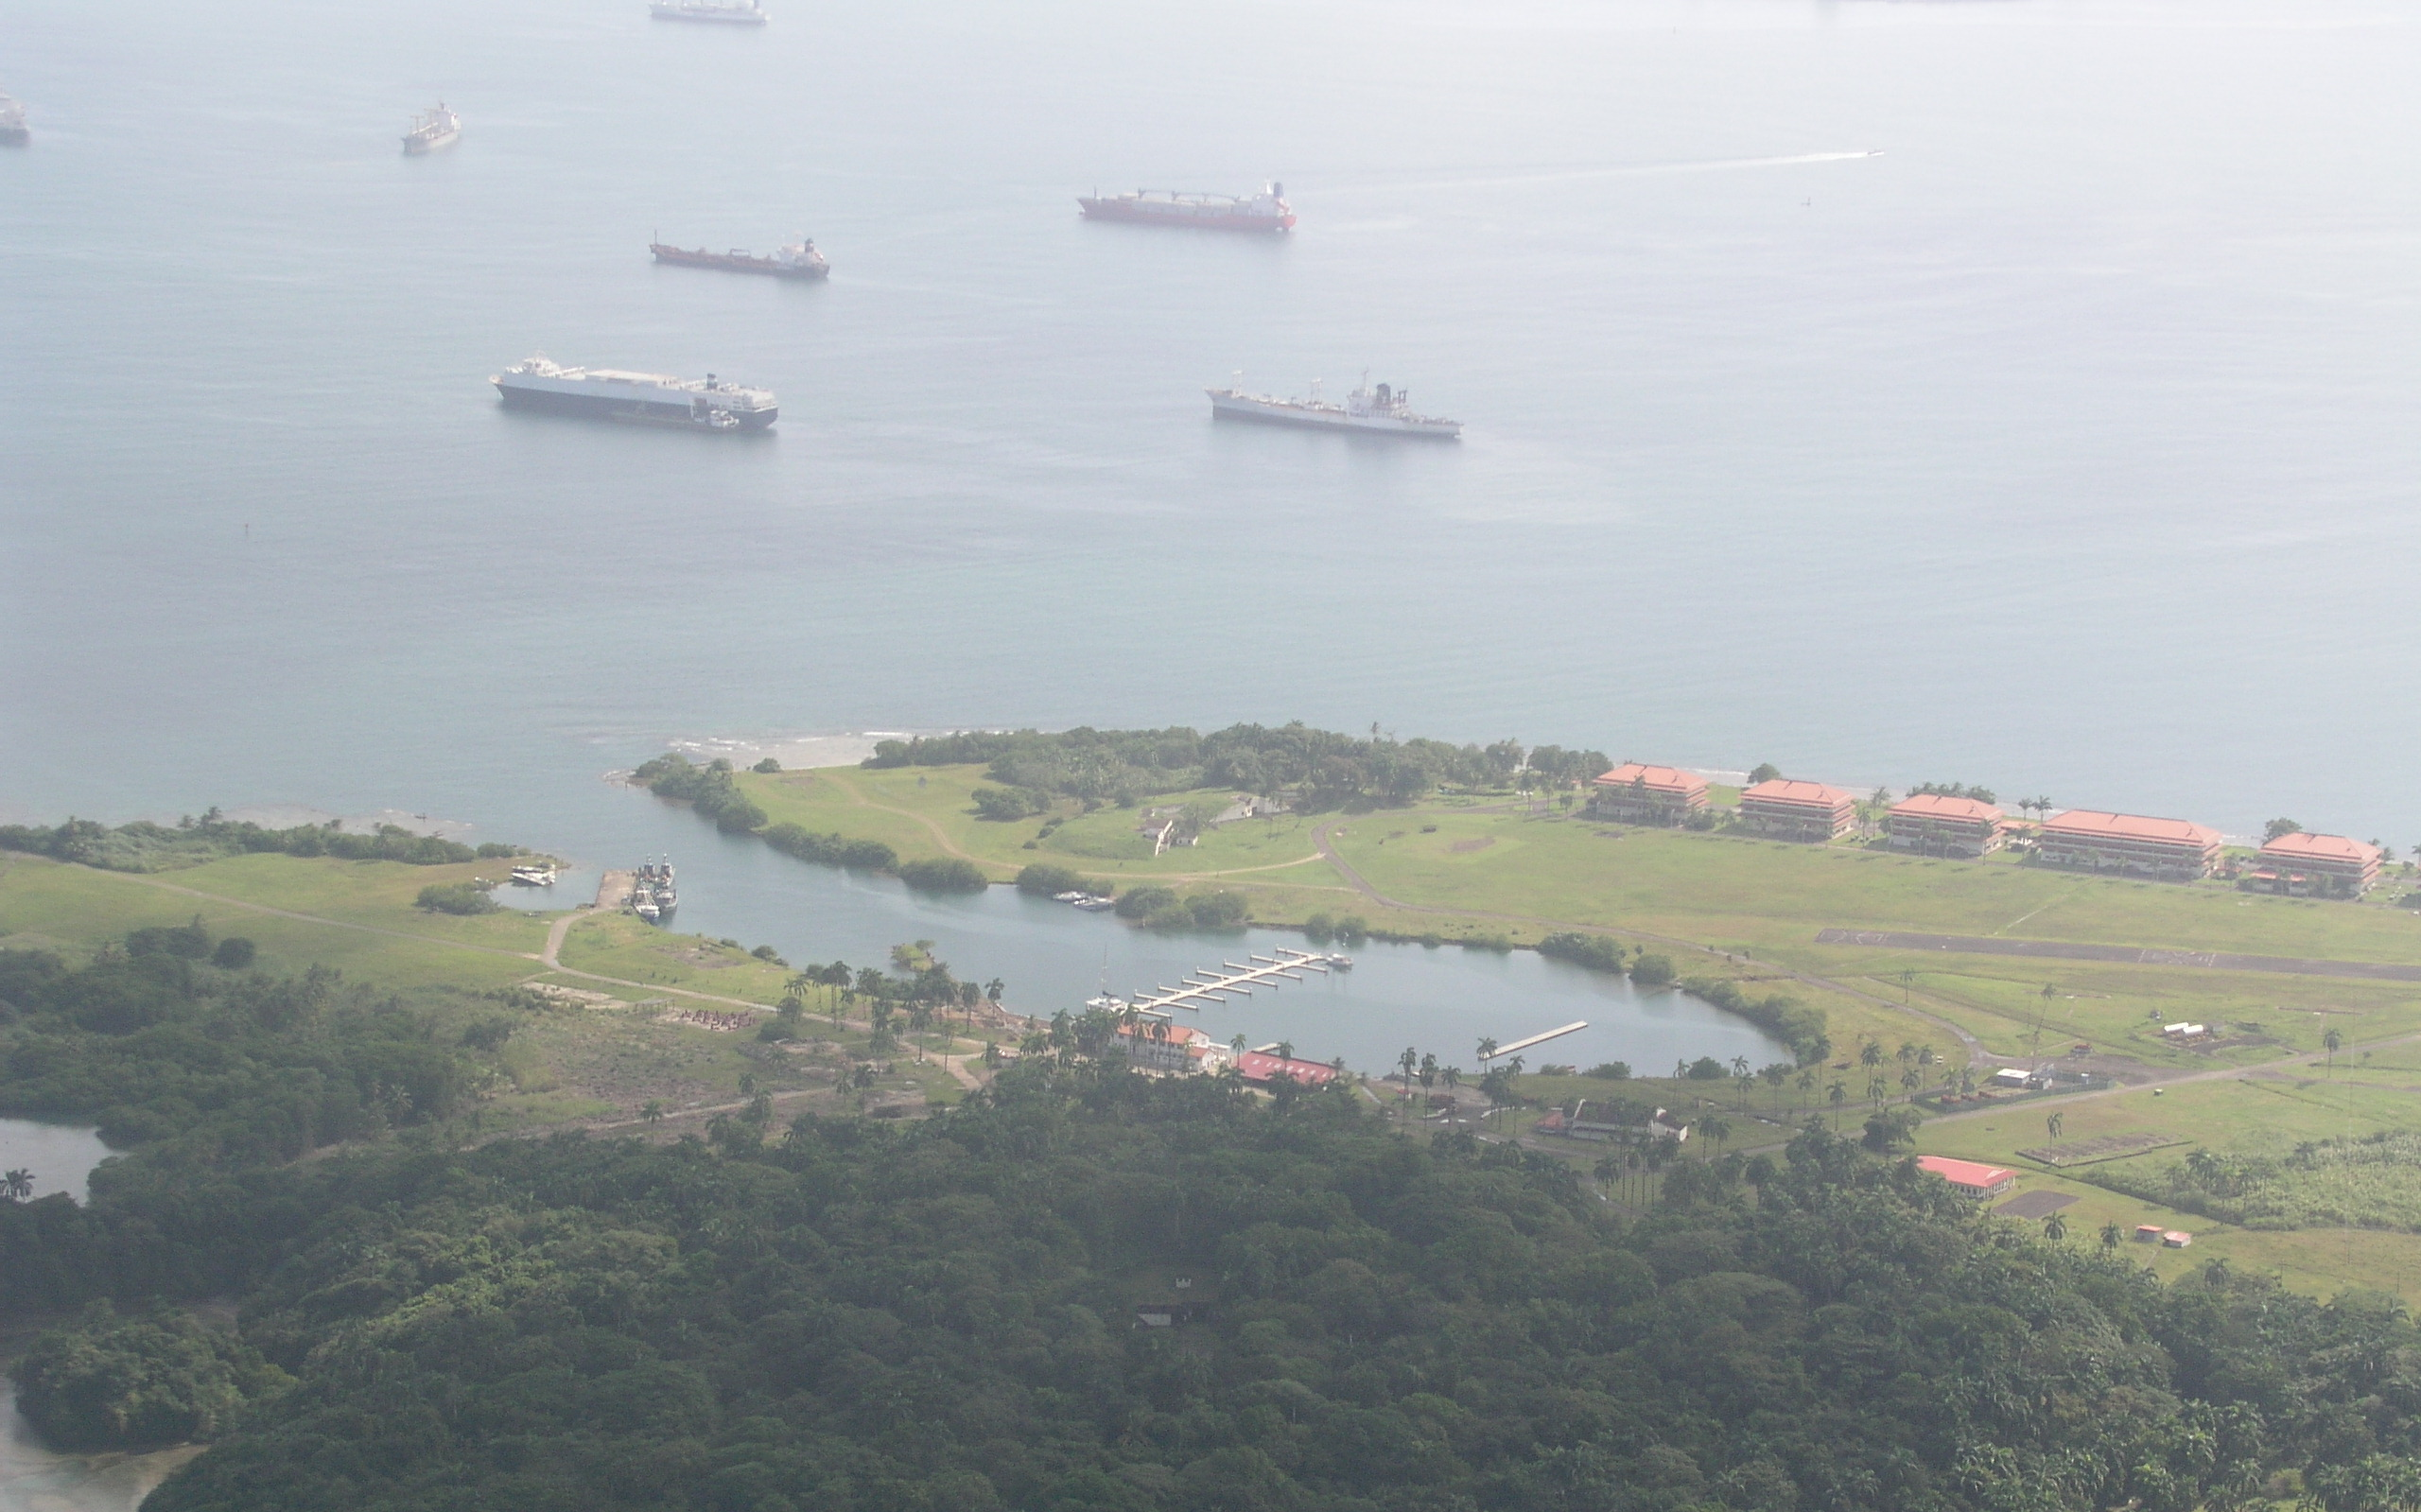
Fort Sherman
Colón Yacht Club

Slide 47
Fort Sherman
Colón Yacht Club

Slide 48
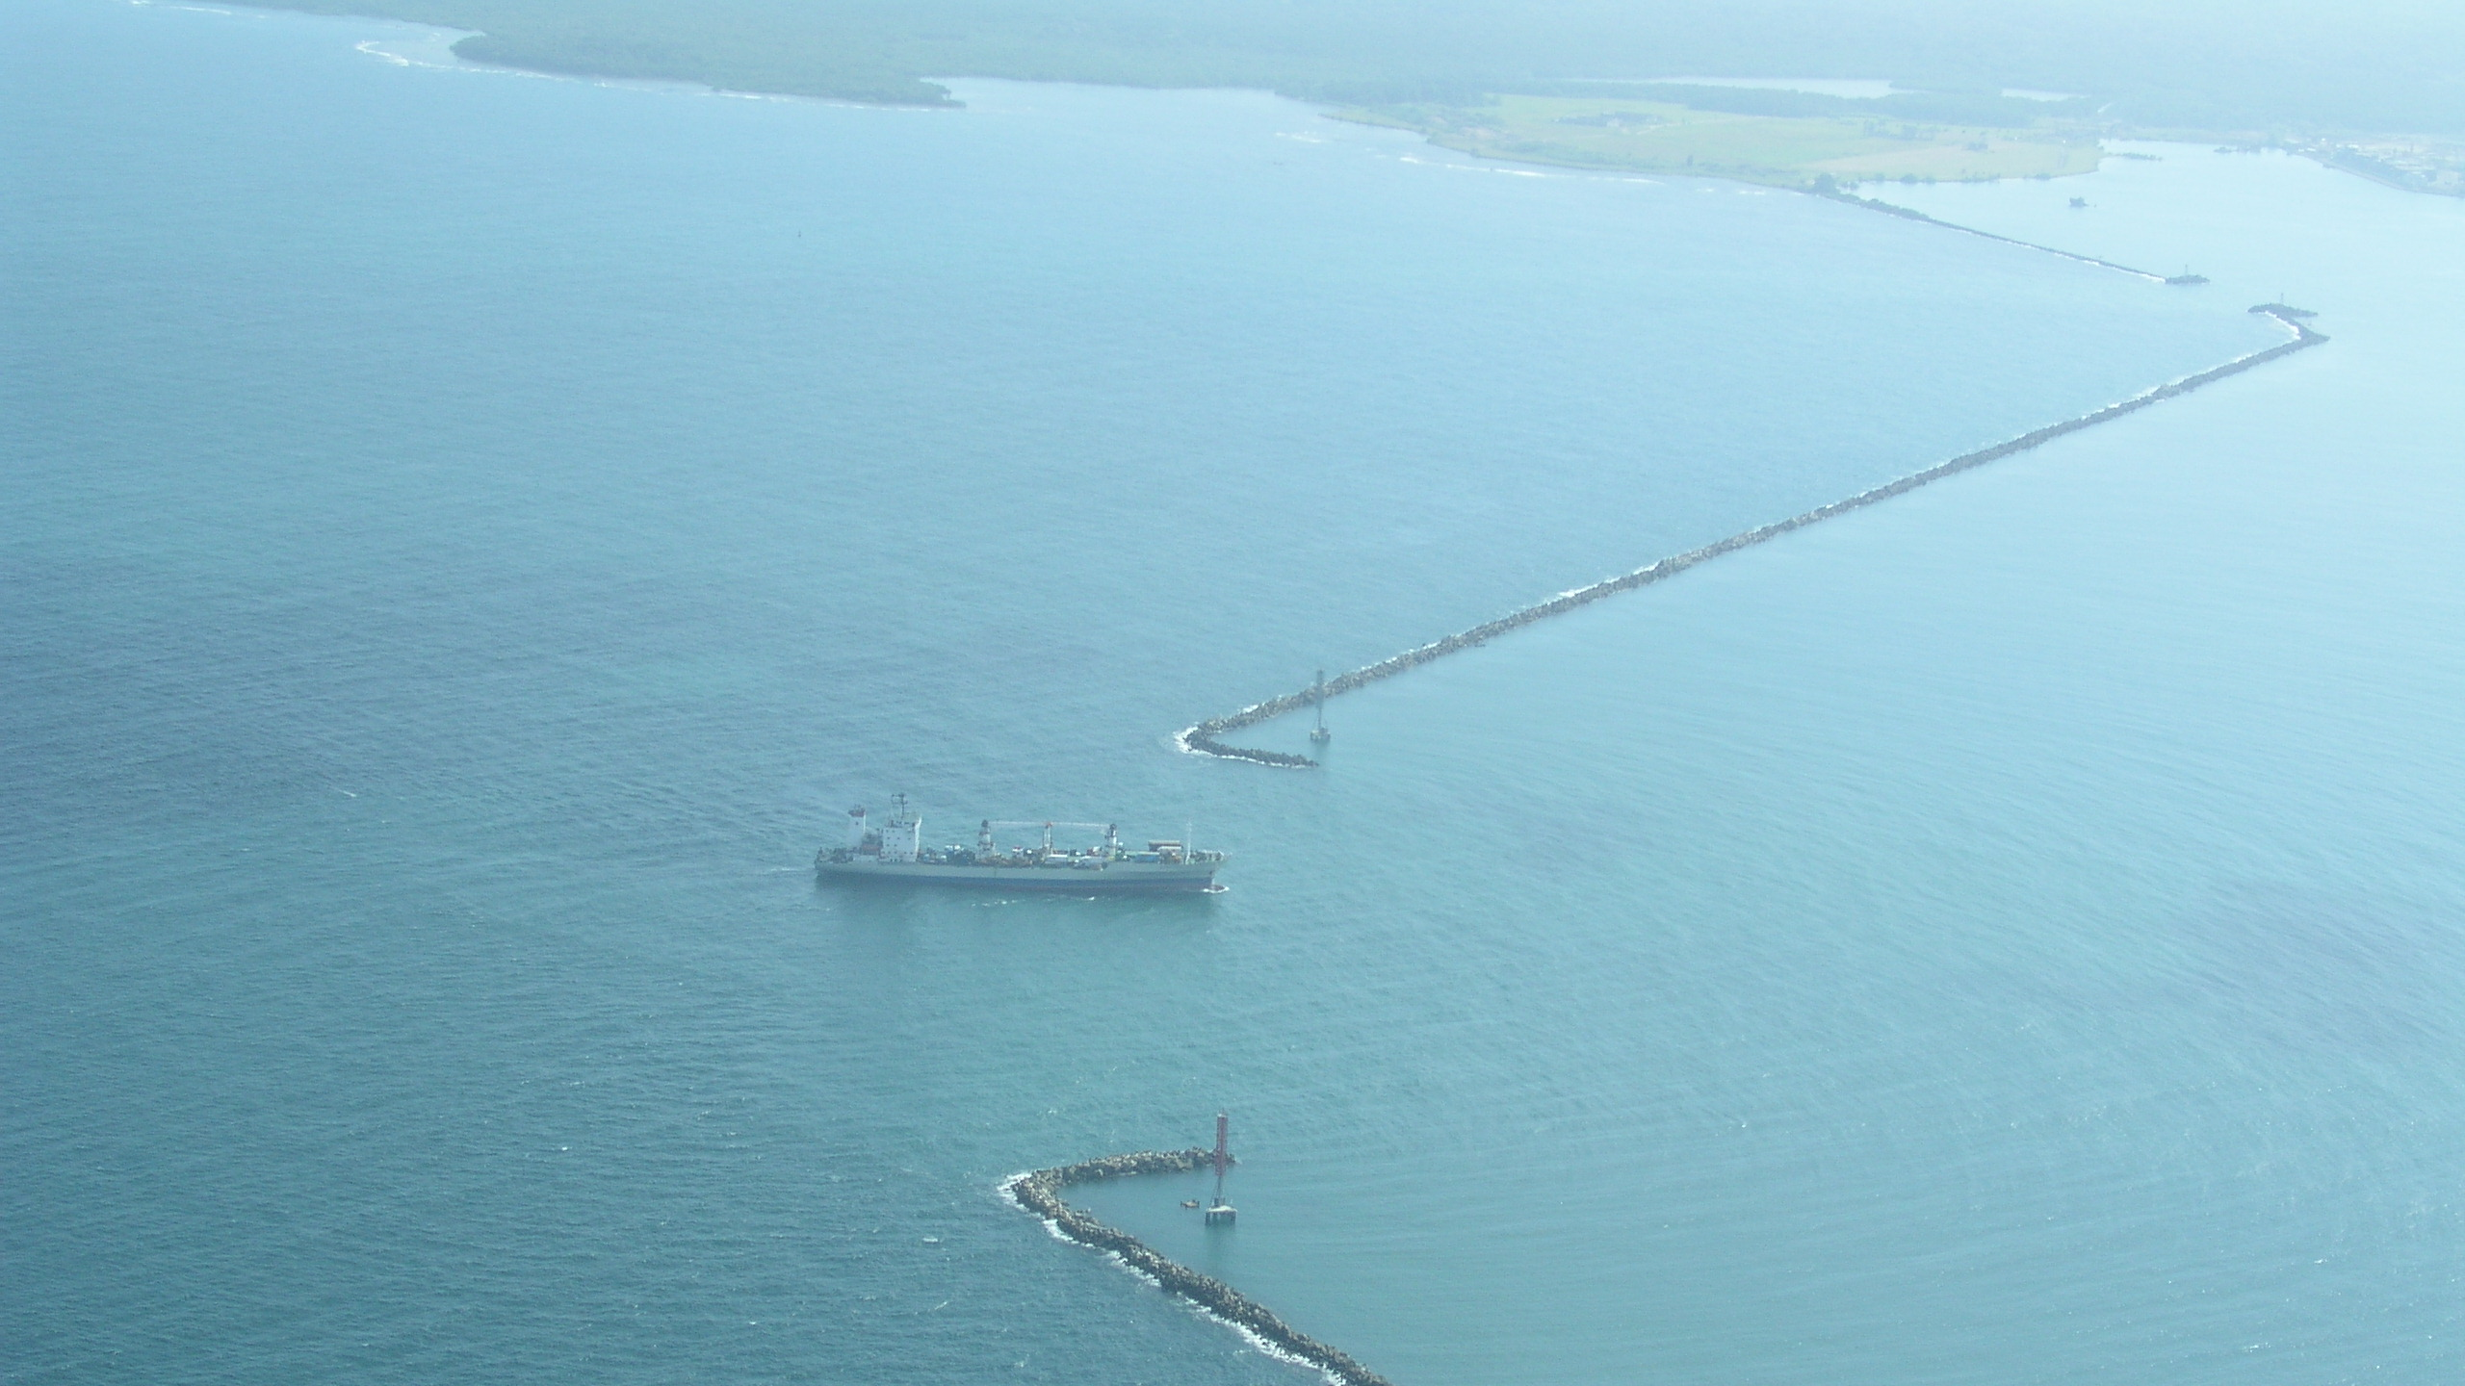
Caribbean Entrance to the Panama Canal
Carribean Sea
Limon Bay

Slide 49
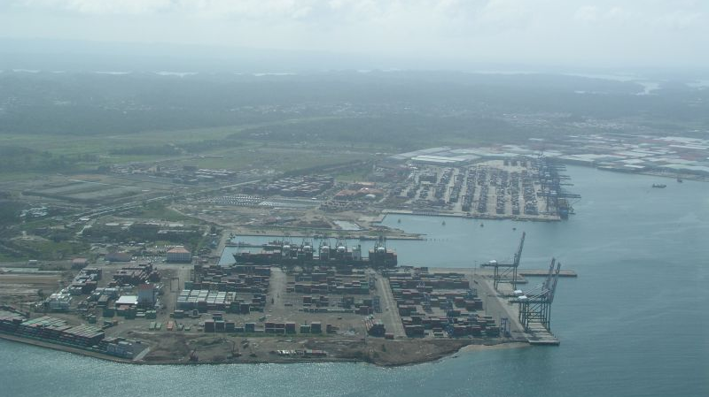
New Cristobal Container Terminals
Manzanillo Bay
22
Notes:
22 Colon

Slide 50
Sections
1 How the Panama Canal Works
2 A Tour of the Canal by Air and on the Ground
3 A History of the Founding of Panama and Construction of the Canal
4 The Story of the Events Leading to the Handover of the Panama Canal to Panama, 1964 to 1999
5 Construction of the Neopanamax Locks, 1943 to 2017
6 Recent Problems and Plans for the Future
7 The Panama Palindrome

Slide 51
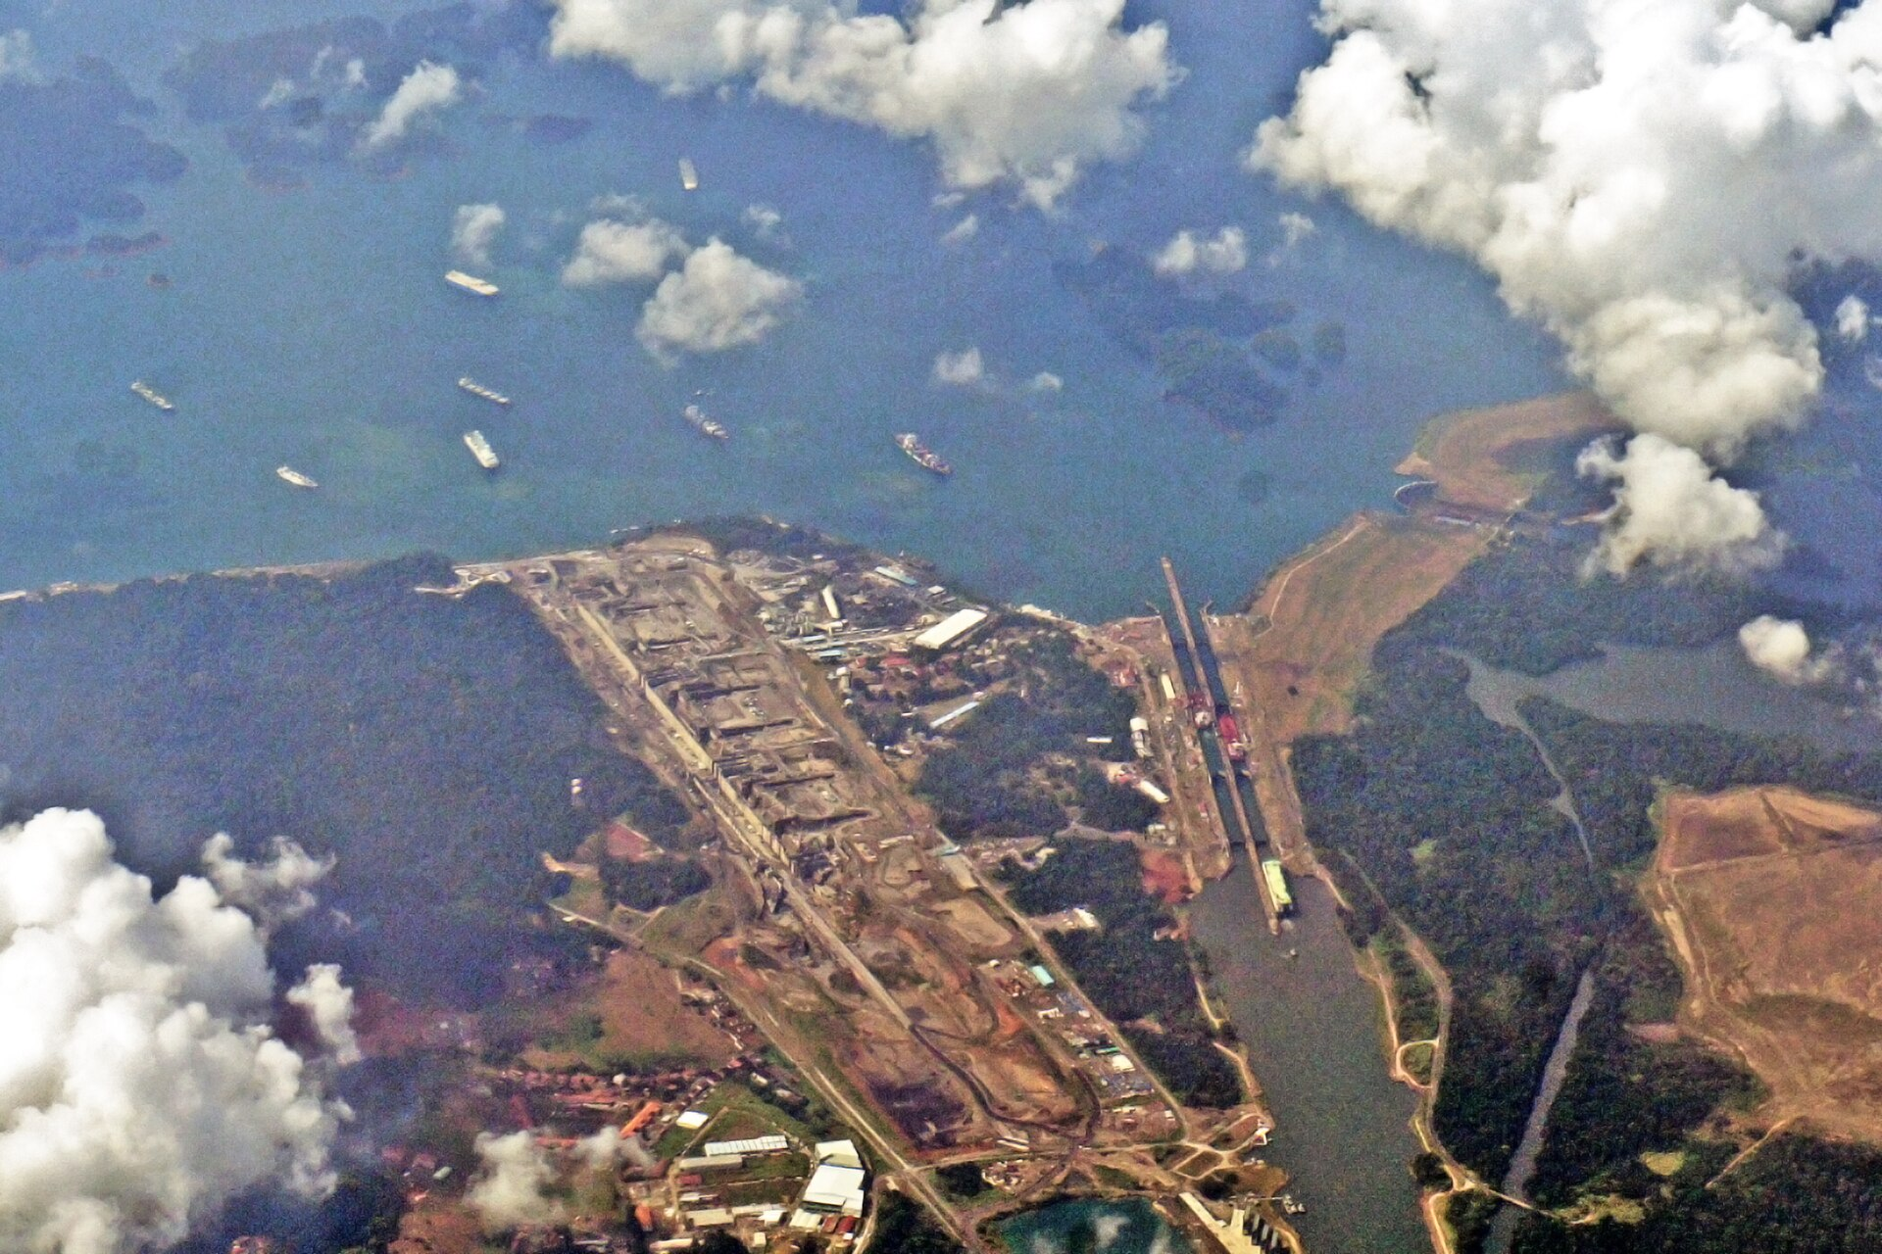

Slide 52
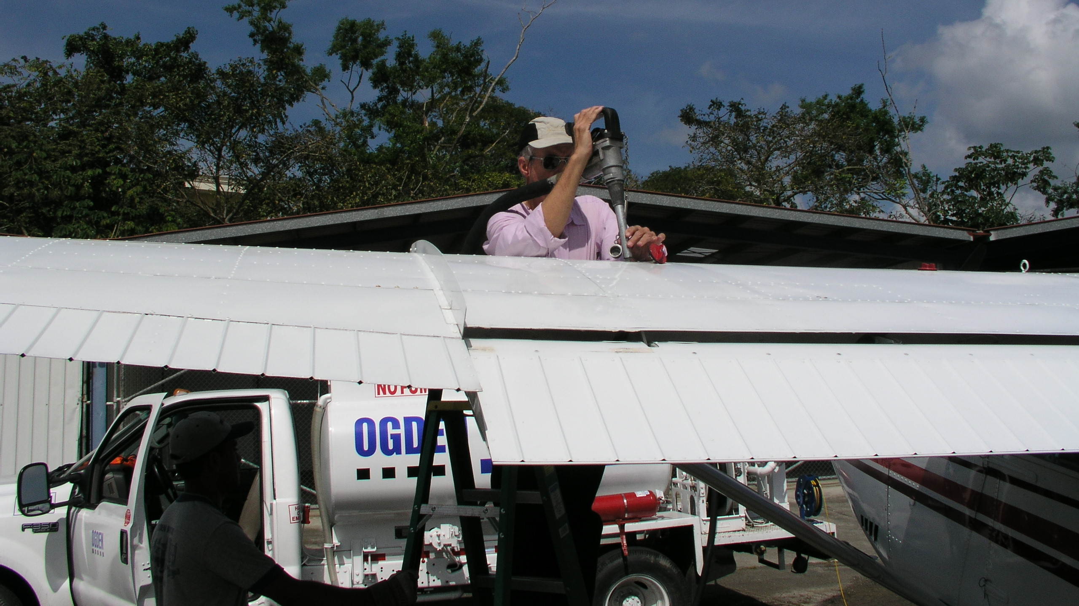
Chris Dillon, Tour Guide and Pilot

Slide 53
Recommended YouTube Videos
Introductions
How Does the Panama Canal Work?, The Panama Canal, 1:02
THE PANAMA CANAL – World’s Most Important Waterway, Interesting Engineering, 5:59
History to 1987
PBS Nova A Man A Plan A Canal Panama, Pickles the Wonder Mutt, 55:57 (Narrated and hosted by David McCullough)
Construction of the Neopanamax Locks
The Extreme Engineering Behind the Panama Canal’s Modern Makeover, Blueprint, 46:49, 2016
A New Experience - Transits Through Expanded Panama Canal

Slide 54
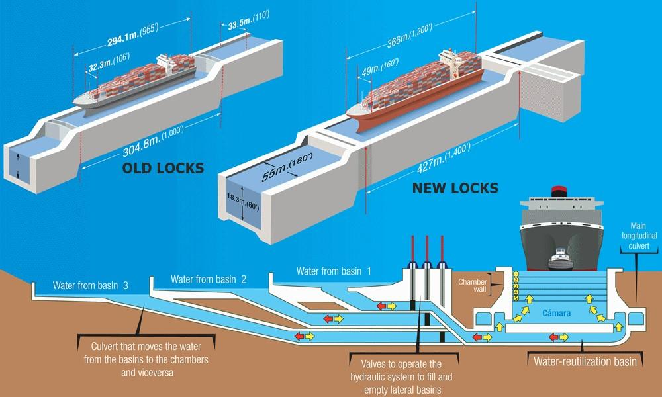
Chamber wall
Lock Chamber
Culvert for water flowing to and from the lock chamber
Valves to operate the hydraulic system to fill & drain the lateral basins
Culvert used to move water to & from the lock chamber

Slide 55
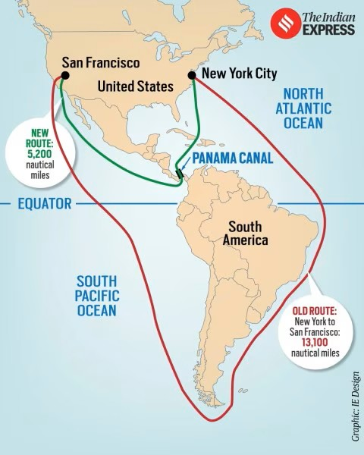

Slide 56
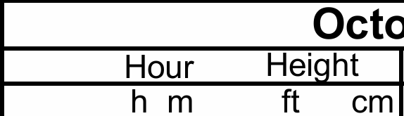
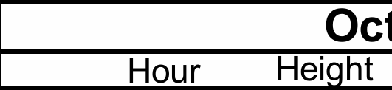
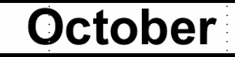
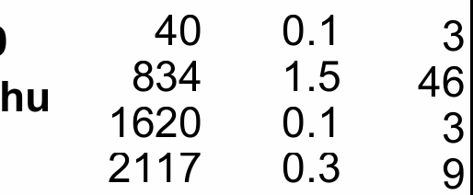
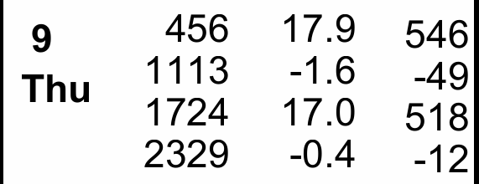
High and Low Tides at the Panama Canal Today (10/9/2025)
Amador Limon Bay
Pacific Ocean Atlantic Ocean

Slide 58
Locations of Tide Measurements in Panama

Slide 59
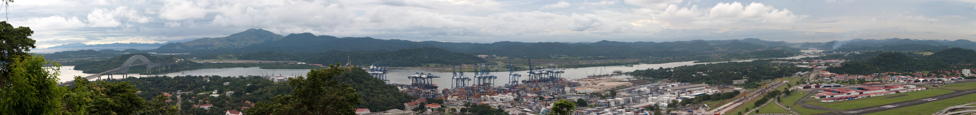
A Panorama View of the Pacific Entrance to the Panama Canal
Bridge of the Americas
Old Navy Base
Hutchinson Balboa Terminal
Miraflores Locks Albrook Field

Slide 60
Panama – The Facts
The current population of Panama is approximately 4,586,000
The population of Panama City is approximately 408,000
The total land area of Panama is 74,340 km² (28,703 sq. miles).
The population density in Panama is 61 per km² (159 people per mi²).
70.65% of the population is urban
The median age in Panama is 30.3 years
Notes:
3 November 1903

Slide 61
Chamber wall
Lock Chamber
Culvert for water flowing to and from the lock chamber
Valves to operate the hydraulic system to fill & drain the lateral basins
Culvert used to move water to & from the lock chamber

Slide 62
Chamber wall
Lock Chamber
Culvert for water flowing to and from the lock chamber
Valves to operate the hydraulic system to fill & drain the lateral basins
Culvert used to move water to & from the lock chamber

Slide 63
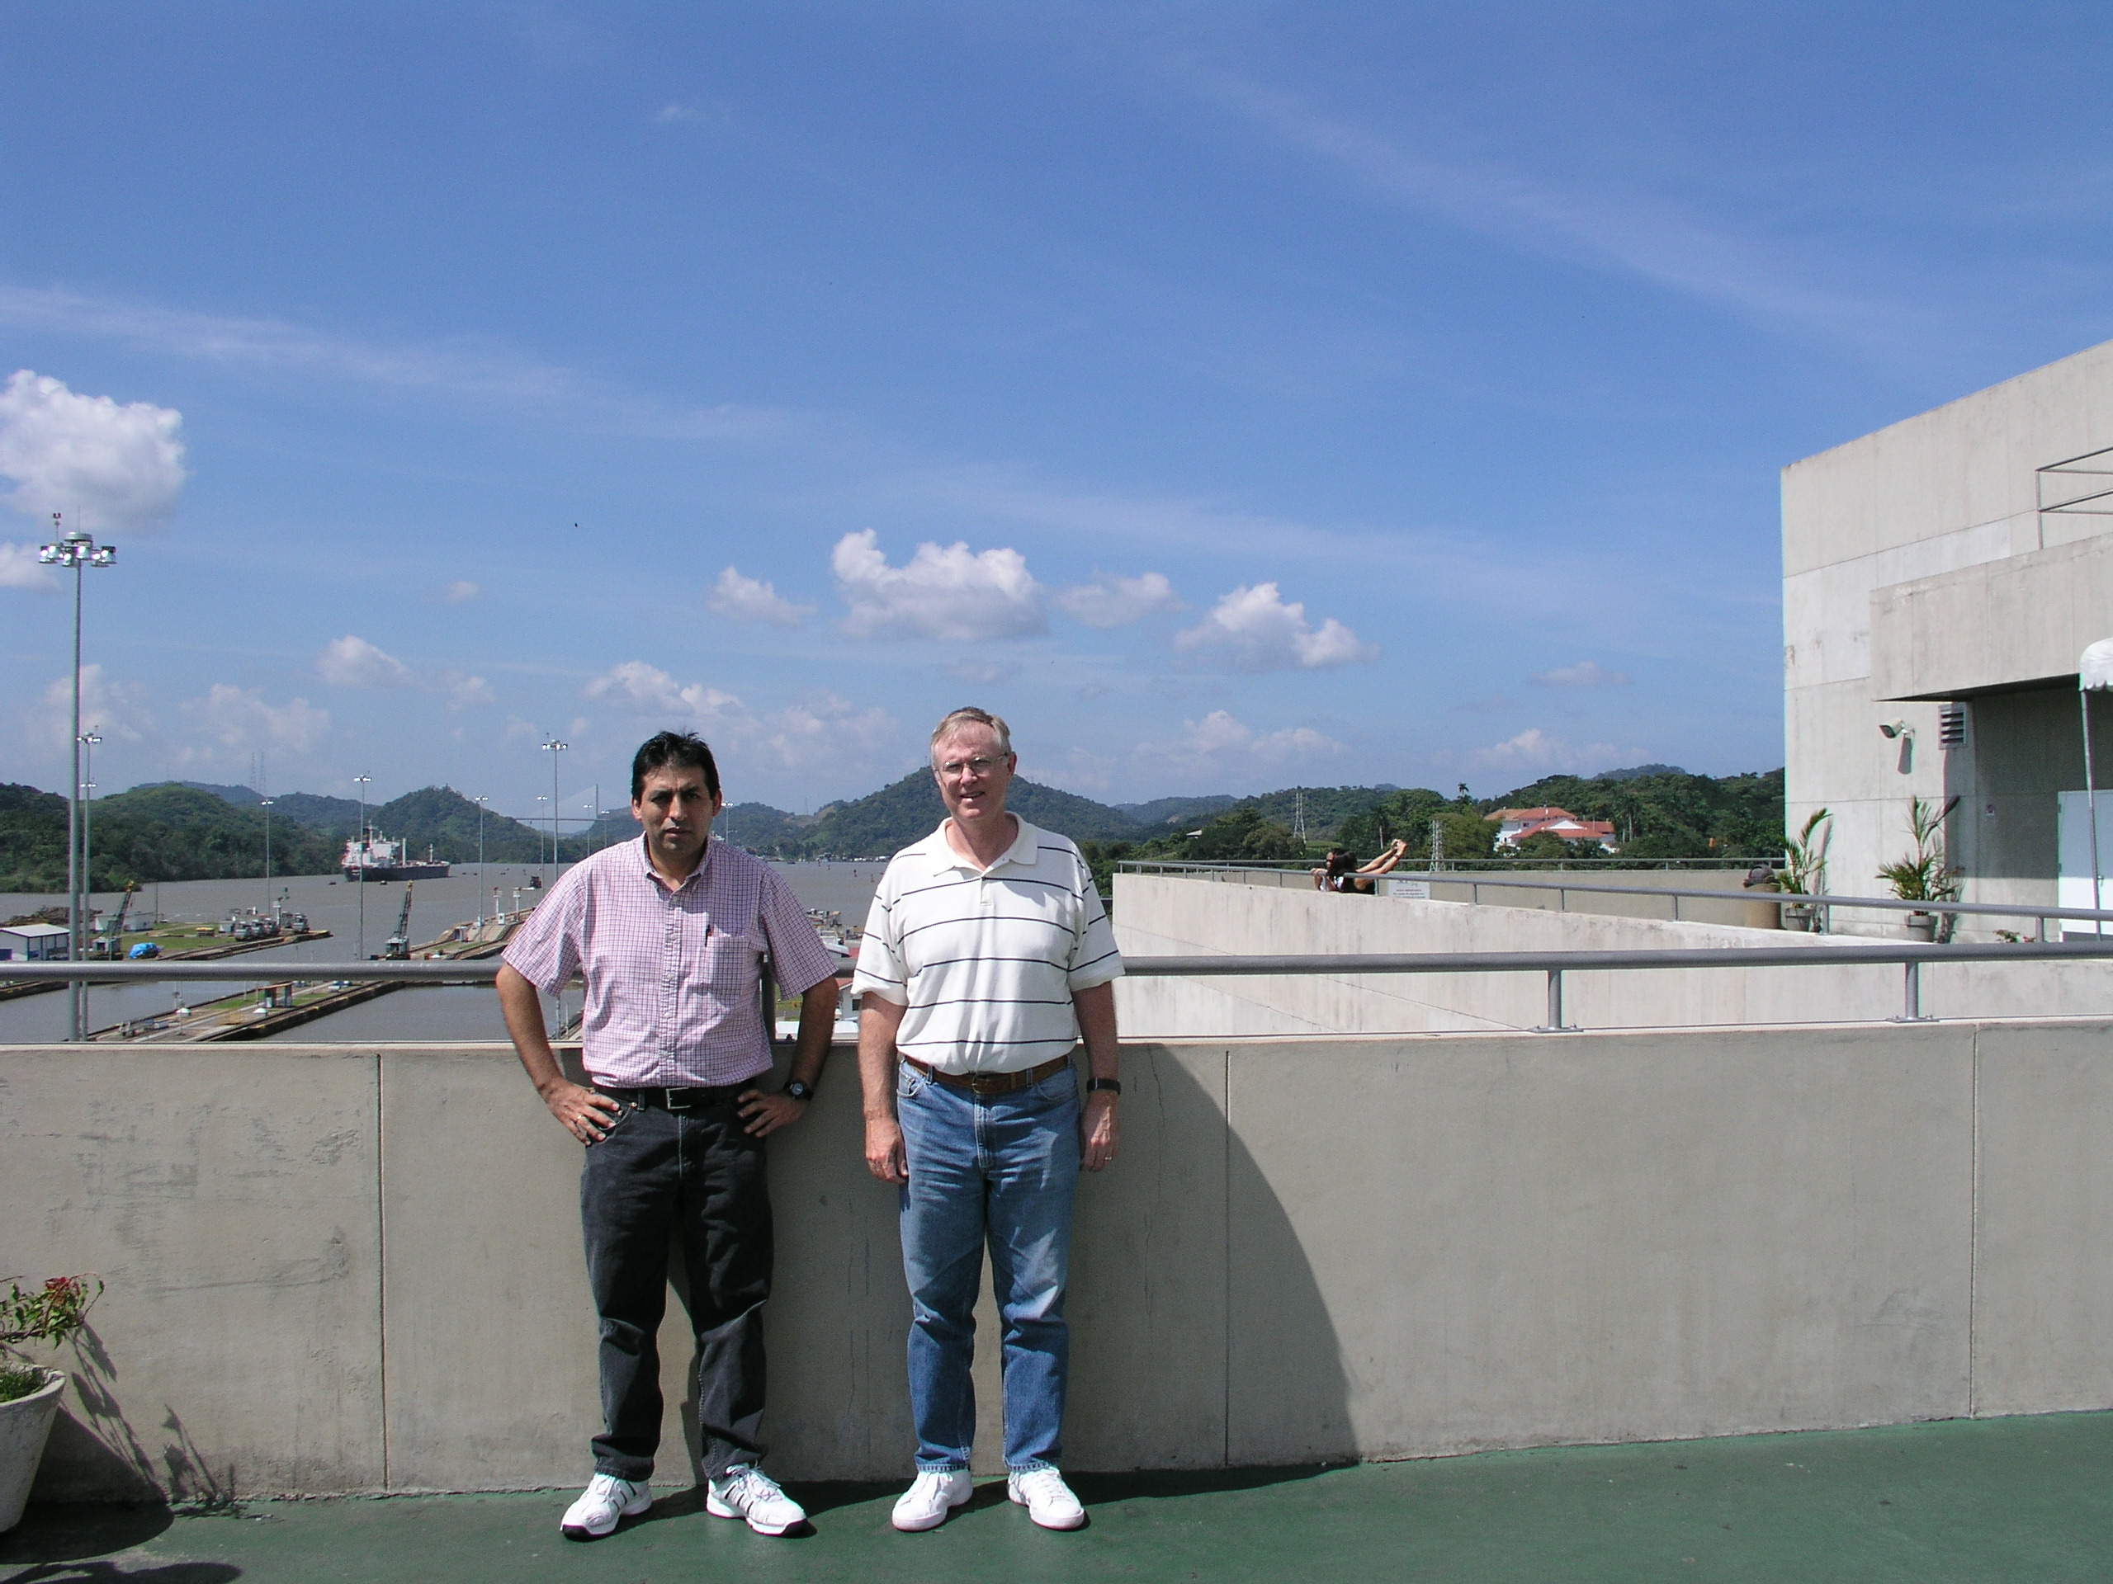
Dr. Gonzalo Vasquez & Me

Slide 64
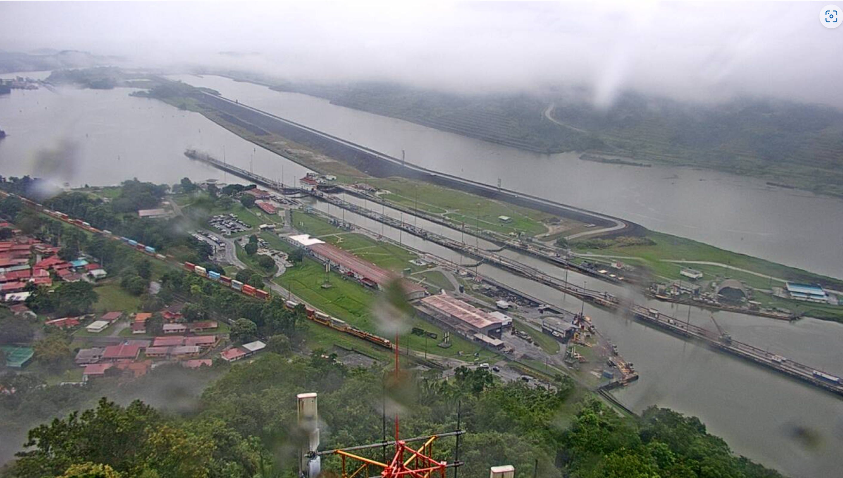
Webcam Photo of Pedro Miguel Lock from Noon Today

Slide 65
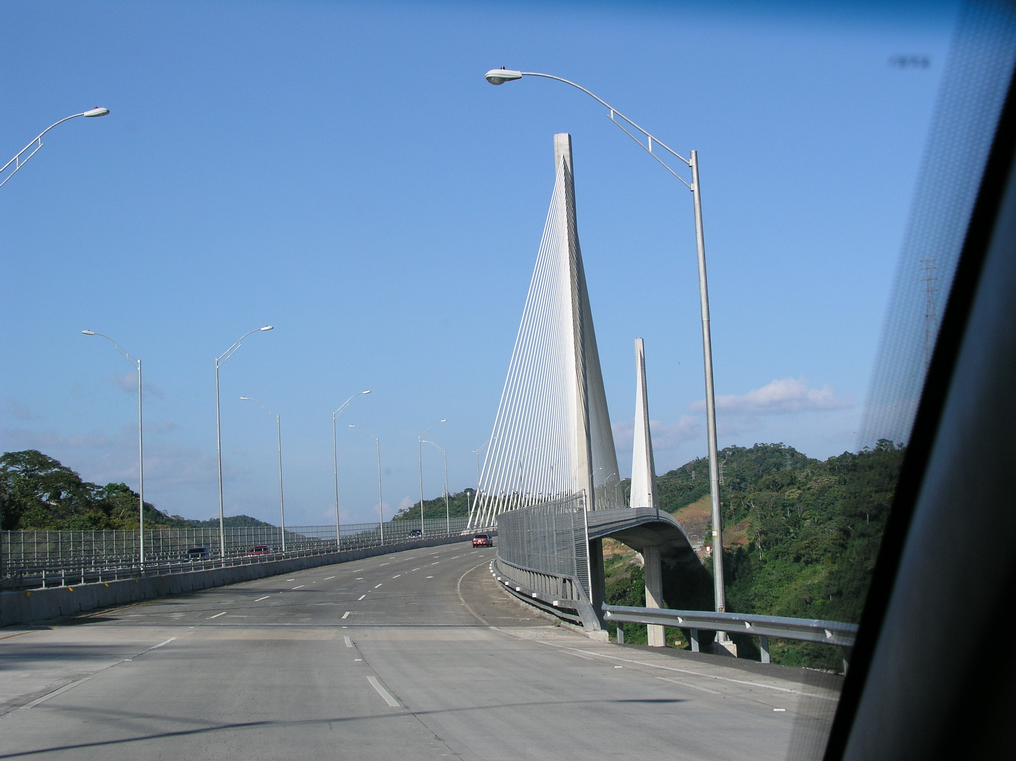
Centennial Bridge, opened in 2004
Notes:
24 Centenial Bridge

Slide 66
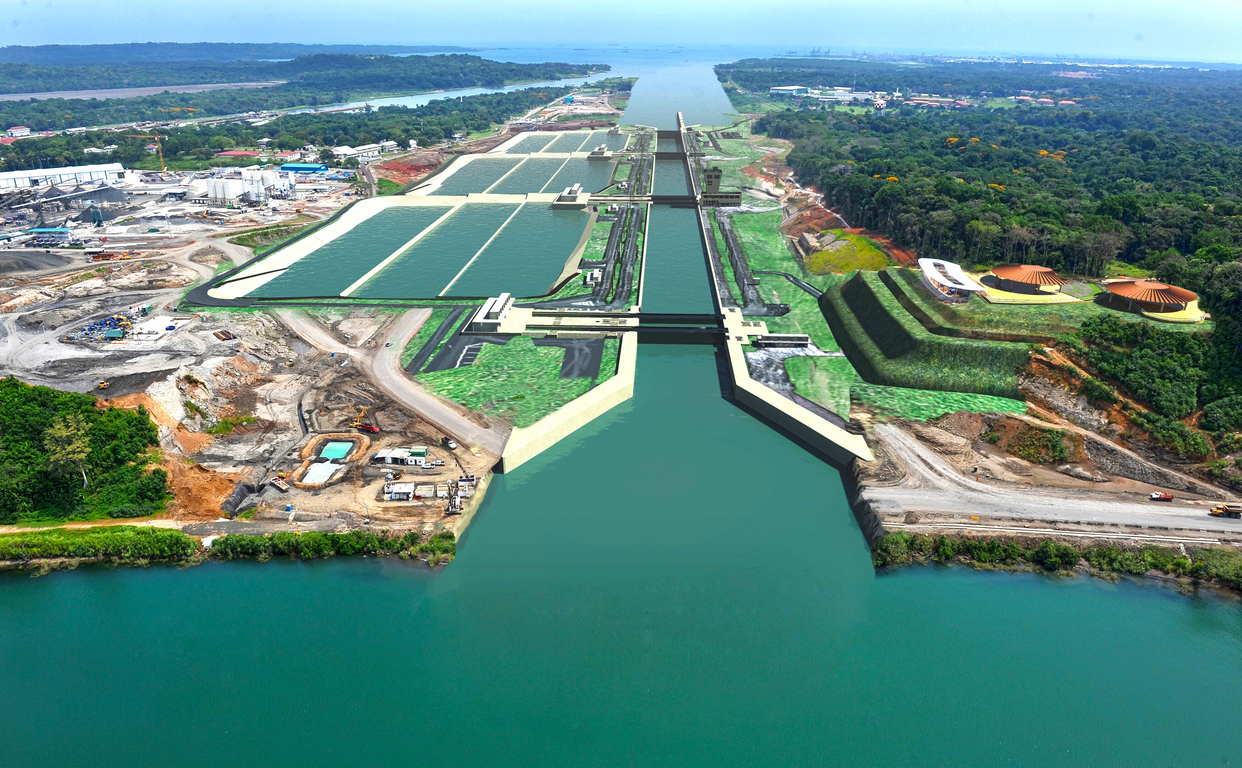

Slide 67
Timeline of Agencies Managing the Panama Canal
1904
1914
1950
1977
12/31/1999
Isthmian Canal Commission
Canal Zone Government
Panama Canal Company
Panama Canal Authority
Autoridad del Canal de Panamá
1900
1910
1920
1930
1940
1950
1960
1970
1980
1990
2000
2010
2020

