Slide 1
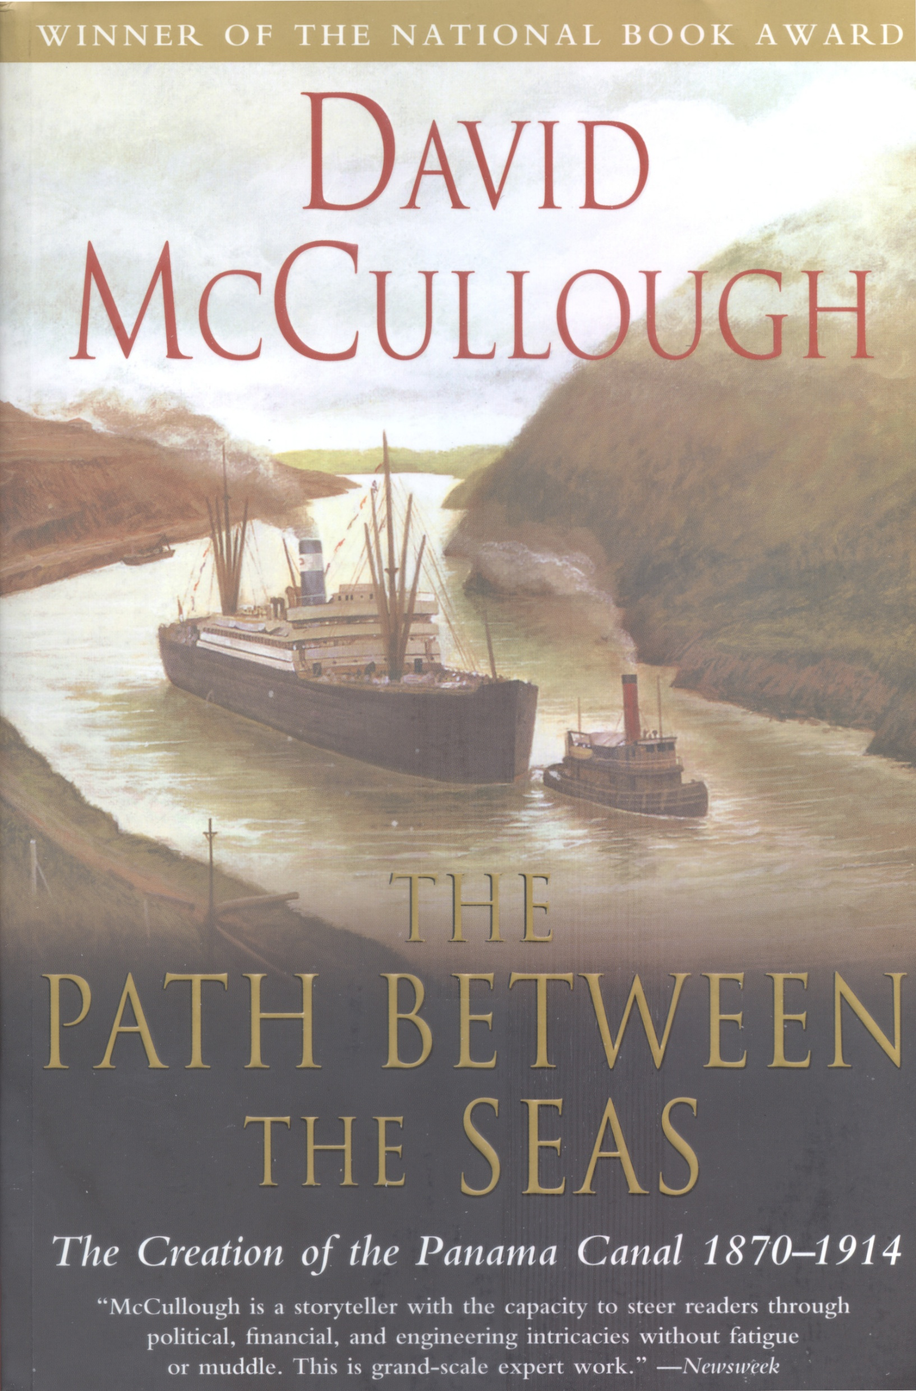
The Best and Most Influential History of the Origin of the Panama Canal
This book was so highly regarded by the civil engineering profession that David McCullough was named a Distinguished Honorary Member of the American Society of Civil Engineers – He is the few people without a degree in civil engineering to be named a Distinguished Honorary Member

Slide 2
The Path Between the Seas
The Path between the Seas, published in 1977, chronicled the challenges of designing and building the Panama Canal. He again turned to ASCE in his research. The volume received the National Book Award and was cited by President Jimmy Carter as influential in turning the US-controlled canal over to Panama.
In 1981, ASCE expressed its gratitude to McCullough by bestowing him with Distinguished Honorary Member status. He received the Presidential Medal of Freedom in 2006.
His preceding book, The Great Bridge (1972) detailed the lives and achievements of bridge engineers John A. Roebling, his son Washington Roebling, and the pivotal role of Washington Roebling’s wife Emily Warren Roebling. The Great Bridge ranked No. 48 on the Modern Library’s list of the best 100 nonfiction works of the 20th century.
In 2013, his native Pittsburgh renamed the 16th Street Bridge the David McCullough Bridge.

Slide 3
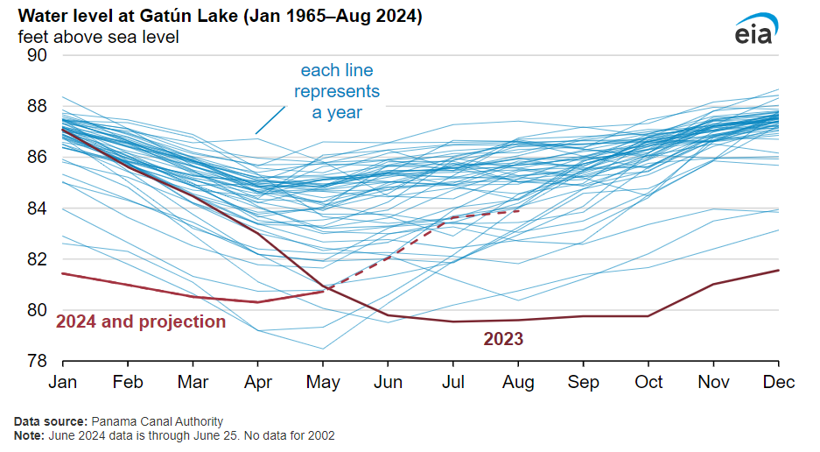
How the Canal Might Die

Slide 4
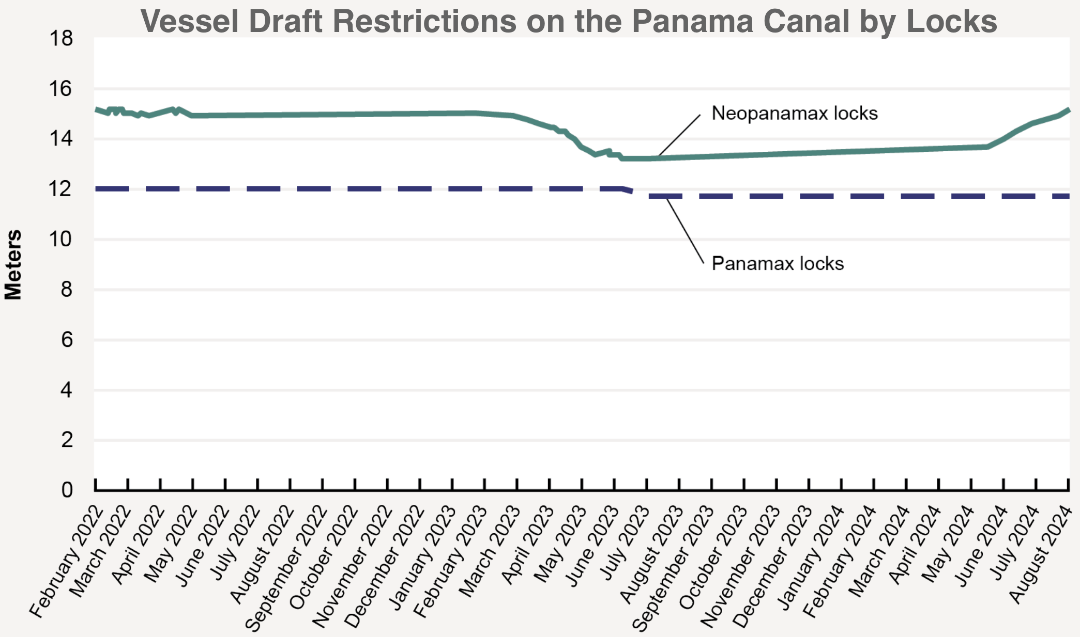
Neopanamax locks=13.24 m (43.4 ft)
Panamax locks=11.72 m (38.5 ft)

Slide 6
Prior “Unsusccessful” Revolutions in Panamá and Colombia
May and October 1850
November 1851
June 1954
December 1858
October 1861
March 1865
March 1866
August 1967
July-August 1868
April 1871
April 1873 to October 1875
August 1876 to April 1877
April 1879 and June 1879
June 1884 and December 1884
January 1885 and March 1885
January to April 1895
October 1899
February to July 1900
July 1901
July 1902
Plus other rebellions, insurrections, riots, and outbreaks that occurred every year for 53 years

Slide 7
TR was proud of the Panama Canal
By far the most important action I took in foreign affairs during the time I was President was related to the Panama Canal, Here again there was much accusation about my having acted in an “unconstitutional” manner - a position which can be upheld only if Jefferson’s action in acquiring Louisiana be also treated as unconstitutional; and a different stages of the affair believers in a do-nothing policy denounced me as having “usurped authority” - which meant that when nobody else could or would exercise efficient authority, I exercised it. - Theodore Roosevelt
Autobiography of Theodore Roosevelt, p. 512

Slide 8
“There are plenty of other things I started merely because the time had come that whoever was in power would have started them. But the Panama Canal would not have started if I had not taken hold of it, because if I had followed the traditional or conservative method, I should have submitted an admirable state paper to Congress ... the debate would be proceeding at this moment ... and the beginning of work on the canal would be 50 years in the future.
Fortunately, the opportunity came at a period when I could act unhampered. Accordingly, I took the Isthmus, started the canal, and then left Congress not to debate the canal, but to debate me.” - Theodore Roosevelt*
*from a speech given by TR at UC Berkeley on March 11, 1911.

Slide 9
The Panama Palindrome

Slide 10
A Man A Plan A Canal Panama

Slide 11
AMan APlan ACanal Panama

Slide 12
AMANAPLANACANALPANAMA

Slide 13
AMANAPLANACANALPANAMA

Slide 14
AMANAPLANACANALPANAMA

Slide 15
AMAN APLAN ACANAL PANAMA

Slide 16
A MAN A PLAN A CANAL PANAMA

Slide 17
A Man A Plan A Canal PANAMA

Slide 18
A Man A Plan A Canal PANAMA
End of Section 7

Slide 19
Extra Slides

Slide 20
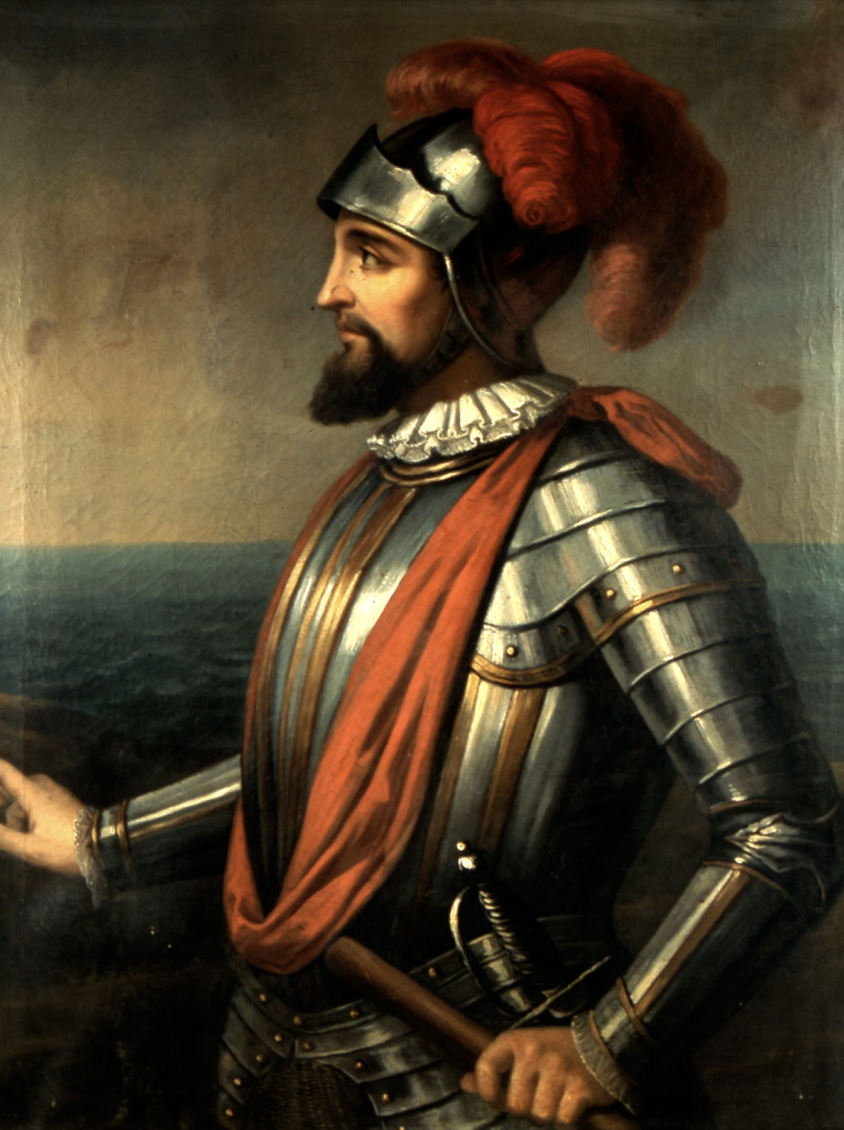
The Era of Exploration and Discovery 1513
Vasco Núñez de Balboa discovered the isthmus of Panama in 1513
Balboa was a Spanish explorer, governor, and conquistador
He is best known for crossing the Isthmus of Panamá to the Pacific Ocean in 1513, becoming the first European to lead an expedition to have seen or reached the Pacific from the New World
Many things in Panamá are named for Balboa…

Slide 21
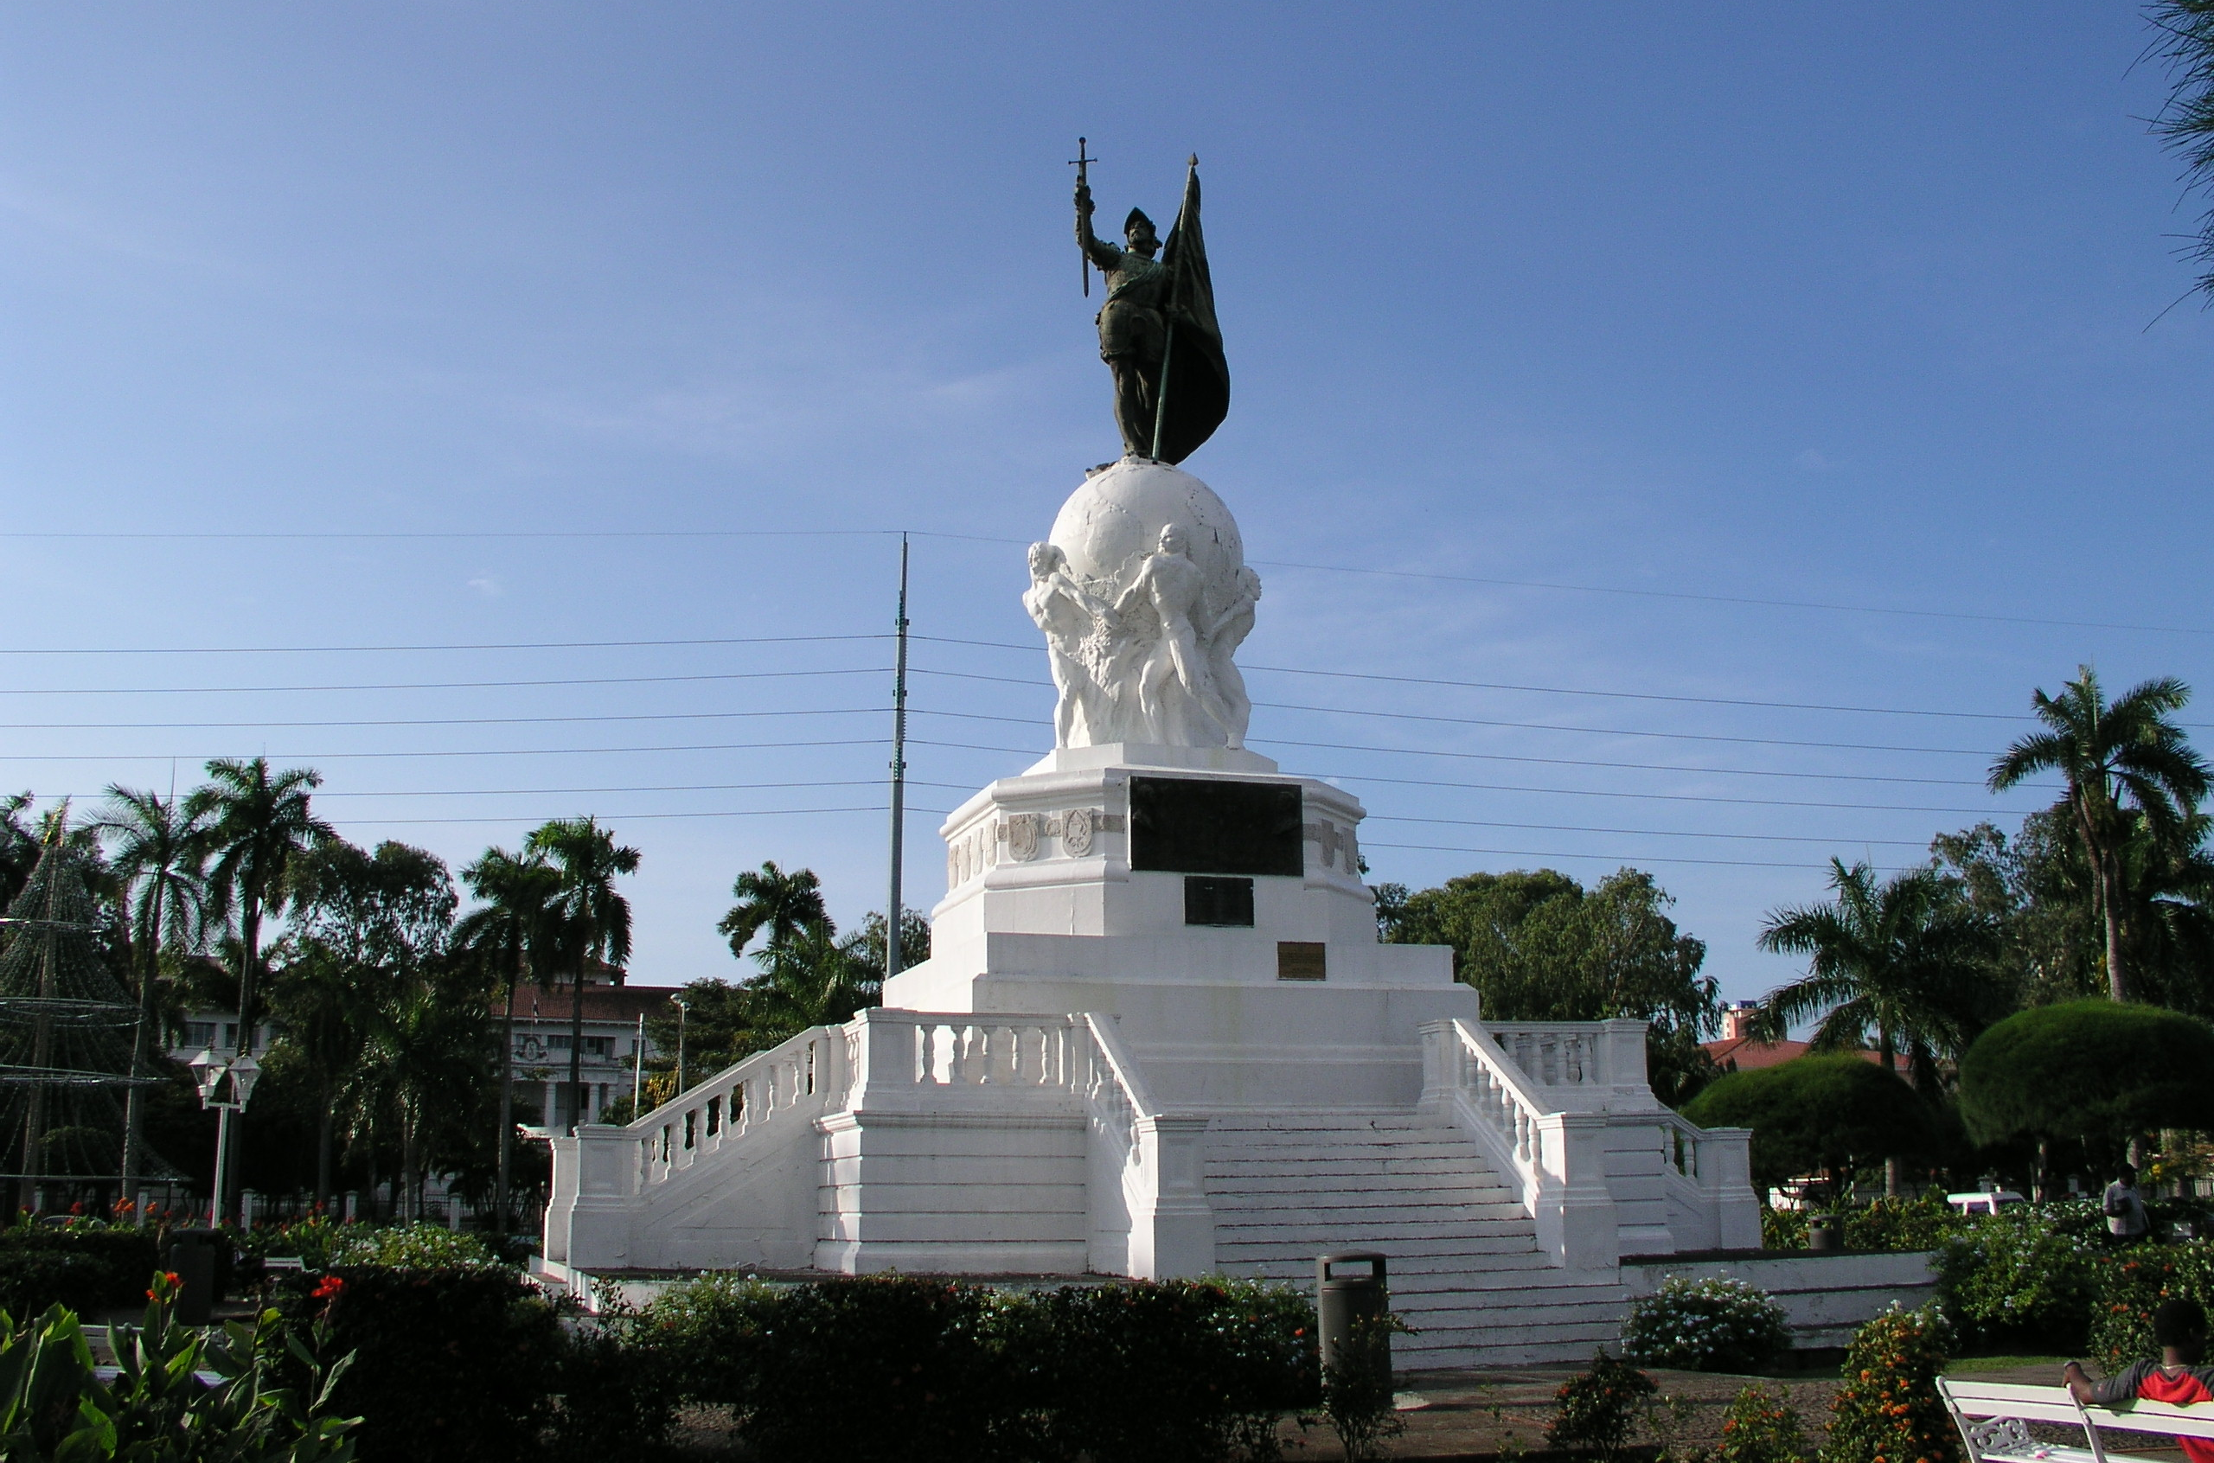
The Balboa Memorial

Slide 22
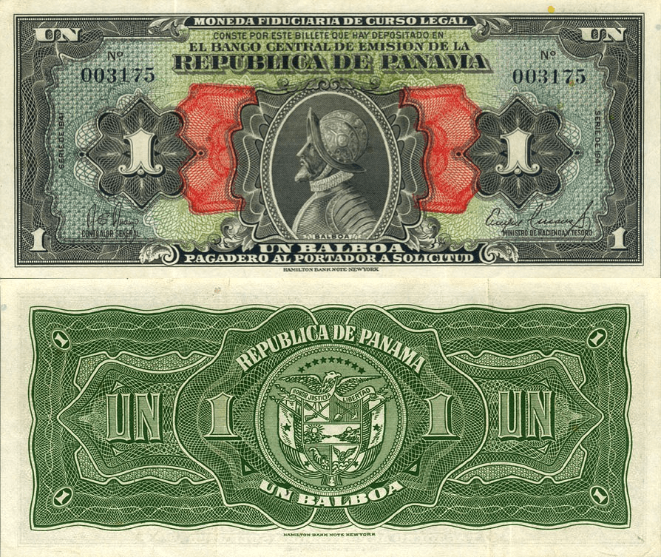
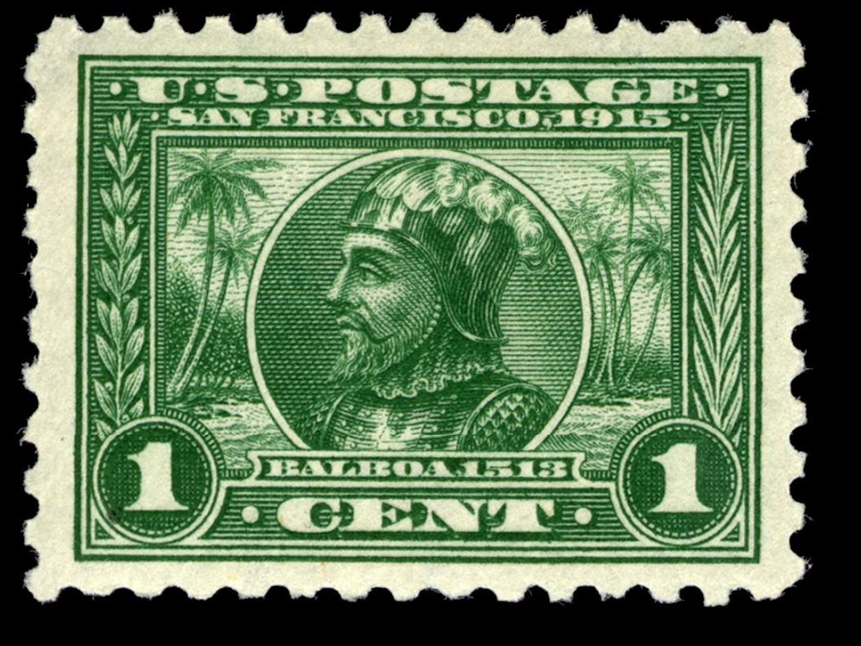
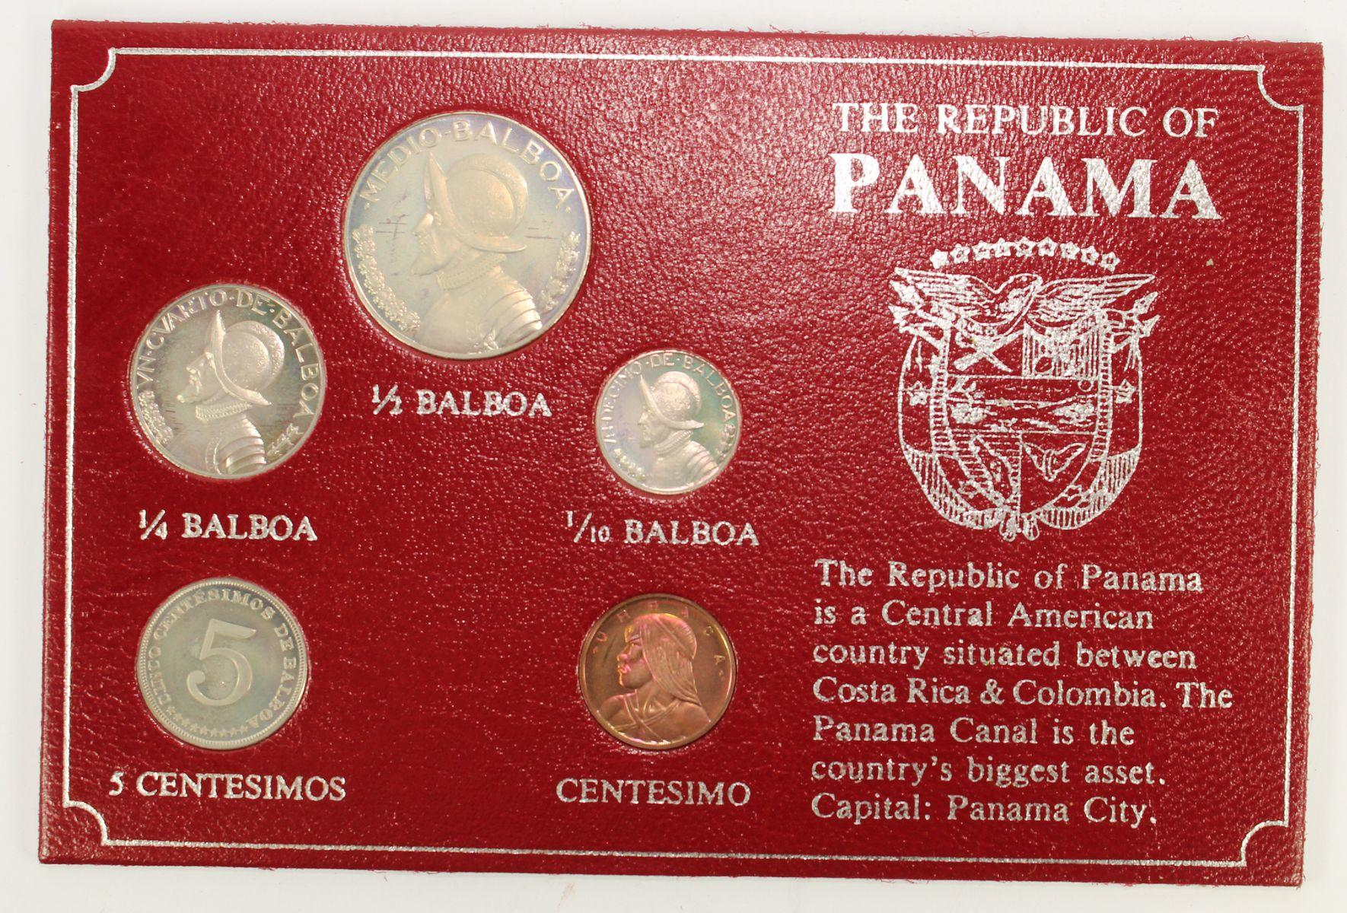
Government Issued “Balboas”
Currency and Coins
Postage Stamps
1 Panamanian Balboa (B/.) = 1 US Dollar ($)
1 Centavo, 1904 issue

Slide 23
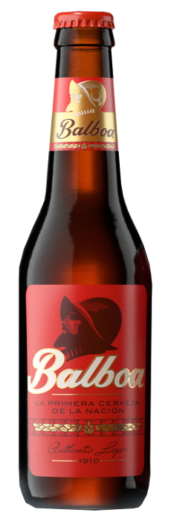
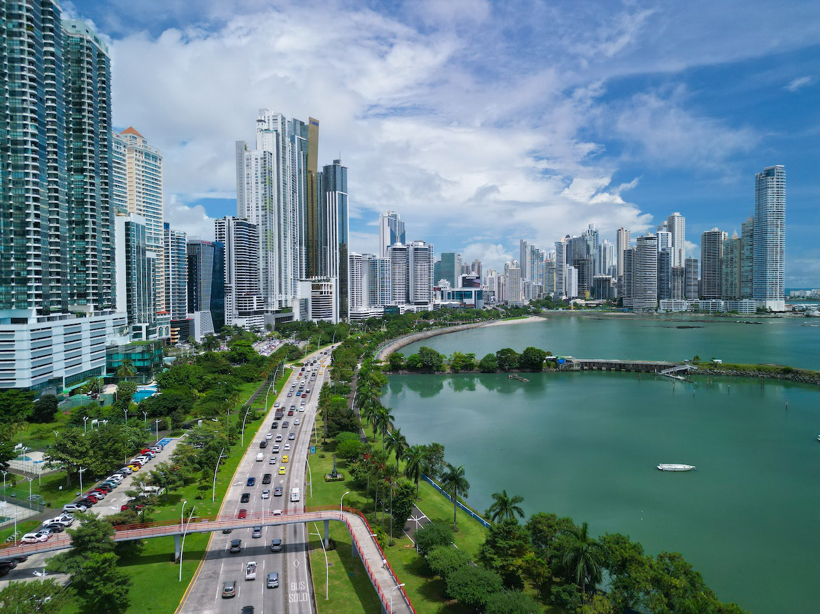
Panamá City’s Largest Street and …
Panamá’s
National
Beer!
Avenida Balboa

Slide 24
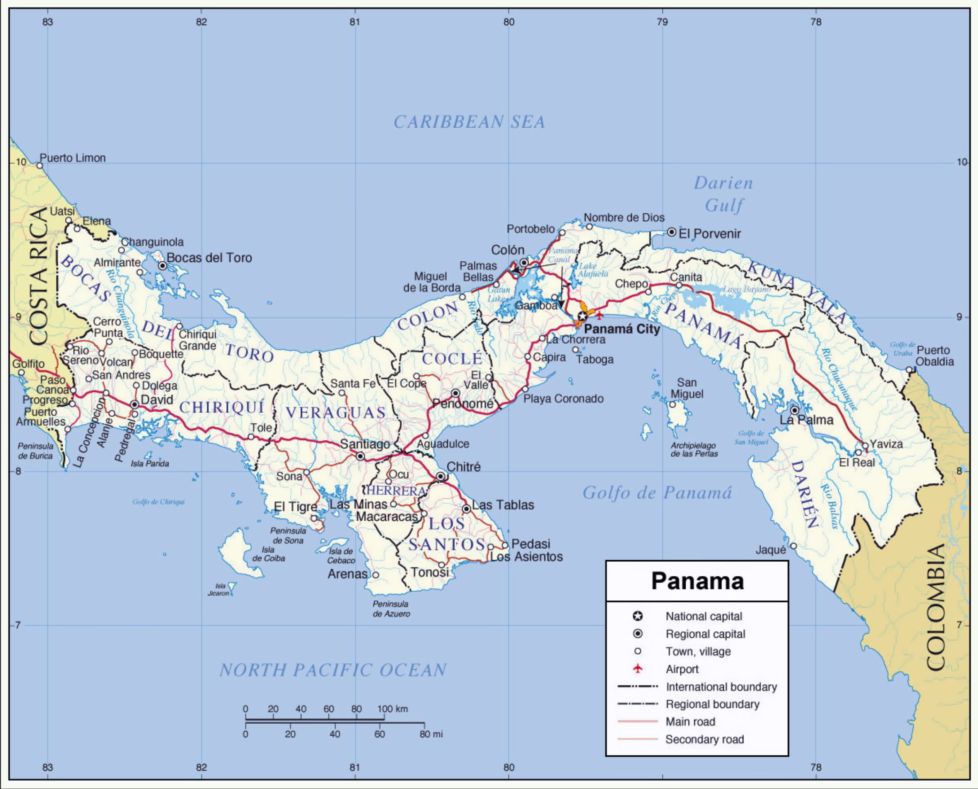
Careta
Isla Rica
San Miguel
Tumaco
Outward
Return

Slide 25
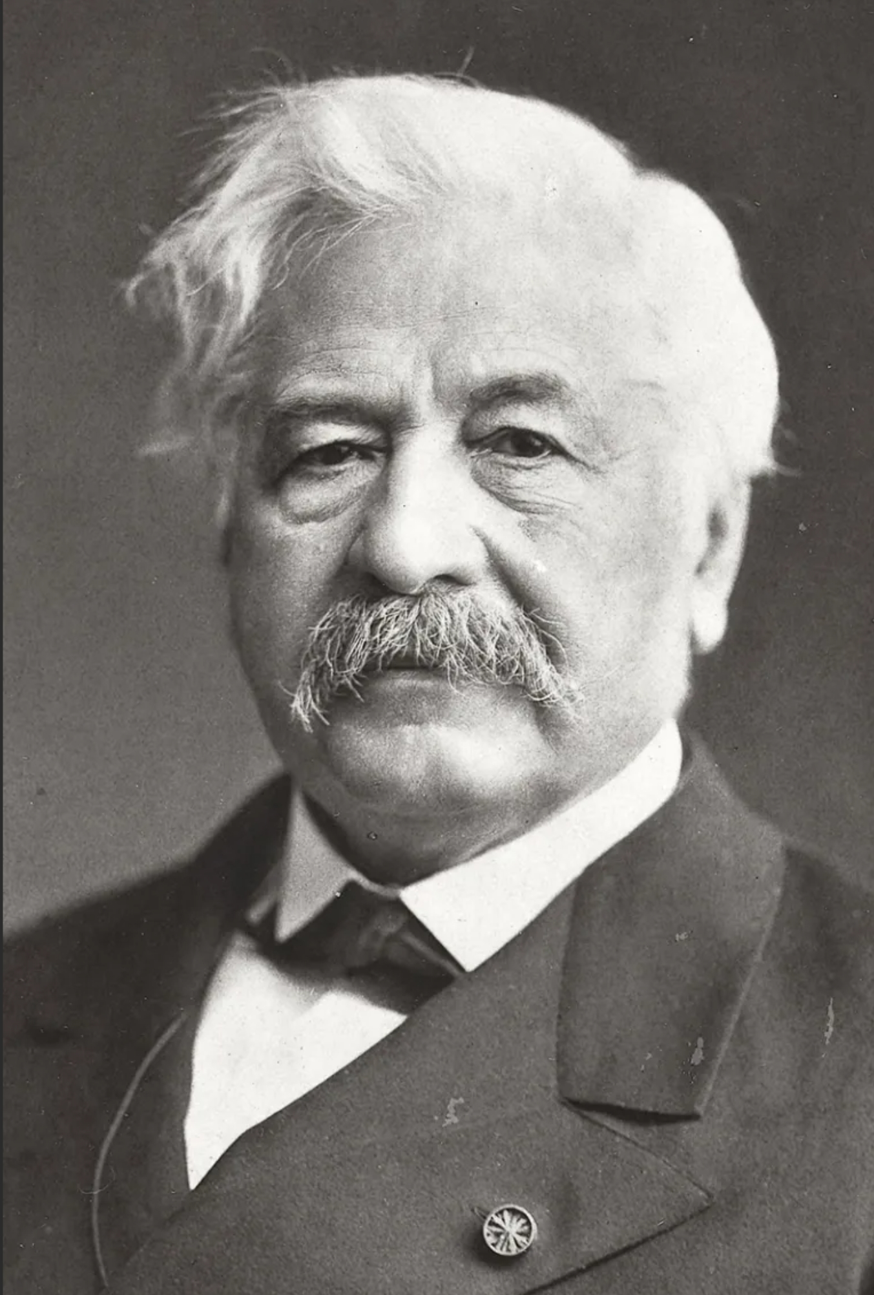
The Pioneer Era 1880 to 1889
Count Ferdinand de Lesseps was the beloved entrepreneur who led the successful and profitable effort to build the Suez Canal
He married for the second time at age 64 and fathered 12 children. A feat that many thought to be as great as building the Suez Canal!
He was considered to be a great man in France
He then organized the first attempt to construct a canal in Panama
He was not an engineer and had no experience of the dangers of working in the tropics
He believed that if was possible to construct a canal at sea-level – a fatal error
His management of the Panamá Canal was remote and naïve and led to failure
Everyone who invested in the French effort to build the Panamá Canal lost all their money

Slide 26
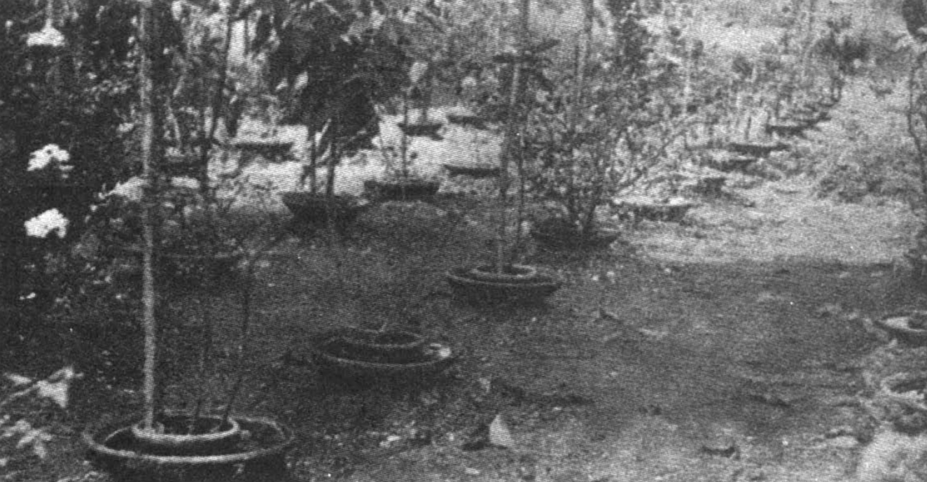
Crockery rings filled with water were used by the French to protect plants on the hospital grounds from the ravages of umbrella ants, but also served as perfect breeding grounds for Stegomyia fasciata, the yellow-fever mosquito
From Mosquito Control by J. Le Prince and G. P. Putnam, 1916 and McCullough, 1977

Slide 27
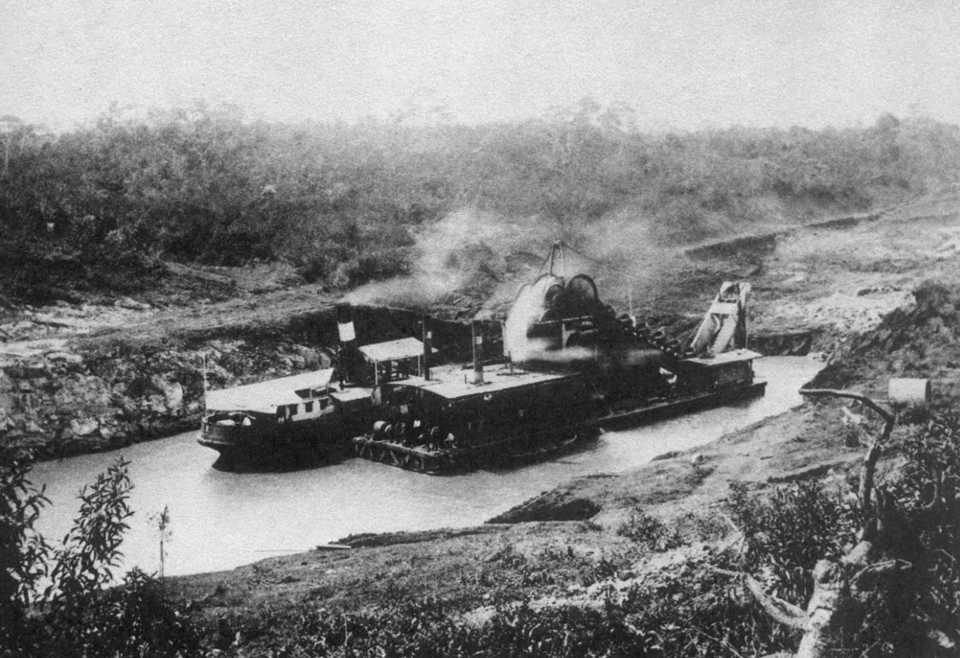
The French from 1880 to 1889

Slide 28
The Causes of the French Failure
Their attempt was about 10 years too early because:
They were stopped by tropical diseases and impossible goal of building a sea-level canal
They did not have knowledge about how to manage public health for living and working in the tropics
The lacked modern building materials (i.e. steel and concrete) and could not obtain these materials in France
The French engineers believed in their design computations rather than being able to work with empirical results from field and laboratory testing, but the main reason was
They ran out of money!

Slide 29
The Leaders of the US Effort, 1904-1914
Theodore Roosevelt was US President from 1902 to 1909. He was the man who took Panamá from Colombia by force to create the Republic of Panamá in November 1903 and began construction of the canal in 1904
John Findlay Wallace was the Chief Engineer. He quit after three months on the job. (Quitting, was his only real accomplishment, because his replacement, John Stevens, saved the project and got it running)
John Frank Stevens, organized and managed the expansion of railroads in the western US, was the second Chief Engineer. For two years he supported Gorgas public health efforts. Then organized the excavation work using trains to remove the soil and rock, quit, (possibly due to burn out).
Col. George Washington Goethals, was the third Chief Engineer. He led USACE oversaw the construction of the locks and the start of canal operations. (TR selected Goethals to the position because he was an Army officer and could not quit like Wallace and Stevens did.)
William C. Gorgas headed the public health efforts in Panama during the construction of the canal (i.e. draining all stagnant pools of water, and, for a time, mowing the grass)
Lieutenant Colonel David DuBose Gaillard oversaw the most difficult section of the Canal, the 9-mile Culebra Cut. In 2000, the Culebra Cut was renamed the Gaillard Cut in his honor.

Slide 30
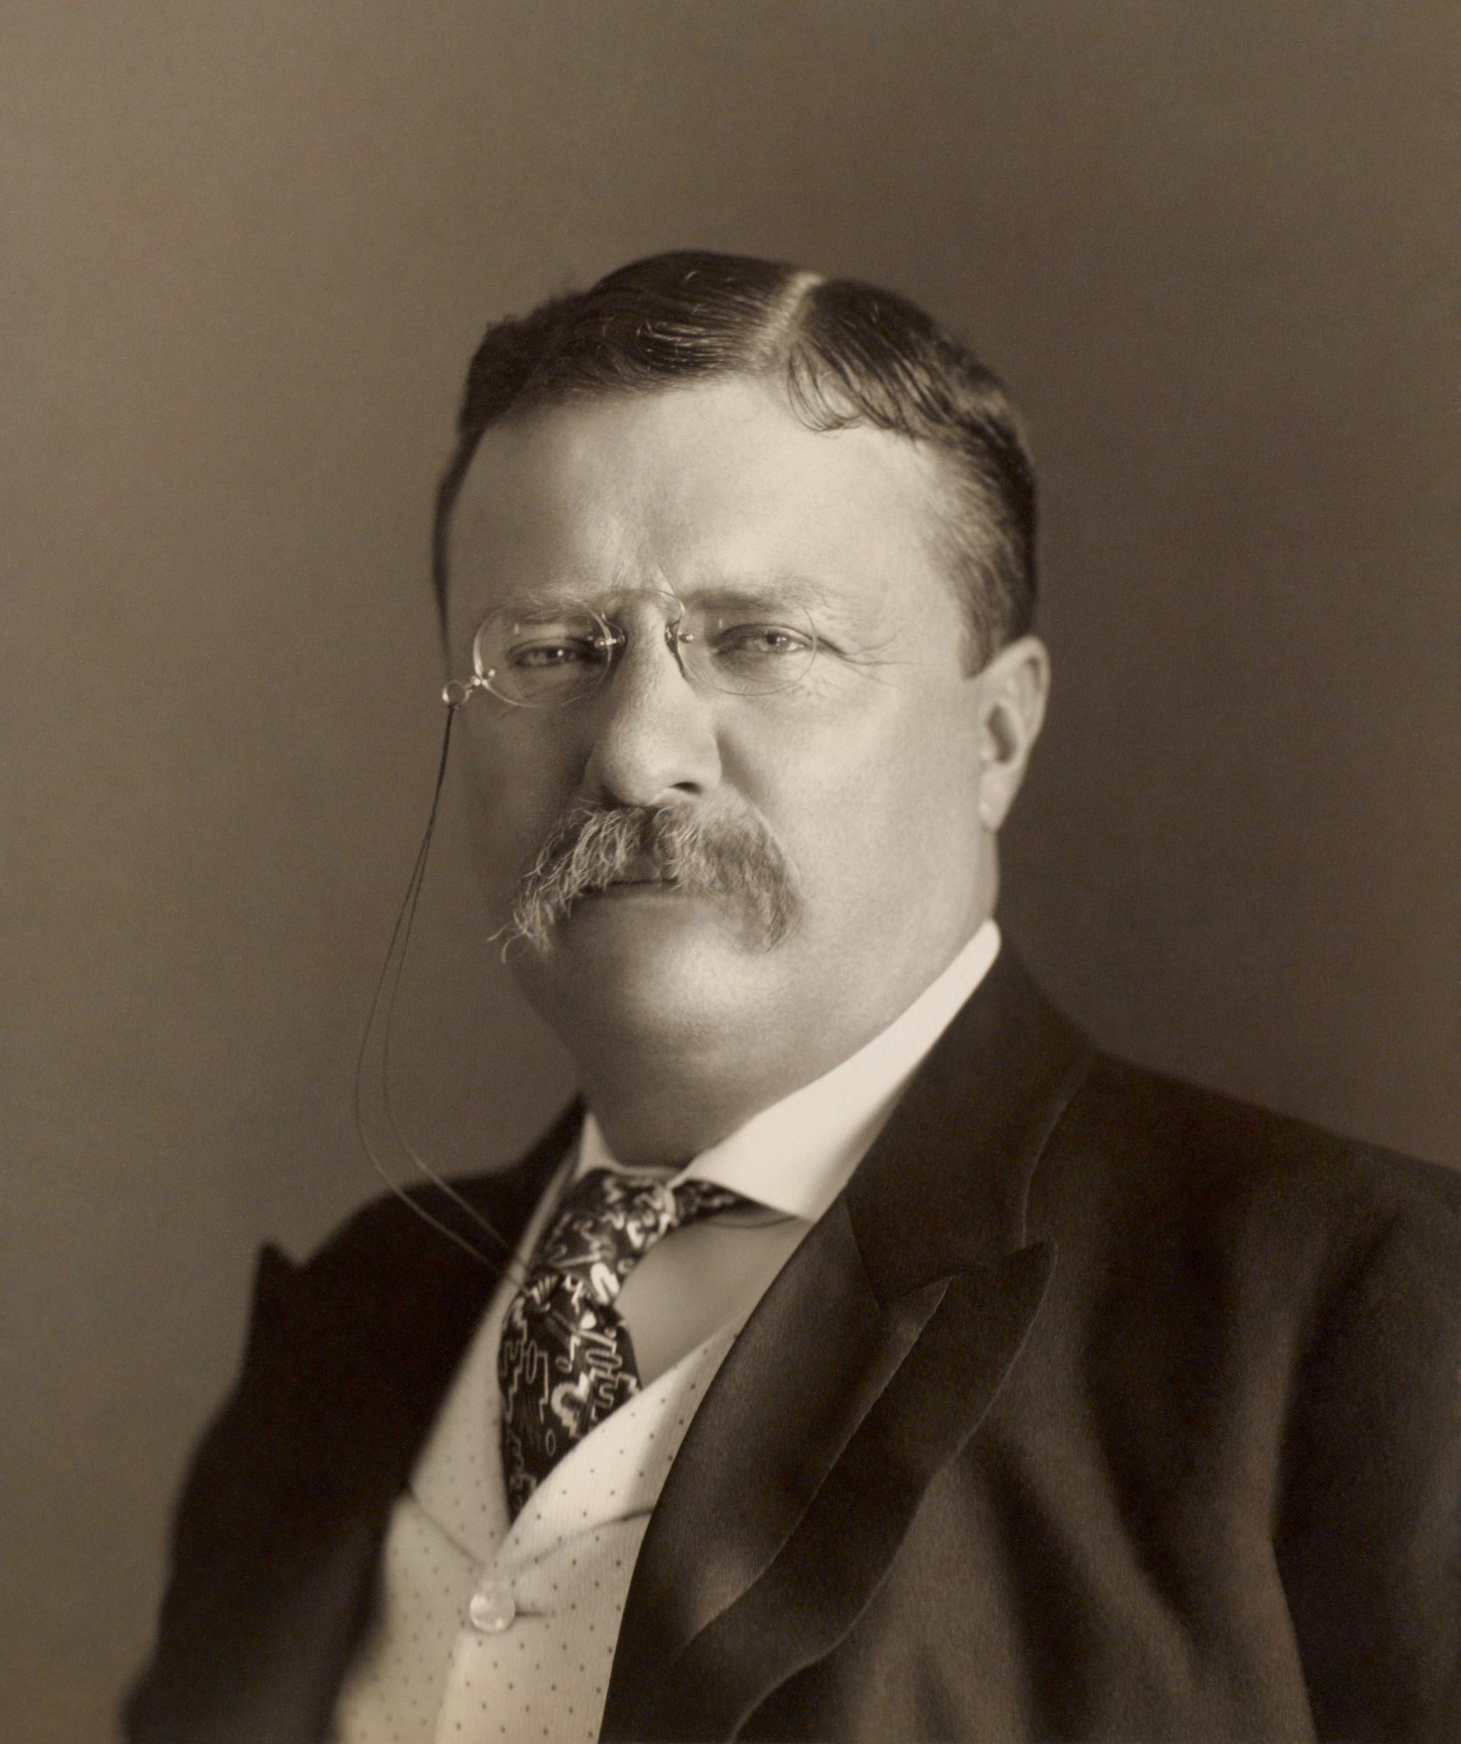
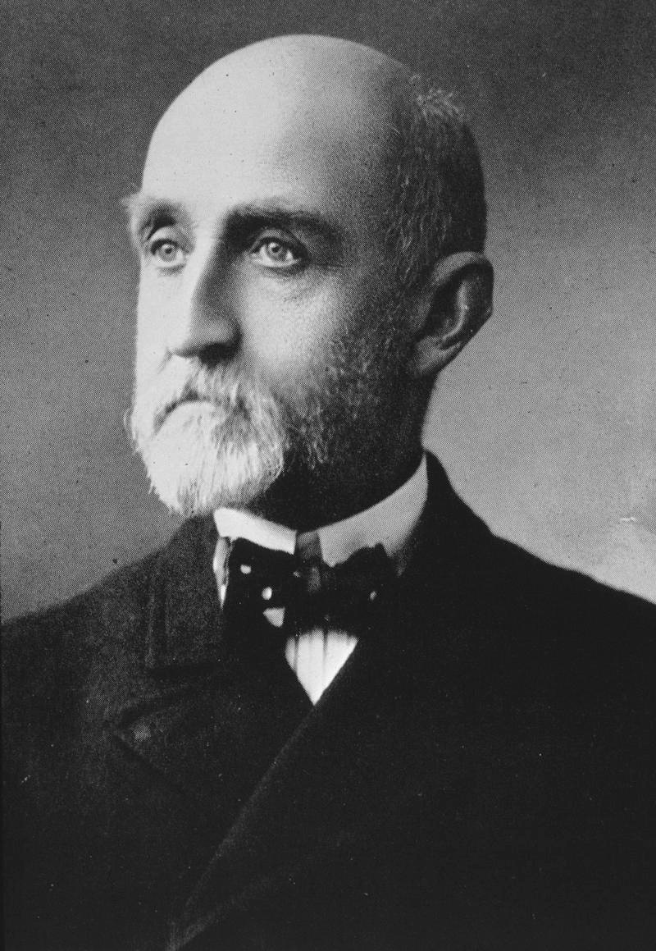
Theodore Roosevelt
President of the United States
Alfred Thayer Mahan
Professor, Naval War College
Notes:
TR met Mahan when he was a visiting lecturer at the Naval War College. Mahan showed TR the importance that a Panama Canal for development as a major economic power and as a Naval power.

Slide 31
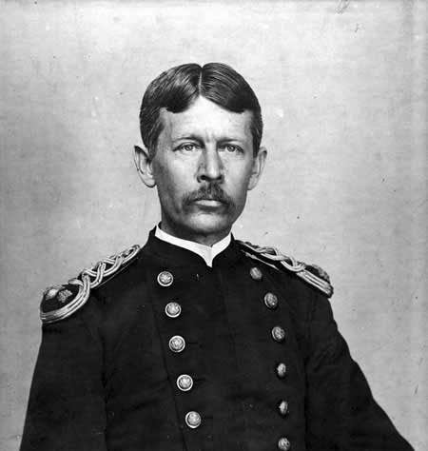
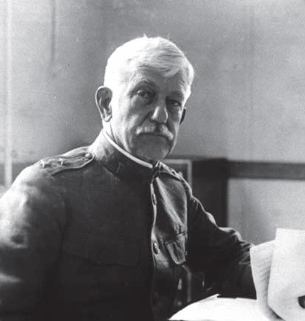
Major Walter Reed, MD
1851-1902
Major General William C. Gorgas, MD
1854-1920
Notes:
Walter Reed confirmed the belief that mosquitos were the disease vector for yellow fever during the Spanish American War. William C. Gorgas made Panama a safe place to work by draining all stagnant water along the route of the canal and throughout the Canal Zone.

Slide 32
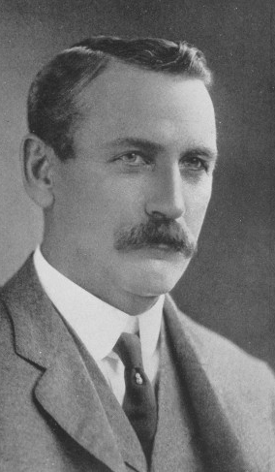
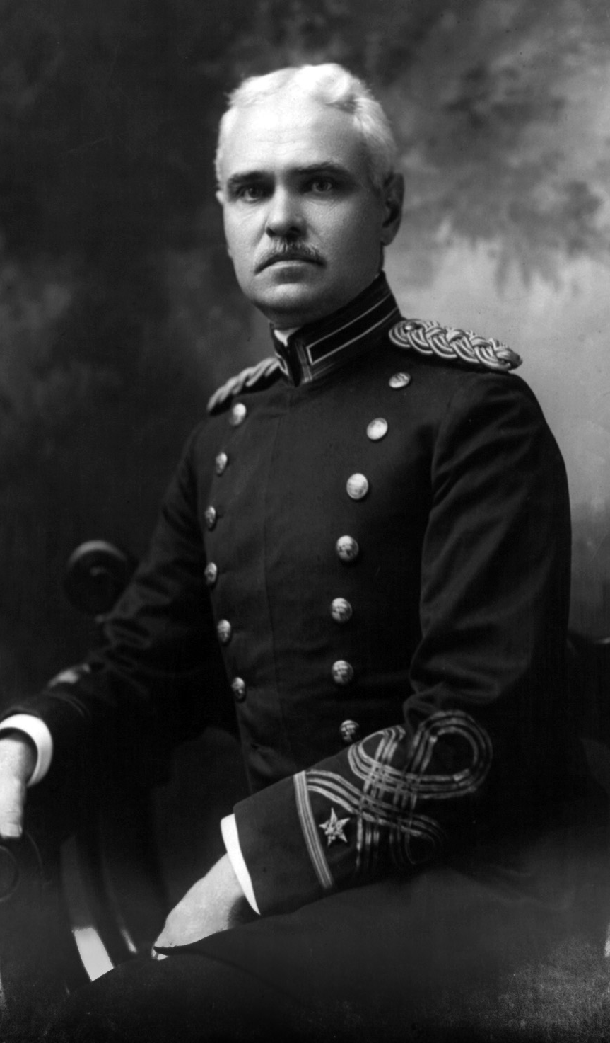
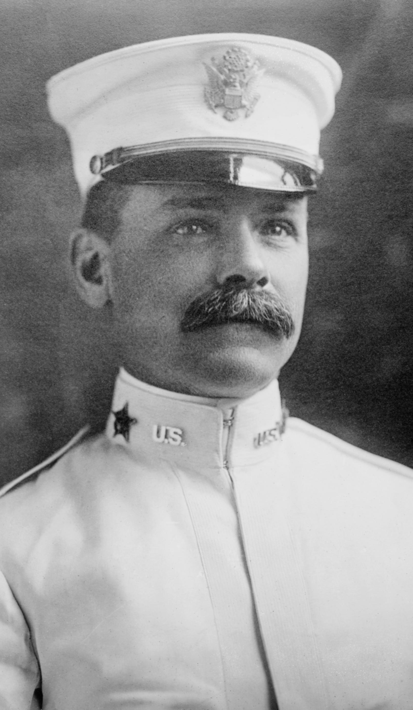
John Frank Stevens
USACE
Col. George W. Goethals
USACE
Lt. Col. David Gaillard
USACE
Notes:
John Stevens did no work on the canal for two years and worked on public health projects of Gorgas instead.
After two years he started the new excavating work. He quickly saw the problem of removing excavated soil and rock from the route of the canal as a major bottleneck. He then adapted the use of movable rail lines and trains to remove the spoil. Then quit. He was free to quit because he was a civilian employee of the USACE.
TR was mad that Stevens quit, so he appointed G. W. Goethals as his replacement because, as an Army officer, he could not quit like Stevens did. This was fortunate because of Goethals’ prior experience in building locks along the upper Mississippi, Ohio, and Tennessee Rivers.
Gaillard finished the most difficult part of the Culebra Cut

Slide 33
Admiral Alfred Thayer Mahan
Professor of history and of naval tactics at the Naval War College in Newport, Rhode Island
President of the Naval War College from June 1886 to January 1889 and from July 1892 to May 1893
Theodore Roosevelt met Thayer when he was a visiting Lecturer at the Naval War College in 1888
His works include:
The influence of Sea Power Upon History, 1660–1783, (1890)
The Influence of Sea Power upon the French Revolution and Empire, 1793–1812 (1892)
The Life of Nelson (Vols. 1 and 2)
The Interest of America in Sea Power, Present and Future, (1897)

Slide 34
Theodore Roosevelt did This in 5 Years (1896 to 9/14/1901)
Served as Assistant Secretary of the Navy during William McKinley’s first term
Resigned to form the Rough Riders to fight in the Spanish-American War in 1898
Elected Governor of New York in 1898 after the Spanish-American War
New York state Republican Party leadership disliked his ambitious agenda and convinced President William McKinley to select him to be Vice-President in 1900
Served as Vice-President for six months prior to the assassination of President William McKinley
Assumed the Presidency on September 14, 1901, at age 42 to become the youngest President in American history
His foreign policy was strongly influenced by the writings of Admiral Alfred Thayer Mahan
TR believed that by building the Panama Canal the US would command the seas because it could move its ships between the seas via the canal

Slide 35
Admiral Alfred Thayer Mahan
Professor of history and of naval tactics at the Naval War College in Newport, Rhode Island
President of the Naval War College from June 1886 to January 1889 and from July 1892 to May 1893
Theodore Roosevelt met Thayer when he was a visiting Lecturer at the Naval War College in 1888
His works include:
The influence of Sea Power Upon History, 1660–1783, (1890)
The Influence of Sea Power upon the French Revolution and Empire, 1793–1812 (1892)
The Life of Nelson (Vols. 1 and 2)
The Interest of America in Sea Power, Present and Future, (1897)

Slide 36
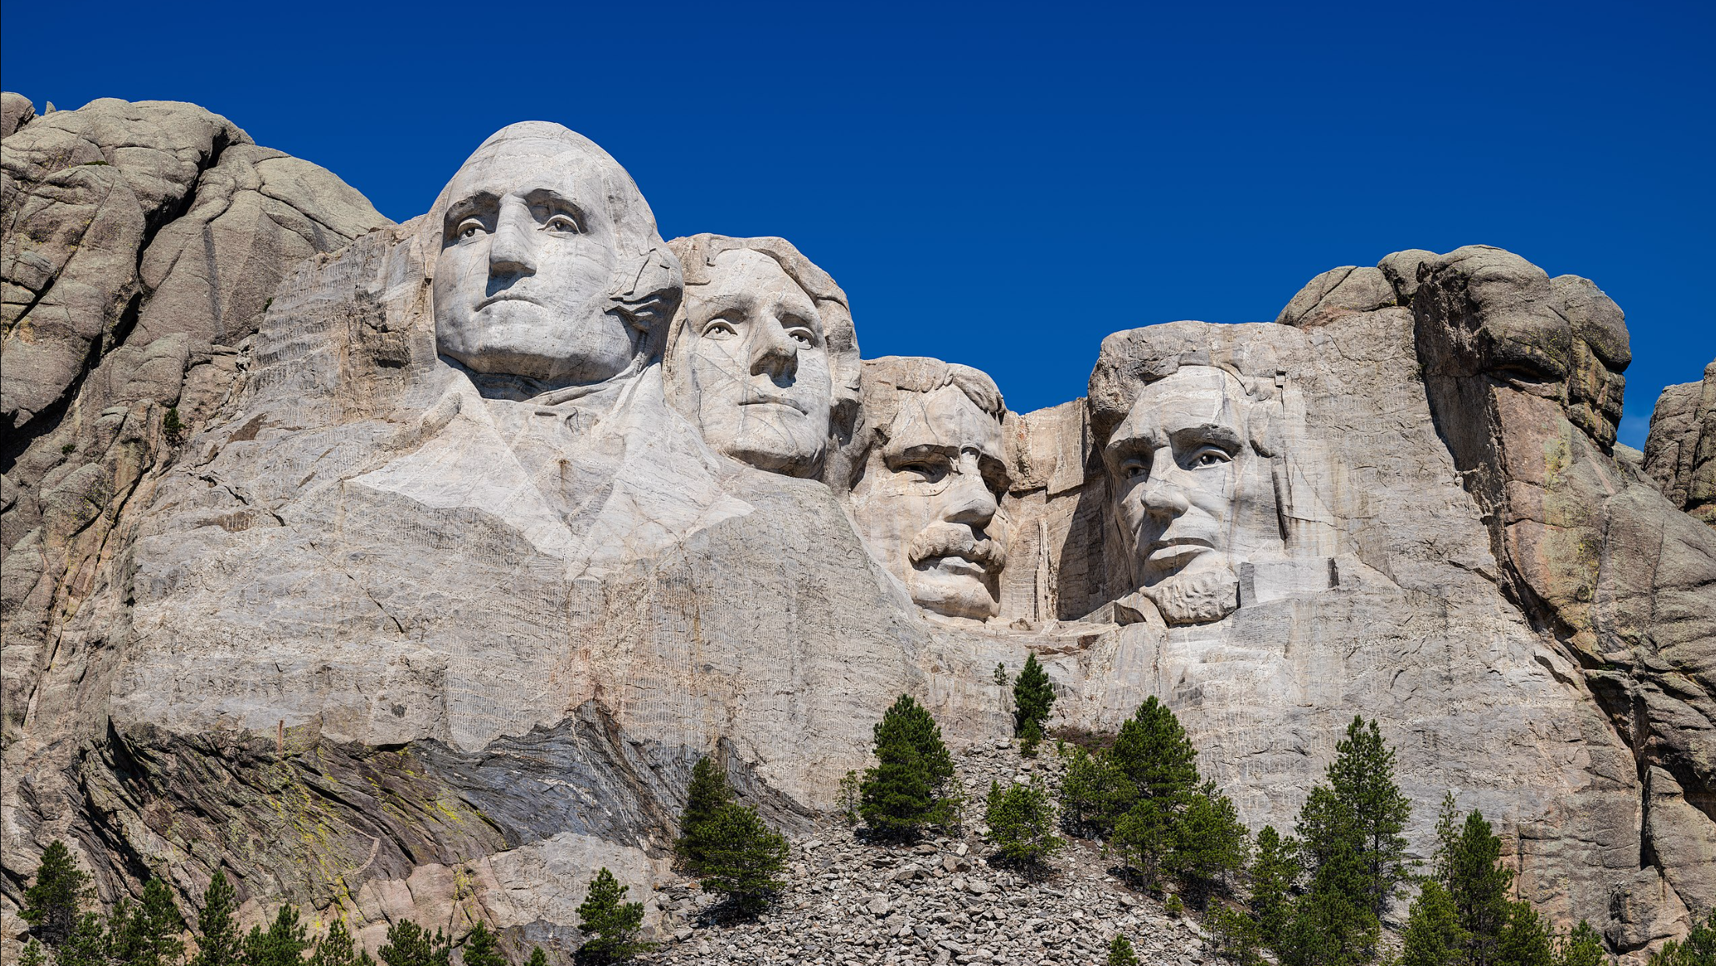
Notes:
George Washington founded the United States.
Thomas Jefferson expanded the United States.
Theodore Roosevelt enforced the Monroe Doctrine and made the US a world power in economics and naval power.
Abraham Lincoln saved the United States.

Slide 37
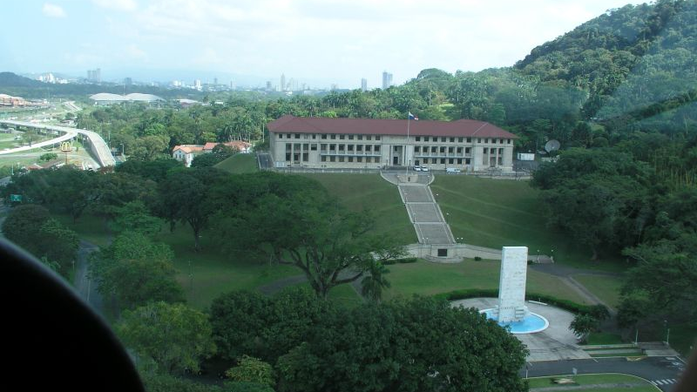
Headquarters Building of the
Autoridad del Canal de Panamá

Slide 38
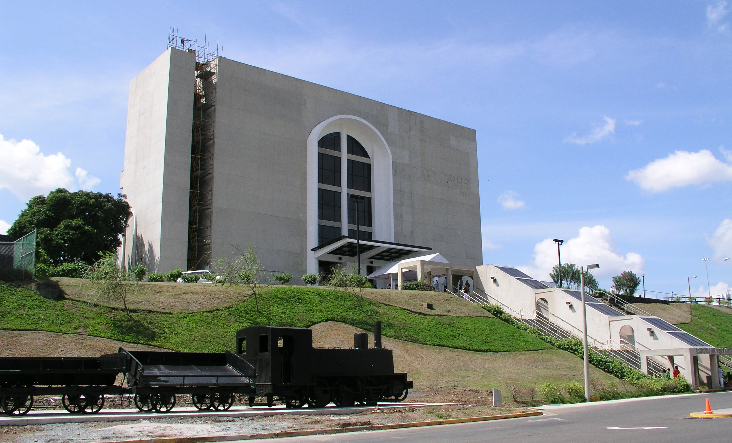
Panama Canal Museum at Miraflores Locks

Slide 39
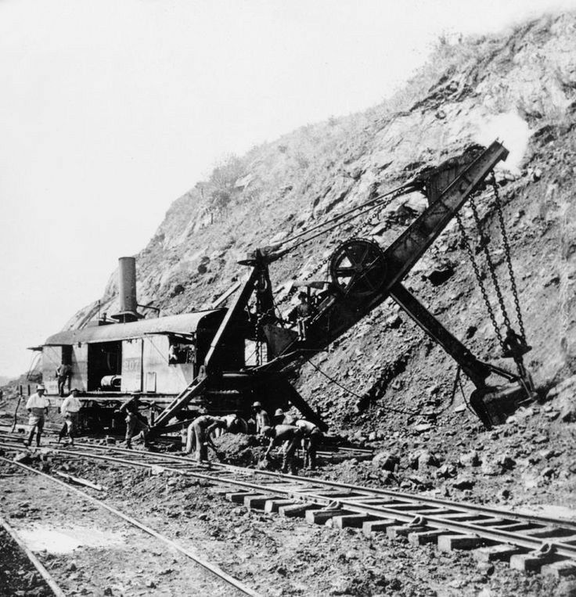
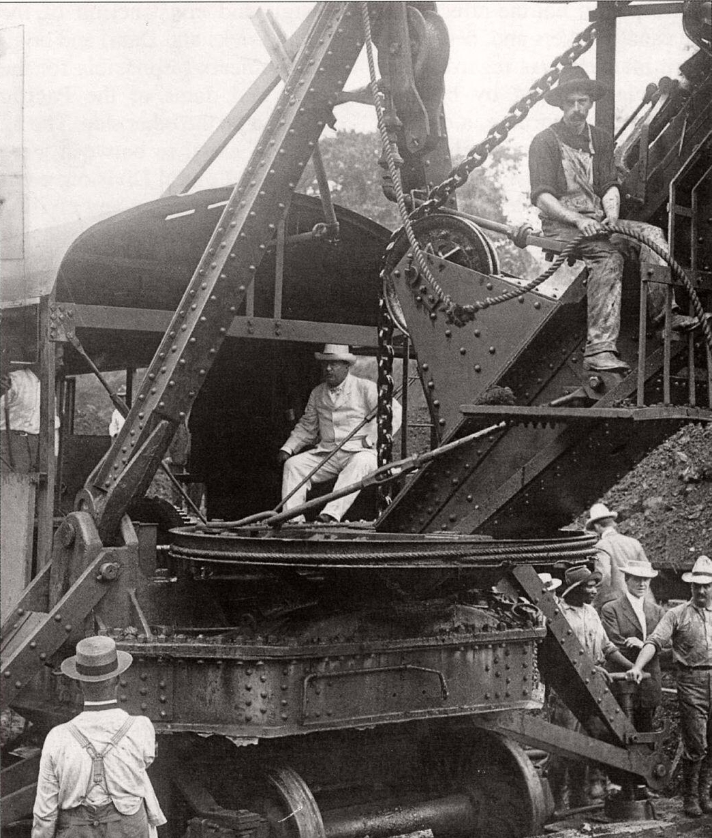
Theordore Roosevelt in 1912

Slide 40
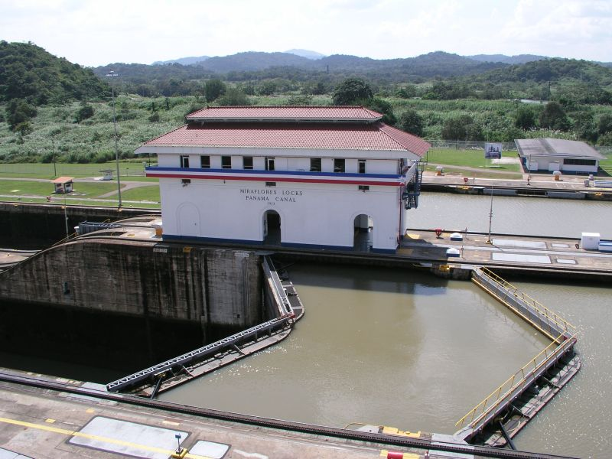
Miter Gates at Miraflores Locks

Slide 41
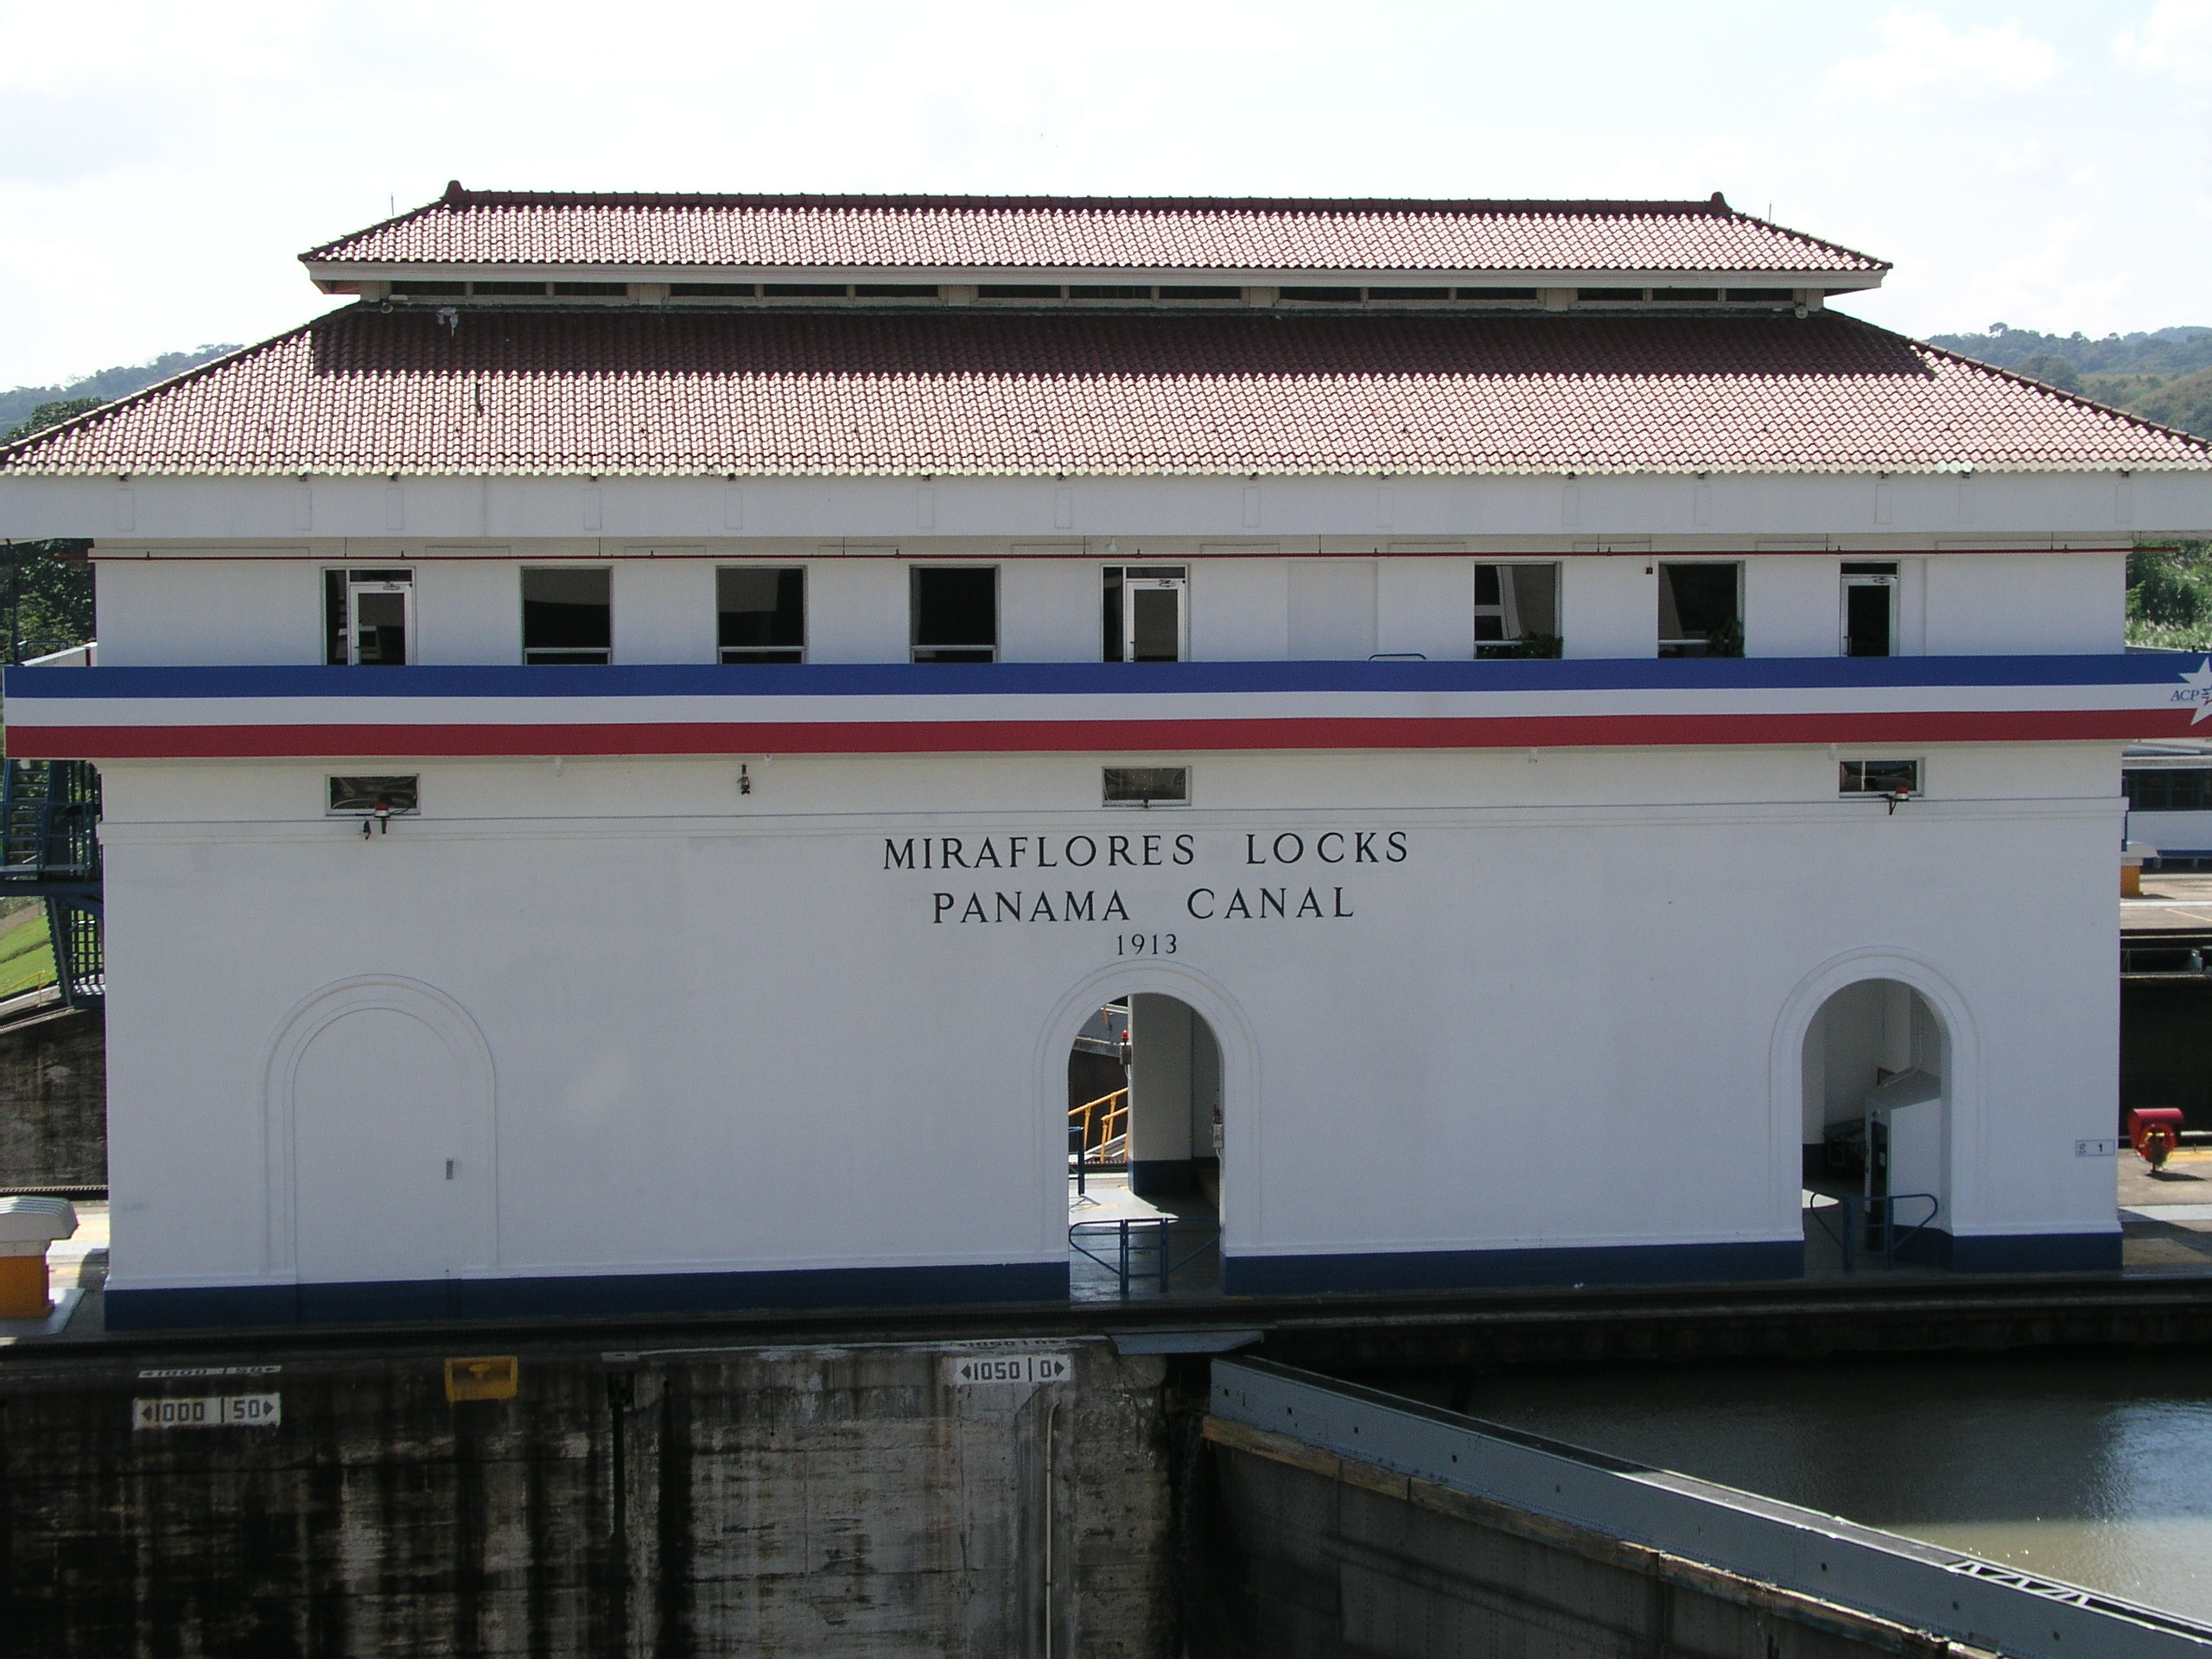
Notes:
15

Slide 42
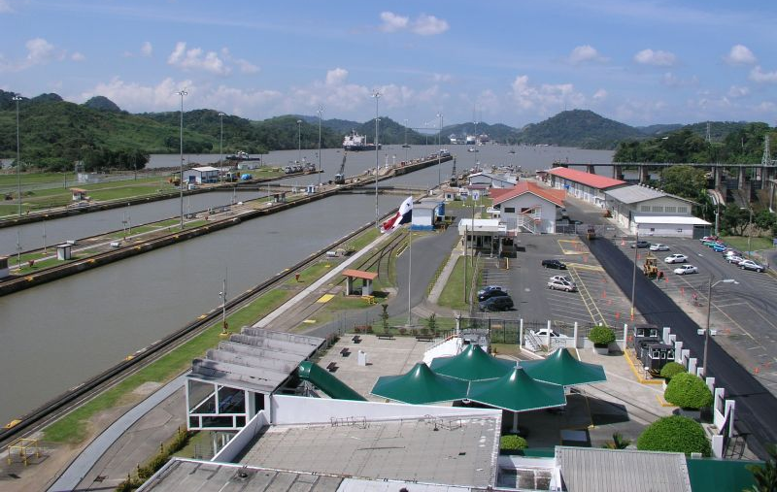
Looking Upstream to Pedro Miguel Locks

Slide 43
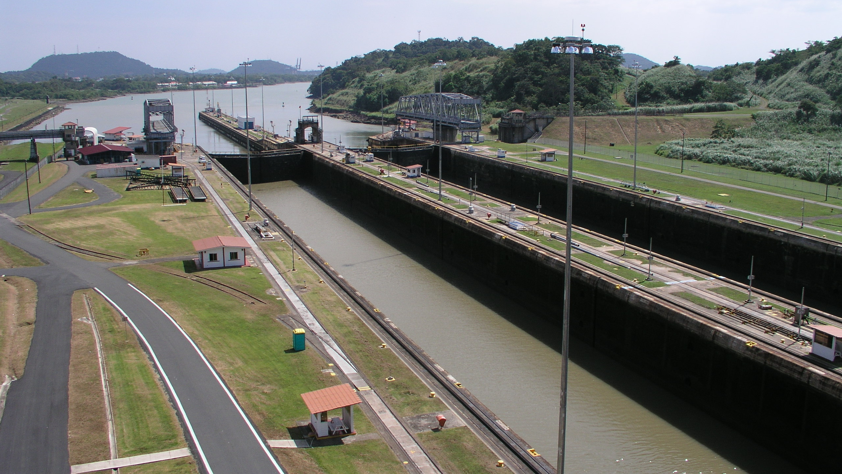
Looking Downstream
to the Pacific Ocean

Slide 44
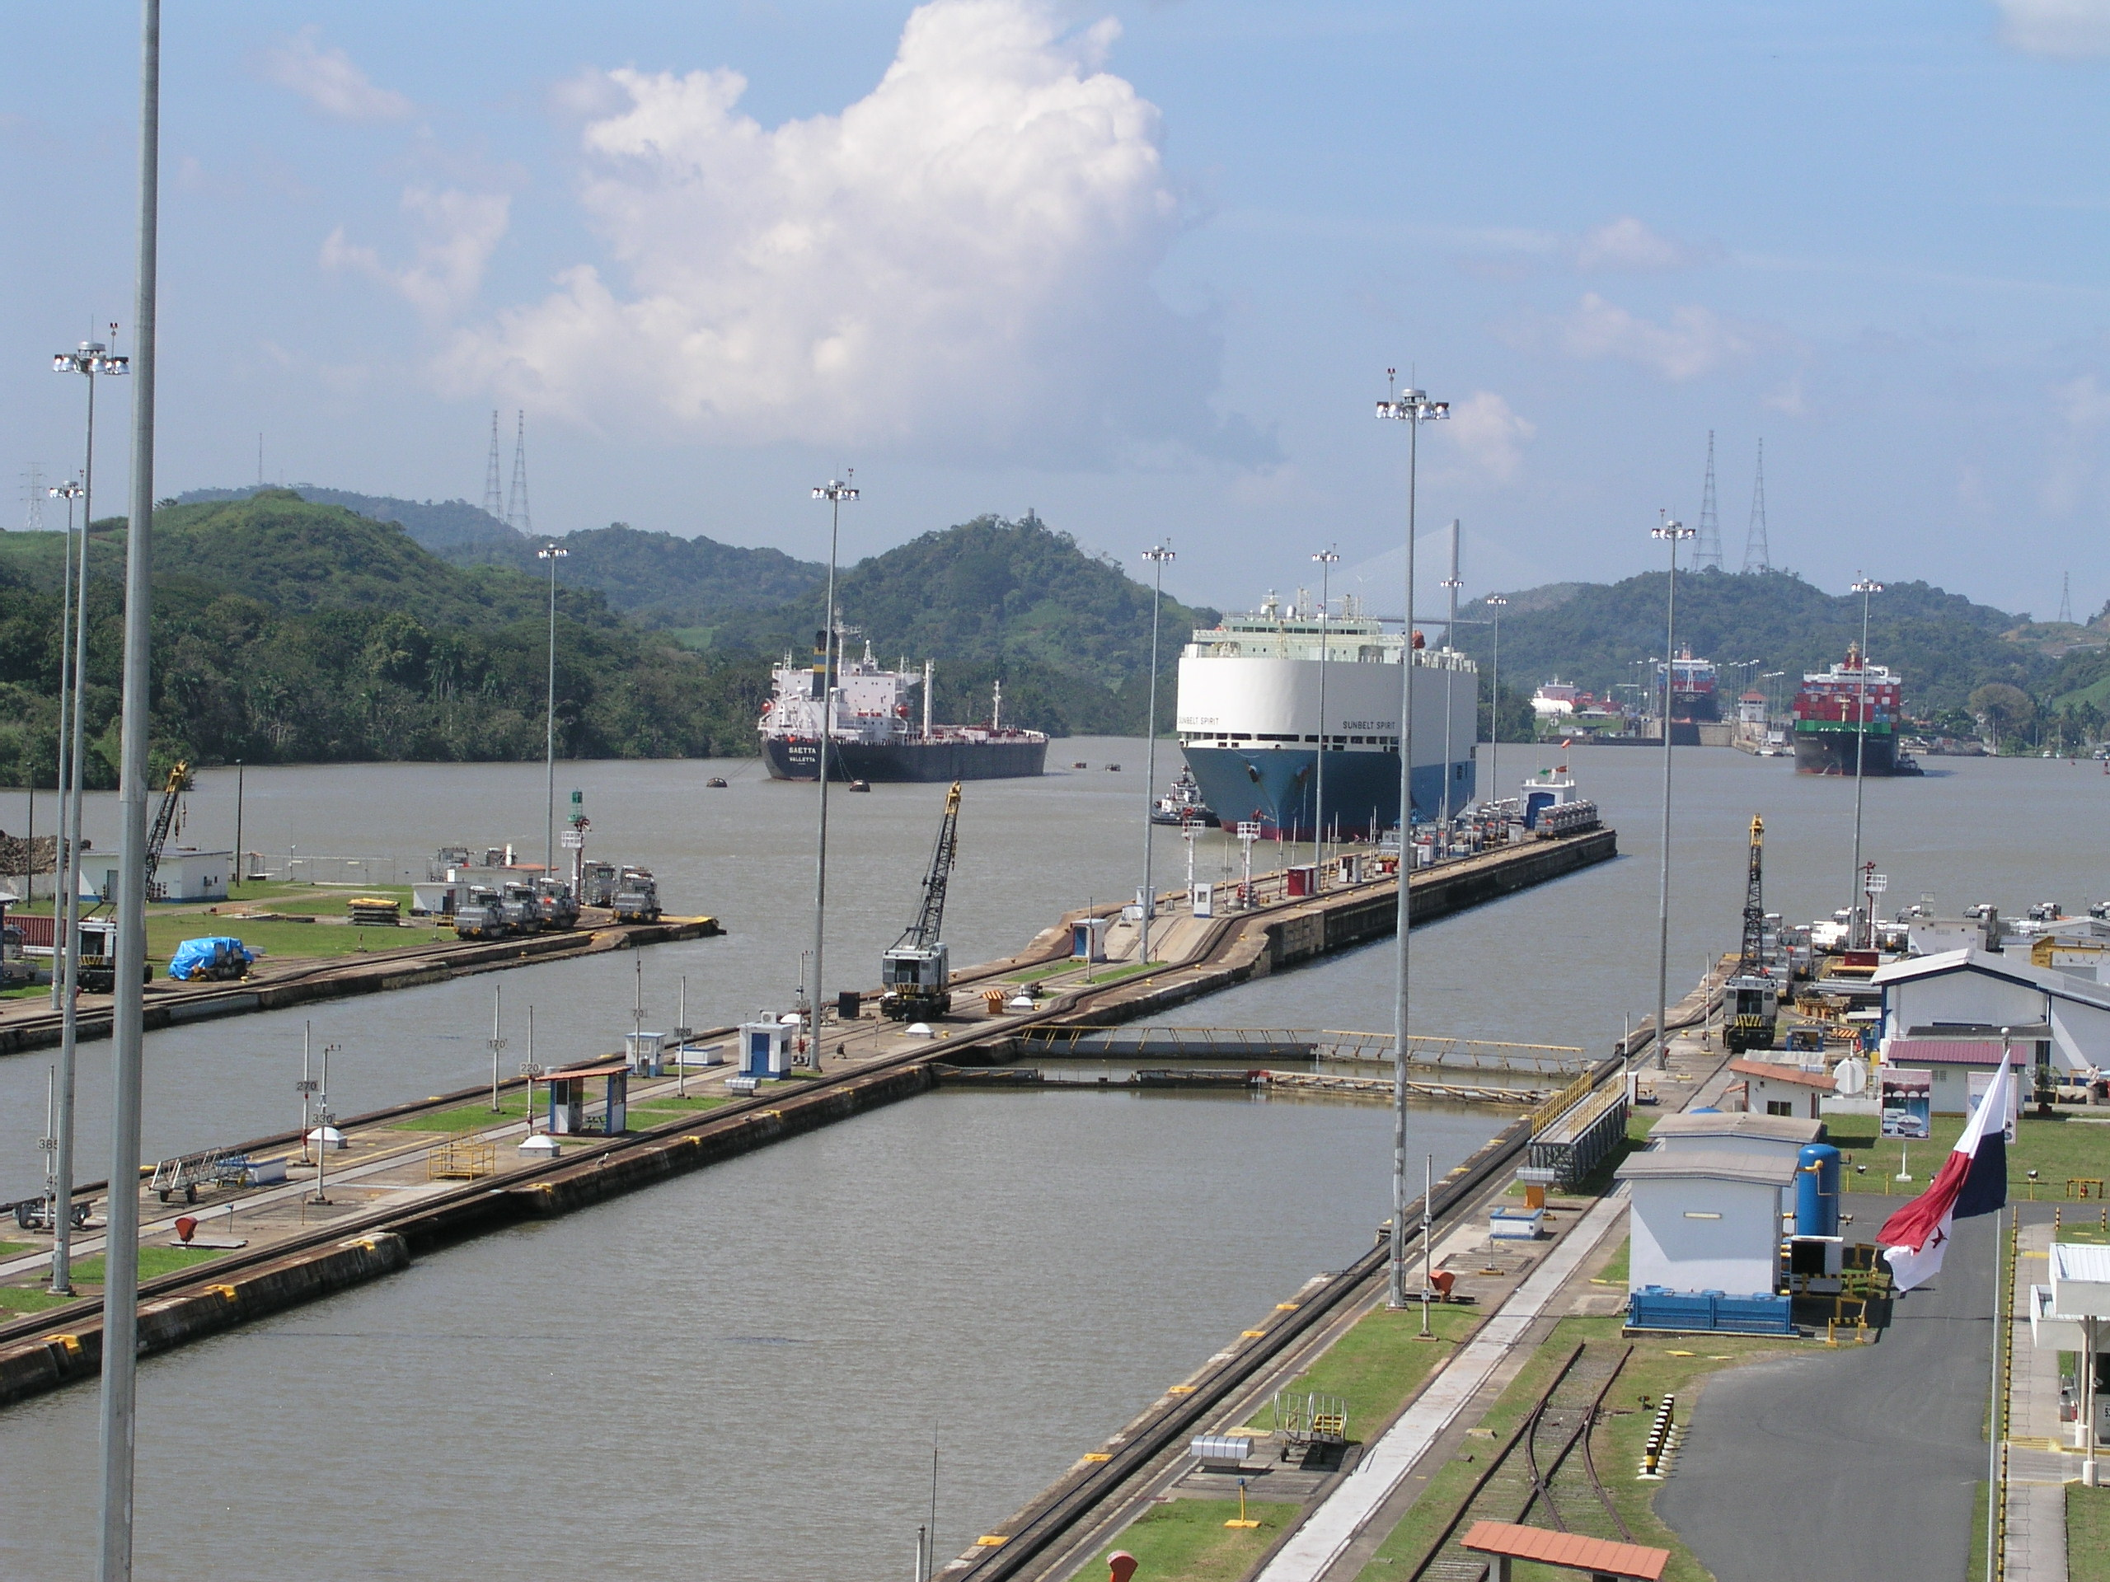
Pedro Miguel Locks
Control House
Notes:
13

Slide 45
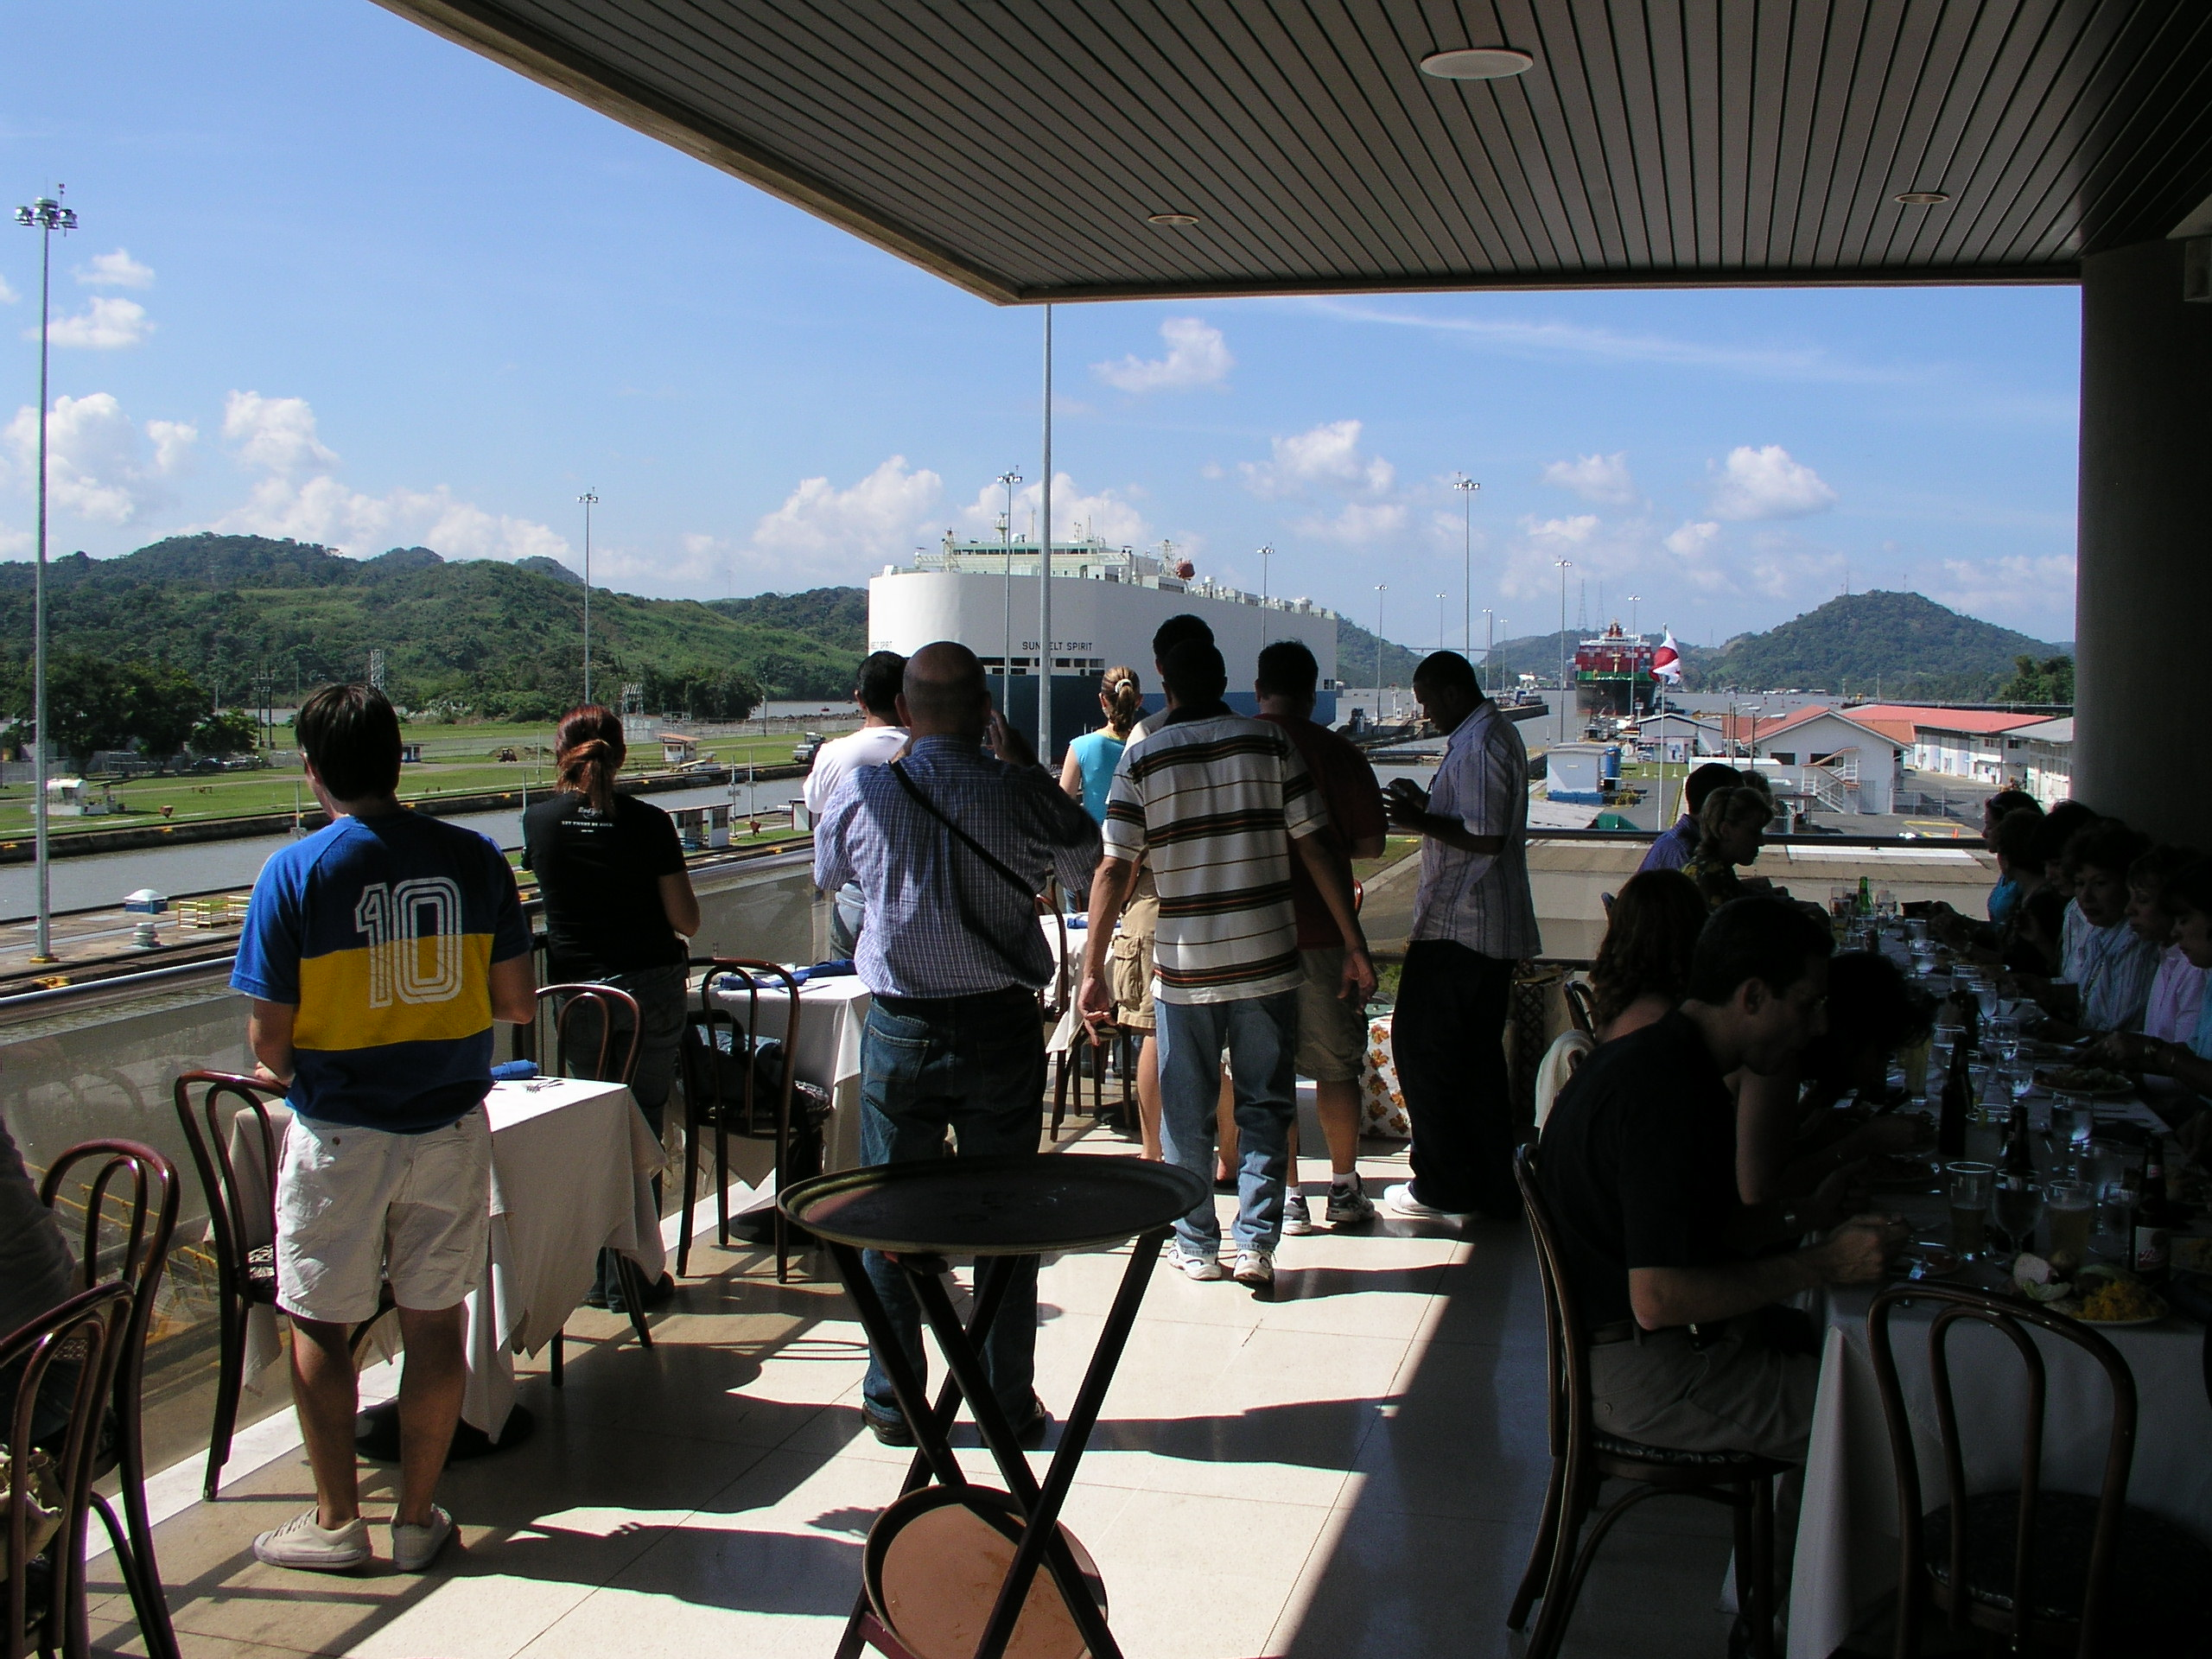
Lunch at the Museum

Slide 46
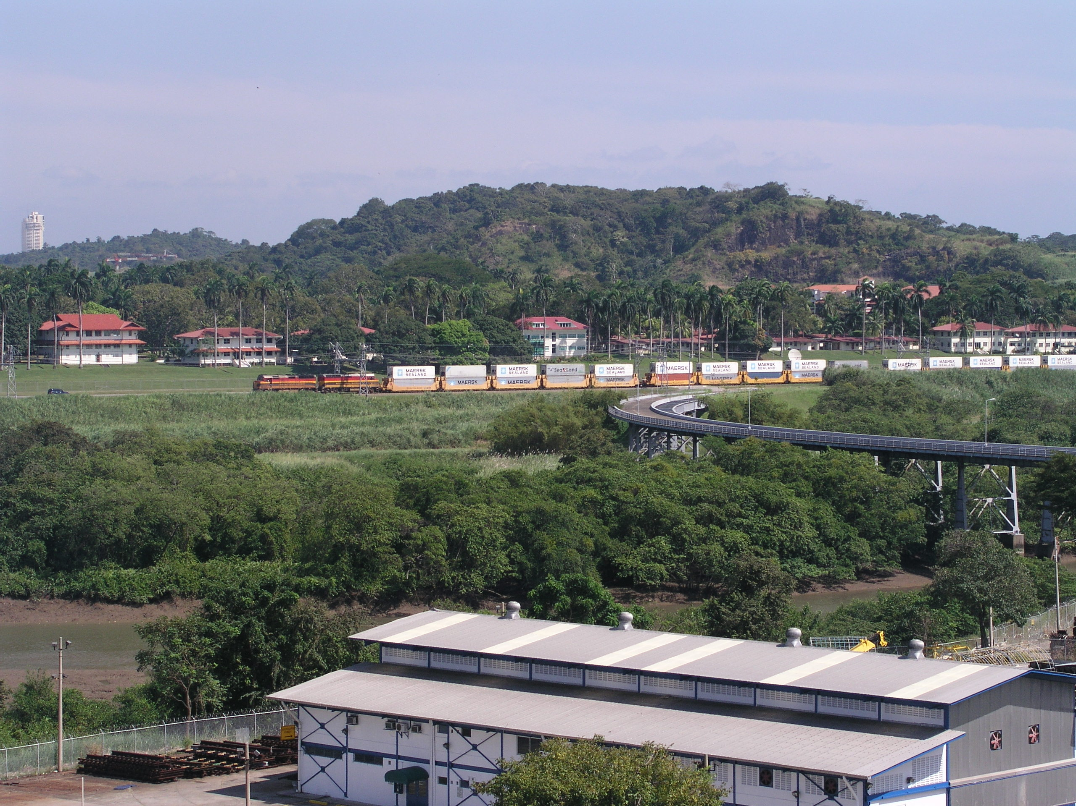
Fort Clayton &
Containers Crossing the Isthmus
on the Panama Railroad
Notes:
16

Slide 47
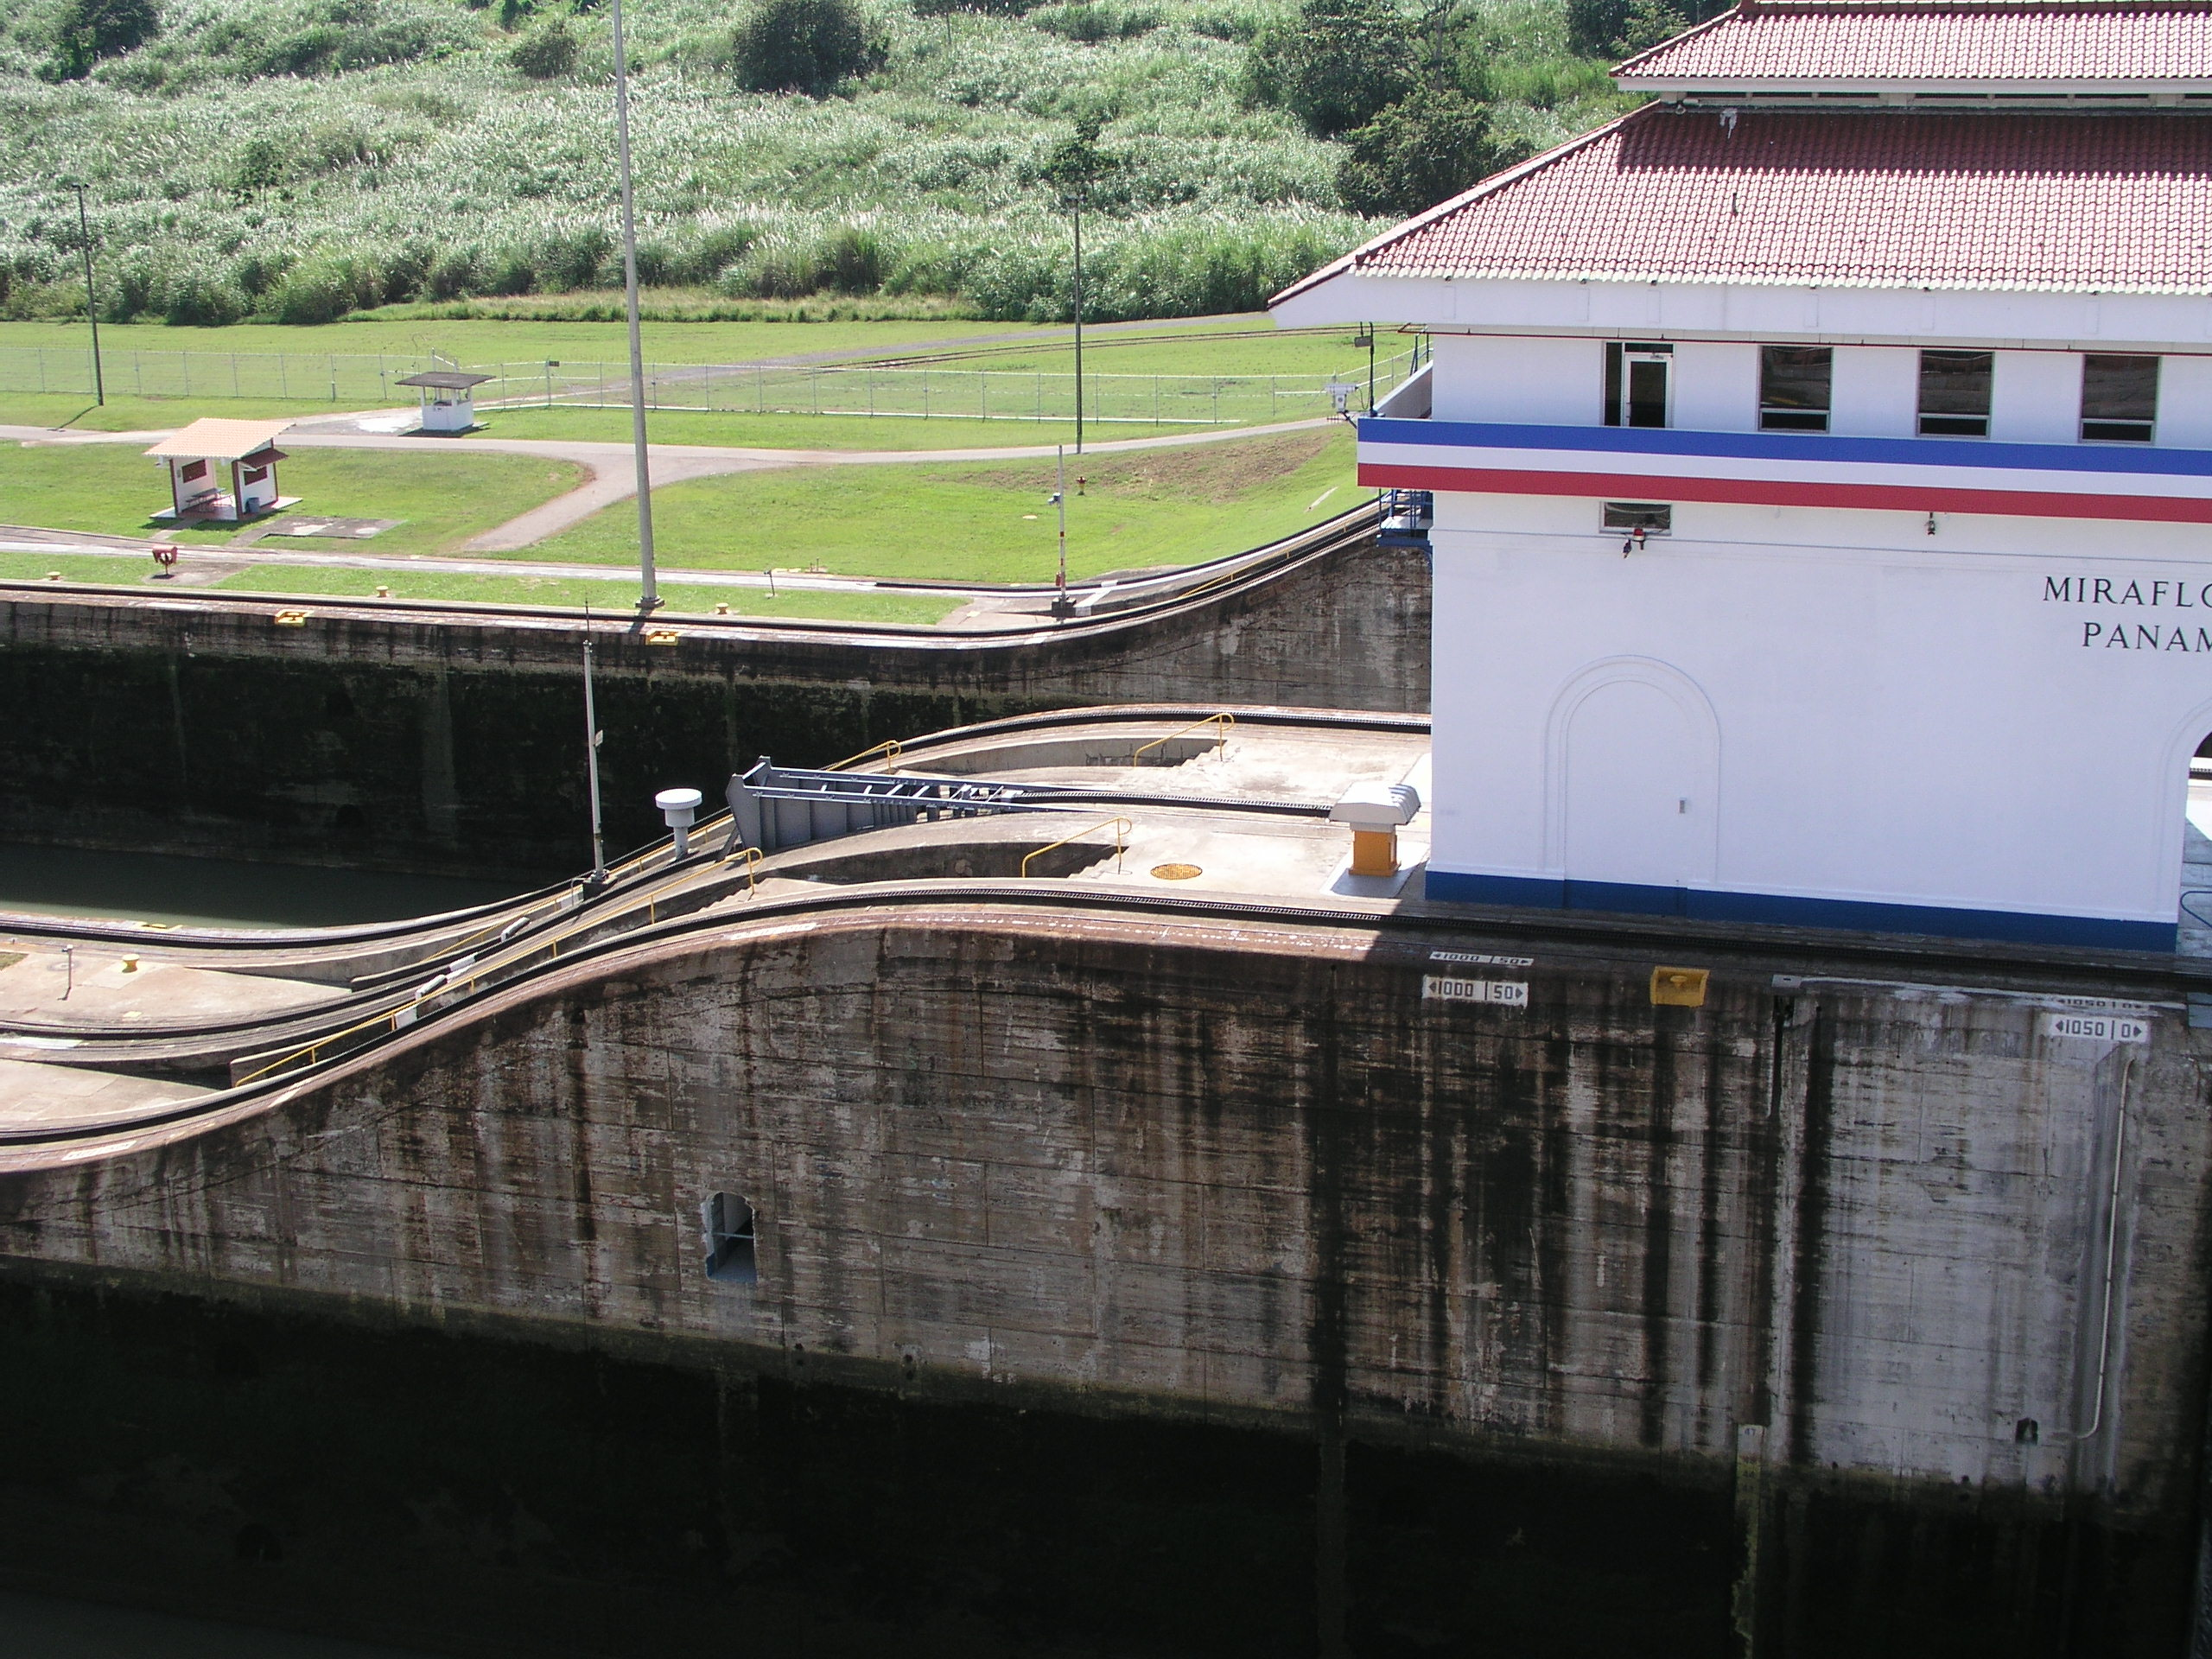
Notes:
17

Slide 48
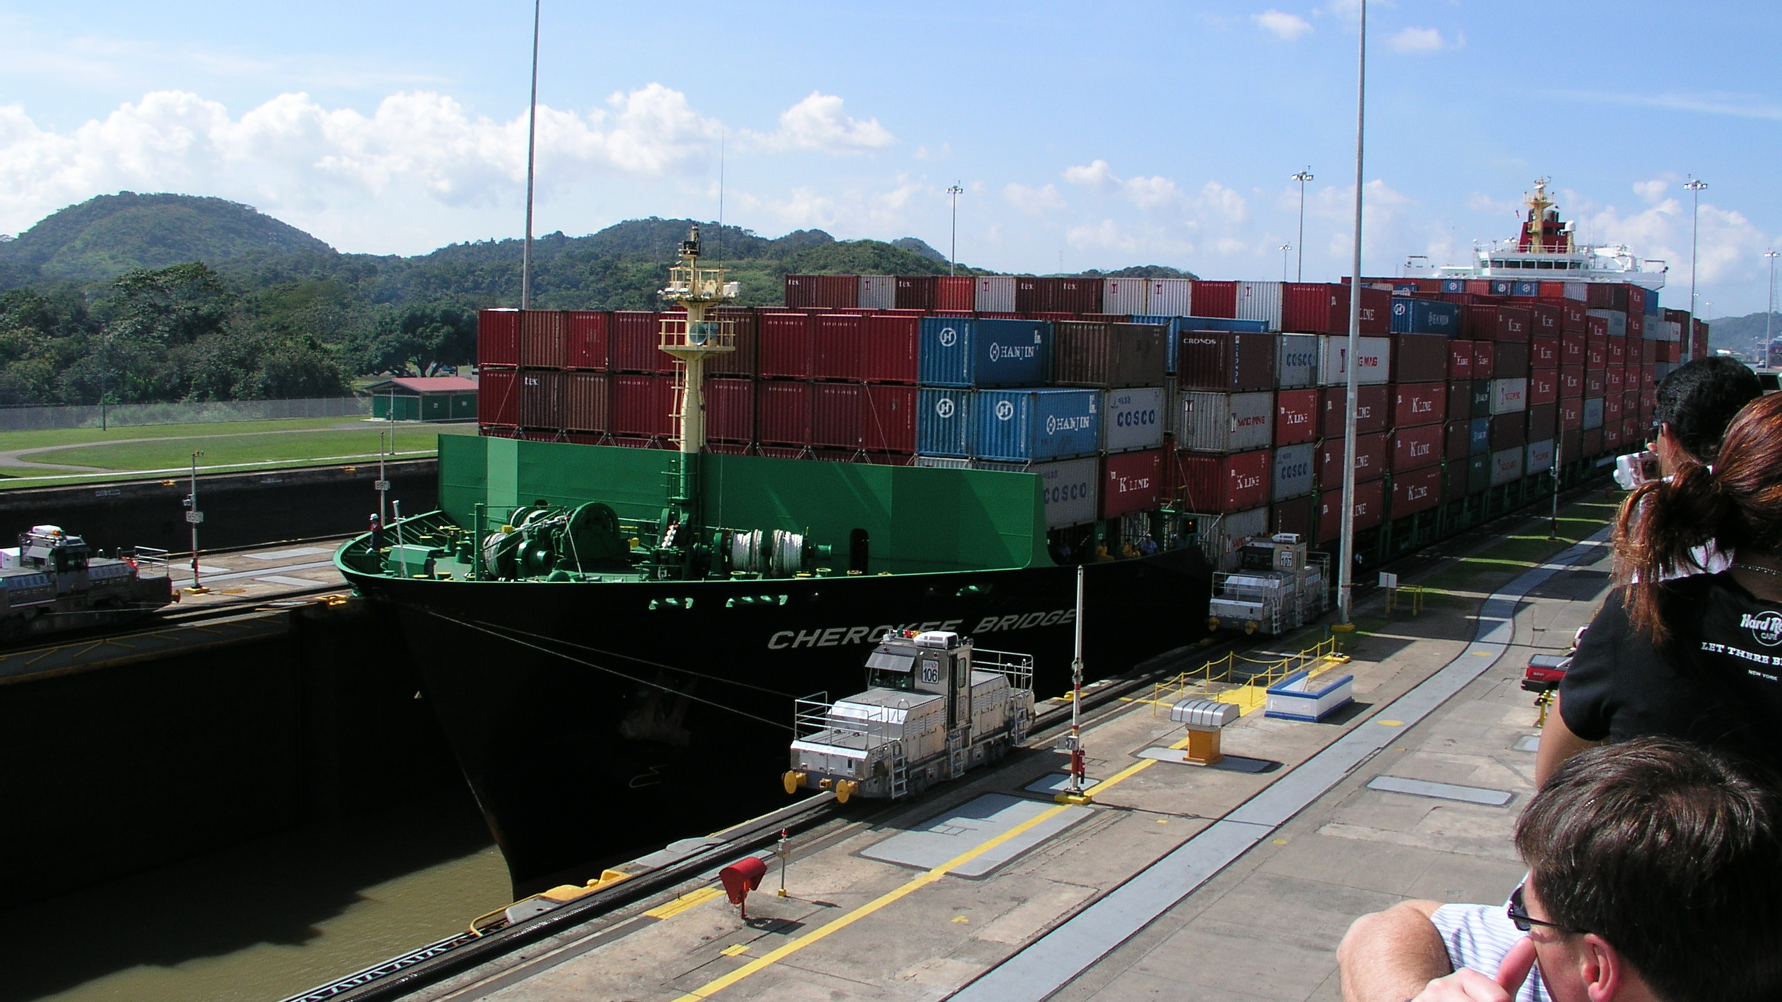
Notes:
18

Slide 49
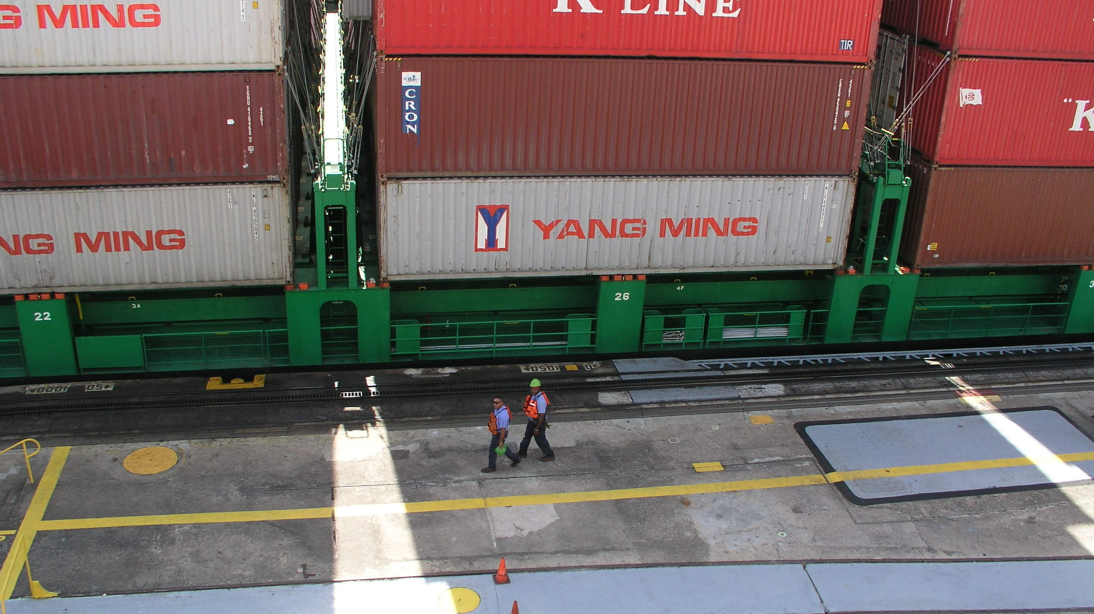
Return to Sections
Notes:
19

Slide 50
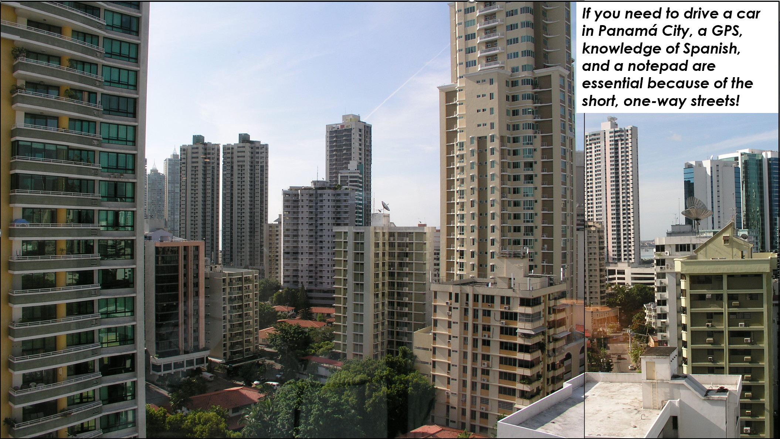
The View from My Hotel Window

Slide 51
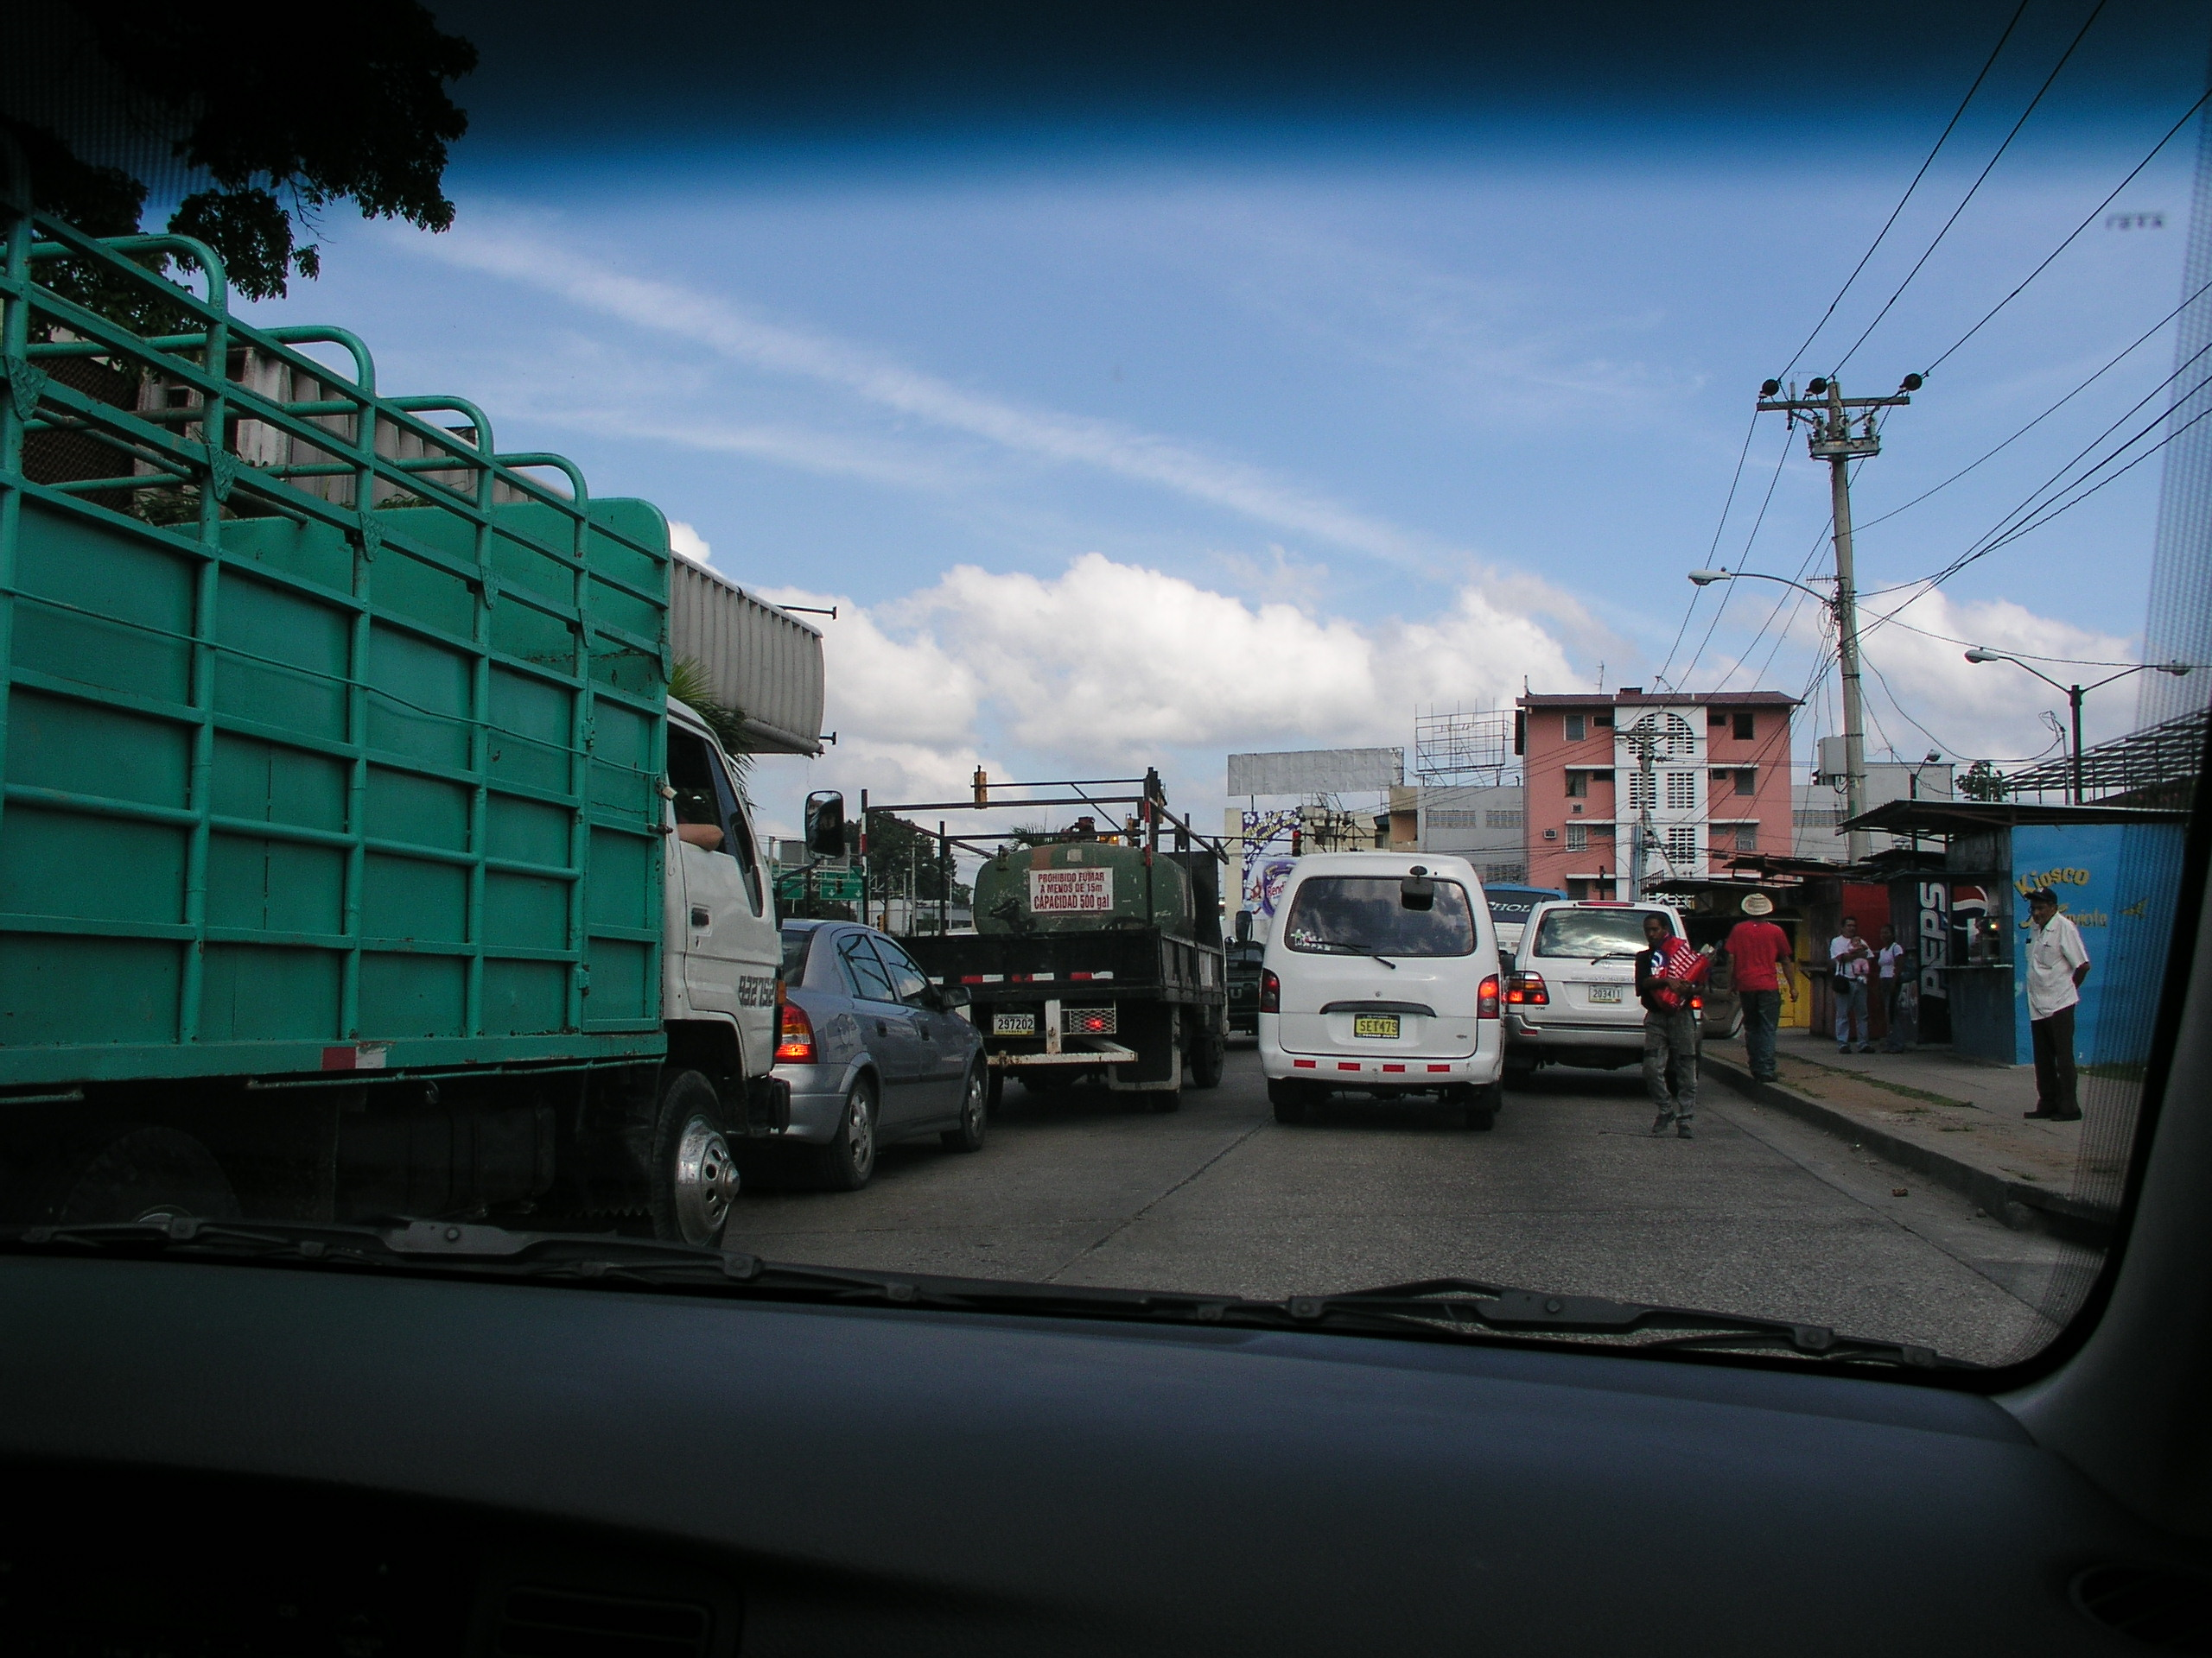

Slide 52
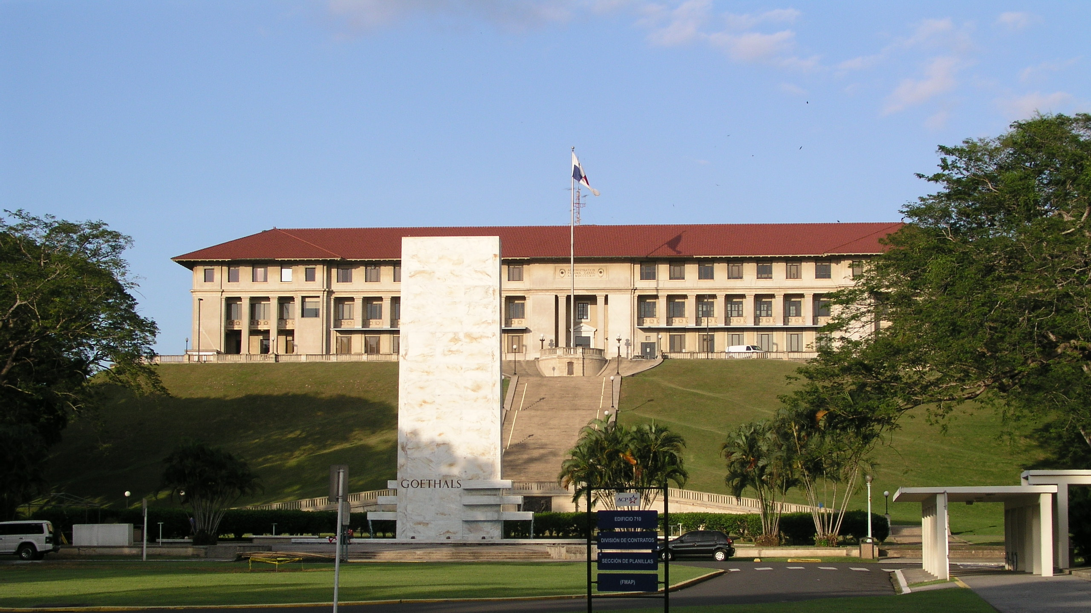
Autoridad del Canal de Panamá Headquarters and the Goethals Memorial
End of Section 2

