Slide 1
High Brightness LED Junction Temperature Measurement
Notes:
http://www.cutter.com.au/
http://www.cutter.com.au/proddetail.php?prod=cut717

Slide 2
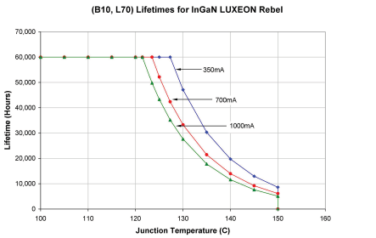
Impact of Junction Temperature© on Lifetime

Slide 3
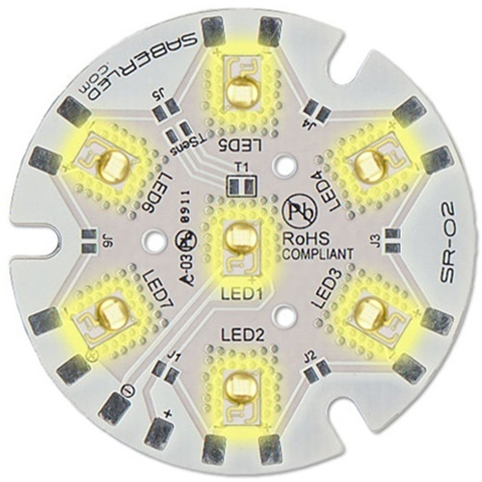
LED BOARD (Neutral White (4100K),(L1) 7 LED 40mm Round Assembly - 1260 lm @ 700mA)
Specifications
Predesigned LED Board
( Important Test Points: TSense(J5), T1(Thermistor)
Neutral White LED Color
- Lumens @ 350mA
1260 Lumens @ 700mA
-
Lumens @ 1000mA
- Efficacy (lm/W) @ 350mA
80 Efficacy (lm/W) @ 700mA
4100 Typical Color Temperature (K) (1)
3500 to 4500 Color Temperature Range (K) (1)
- Color Rendering Index (CRI) (1)
700 Recommended Operating Current (mA) (2)
1000 Maximum Rated Drive Current (mA)
22.4 Typical Forward Voltage (Vf) (3)
27.9 Maximum Forward Voltage (Vf) (3,5)
17 C°/W Thermal Resistance (C°/W) (1,5)
150 Maximum Junction Temperature (C°)
-40 - 125 Operating Temperature Range (C°)
40mm x 3mm Dimensions (Dia./H)
Notes:
Reference: http://www.luxeonstar.com/Neutral-White-4100K-7-LED-40mm-Round-Assembly-p/sr-02-wn100.htm
http://www.luxeonstar.com/PhotoDetails.asp?ShowDESC=N&ProductCode=SR-02-CUSTOM

Slide 4
Steps for Measuring (Junction Temperature of L1 -LED
Measurement Technique
Use Test Procedure from sr-02 thermal management document.
Measure Thermal Resistance across ( TS)-Indicated Test point TSENSE on Board using a PC Based DVM on Board.
Heat is transferred via Thermistor(T1) on board
Convert Thermal Resistance to TSP/TJ using look up table in sr-02 document
Notes:
Reference: SR-02 Thermal Management Principles –( LuxeonStar.com)

Slide 5
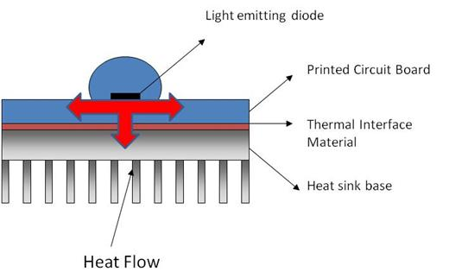
Testing Methodology
Connect 1 LED.
Measure Thermal Resistance for one LED by measuring the voltage across T(SENSE)

Slide 6
Testing Methodology
Measure TS – One week – 8 hours(192 hours).
Record , DO NOT ANALYZE
Measure T(A) –T (ambient)
Different VPower voltages
Measure VF
IF inferred.
Analysis –Measure TJ

Slide 7
Measurement of Tj(LED Junction Temperature)
TJ = TS + ( T thermal resistance *PD)
TS= Temperature of Thermistor or Soldering Point( Important parameter and should be measured based on the manufacturers recommendation)
T thermal resistance = Includes thermal resistance from LED to substrate(internal)+ thermal resistance from LED to Thermistor
Notes:
Reference: Show the Luxeon PDF Document

Slide 8
Measurement of LED Junction Temperature
LED: Rebel White LED,
Vf = 2.97Volts
Ts= 10 ohms
TS = 60 ⁰C
If = 700 ma(LED operating current-specs parameter)
TJ = 60 + 10 (2.97*0.7)
TJ = 60 +20.79 = 80⁰ C

Slide 9
Measurement of LED Junction Temperature(Case II)
LED: Rebel White LED,
Vf = 3.3Volts
Ts= 10 ohms ( From manufactures sheet)
TS = 100 ⁰C ( Measured )
If = 1000 ma(LED operating current-specs parameter)
TJ = 100 + 10 (3*1)
TJ = 100 +30 = 130⁰ C

Slide 10
Impact of Junction Temperature© on Lifetime

Slide 11
Ideal Thermal Interface Material
High Thermal Conductivity ( > 1000 W/K/M2)
Insulation Properties( This is a challenge with some nano materials)
Must correlate Efficiency with multiple LED manufacturers( Lumens/Watt Improvement)
Must correlate Product Reliability
Low Cost Manufacturing (20% of Light Fixtures = Thermal Management costs)

Slide 12
Ideal Thermal Interface Material
Results of testing and modeling should correlate and deviations must be explained.
Standard Diode Vf , Equation and measuring TJ does not correlate with manufacturers specifications
No standard models exist, New CFD tools emerging
LED field failures should be put into the model to distinguish between Device Lumens/Watts and Light Fixture Lumens/Watt
Leakage loss when LED is OFF (Reverse saturation current –not taken into account in most models)

Slide 13
Results
Heat Dissipation is one of the key barriers to LED deployment for High Brightness(HB) LED’s.
Light Fixtures requires two types of Thermal Management solutions:
Thermal Interface Material between LED and Substrate( Needs innovative materials with High Thermal Conductivity)
Thermal Interface Material from LED to Heat Sink
Data from City Lighting Products indicate 10% operating failures during first year

