Slide 1
NanoThermo
Nanomaterial innovations for Energy Efficiency
Nano Materials that Enhance Light Emitting Device (LED) Efficiency and Performance
Rekha Bangalore
Chief Technology Officer, (CEO/ CTO)

Slide 2
NanoThermo, Inc.
Early stage technology company
Prototype developed
Provisional Patent Filed at US PTO
In discussions with multiple customers and research partners
Highly accomplished management team
Seeking funding, strategic partnerships and expertise

Slide 3
Value Proposition
NanoThermo provides easy integration, improves LED efficiency by 20%, increases lifecycle by 10% and saves 75% energy.
NanoThermo also reduces the LED fixture with smaller heat sinks and fans that are used currently.

Slide 4
Team
Rekha Bangalore –Chief Technology Officer (CEO/CTO)
Over twenty of experience in semiconductor industry and technology commercialization
BS and MS in Electronics and Computer Engineering and a MS in Technology Commercialization
Madhavrao (Rao) Govindaraju , Ph.D.– Chief Operating Officer (COO)
Over twenty years of industrial and product development experience in materials science, nanotechnology
Ph.D. in Materials Engineering, University of Iowa, IA.
Prof. A.M. Rao, Ph.D. – Chief Scientific Officer (CSO)
Recognized for his outstanding contributions to nanotechnology
Earl Hager-Vice President, Strategy and Marketing
Over twenty years experience in Technology Commercialization and Business development
B.S in Business
Technical Advisors
Prof. Clois Powell, Texas State University, San Marcos, TX
32 Years in Polymer Research
Production Patented technologies in products
Saumil Shah, President, Live Oak Logic, LLC
Established long standing, profitable, beneficial business related to semiconductor, device manufacture
Established relationships with semiconductor industry

Slide 5
LED Thermal Management Problem
Heat dissipation is one of the core problems effecting the efficiency and performance of high-brightness light emitting devices (HB-LEDs), which is an attractive candidate for future lighting applications.
Luminance of HB-LEDs will reduce linearly while the life will reduce exponentially with the increasing junction temperature.

Slide 6
LED Barrier Heat Dissipation Problem

Slide 7
Heat vs LED Performance

Slide 8
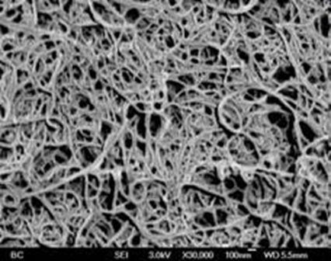
NanoThermo’s Proprietary Technology
Bucky papers made from metal decorated carbon nanotubes
Advantages
Lightweight
High thermal conductivity
High mechanical properties
Reduces Temperature of Soldering point by 8 degrees Celsius
Improves operating life by 1.4 years

Slide 9
Competition
Higher Thermal Conductivity
Lowers LED Luminous Degradation
Improves Operating Life(1.5 years)
and Reliability
Integrates Heat Sink in Phase II

Slide 10
Business Model
The business model stresses by taking the new nano material through the market validation stage with an identified alpha customer-American light systems.
This adds value by product performance and field testing that are required for certification and provides direct sales income.

Slide 11
Business Opportunity

Slide 12
Technology Development
Phase1
New Thermal Interface Materials and packaging
Improves: Reduces junction temperature for LED’s and results in improved Lumen Performance
Phase2
Integrates New Nano material into existing/New Luminares Fixtures
Improves: Energy Efficiency and Life Cycle of LED’s
Phase3
Integrates Heat Sink with Thermal Interface Material
Improves: Product Efficiency

Slide 13
High Brightness (HB) LED Market- Street Lighting

Slide 14
Ideal Solution

Slide 15
Customer Base

Slide 16
Summary
NanoThermo’s products will lead to greater energy savings, lower the cost of LEDs, and will accelerate adoption of HB-LED products, leading to higher sales to OEMs.
Customers of HB-LEDs (such as cities & developers) can save capital investment money.

Slide 17
Thank You

