Slide 1
IEEE Conferences
2022 IEEE ComSoc Student Tech Leadership Conference (CSTLC)
9 April 2022 | Austin, Texas, USA
Sponsors: IEEE Communications Society
2022 IEEE Wireless Communications and Networking Conference (WCNC)
10 - 13 April 2022 | Austin, Texas, USA
Sponsors: Central Texas Section; Central Texas Section SP/COM Joint Chapter; IEEE Communications Society; Lone Star Section
2022 IEEE International Symposium on Circuits and Systems (ISCAS)
27 May - 1 June 2022 | Austin, Texas, USA
Sponsors: IEEE Circuits and Systems Society
2022 IEEE Electrical Energy Storage Application and Technologies Conference (EESAT)
8 - 9 November 2022 | Austin, Texas, USA
Sponsors: IEEE Power & Energy Society
2022 IEEE International Performance, Computing, and Communications Conference (IPCCC)
11 - 13 November 2022 | Austin, Texas, USA
Sponsors: IEEE Computer Society

Slide 2
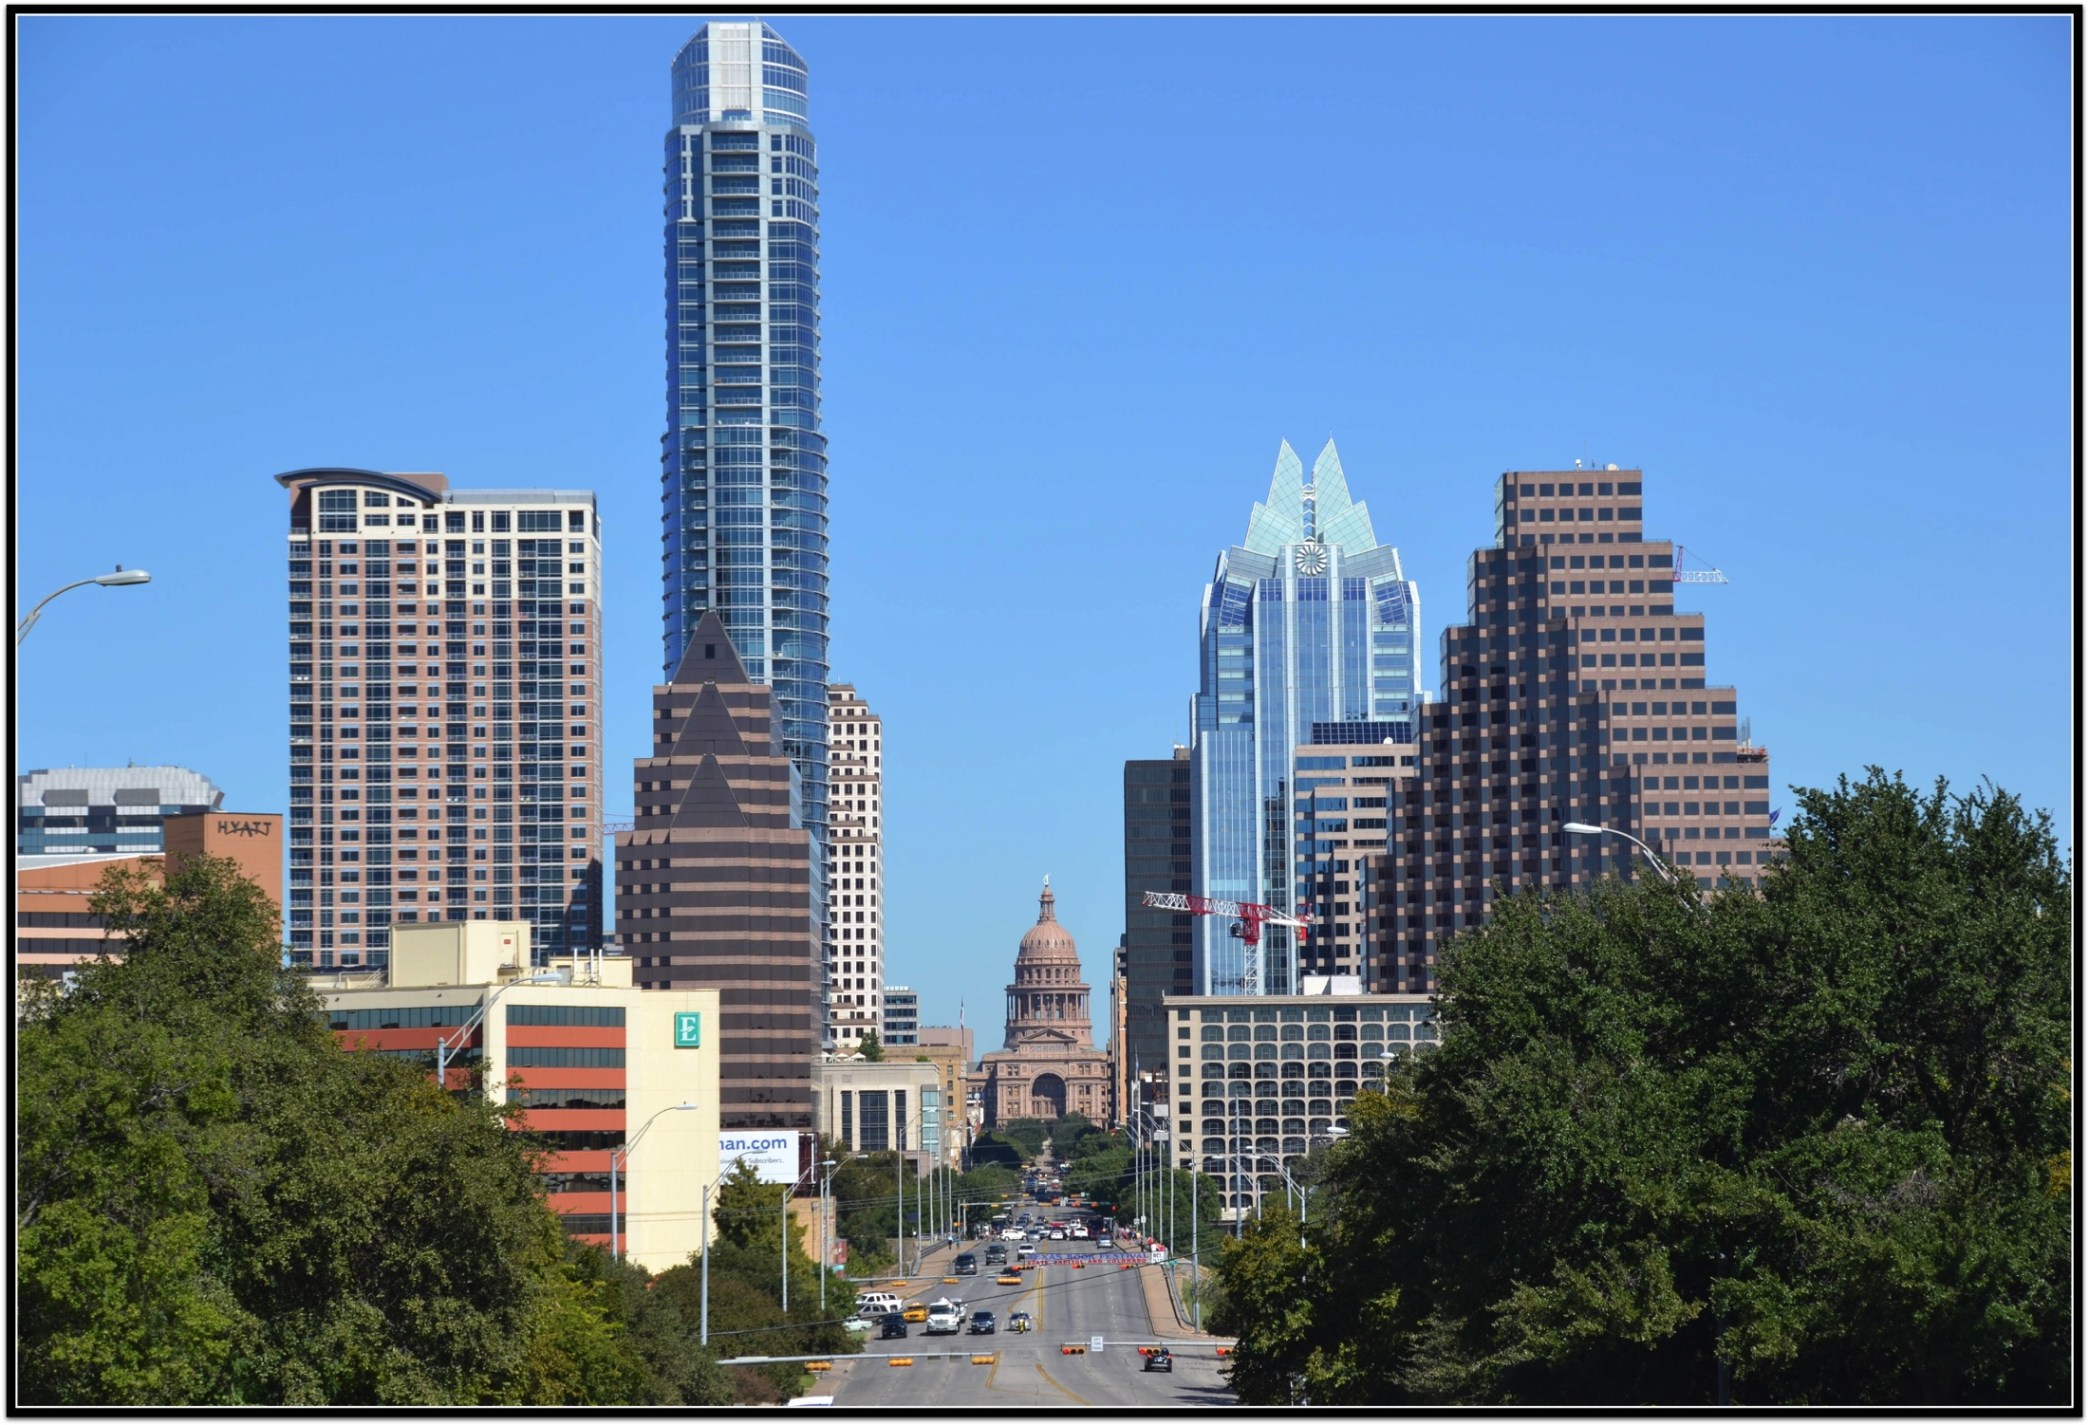
WCNC 2022, Austin April 10-13
Boosting Verticals into Wireless Orbit
IEEE WCNC 2022
Austin, TX
https://wcnc2022.ieee-wcnc.org
F. Behmann
January 2022

Slide 3
WCNC 2022 - April 10-13
WCNC 2022 Current Schedule at Glance
IEEE WCNC 2022
Austin, TX
 | Sunday April 10 | Monday April 11 |  | Tuesday April 12 |  | Wednesday April 13
9:00 – 10:30 | Tutorials & Workshops | Opening Plenary/Keynotes |  | Keynotes |  | Keynotes
10:30 – 11:00 | Networking Break | Networking Break |  | Networking Break |  | Networking Break
11:00 – 12:30 | Tutorials & Workshops | Technical Sessions | Industrial Panels | Technical Sessions | Industrial Panels | Technical Sessions | Industrial Panels
12:30 – 14:30 | Lunch | Lunch |  | Lunch |  | Lunch
14:00 – 15:30 | Tutorials & Workshops | Technical Sessions | Industrial Panels | Technical Sessions | Industrial Panels | Technical Sessions | Industrial Panels
15:30 – 16:00 | Networking Break | Networking Break |  | Networking Break |  | Networking Break
16:00 – 17:30 | Tutorials & Workshops | Technical Sessions | Industrial Panels | Technical Sessions | Industrial Panels | Technical Sessions | Industrial Panels
18:00 – 20:00 | Welcome Reception | Dialogue with Industry Leaders |  | Conference Banquet

Slide 4
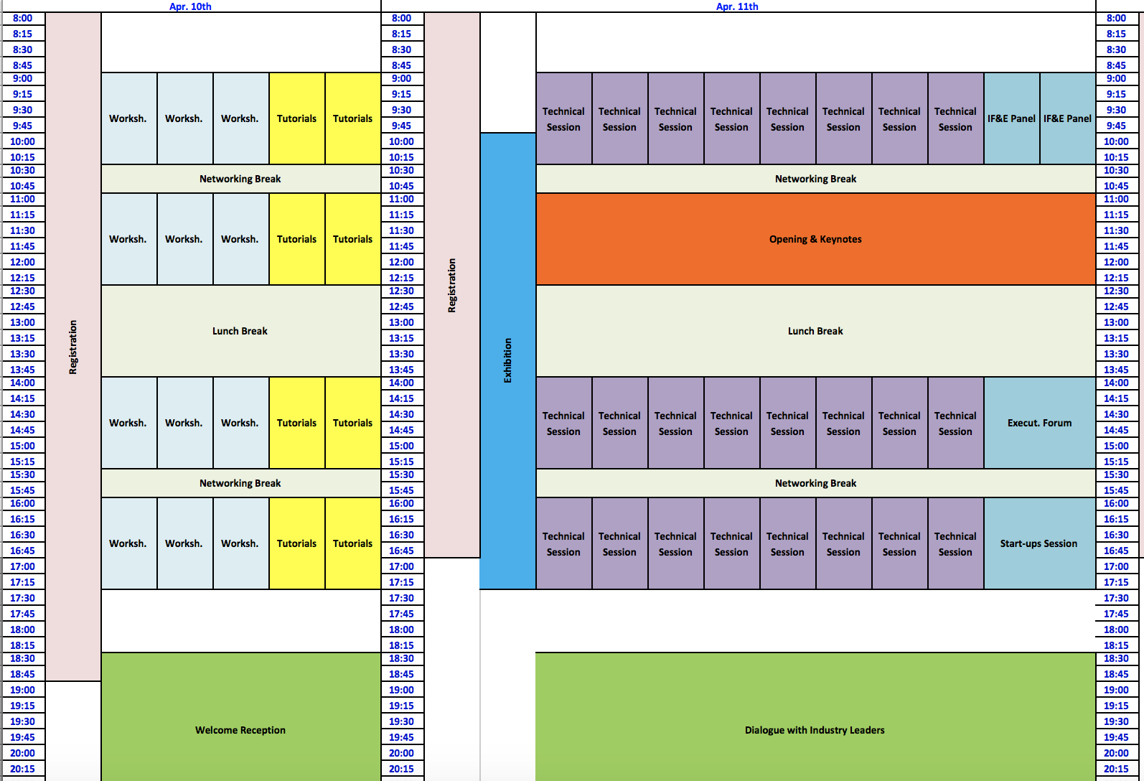
WCNC 2022 - April 10-13
Program Matrix April 10, 11
IEEE WCNC 2022
Austin, TX
https://wcnc2022.ieee-wcnc.org

Slide 5
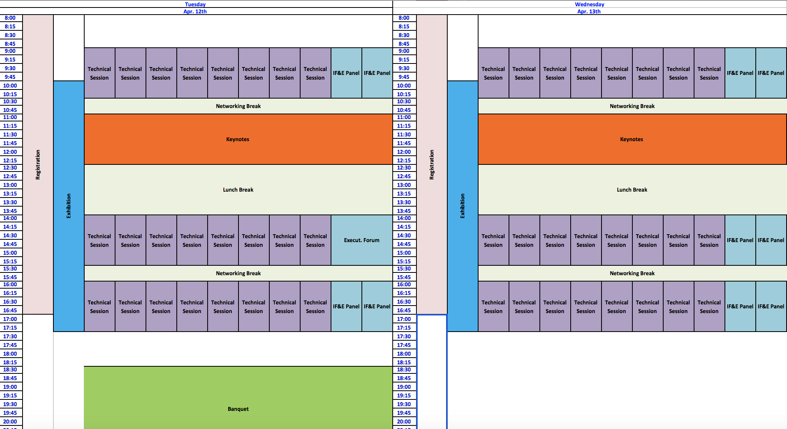
WCNC 2022 - April 10-13
Program Matrix April 12, 13
IEEE WCNC 2022
Austin, TX
https://wcnc2022.ieee-wcnc.org

Slide 6
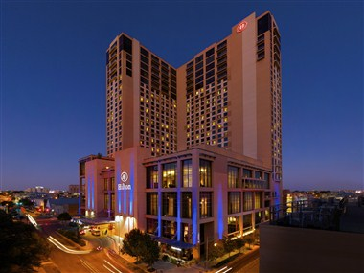
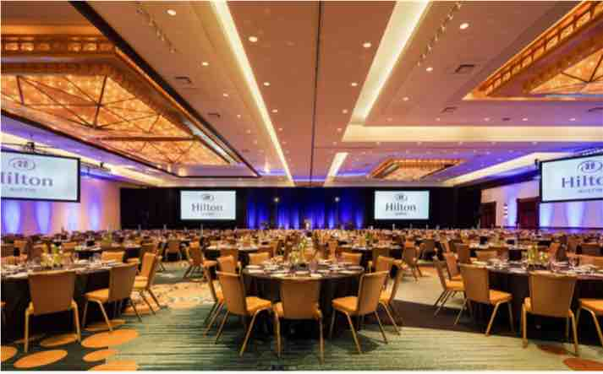
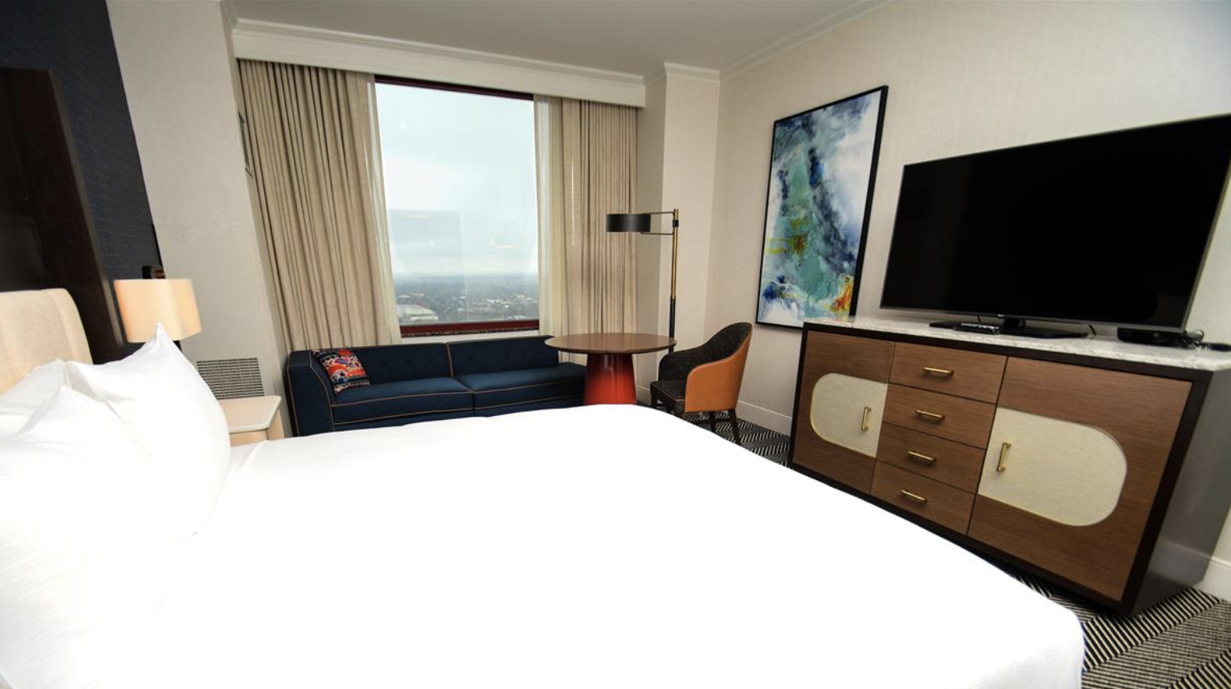
IEEE WCNC 2022
Austin, TX
Austin Hilton
500 East 4nd Street
Austin, Texas 78701
512.482.8000
www.austin.hilton.com
Conference Meetings Space

Slide 7
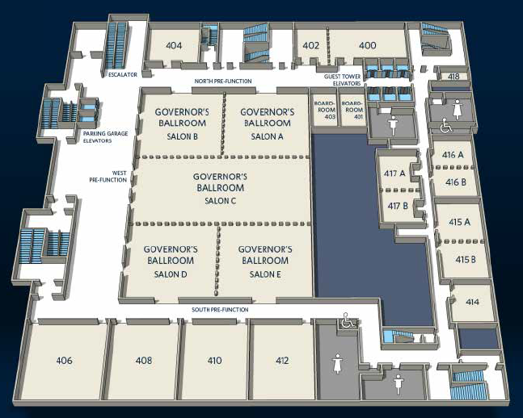
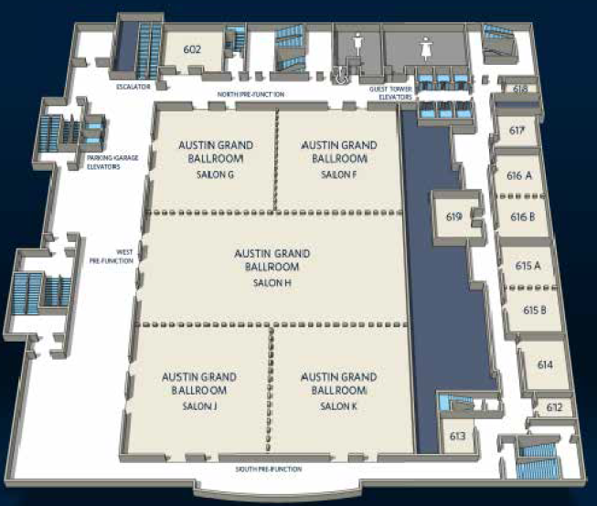
WCNC 2022 - April 10-13
Hilton Hotel Allocated space
IEEE WCNC 2022
Austin, TX
General Session / 1-2 Breakouts
Reg Desk A
Lunch / Exhibits
Not Available
4th Floor
6th Floor

Slide 8
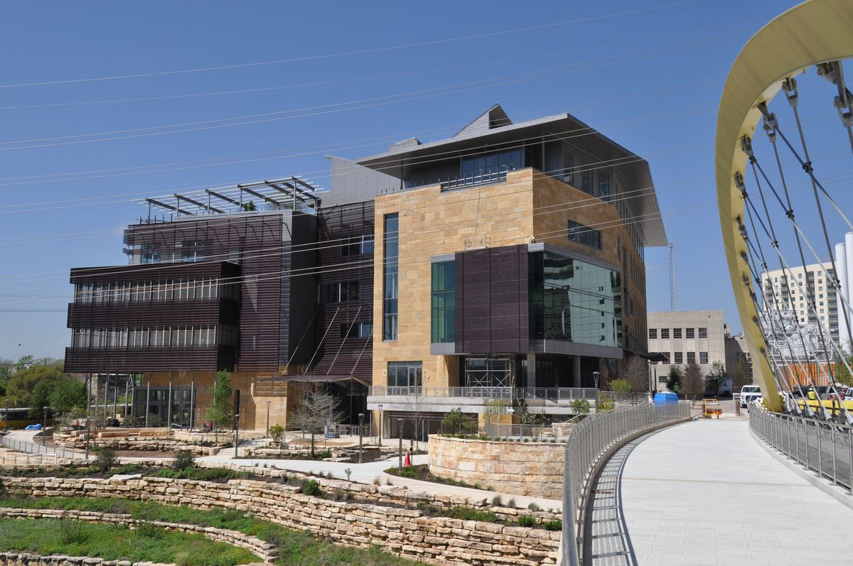
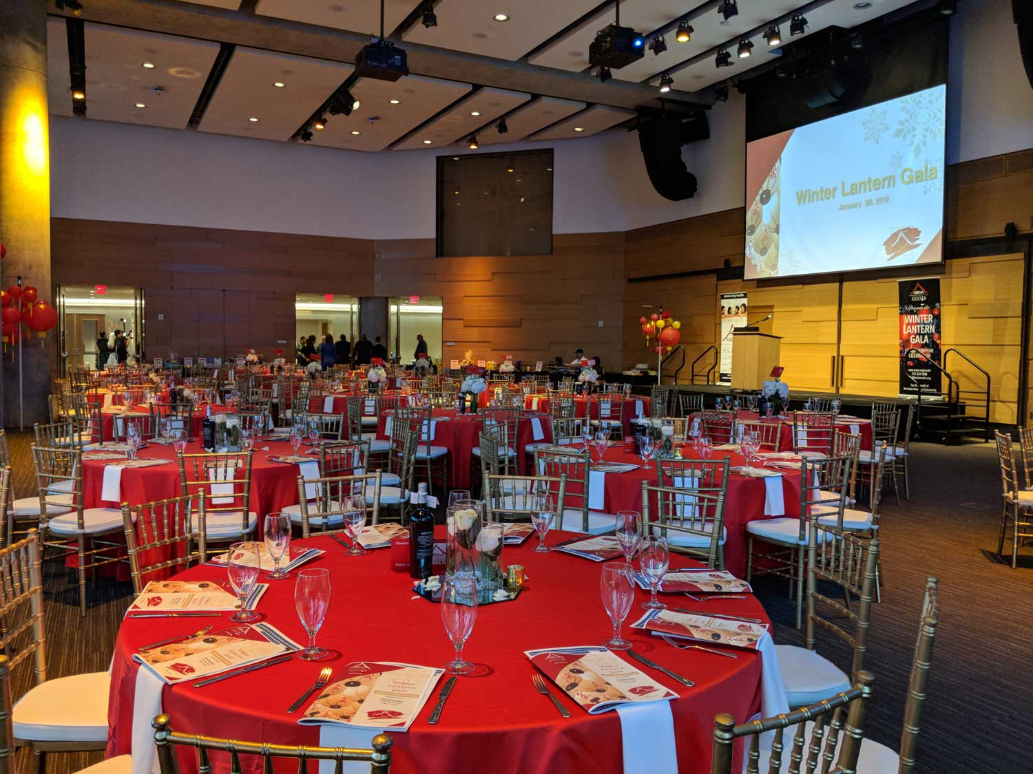
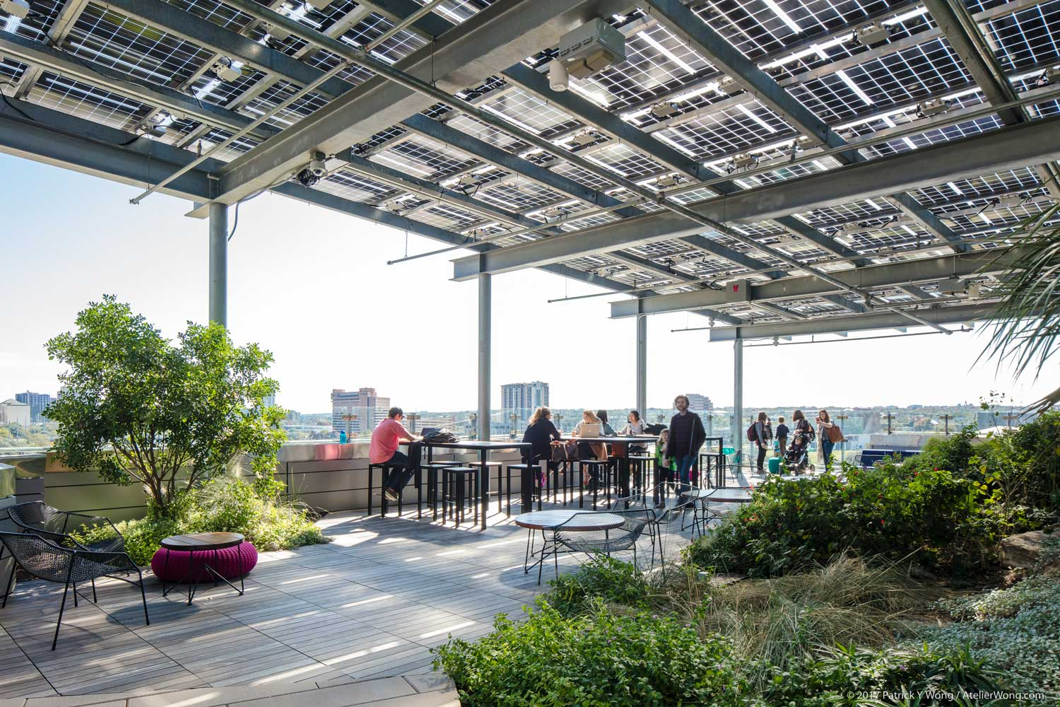
WCNC 2022 - April 10-13
IEEE WCNC 2022
Austin, TX
https://wcnc2022.ieee-wcnc.org
On-site visit – Banquet space
Austin Central Library Event Center
https://library.austintexas.gov/
Roof Garden
WCNC 2022 Banquet Hours
Doors open 6:30 pm
Bars open 6:30 pm until 8:30pm
Dinner served 7:30 pm
Event ends by 9 pm
Departure by 10 pm

Slide 9
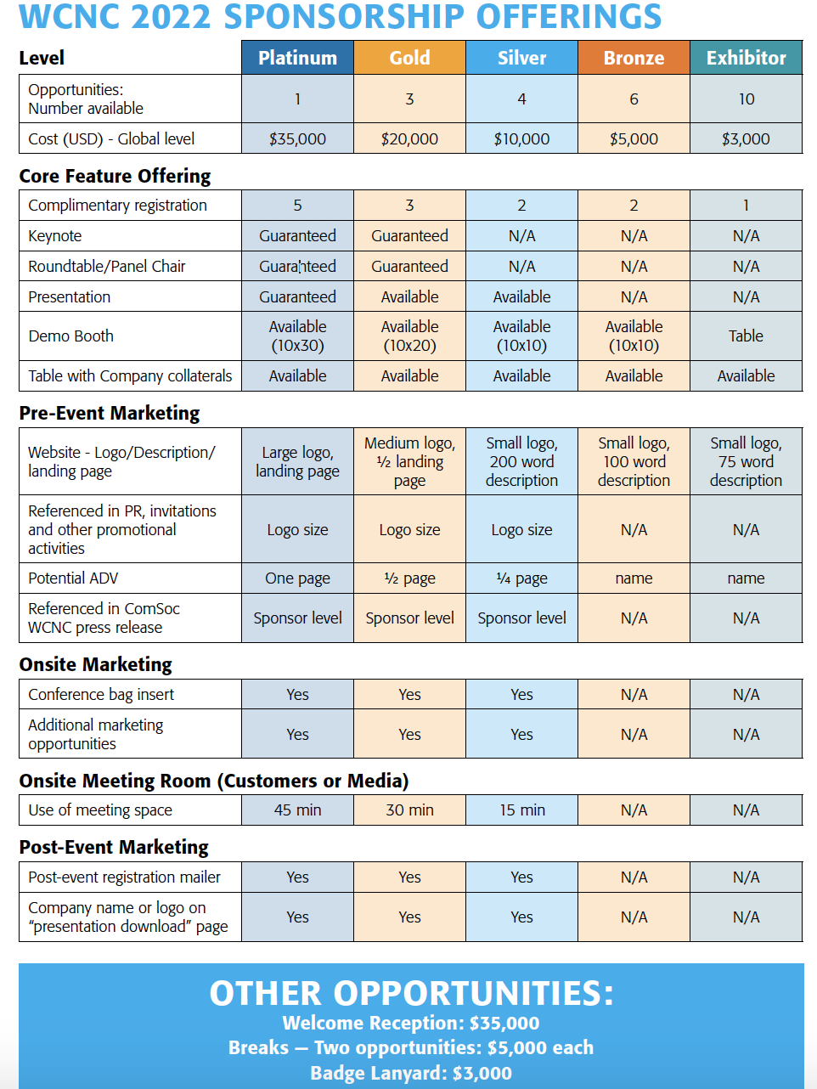
WCNC 2022 - April 10-13
WCNC 2022 Enhanced Industry Program
IEEE WCNC 2022
Austin, TX

Slide 10
WCNC 2022 - April 10-13
IEEE WCNC 2022
Austin, TX
https://wcnc2022.ieee-wcnc.org
Content Collection, Delivery Platform and Space/Location
Content Generation
WS/TUT
TRK
1
TRK
2
TRK
3
TRK
4
KN
IND
LDR
IND
Forum
Others
Panels
Content/Platform
Content (Tech, IF&E)
Platform (OPS)
Repository - EDAS
Repository - Google Drive
Program Components Matrix / website/ mobile/
Delivery Hybrid Platform
Space/Rooms/Location
Space Allocation (OPS)
Contractual Space (LA)
Space Allocation (to Tech, Industry, others)
Space Ref. (plenary, breakout rooms, exhibits, lunch, ..)
TC – Technical Program
IF&E – Industry Program
OPS - Operations
LA – Local Arrangement
Notes:
Technical
Peer review
Acceptance
Publication

Slide 11
WCNC 2022 - April 10-13
IEEE WCNC 2022
Austin, TX
Volunteer Help Needed
TECHNICAL MARKETING, MESSAGING AND COMMUNICATIONS
OUTREACH TECHNICAL COMMUNITY AND LOCAL COMPANIES
WEBSITE SUPPORT
OPERATIONS SUPPORT
LOCAL ARRANGEMENT
If interested email fawzi behmann @ f.behmann@ieee.org

