Slide 1
IEEE Central Texas Section 2022 Summer/Fall Leadership Planning Meeting January 22, 2022 San Marcos, TX & Virtual
Section Committee/Officer Name: Nick Garrard
Chapter/Affinity Name: Texas State University
Prepared by: Nick Garrard
Prepared by:

Slide 2
Vision, Leadership Team
Texas State IEEE
In 2022 we want to provide TXST EE and CS students with a blend of technical workshops, professional development and social activities. In 2021, with the return to face to face, the balance of guest speakers and technical workshops with the mixture of social events was a huge success for the organization. We saw our highest number of new national members join IEEE and plan to increase that amount in 2022. We plan on achieving these goals with our diverse leadership team. Each member of our 16-person officer team brings unique skills that can directly apply to benefit the organization and its members.
Executive Leadership Team
Chair Nick Garrard
Vice Chair Victoria Jordan
Vice Chair Christian Cisneros
Treasurer Sarah Picas
Secretary Yasmin Baqdounes
Size and profile
Fall 2021 Dues paying members: 121 members total
87 National Members
34 TXST members

Slide 3
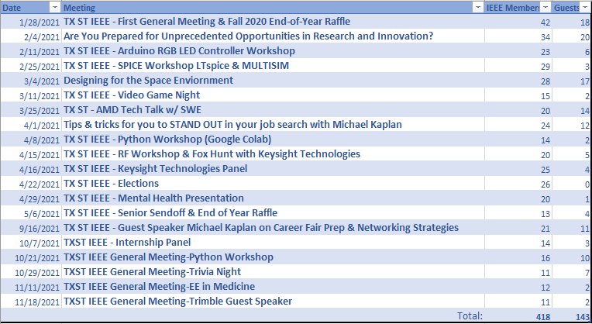
2021 Activities
Meetings Held/Reported in vTools (month, topic,):
Other Activities/Events:
Multiple hikes in the San Marcos area during spring 2021
After meeting social gatherings – weekly Fall 2021

Slide 4
2022 Chapter Vitality & Help Needed
Chapter Vitality Assessment:
Top Help Needed/Issues for 2022
A few of our top issues for 2022 are:
Determine an effective fundraising strategy.
Increase student involvement after first
few meetings.
Collaborate with UT section
Collaborate with local k-12 students
Plans for 2022
Resume workshop with Google (1/27/22).
MATLAB workshop & other technical workshops.
Send a robotics, design, ethics and poster teams to the R5 competition.
Keysight Technologies FieldFox foxhunt Event (TBD) .
Biweekly social events (Depending on COVID).
Sell cold brew coffee & tea inside the engineering hall.
15% off the merchandise store when students become dues paying members.
Topic: | Status:
Attendance | Ok
Recruitment | Strong
Volunteers | Strong
Fundraising | Needs Improvement
Relevance | Strong

Slide 5
CTS Leadership
CTS Officers Chair: Larry Larson; Vice Chair: Andrew Bluiett;
Treasurer: Bill Martino; Secretary: Martha Dodge
Past Chairs: Fawzi Behmann, Leslie Martinich
Standing Committees & | Coordinators
Committee Chair (K12 STEM) | John Purvis
Conference Chair | Fawzi Behmann
Consultants Net (Coord) | Luis Basto
Coordinator-Life Member | Kai Wong
Educational Activities | Leslie Martinich
Electronic Comm Coordinator | James Mercier
Finance Committee
Govt Activities Coordinator | Leslie Martinich Mina Hanna
Membership Development | James Mercier
Newsletter Editor | Semih Aslan
Nomin & Appointmts Chair | Leslie Martinich
Outreach Program-Corporate | Fawzi Behmann
Policies and Procedures | John Purvis Tom Grim
PACE Chair (coordinator) | Norma Antunano
Professional Activities | Fawzi Behmann
R5 South Chair | Christopher Sanderson
OU Analytics | James Mercier

Slide 6
CTS Leadership - Executive Committee
 | Section Chair | Larry Larson
 | Vice Chair | Andrew Bluiett
 | Manager of Electronic Communications | James Mercier
 | Secretary | Martha Dodge
 | Treasurer | Bill Martino
 | One of Two Immediate two Past Section Chairs | Fawzi Behmann
 | One of Two Immediate two Past Section Chairs | Leslie Martinich
CH05005 | Comm/Sig Proc./Consumer Tech (COM19/SP01/CE08) | Fawzi Behmann *
CH05006 | Computer & EMBS (C16/EMB18) | Fawzi Behmann. *
CH05008 | Electromagnetic Compatibility (EMC27) | Ross Carlton
CH05009 | (PI)² (PE31, PEL35 ,IE13, IA34, PSE43) | Ruth Sulzer
CH05069 | Photonics (PHO36) | Daniel Wasserman #
CH05188 | Ckts & Sys/Solid State (CAS/SSC) | Jaydeep Kulkarni
CH05202 | Education (E25) | Leslie Martinich *
CH05220 | Ant. Prop. & MW Tech (AP03/MTT17) | Casey Latham #
CH05225 | Instrument & Measurement (IM09) | #
CH05230 | CEDA44 Council/Electronic Design& Automation | Kevin Nesmith
CH05235 | Tech & Engr Mgmt (TEM14) | Leslie Martinich *
CH05240 | SEN39 Sensors Council | Brent Lunceford
CH05250 | Tech & Engr Mgmt (TEM14) (UT-Austin Grad) | Rachel Rajarathnam
CH10136 | Electron Devices (ED15) | Larry Larson *
CN50005 | Consultants Network (CN) | Luis Basto
YP50005 | Young Professionals (YP) | Karina Paz/Daniel Lewis
LM50005 | Life Member (LM) | Kai Wong
WE50005 | Women in Engineering (WE) | Leslie Martinich *
SSR | Section Student Representative (SSR) | Justice Micka (TX State)
Quorum 13 | * Another Chap/AG Officer can vote for the Chair | # Inactive
For a 50% quorum:
A separate individual is required for each of the 13 votes required 8.29.2020

Slide 7
CTS Leadership - Section Committee
Section | Section Chair | Larry Larson
Committee | Vice Chair | Andrew Bluiett
 | Manager of Electronic Communications | James Mercier
 | Secretary | Martha Dodge
 | Treasurer | Bill Martino
 | Immediate two Past Section Chairs | Fawzi Behmann
 | Immediate two Past Section Chairs | Leslie Martinich
Standing | Awards and Recognition | Leslie Martinich
Committees | Electronics Communications | James Mercier
 | K-12 Educational Activities | John Purvis
 | Membership Development | James Mercier
 | Policies and Procedures | Tom Grim
 | Professional Activities | Fawzi Behmann
 | University Student Liaison | Larry Larson
Quorum 8 | vTools | Kenny Rice
Other Chairs | Newsletter Editor | Semih Aslan
 | PACE Chair | Norma Antunano
 | Government Activities | Leslie Martinich
For a quorum: A separate individual is required for each of the 8 votes required 8.29.2020

Slide 8
CTS Student Leadership
STB04141 | Texas State Branch Chair/President 2021-22 | Nick Garrard | ncg36@txstate.edu
STB04141A | Texas State Computer Engr Branch Chapter Chair/President 2021-22 | Jessie Smith | j_s817@txstate.edu
STB01971 | UT Austin Branch Chair/President 2021-22 | Pranesh Satish | chair@ieeeut.org
SBC01971A | UT-Austin (COM19) Communications |  | Not active
SBC01971B | UT Austin Branch RAS Chapter Chair/President 2021-22 | Ian Krause | ras_president@utlists.utexas.edu
SBC01971C | UT-Austin (PE31) Power & Energy 2021-22 | Umar Burney | president.ut.ieeepes@gmail.com
HKN023 | UT Eta Kappa Nu, Psi Austin 2021-22 | Madilyn Sikorski | president@hkn.ece.utexas.edu

