Slide 1
IEEE Central Texas Section 2022 Winter Leadership Planning Meeting January 22, 2022 San Marcos, TX & Virtual
Section Committee/Officer Name: Andrew Bluiett
Chapter/Affinity Name: Central Texas Section- Vice Chair
Prepared by: Andrew Bluiett
Prepared by:

Slide 2
Vision, Leadership Team
Drive immediate organizational efficiency
Updated Website (https://r5.ieee.org/ctx/)
Officer Elections
Report New Officers
Provide training and knowledge sharing sessions (May)
(CTS - WebEx training. Recorded Trainings in Google Docs.)
Conduct/Support marketing events to grow membership
IEEE Day - October 5 2021; IEEE Day Ambassador; Shared CTS Events
Industry speaker acquisition – More available due to Virtual Meetings
Appreciation Dinner- In person/Schultz Garten/Entertainment/Food/Gift Cards (November)

Slide 3
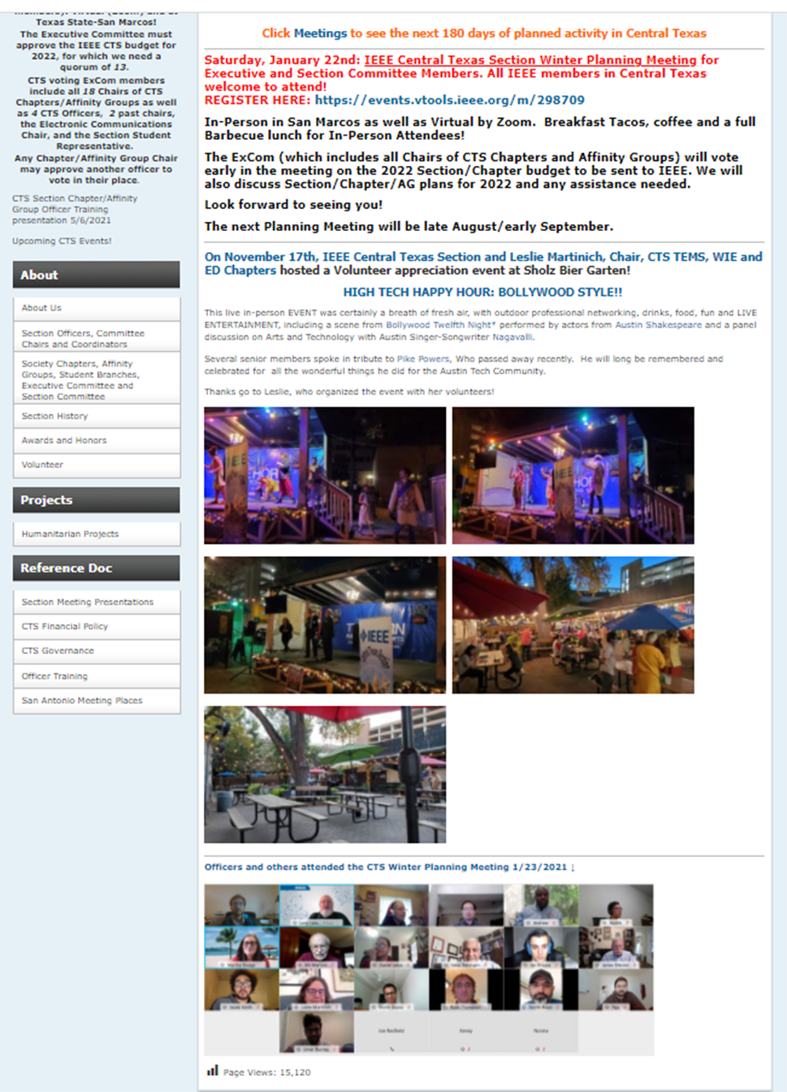
CTS Website

Slide 4
2021 Key Accomplishments
Training:
Officer training for Chair, Vice Chair, Treasurer, and Secretary
New Training this year to focus on Treasurer responsibilities
New Officers/Members/Elevations:
Welcome new officers from student chapter
Reach new membership to encourage participation.
Participate in Senior Member upgrade review panel.
Successful end of the year celebrations at CTS and other chapters/affinity groups.

Slide 5
CTS Leadership
CTS Officers Chair: Larry Larson; Vice Chair: Andrew Bluiett;
Treasurer: Bill Martino; Secretary: Martha Dodge
Past Chairs: Fawzi Behmann, Leslie Martinich
Standing Committees & | Coordinators
Committee Chair (K12 STEM) | John Purvis
Conference Chair | Fawzi Behmann
Consultants Net (Coord) | Luis Basto
Coordinator-Life Member | Kai Wong
Educational Activities | Leslie Martinich
Electronic Comm Coordinator | James Mercier
Finance Committee
Govt Activities Coordinator | Leslie Martinich Mina Hanna
Membership Development | James Mercier
Newsletter Editor | Semih Aslan
Nomin & Appointmts Chair | Leslie Martinich
Outreach Program-Corporate | Fawzi Behmann
Policies and Procedures | John Purvis Tom Grim
PACE Chair (coordinator) | Norma Antunano
Professional Activities | Fawzi Behmann
R5 South Chair | Christopher Sanderson
OU Analytics | James Mercier

Slide 6
CTS Leadership - Executive Committee
 | Section Chair | Larry Larson
 | Vice Chair | Andrew Bluiett
 | Manager of Electronic Communications | James Mercier
 | Secretary | Martha Dodge
 | Treasurer | Bill Martino
 | One of Two Immediate two Past Section Chairs | Fawzi Behmann
 | One of Two Immediate two Past Section Chairs | Leslie Martinich
CH05005 | Comm/Sig Proc./Consumer Tech (COM19/SP01/CE08) | Fawzi Behmann *
CH05006 | Computer & EMBS (C16/EMB18) | Fawzi Behmann. *
CH05008 | Electromagnetic Compatibility (EMC27) | Ross Carlton
CH05009 | (PI)² (PE31, PEL35 ,IE13, IA34, PSE43) | Ruth Sulzer
CH05069 | Photonics (PHO36) | Daniel Wasserman #
CH05188 | Ckts & Sys/Solid State (CAS/SSC) | Jaydeep Kulkarni
CH05202 | Education (E25) | Leslie Martinich *
CH05220 | Ant. Prop. & MW Tech (AP03/MTT17) | Casey Latham #
CH05225 | Instrument & Measurement (IM09) | #
CH05230 | CEDA44 Council/Electronic Design& Automation | Kevin Nesmith
CH05235 | Tech & Engr Mgmt (TEM14) | Leslie Martinich *
CH05240 | SEN39 Sensors Council | Brent Lunceford
CH05250 | Tech & Engr Mgmt (TEM14) (UT-Austin Grad) | Rachel Rajarathnam
CH10136 | Electron Devices (ED15) | Larry Larson *
CN50005 | Consultants Network (CN) | Luis Basto
YP50005 | Young Professionals (YP) | Karina Paz/Daniel Lewis
LM50005 | Life Member (LM) | Kai Wong
WE50005 | Women in Engineering (WE) | Leslie Martinich *
SSR | Section Student Representative (SSR) | Justice Micka (TX State)
Quorum 13 | * Another Chap/AG Officer can vote for the Chair | # Inactive
For a 50% quorum:
A separate individual is required for each of the 13 votes required 8.29.2020

Slide 7
CTS Leadership - Section Committee
Section | Section Chair | Larry Larson
Committee | Vice Chair | Andrew Bluiett
 | Manager of Electronic Communications | James Mercier
 | Secretary | Martha Dodge
 | Treasurer | Bill Martino
 | Immediate two Past Section Chairs | Fawzi Behmann
 | Immediate two Past Section Chairs | Leslie Martinich
Standing | Awards and Recognition | Leslie Martinich
Committees | Electronics Communications | James Mercier
 | K-12 Educational Activities | John Purvis
 | Membership Development | James Mercier
 | Policies and Procedures | Tom Grim
 | Professional Activities | Fawzi Behmann
 | University Student Liaison | Larry Larson
Quorum 8 | vTools | Kenny Rice
Other Chairs | Newsletter Editor | Semih Aslan
 | PACE Chair | Norma Antunano
 | Government Activities | Leslie Martinich
For a quorum: A separate individual is required for each of the 8 votes required 8.29.2020

Slide 8
CTS Student Leadership
STB04141 | Texas State Branch Chair/President 2021-22 | Stephen Smyth | wpx1@txstate.edu
STB04141A | Texas State Computer Engr Branch Chapter Chair/President 2021-22 | Jessie Smith | j_s817@txstate.edu
STB01971 | UT Austin Branch Chair/President 2021-22 | Pranesh Satish | chair@ieeeut.org
SBC01971A | UT-Austin (COM19) Communications |  | Not active
SBC01971B | UT Austin Branch RAS Chapter Chair/President 2021-22 | Ian Krause | ras_president@utlists.utexas.edu
SBC01971C | UT-Austin (PE31) Power & Energy 2021-22 | Umar Burney | president.ut.ieeepes@gmail.com
HKN023 | UT Eta Kappa Nu, Psi Austin 2021-22 | Madilyn Sikorski | president@hkn.ece.utexas.edu

