Slide 1
IEEE Central Texas Section
2022 Winter/Spring Leadership Planning Meeting
January 22, 2022
San Marcos, TX & Virtual
Section Committee/Officer Name: James J. Mercier, P.E.
Membership Develoment, OU Analytics, Sr. Member Upgrade Coordinator, Electronic Comm Coordinator
Prepared by: Ruth Sulzer
Prepared by:

Slide 2
Duties
Electronic Communications Coordinator
Maintain CTS Listserve
Send out notices to Section via Listserve
OU Analytics Contact
Access OU Analytics (Need a list of your members? Let me know.)
Membership Development Coordinator
Encourage membership increase and retention in the Section and the Chapters
Sr. Member Upgrade Coordinator
Are you an IEEE Sr. Member? If not, talk to me!

Slide 3
Electronics Communications
You can change your information on the Listserve
Or, I can do it for you.
I send out the CTS Analog newsletter
I can send out special announcements (with Larry’s permission)
Send it as an email with what you want in the body, exactly as you want it posted.
I can not fix your (or my) computer problems – I’m an electrician, not a Software geek.

Slide 4
OU Analytics Membership Lists

Slide 5
Membership Lists (cont)

Slide 6
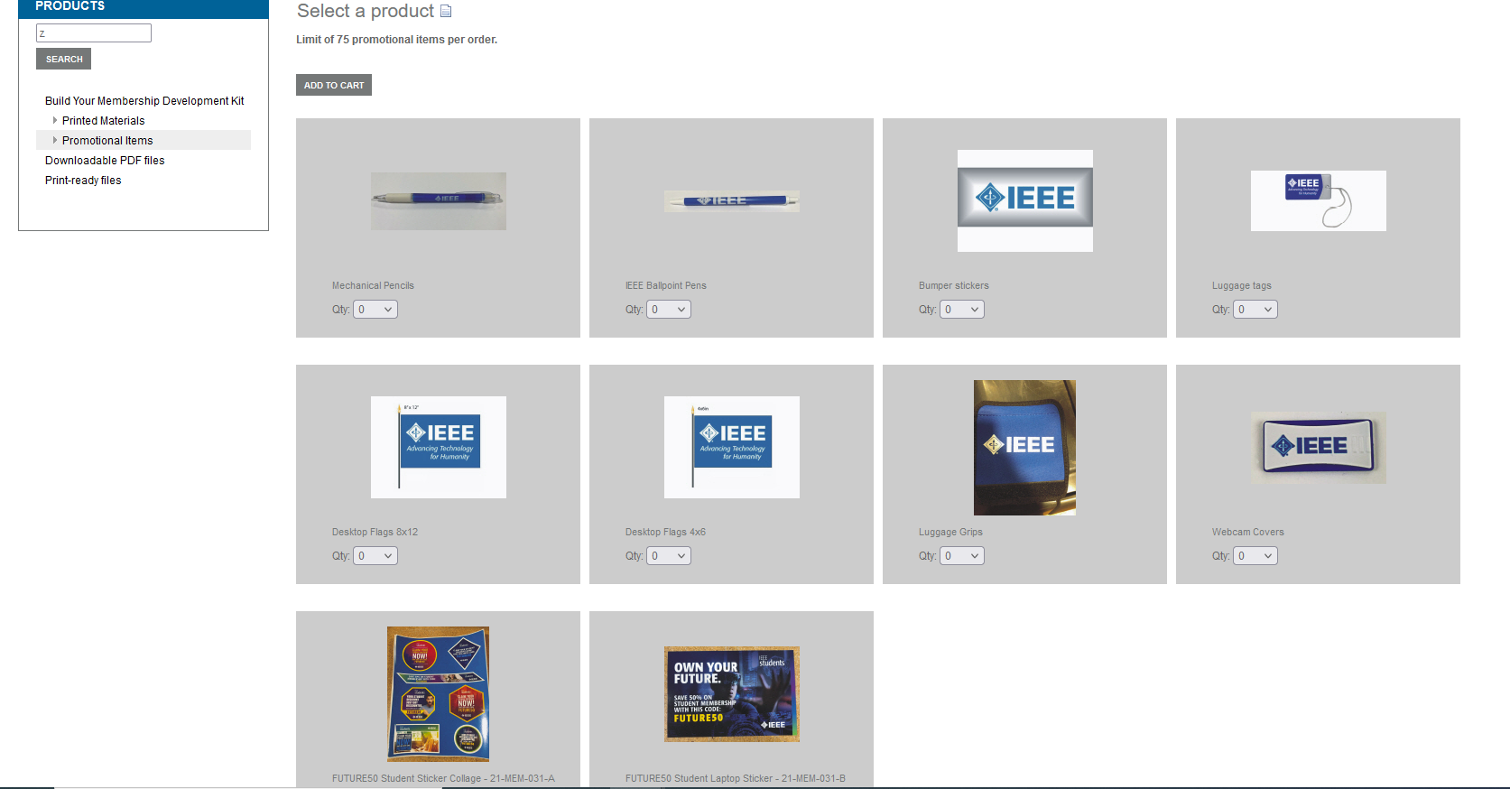
Membership Development

Slide 7
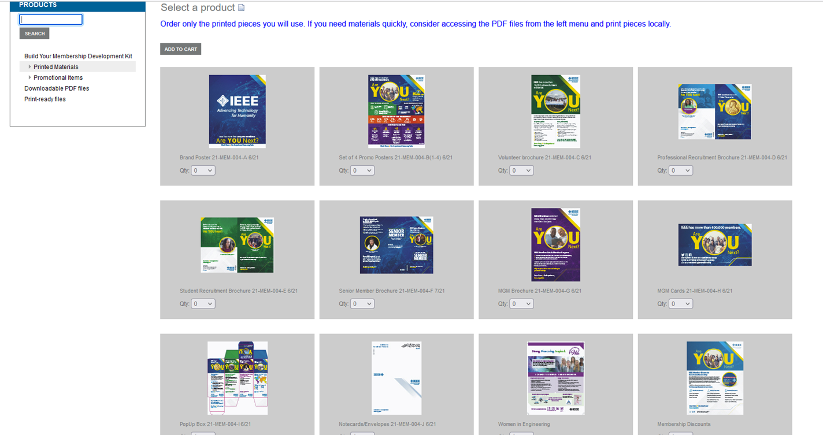
Membership Development (cont)

Slide 8
Sr. Member Applications
I will guide your application process
I will nominate you
I will assign your Reference Writers
I have guidance for Reference Writers
I will monitor your Reference Writers

Slide 9
Sr. Member – A&A Panel Dates
Review panel dates and locations
Region | Location | 2022 Dates
N/A | TBD | 19 Feb
N/A | TBD | 23 Apr
N/A | TBD | 25 Jun
N/A | TBD | 13 Aug
N/A | TBD | 1 Oct
N/A | TBD | 19 Nov
Cutoff for submissions is 10 (ten) days prior.

Slide 10

…, finally

