Slide 1
IEEE Central Texas Section
2022 Summer/Fall Leadership Planning Meeting
January 22, 2022
San Marcos, TX & Virtual
Section Committee/Officer Name: Justice Micka
Chapter/Affinity Name: Texas State University / CT SSR
Prepared by: Justice Micka
Prepared by:

Slide 2
Presentation Objectives
Establish a tentative scheme of involvement and responsibilities for the Section Student Representative (SSR) role
Provide ideas to the CTS board and chapter officers to influence general IEEE growth

Slide 3
Section Student Representative
“The Student Representative acts as a link between IEEE student organizations in the section and the Executive committee.” – IEEE Website

Slide 4
Section Student Representative
Tentative core functions for SSR:
  Work with UT & TXST officers to establish Key Performance Indicators to gauge chapter growth (for reporting to CTS executive board)
  Pursue funding/fundraising opportunities for IEEE chapter initiatives
  Engage with companies to bring opportunities to IEEE students; job searching, internships, etc.
Extended functionality:
  Steward exposure to research opportunities and interdisciplinary collaboration
Notes:
My understanding is that the SSR position is fairly new to the Central Texas section. General ideas as to how the SSR could best serve the section include:
1. Assisting student chapters with their data collection/metrics collection for effective reporting to the executive board
2. Stewarding an interdisciplinary relationship between STEM departments, to expose IEEE students to research opportunities
3. Working with social media coordinators to effectively market/bring exposure to IEEE activities, to engage interest from investors and prospective students

Slide 5
Regarding Chapter KPIs
Question: What KPI’s could student chapters prioritize?
Common:
  Increase average member attendance to meetings and events
  Increase number of guest speakers from companies
  Increase project funding based on utility and quality
Uncommon:
  Quantify/qualify engagement via social media
  Increase total number of IEEE students actively engaged in academic research
Notes:
General idea: data collection is important and effective! Ensuring that chapters have an idea of important KPIs to pursue means that the executive board will have affirmation of their legislative and funding decisions. The desired outcome is that student chapters will have extra support for future initiatives.

Slide 6
Regarding Chapter KPIs
Data can be used to instill confidence in the CTS executive board that funding and legislative decisions have been effective for student chapters
Keeping track of chapter growth through strategic KPIs can also be used for attracting prospective companies!
Notes:
General idea: data collection is important and effective! Ensuring that chapters have an idea of important KPIs to pursue means that the executive board will have affirmation of their legislative and funding decisions. The desired outcome is that student chapters will have extra support for future initiatives.

Slide 7
Regarding Chapter KPIs
Overall Goal - SSR would assist chapters with optimizing their metrics tracking to:
Provide satisfactory reporting to the executive board to ensure funding and legislative decisions are effective
Ensure chapter initiatives are always supported
Ensure prospective companies have data to assess IEEE chapters
Notes:
General idea: data collection is important and effective! Ensuring that chapters have an idea of important KPIs to pursue means that the executive board will have affirmation of their legislative and funding decisions. The desired outcome is that student chapters will have extra support for future initiatives.

Slide 8
Regarding Interdisciplinary Collaboration
A possible way for the SSR to serve student chapters is by stewarding additional research opportunities!
EE students are versatile in their technical acumen. They are ready to assist non-EE researchers with knowledge of electrical engineering, computer science, and manufacturing practices.
Notes:
General goal is to encourage not only IEEE growth through membership increase, but also improve the reputation of IEEE chapters by providing opportunities for students to make impacts in non-EE fields. A large IEEE student population actively involved in research looks great for the university and IEEE chapter overall.

Slide 9
Regarding Interdisciplinary Collaboration
The SSR could steward collaboration between IEEE chapters and non-EE departments by suggesting potential research aids based on student technical expertise and interest
A side effect of interdisciplinary collaboration is enabling IEEE student access to incredible scientific instrumentation! AFM, STM, etc.
Notes:
General goal is to encourage not only IEEE growth through membership increase, but also improve the reputation of IEEE chapters by providing opportunities for students to make impacts in non-EE fields. A large IEEE student population actively involved in research looks great for the university and IEEE chapter overall.

Slide 10
Proposal for Student Chapters
Question: Imagine the following statement is a social media post. Does this “grab” your attention?
“According to electromagnetic theory, if a charged particle moves in a circular orbit, then the acceleration of the particle will cause a ripple in the surround EM field, corresponding to the emission of EM radiation…”
Probably not. However, what if it could be visualized?
Notes:
General idea: how do we attract prospective students and investors for funding? Effect social media campaigns exist, it just takes experimenting to find the right formula!

Slide 11
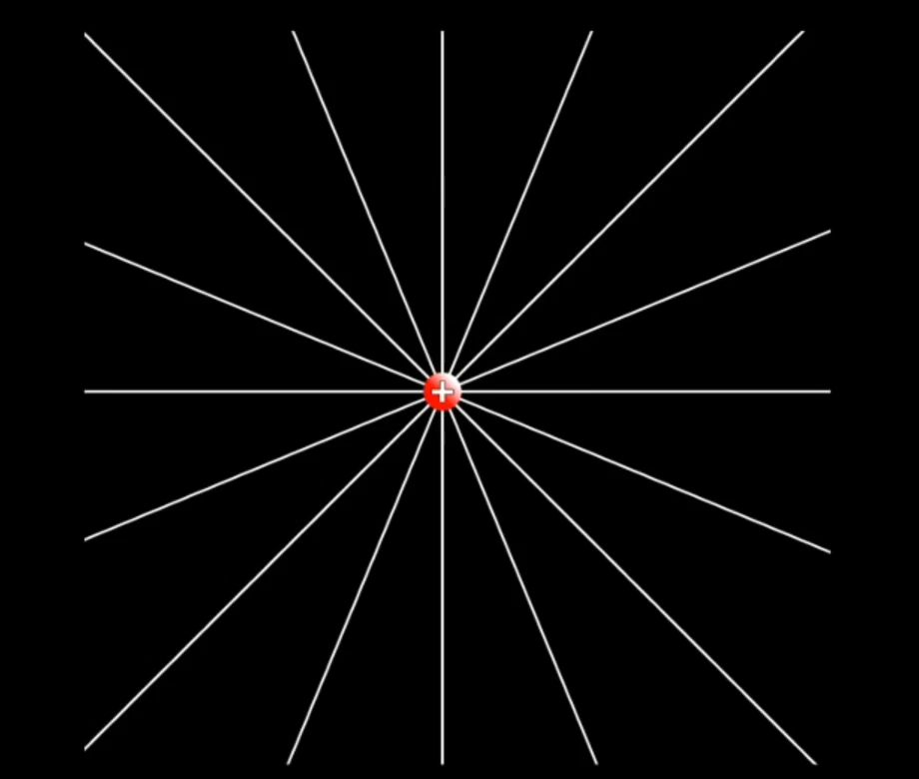
An accelerating charged particle is worth a thousand words!
Notes:
(This is a short video, click the slide to play!)
General idea: effective visualizations pique interest and can be used for SM campaigns!

Slide 12
Proposal for Student Chapters
Generating interest from prospective students, investors, and the local community, can be achieved through creative demonstrations of science!
SSR vision: challenge student IEEE members to put together simple visualizations/demonstrations of their favorite science topics and use them in media campaigns
Goal: increase external interest in UT and TXST IEEE projects, initiatives, and student research
Incentivize exceptional demonstrations with rewards (Scholarships? Research opportunities? Conferences?)
Notes:
The desired outcome with prioritizing social media campaigns is a cyclic feedback loop:
IEEE groups showcase their work -> Attract interest from students and investors -> Increase in guest speakers from companies and faculty -> Increase in student membership -> More projects to showcase!

Slide 13
Thank you!

