Slide 1
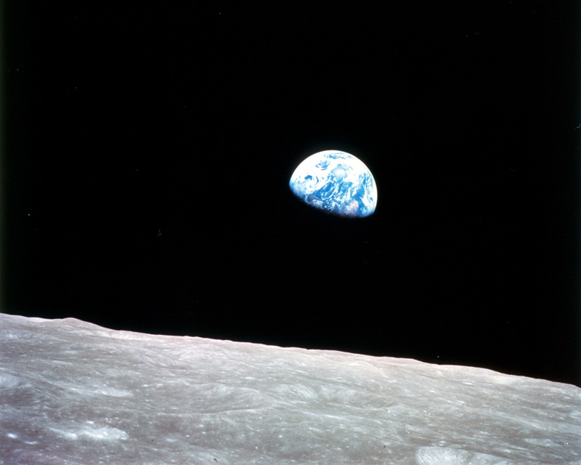
IEEE LMAG Climate Discussion In the Time of Coronavirus – Basics and Policy
April 17, 2020
Chuck Wilson (J. C.)
Retiring
Distinguished University Professor
University of Denver
Department of Mechanical
and Materials Engineering James.Wilson@du.edu
Thank you for your attention. Feel free to contact me with more questions or discussion
NASA Photo. Dec 24, 1968: Earthrise by Wm. Anders
Notes:
With apologies to Marquez

Slide 2
Some Recommendations
Detailed Reports
USGCRP Report (2018)
  Na2018.globalchange.gov
US National Academy of Sciences Reports
Intergovernmental Pannel on Climate Change (IPCC)
IPCC.CH
  Global Warming of 1.5 C (2018)
    ipcc.ch/sr15/
  AR5 (2014)
Videos
Gavin Schmidt-TED Talk on models
Richard Alley – Just about anything
NOVA – Polar Extremes
Oreskes and Conway: “Merchants of Doubt”
Andrew Dessler (intro text books)
Katharine Hayhoe

Slide 3
1824: Jean Baptist Joseph Fourier got this*
Anders’ photo: Some sunlight (white arrows) is reflected back to space. The percent reflected is called Albedo (~30% for Earth). The difference or net is absorbed and provides essentially all the energy that drives climate and biology (and soon human industry). (Fourier knew about geothermal heat.)
*net energy from the sun that is absorbed has to equal net energy escaping if climate was to be stable.
We say the escaping energy is in the Infrared. He called it ‘dark energy’ after the observations of Hershel in 1800.
NASA Photo. Dec 24, 1968: Earthrise by Wm. Anders
Notes:
Fourier is possibly the best known engineer in the history. He formulated conductive heat transfer in addition to doing math that every undergrad knows about. Fourier got this idea of radiation balance (our words) 25 years before Clausiuses formulation of the 1st Law of thermodynamics.

Slide 4
The amount of radiated power per unit area depends upon temperature (K).
P/a = σT⁴ W/m²
T in degreesK
K= ◦C+273.15
Sun: 67.4 Million W/m²
Earth: 379 W/m²
Thermal Radiation: (Stefan, Boltzmann, Wien and Planck ~1900)
Sun
5873 K
Watts/m² – μm
Nearly Earth Temperature.
Warmer temps -> more radiation
Watts/m² – μm
293 K
Notes:
75 years after Fourier’s insight, these giants of physics in 1900 provided the quantitative description. A few years later Einstein puts the cherry on the Sunday. Nerd Talk.

Slide 5
What happens when IR emitted to space exceeds absorbed solar? Has it ever happened? Did humans see it?

Slide 6
What happens in this scenario?
Incoming Short Wavelength (~0.5 μm)
1360 W/m²
Reflected: 30%
(Albedo)
Average net:
238 W/m²
Out going long wavelength
(~5μm to ~20μm)
Average net
237.7 W/m²
NASA Photo. Dec 24, 1968: Earthrise by Wm. Anders
Notes:
Fourier is possibly the best known engineer in the history. He formulated conductive heat transfer in addition to doing math that every undergrad knows about.

Slide 7
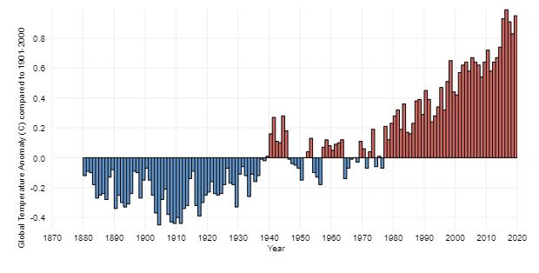
History of global surface temperature since 1880
https://www.climate.gov/news-features/understanding-climate/climate-change-global-temperature
Surpasses Previous Hottest Year

Slide 8
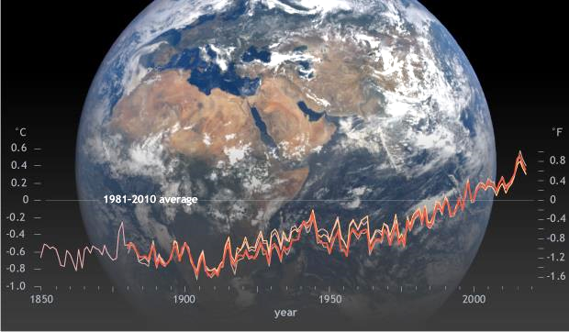
Compare 4 different temperature records.
Global surface temperature 1850-2018
https://www.climate.gov/news-features/understanding-climate/climate-change-global-temperature
NOAA (red), NASA (tan), University of East Anglia (pink),
and the Japan Meteorological Agency (orange).
Notes:
See also Berkeley Earth: Housfather, Mueller.

Slide 9
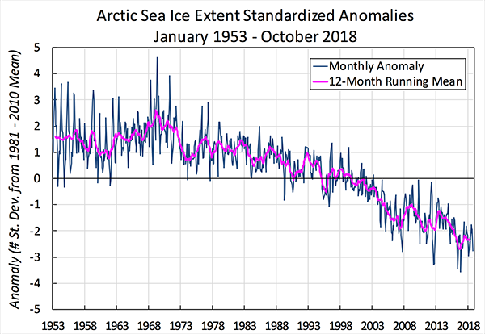
https://nsidc.org/cryosphere/sotc/sea_ice.html
National Snow and Ice Data Center
For January 1979 present, data are derived from passive microwave satellite sensors.

Slide 10
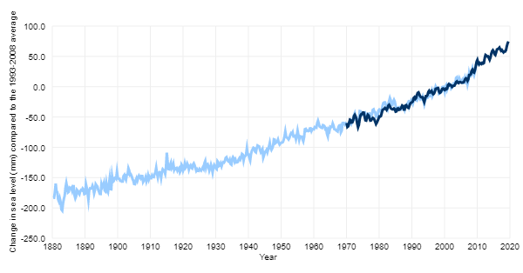
https://www.climate.gov/news-features/understanding-climate/climate-change-global-sea-level

Slide 11
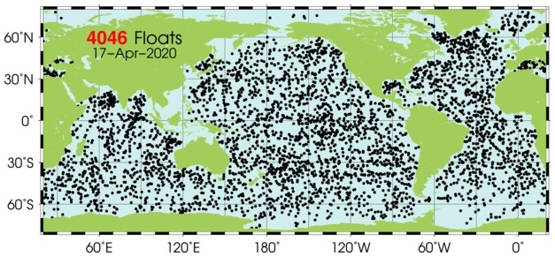
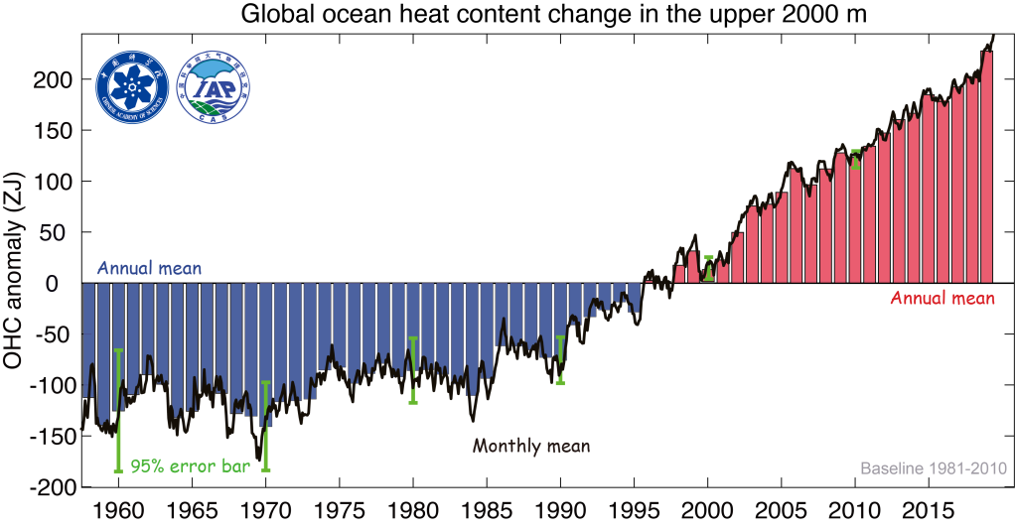
ARGO Floats Descend to 2000 m. Ascend and Profile
0.001 C accuracy.
ZJ=10²¹ J

Slide 12
https://www.ncei.noaa.gov/news/ocean-heat-content-rises
ZJ=10²¹ J

Slide 13
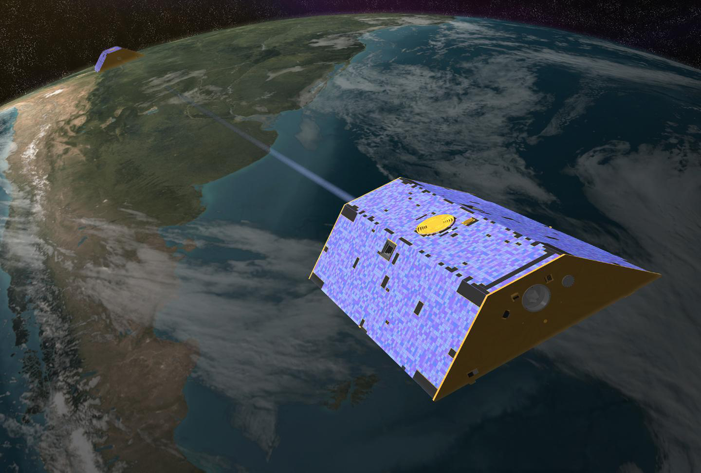
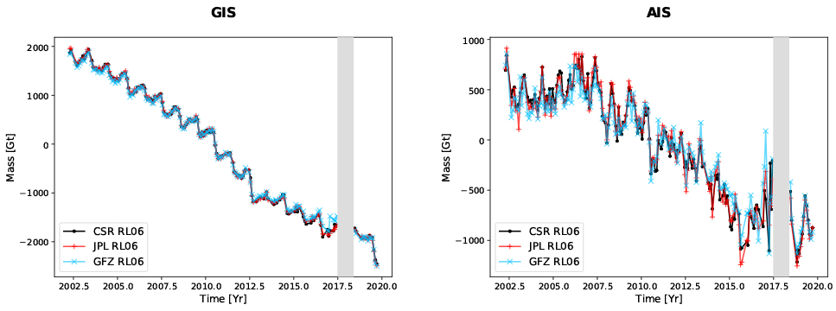
GRACE and GRACE-FO
Satelites show Ice Loss in GIS and AIS

Slide 14
GRACE and GRACE-FO:
Satellites show Ice Loss in GIS and AIS
Continuity of ice sheet mass loss in Greenland and Antarctica from the GRACE and GRACE Follow-On missions, GRL, Velicogna et al., 2020. doi: 10.1029/2020GL087291

Slide 15
More Energy Absorbed than Radiated to Space
Energy in the climate system is going up
Surface Temperature Increasing
Ice Melting
Oceans Warming (mostly Southern Ocean in this case)
Sea Level rising (half melt, half expansion)
Lower atmosphere is warming: (NOAA MSUs and AMSUs: Satellites. (UAH and RSS)

Slide 16
We see that:
Data are plentiful
Measurements and analyses are corroborated by independent investigators
Satellites provide lots of public data
Warming is unequivocal

Slide 17
Experienced Impacts of Warming
Enhancement of Extreme Weather and Fires:
  European Heat Wave of 2003 (Battisti on Ag)
  Russian heat Wave and Pakistani floods of 2010
  Hurricane Harvey
  Spring floods in US midwest
  Californian and Australian Fires
  Mideast droughts leading to migration and wars
Disruption of ecosystems
  Migration of fish away from subsistence fishers
  Destruction of iconic ecosystems (pine beetle etc)
  Mass extinctions

Slide 18
Experienced Impacts of Warming
Impact of sea level rise on ports and seacoasts
  Sunshine flooding in Florida
  Venice
  London
  US Ports (ask the Navy)
Impacts on agriculture
Read IPCC 1.5 Report.

Slide 19
Expected Impacts of Warming
Increases in average temperatures
Hot extremes in inhabited regions
Heavy precipitation in several regions
Probability of drought and precipitation deficits in some places
Temperature extremes will warm more than average temperatures
Shift marine species to higher latitude
Ecosystem damage
Damage to costal ecosystems fisheries and aquaculture (esp at low latitudes)
Increased damage due to ocean acidification
Read IPCC 1.5C Report (ipcc.ch/sr15/).

Slide 20
Expected Impacts of Warming
Risks to health, food security, livelihoods, water supply, human security, economic growth
Greatest risk: disadvantaged and vulnerable populations, some indigenous peoples, and local communities dependent on agricultural or coastal livelihoods
Regions at higher risk: Arctic, dryland, small island states, least developed countries
Worse at +2 C than +1.5 C
Read IPCC 1.5C Report – Summary for Policy Makers (ipcc.ch/sr15/).

Slide 21
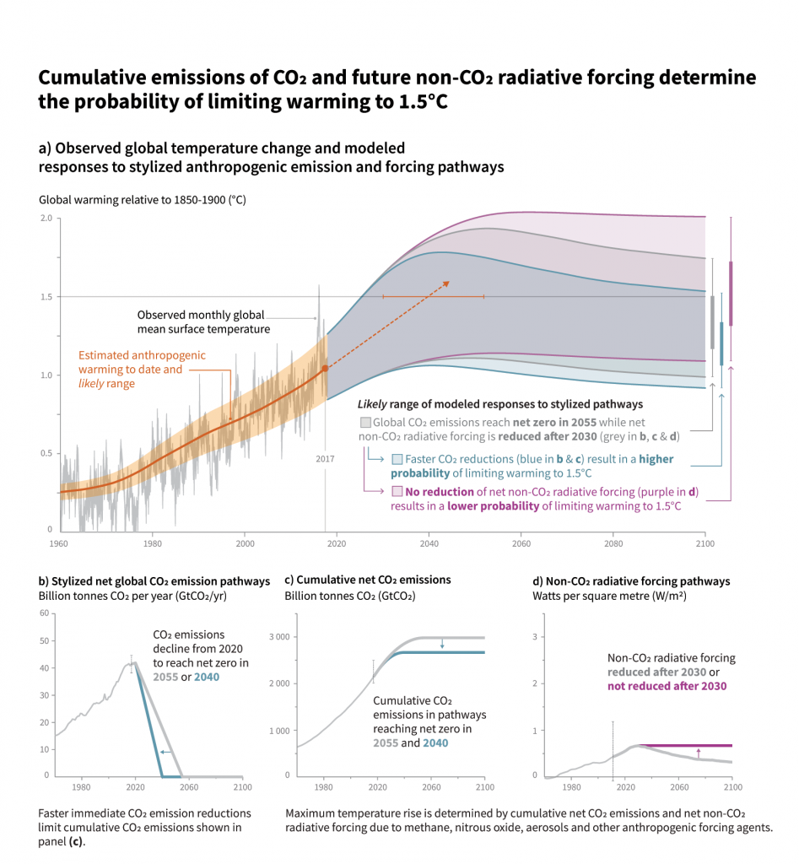
Question is how to get to 1.5C

Slide 22
Look at projections of US EIA and changes in sources are not any thing like what is needed to avoid 1.5 or 2 C warming.
Policy Intervention is required and soon…

Slide 23
Science Topic: How do we know its GHGs?
Look at Entire Atmosphere and Mechanism for Warming
What are Greenhouse gases (GHG’s) ?
How does adding GHG’s warm the surface?

Slide 25
From this picture, we know:
It is colder high up
That the IR emitted to space is mostly emitted high up
That lots of IR is absorbed in the atmosphere
Lots of IR is emitted by the atmosphere in the upward and downward directions.

Slide 26
Use PHET Simulation to show:
(https://phet.colorado.edu/en/simulation/legacy/greenhouse)
Complex molecules (GHGs) absorb IR Photons, become excited and emit the photons
In the atmosphere these molecules redirect IR photons to the surface and lead to warming of the surface.
Prevent escape of energy on IR photons returned to surface. Drives radiation balance to warming.
Clouds reflect sunlight and absorb IR photons. Low clouds cool on balance. High clouds warm.

Slide 27
Observed Cumulative Change in Internal Energy of the Climate System (1970-2010).
Energy changes derived from measured changes shown above.
(Mass x Specific heat x Change in temperature)
IPCC WG1 AR5 Chapter 3. 2013
Where did the energy to do this come from?

Slide 28
For the ice, multiply the mass of ice lost times the latent heat of melting.
Standard engineering calculations based on measured changes in temperature and ice mass.
IPCC WG1 AR5 Chapter 3. 2013
Where did the energy to do this come from?

Slide 29
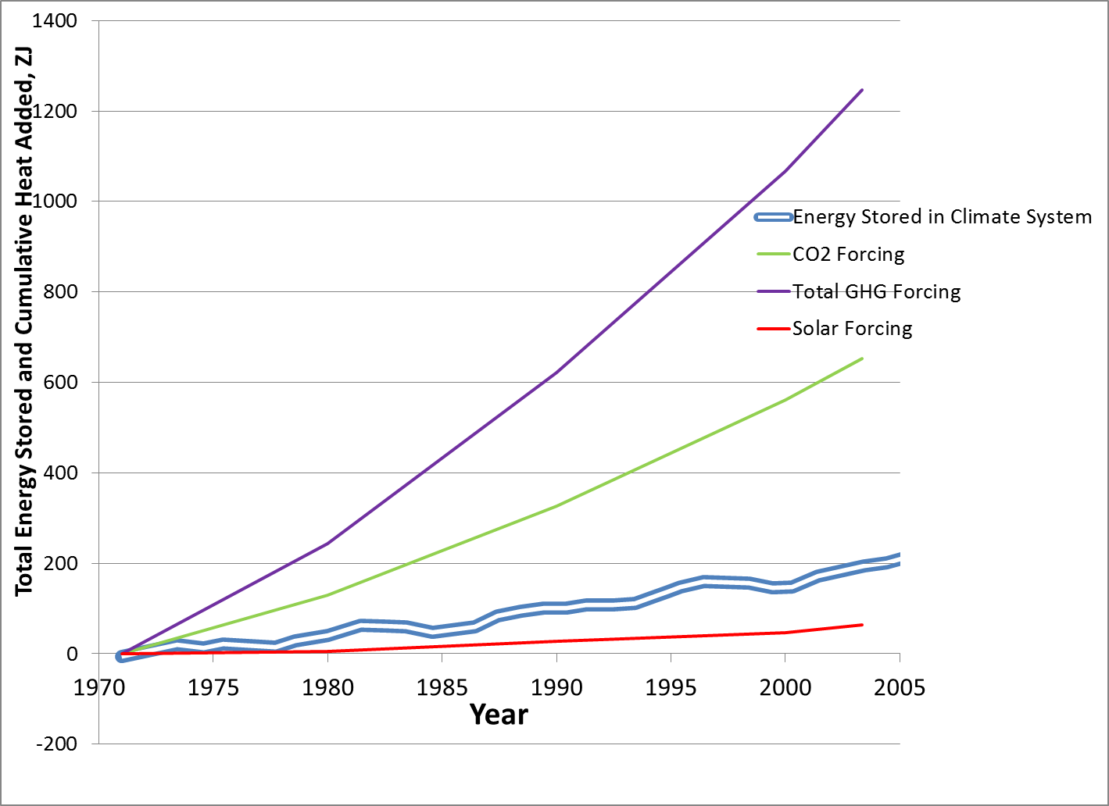
Calculate Cumulative Forcings: Measured Sun changes, Measured GHG increases and known physics of GHGs and Heat transfer
Cumulative energy added by added CO₂= ~679 ZJ
Total energy added by all added
GHGs = ~1300 ZJ
Energy required to heat and melt = ~200 ZJ
Total Energy trapped by added CO2
Stored Energy from previous graph

Slide 30
Over this time period (1970-2005)
GHGs supplied ~6.5 times the energy needed to create the observed warming and melting.
CO₂ alone provided over 3 times the energy needed to warm and melt.
More than enough demonstrated cause to create the observed effect.

Slide 31
Why didn’t we warm more?
Aerosol particles from human emissions of particulate matter and gases increased in this time period and provided needed cooling to reduce the impact of the emitted GHGs.
Direct effect: Particles reflect sunlight back to space and reduce the amount of energy absorbed by the climate system. Pollution and volcanoes.
Indirect effect: Particles change the character of clouds leading to more reflection to space

Slide 32
Science and Policy Topic
How do we know what is coming?
Models predict futures depending on how much we emit.
How do those models perform and what do they say?

Slide 33
(See Gavin Schmidt TED)
To Model Futures We Must:
Project and input emissions of GHGs
Model removal of GHGs (Phys, Bio, Chem)
Calculate winds, temperatures (Phys)
Project pollutants, Estimate interactions of particles and clouds (parameterizations – Approximate because of scale mismatch)
Calculate albedo, IR absorption and emission throughout the atmosphere (Phys)

Slide 34
Model Projections of Future Temperatures

Slide 35
Large Spread in Predictions Results from Differences Among Models in Parameterizations of Cloud-Aerosol Interactions.
And there are large bands of uncertainty around each average projection

Slide 36
USGCRP CSSR Ch 3
Models capture the trends within a wide band of possible results on left. All forcings (on left) includes natural plus human caused. Natural foricngs only excludes human emitted CO2.
Overall trend is captured by models that include human-emitted CO2. This warming is not ‘natural.’ That simulation stays low.

Slide 37
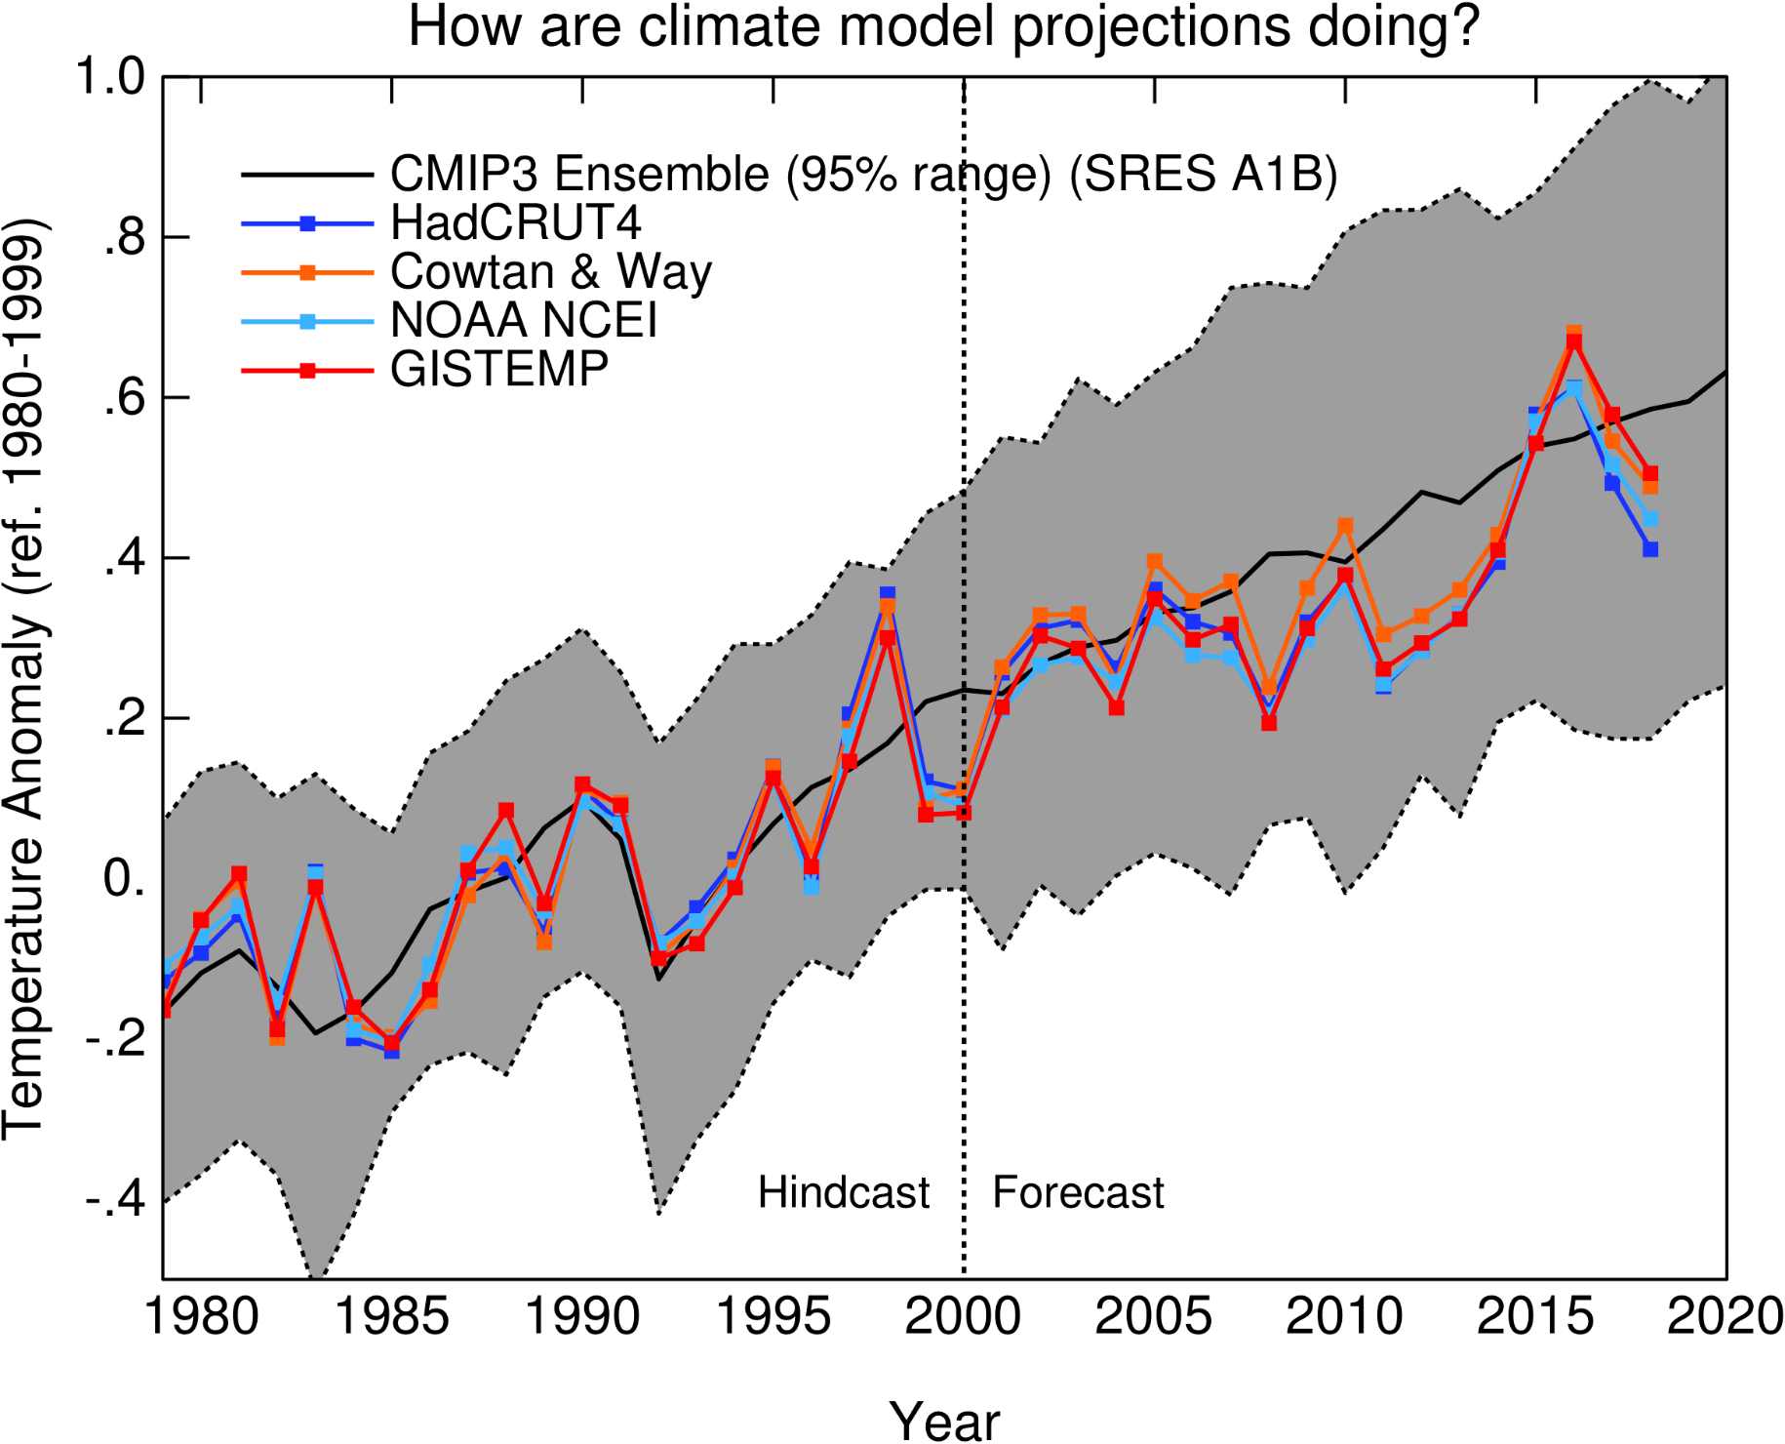
Black line: Average of many models
Grey Band: Range of Models.
On average, models projected
(Forecast) what the climate
Did.

Slide 38
What matters is the total amount
we emit.

Slide 39
Policy Topic
State of Play. Where is policy today.

Slide 40
Lessons from the Past:
Ozone Depletion and Montreal Protocol
  Stratospheric Ozone expected to go away because of CFCs
  Ozone observed to be destroyed in Antarctic Ozone Hole
  Research demonstrated the causes (airplanes, balloons, satellites)
  Global agreements stopped the global decrease in stratospheric ozone
  Agreements modified at regular intervals to take changes and new threats into account. Many substances banned.
  Poor countries were subsidized so that they could afford replacements
  Often regulations are killed by:
    Ideology
    Financial Interest
  Montreal Protocol worked because Reagan did it and DuPont was in favor.

Slide 41
Climate
Framework Convention on Climate Change signed by the whole world.
20 years of talk produced an agreement in Paris in 2015 because Obama and Xi saw what was at stake.
The Trump administration is pulling out of the Paris accord and rolling back regulations that were reducing emissions by USA.
In the UN, Trump stated he prefers nationalism over global cooperation.

Slide 42
Policies that work:
Libertarians invented a number of policies that actually work like carbon tax. They minimize messing with markets. Regulator does not specify actions to be taken by a specific emitter. Markets drive decisions. Bells and whistles are needed to deal with trade etc.
Cap and Trade works about as well as carbon tax and has been used to regulate SO₂ in the US since 1995. It is cheaper than command and control or Best Available Technology. Regulator does not specify actions to be taken by a specific emitter.
Economists tell us that regulatory policies like fuel efficiency standards or utility renewable mandates are inefficient. But they are often politically popular or possible.

Slide 43
IPCC Reports (http://www.climatechange2013.org/images/uploads/FS_what_ipcc.pdf)
The Intergovernmental Panel on Climate Change (IPCC) is the international body for assessing the science related to climate change. The IPCC was set up in 1988 by the World Meteorological Organization (WMO) and United Nations Environment Programme (UNEP) to provide policymakers with regular assessments of the scientific basis of climate change, its impacts and future risks, and options for adaptation and mitigation.

Slide 44
IPCC Reports
IPCC assessments provide a scientific basis for governments at all levels to develop climate related policies, and they underlie negotiations at the UN Climate Conference – the United Nations Framework Convention on Climate Change (UNFCCC).

Slide 45
Selected Events http://unfccc.int/timeline/#inwords
1988 World Meteorological Organization (WMO) and UN Environmental Program (UNEP) establish Intergovernmental Panel on Climate Change. IPCC assessments provide scientific underpinning of international negotiations.
1988 James Hansen, NASA, testifies in US Senate that global warming has begun
1990 IPCC says CO₂ is going up
1992 UNFCCC (United Nations Framework Convention on Climate Change) opens for signatures after 2 years of negotiations.
Notes:
References throughout to aid in finding sources for information in papers.

Slide 46
1994 UNFCCC enters into force. 196 Parties. Annual Conference of the Parties.
  Aims for targets and timetables to limit emissions
  Aims for mechanisms to help fund and transfer tech to poor countries
  Recognizes ‘common but differentiated’ responsibilities for developed and developing
1996 Kyoto Protocol to reduce GHG Emissions. Focused on developed nations. Proposed ~5% reductions.
  US Senate votes 95-0 for resolution rejecting any climate agreement that failed to limit developing countries’ emissions simultaneously. US did not join Kyoto.
Notes:
Ask what differentiates developed and developing countries wrt climate? Pause. Developed world got rich by exploiting carbon fuels. Developing world does not want to be precluded from development.
How many countries are there?

Slide 47
Lots of COPs and agreements on mechanisms to assist developing countries but no agreement on emission limits from the first meeting until the 21st.
2015: Paris agreement adopted. COP 21. 194 Parties have signed. 183 have ratified (Provided NDCs).
  Agreed to keep warming well below 2 C and make best effort go keep it below 1.5 C. (Island States)
  No mandated emissions levels. Each signatory pledges its own targets in NDC. No enforcement mechanism
  No need for US Senate approval.
2017 President Trump announces plan to withdraw from Paris and refused to fund any aid to UNFCCC programs.
Notes:
NDC: Nationally Determined Contribution

Slide 48
Paris 2015 was just the first step
The sum of the individual country pledges was not enough to keep warming below 2 C or 1.5 C.
Continued ambitious agreements were going to be needed.
More rounds of pledges were going to have to happen.
This was not a surprise.
Now what? Largest economy is out. TBD.

Slide 49
Policy Topic
How does IPCC work?
What are the rules and why does it work?
Examples follow:

Slide 50
IPCC Provides Assessments which guide the negotiations of the UNFCCC. https://www.ipcc.ch/documentation/procedures/
IPCC Procedures establish comprehensiveness, objectivity, openness and transparency as guiding principles of IPCC Work.
Summaries for Policy Makers are agreed to line-by-line by every party.
All relevant scientific literature is assessed by expert, international committees.

Slide 51
IPCC Reports https://www.ipcc.ch/reports/
Hundreds of scientists, dozens of countries, open review process, all comments and responses are public.
Three Working Groups
  Scientific Basis
  Impacts and Vulnerability
  Mitigation
AR1 – 1990; AR2-1996; TAR-2001; AR4 – 2007; AR5 – 2013/14; AR6- 2021
Special Reports: SR15.
Notes:
Motivation for SR15.

Slide 52
IPCC Does Scientific Assessments

Slide 53
Other Authoritative Sources
United States Global Change Research Program Reports
US Government Agencies (veracity may be at risk): EPA, NOAA, NASA, DOE, DOE EIA, National Science Foundation.
US Government Funded National Laboratories: DOE: NREL and 16 others; Others: NCAR, NIST, ONR
United States National Academy of Sciences and National Research Council Reports
  Established in Lincoln Administration. Chooses own members.
  Many countries have highly reputable Academies
Professional Societies: AAAS (publisher of Science), AGU, ACS, AMS, ………
Notes:
Skeptical(?) sources: Places where you might find some scientific discussion of climate from people who think that CO2 is not the cause of the effect or that the effect is not real:

